Slide 1

Rio25 Upgrade Webinar
Trainer –

Slide 2
Rio25 Upgrade changes
The Landing Page
Home Button
Diagnosis – ‘drag n drop’
Changes to Appointment Outcome screen – HCP Diary and Clinics
Appointment Search – Multiple streams
Viewing Archived Forms (Legacy Forms)

Slide 3
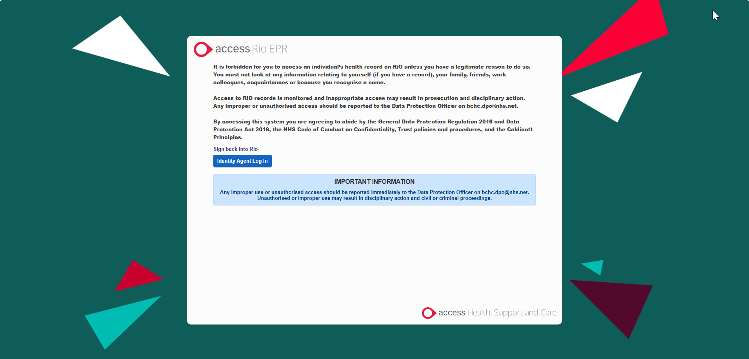
Rio25 Upgrade changes
The landing Page

Slide 4
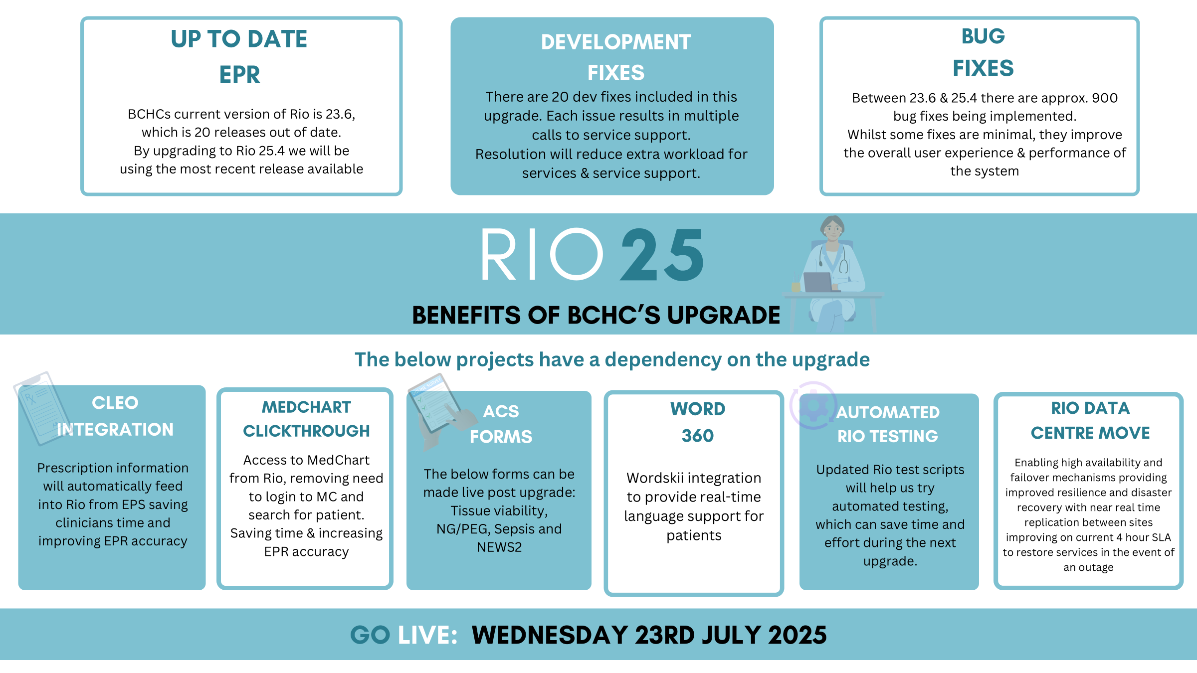
Benefits of Rio25 upgrade

Slide 5


Support Materials
Quick Reference User Guides and How to Videos are available via the Virtual Campus
Access the Virtual Campus on your computer’s desktop
Alternatively access Microsoft Edge and key in
URL (https://bchceducation.co.uk/)
Scroll down & select Digital Skills
Select Rio Support Materials

Slide 6

Further Support
Rio Trainer Support
Contact the Digital Skills Training Team
bchc.itt@nhs.net
Rio Access & Smartcard Issues
Contact the Service Support Team
Via the DTS Self-Service Portal
Technical and Equipment issues
Contact the IT Helpdesk
Via the DTS Self-Service Portal

