Slide 1
National Early Warning Score 2
(NEWS2)
Adults and Specialist Rehabilitation Division
Feedback

Slide 2
Background to NEWS
Number 1 cause of death is failure to recognise and act on deterioration.
NEWS is a common language to replace 60-70 scoring systems in the UK. It is used to:
  Assess acute illness severity
  Detect clinical deterioration
  Initiate a timely and competent clinical response.
  Provide guidance on competence and frequency of monitoring.
Downward trajectory when patients score 5- high risk of ITU, death, cardiac arrest
NEWS2 has formal endorsement from NHS England and NHS Improvement to become the early warning score to identify acutely ill patients including those with sepsis in hospitals in England.

Slide 3
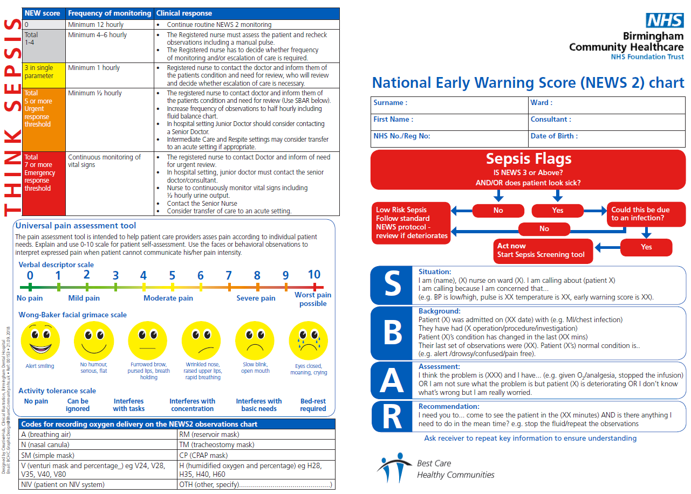
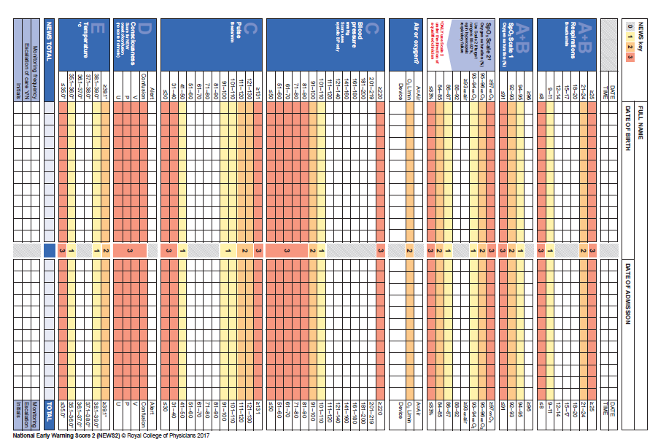
What’s ?
NEW

Slide 4
What’s ?
NEW
Reordered to reflect the ABCDE sequence (Resuscitation Council UK)
New colour scheme to minimise problems with red/green colour blindness
6 parameters RR, SpO2, systolic blood pressure, HR, level of consciousness or new confusion*, temperature
Range of boundaries for each parameter are shown on the chart.
Risk of Sepsis is emphasised.
Exemptions
DO NOT USE in CHILDREN or PREGNANT LADIES.
Does NOT replace competent clinical judgement.
Any urgent concern should require urgent assessment irrespective of the NEW2s score.

Slide 5
NEWS2 chart is safer for patients with hypercapnic respiratory failure
_{Two (Oxygen Saturation)} _{SpO2 Scales}
    the existing Scale 1
    and a dedicated SpO₂ scoring system for patients with hypercapnic respiratory failure whose desired oxygen saturations are set at a lower level (88-92%), with the NEWS2 scoring system adjusted accordingly.
SpO2 Scale 2
Should only be used in patients confirmed to have hypercapnic respiratory failure on blood gas analysis on either a prior, or their current, hospital admission. Often these patients have COPD.
NEW

Slide 6
Which SpO2 Scale?
The decision to use the new SpO₂ scoring Scale 2 should be made by a competent clinical decisionmaker and should be recorded in the patient's clinical notes.
In the Adult and Specialist Rehabilitation Setting, this will be determined by a Doctor, Advanced Clinical Practitioner, or Advanced Nurse Practitioner.
Within the Learning Disabilities Service and Prison Healthcare this will be locally agreed.
In all other circumstances, the regular NEWS SpO₂ scoring scale
(Scale 1) should be used.
For the avoidance of doubt, the SpO₂ scoring scale not being used should be clearly crossed out across the chart.

Slide 7
Supplemental Oxygen
Patients requiring supplemental oxygen are at greater clinical risk.
A weighting score of 2 should be added to the aggregate NEWS2 score for any patient requiring supplemental oxygen.
The mode and rate of oxygen delivery are often poorly documented.
Recording the rate of oxygen flow (L/min) without recording the mode of delivery or device does not define how much oxygen the patient is receiving.
The NEWS2 chart has been updated to allow clearer recording of whether the patient is breathing air or oxygen; the device being used, if any; and the rate of oxygen delivery.

Slide 8
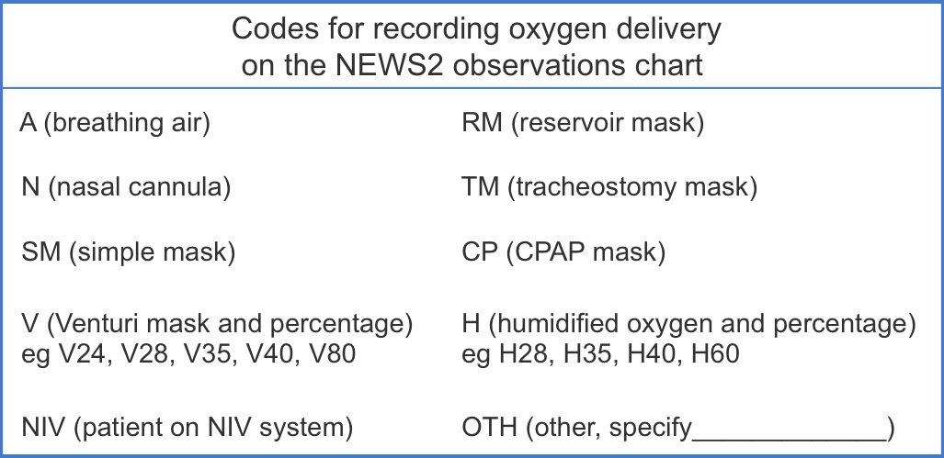
For the documentation of the oxygen delivery system, use the device codes as recommended by The British Thoracic Society should be used (see table).
NEW

Slide 9
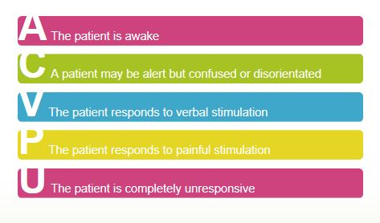
Refinement of the AVPU classification to include new confusion
NEW

Slide 10
NEW Confusion
Beyond the recording of level of consciousness using the AVPU scale, it is well recognised that the onset of acute 'new confusion' (delirium), can be an important sign that a patient requires urgent assessment.
New-onset confusion (any new reduction in the Glasgow Coma Scale or delirium would also fit this criterion) is a sign of potentially serious clinical deterioration in patients and especially those with confirmed or suspected sepsis.
New confusion scores 3 on the NEWS2 chart, indicating (for a single parameter score of 3) the patient requires urgent assessment and hourly observations.
NEW

Slide 11
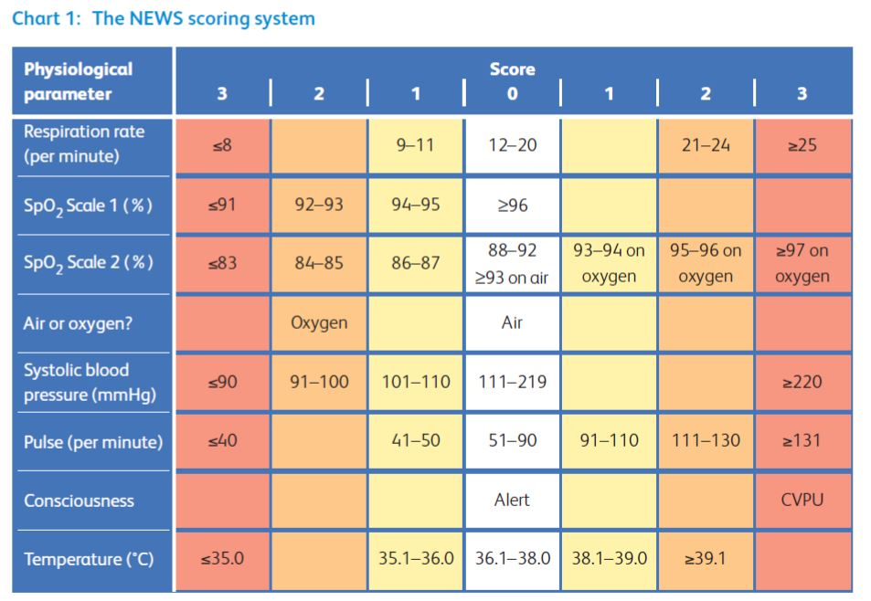
The NEWS2 Scoring System
NEW
NEW

Slide 12
How to calculate a NEWS2 score?
Step 1 Measure and Record the 6 Parameters
Step 2 Add the scores together
to calculate the NEWS2 score AND check if the trigger threshold (3) for a single parameter has been reached
Step 3 Use the NEWS2 score to define and record:
      Whether escalation of clinical care is required and its urgency
      The competencies of the clinical review required
      The frequency of monitoring required
      The most appropriate clinical setting for ongoing clinical care

Slide 13
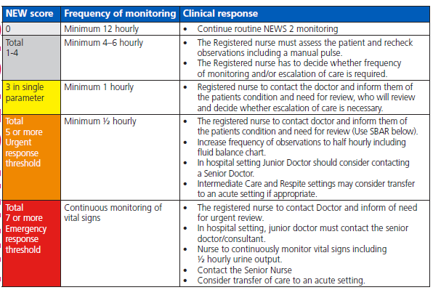
NEW
Note the Nationally Recommended
frequency of observations has changed to twice daily
A score of 3 in any single parameter prompts medical review and hourly obs
Continuous monitoring
(at least every 15 mins)

Slide 14
THINK SEPSIS!
Is the NEWS2 Score 3 or above?
AND/OR does the patient look sick?
Complete Inpatient Sepsis Screening and Action Tool.

Slide 15
.

