Slide 1

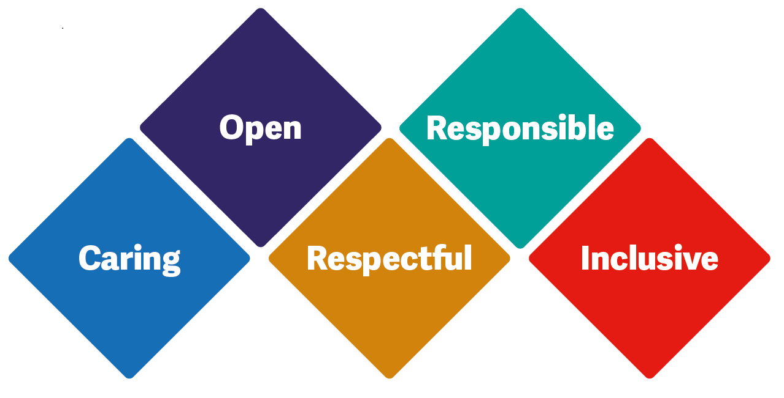

Handover
Clinical rounds
Huddles

Slide 2
HANDOVER GUIDANCE
Handover to start promptly
Allow between 30 – 45 minutes depending on size of team ALL Team members on duty to attend
Mobile Phones to be on silent unless expecting urgent call No other conversations to take place
Landlines phones should not be answered by clinical staff Handover action log to be reviewed from previous days
Team diary and allocation sheet to be allocated to a team member
Senior team member to facilitate handover using a Confirm and Challenge approach documenting actions on Action log

Slide 3
Handover
Relevant changes only to be reported:
-New Patients - Discharges - Follow up visits - Patient concerns
Hospital admissions RIP and High risk Patients list to be documented on a board Update pressure ulcer board/Safety boards
Ensure pm calls are accounted for verbally with each staff member

Slide 4


SBAR
https://youtu.be/Rlon4LbHOPo?feature=shared

Slide 5


HUDDLES:
What is the purpose of a huddle?
A huddle is a short, stand-up meeting — 10 minutes or less — that is typically used once at the start of each workday in a clinical setting and gives teams a way to actively manage quality and safety, including a review of important standard work such as checklists.
Clinical Rounds CAT TOOLS/PDR 1-1s

