Slide 1



District Nursing Assessment

Slide 2

**** go away and leave me alone.
I won’t take the tablets – they make me wee all of the time.
I don’t need help, I can care for myself.
I don’t believe in ‘sell by’ dates, they are a con to make us spend more. GO AWAY!
Maud has a history of heart failure & her swollen legs reduce her mobility, resulting in falls.
She hasn’t taken her medication for some time or attended any GP or Consultant appointments.
The house is dirty & cluttered. Her clothes appear loose & soiled & she appears confused
Mouldy food in fridge.
Animal excrement on surfaces.
Notes:
GP referral to visit Maud because she hasn’t ben able to get to surgery for wound care following afall.

Slide 3

The nurse visited again today. She tells me that my bottom is sore. I thought that would be the case as I noticed a red stain in my knickers. She was not happy with me when I told her I was still sleeping in my chair.
I don’t know what all the fuss is about. I wish they would go away & leave me alone.
Maud is showing signs of malnutrition & dehydration.
There is now a cat 3 ulcer on her bottom which is often contaminated with faeces.
Maud is sleepy most of the time & it is often difficult to gain access to her home.
Paramedic called yesterday but Maud declined hospitalization.

Slide 4
‘Assess, Plan, Implement’ – The Nursing Process in D/Nursing
stay on DN caseload or refer on to other services eg: social care package
Triage referral
Appropriate ref’
Identify needs eg health/social, medical self
-care ? teach
Visit patient
See the patient and home environment
Nursing assessment
Using the Nursing process and ADL model, clinical tools
Evidence based with an end goal and either self care or care plan
LTC or discharge
Provide Care

Slide 5
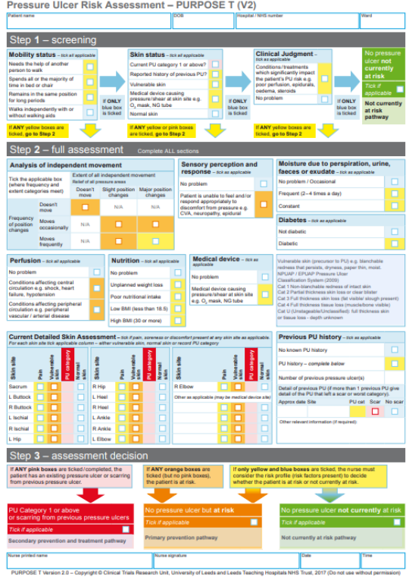
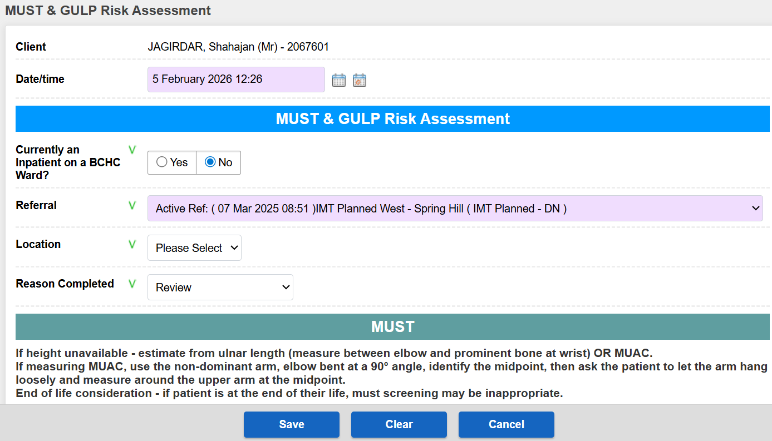
Supporting Assessment Tools
Pressure risk – ‘Purpose T’
GULP (Must and hydration)

Slide 6
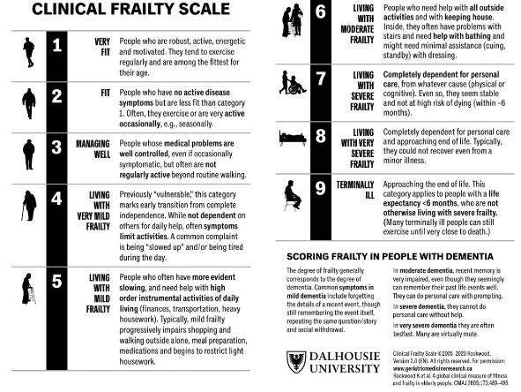
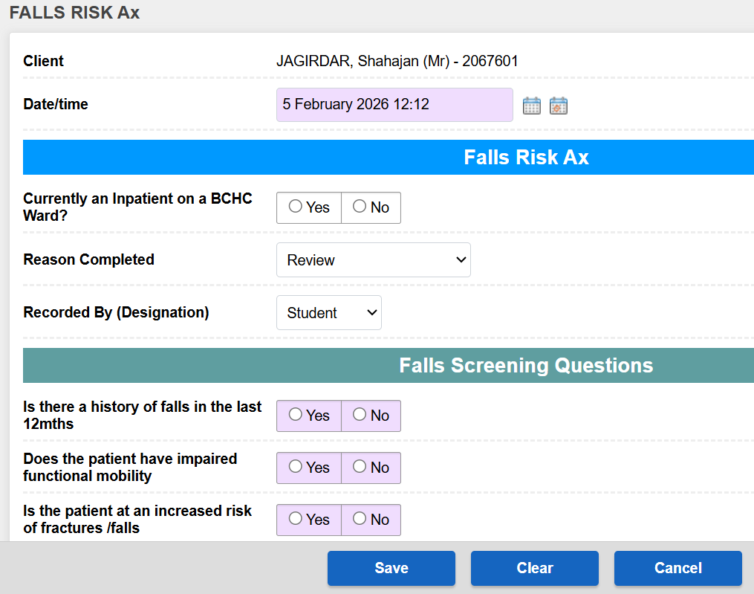
Supporting Assessment Tools
Frailty scale
FRAM – falls assessment

Slide 7
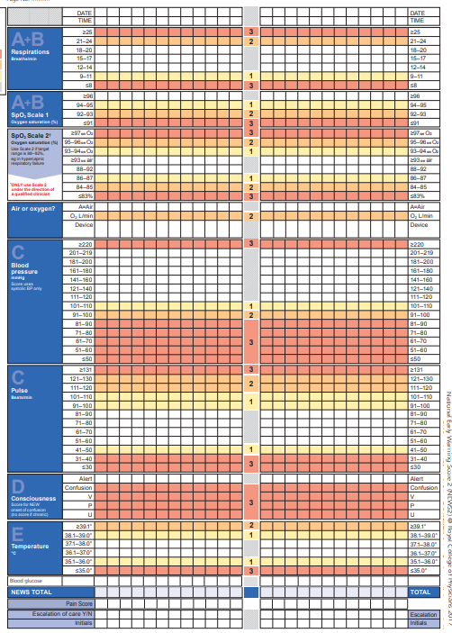
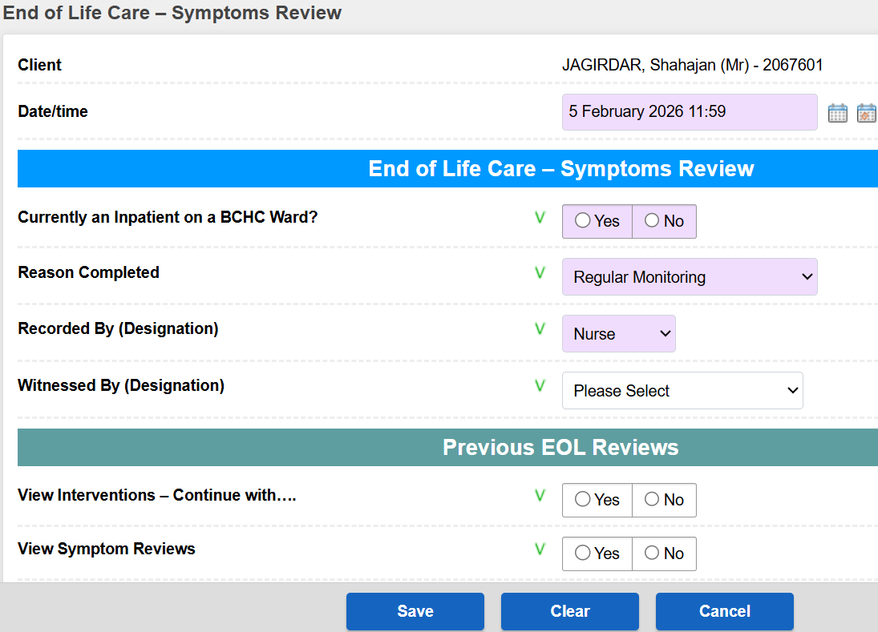
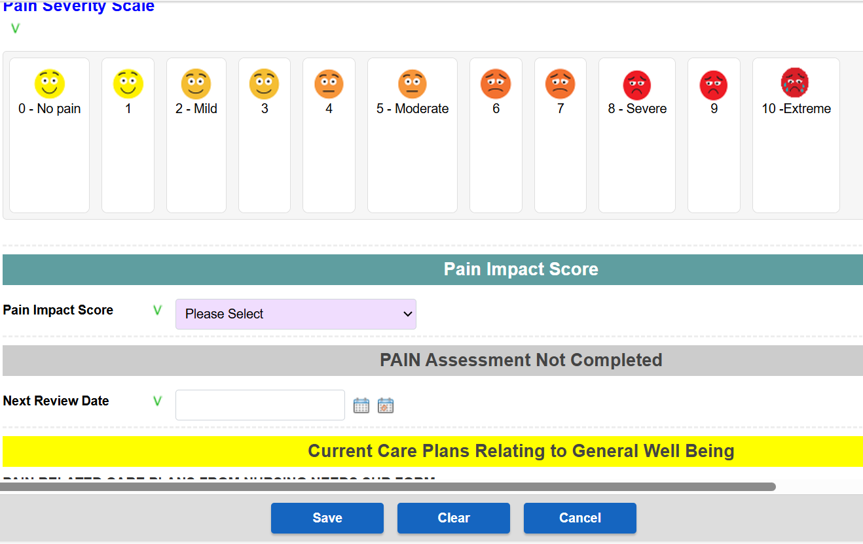
Supporting Assessment Tools
NEWS
SCP
Pain

Slide 8
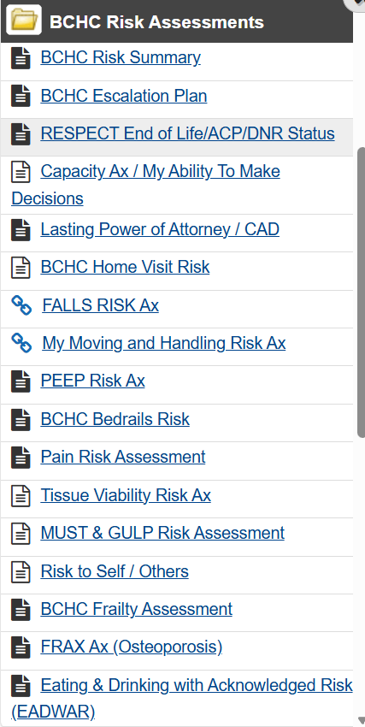
Other Supporting Assessment Tools on RIO

Slide 9
Before visiting the patient……
‘Triage’ the referral:
Check initial message – if available for key info: allergies, yellow card
Appropriate for D/Nursing, nursing need, self care ? call referrer for more info if necessary.
housebound status
Home or still in hospital – call patient before visiting
Keysafe, emergency/NOK contact
Check RIO for:
Known to other services in Trust
Alerts (before you visit patient), safe to visit on your own ?
Shared care records (medical summary, letters, meds)
Lone worker checklist – this is about your safety !
Use as prompt for patients ‘new’ to you
Ready to go ?
ID on clip, name badge, hand gel, Ipad, Phone charged, Nurse bag, note pad

Slide 10
During the visit…
Introduce yourself and role (eg staff nurse and why you are there)
Ask to see any paper records (paper records ?, RESPECT form)
Agree/consent to care. Explain procedure, note stock
Any new problems - create ‘to do’ list’ (nursing, medical, social…anything else ?). resolve, escalate or prioritise. Unsure – call colleague or discuss at handover
Wound care – do you need photo of wound for evaluation ? Use iPad (not phone)
MUST – you can calculate & MUAC
Agree next visit/schedule review
Clinical record keeping in home or car - before moving to next patient.
If you need to escalate: do all obs via ‘NEWS2’ and use SBAR

Slide 11
After the visit
Completing assessment on iPad: in car, prioritise referrals, equipment or Abena ? Same day
Any schedule change to admin
Refer to ‘To do’ list for actions from the day and prioritise (calls, emails, referrals etc)
Be prepared for handover re: ‘confirm & challenge’ via the ‘Action Log’ used at handover.
Identify learning gaps and address via team manager
Seek clinical supervision – if reqd

Slide 12
Equipped for the role ?
Team ‘Watsap for on/off duty, urgent messages.
Uniform compliance eg: hand gel, jewellery, wipeable shoes, lanyards, hair tied back etc
IPC & public health compliance: sharps bin opening date, single use sterile scissor, infestations in homes, hoarding - Support - Clouds End Hoarding Support and Training
ID + name badge
Fluids/emergency snacks in car !
Work phone - Ipad (charged), Medical equipment (BG, BP, oximeter (spare batteries in car) - everything works ok.
Clinical bag (minimum stock) and what equipment to take into Pt home (see bag list)
Stock in car boot – gloves, aprons, dg packs (no patient property)
Professional boundaries with both colleagues and Patient/carers
User account and training for: RIO (EPR), Abena, Medequip

Slide 13
Clinical Priority!
Immediate presenting health/social needs - prioritise
Have you met the ECI standard - Baseline obs + tools
Populate a ‘realistic plan of care’ with ‘scheduled RIO’ review date – Personalised care
Have you left the Pt safe – clinically prioritise
Who else needs to be involved and why ? – follow up refs’

Slide 14

Any Questions?

