Slide 1
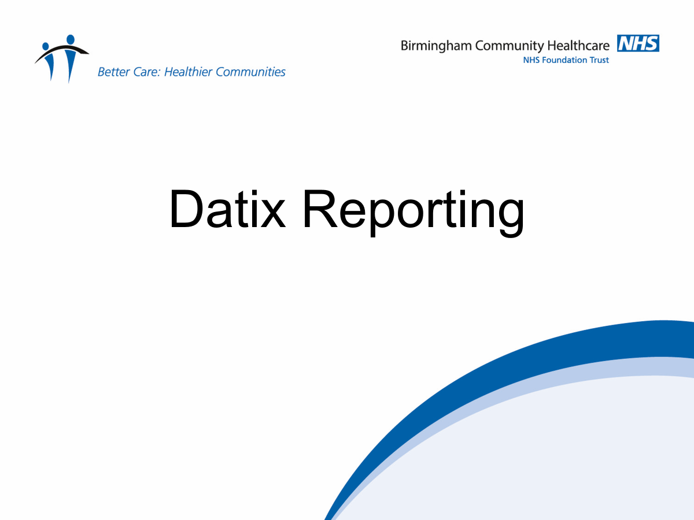

Slide 2




Why Report
We have a statutory requirement to report and investigate accidents or incidents that occur
There are several external monitoring agencies that oversee this and require this information
To identify trends
Protect Staff and Patients
So we learn from them

Slide 3
What happens once you report an Incident?
The Board
CEO Weekly Incident Report
Various Trust and Divisional Committees
Specialist Leads
Commissioners
External Monitoring

Slide 4

What do we report?
Near miss or Prevented incident
Any incident that had the potential to cause harm but was prevented (by chance or appropriate intervention) and resulted in no harm.
These should be reported on DATIX
Incident
An event or circumstance that could have, or did result in, unnecessary damage, loss or harm such as physical or mental injury to a patient, staff, visitors or members of the public. This includes both clinical and non-clinical incidents.
Each incident should be reported on DATIX

Slide 5
What do we report? Cont..
Never Events
Never events are defined by NHS England as incidents where there are or should be systems in place, at a national level, to make such errors "wholly preventable".

Slide 6
Duty of Candour
Following the Francis Inquiry into Mid Staffs
The Duty of Candour is a legal duty on hospital, community and mental health trusts to inform and apologise to patients if there have been mistakes in their care that have led to significant harm.
Duty of Candour aims to help patients receive accurate, truthful information from health providers
In the event of an incident which results in moderate harm, severe harm or death of patient all staff must:
Give a verbal face to face apology/acknowledgement of the harm
A written apology needs to be given within 10 days
A follow up letter after the investigation is complete
Apologies do not open the Trust up to any litigation, so no matter the cause, when harm is caused to a patient in our care we need to follow this process.

Slide 7
Organisational Learning
How can you be involved?
Share
How are you sharing your learning so that we can learn across the Trust?
Are you sharing your learning at Service /Divisional/Corporate meetings?
Report
Report
It is really important that we report incidents and near misses - this information is used in a number of ways to improve patient/staff safety.
Share
Learn
Apply
Learn
Are you discussing your incidents with your teams and what learning has been identified from the incidents?
Apply
How has your learning from incidents been applied in practice in your team? How are you ensuring that changes in practice are taking place and how are they being monitored?

Slide 8
Patient Safety Incident Response Framework (PSIRF)
The Patient Safety Incident Response Framework (PSIRF) sets out the NHS’s approach to developing and maintaining effective systems and processes for responding to patient safety incidents for the purpose of learning and improving patient safety.
PSIRF promotes a proportionate approach to responding to patient safety incidents by ensuring resources allocated to learning are balanced with those needed to deliver improvement.

Slide 9
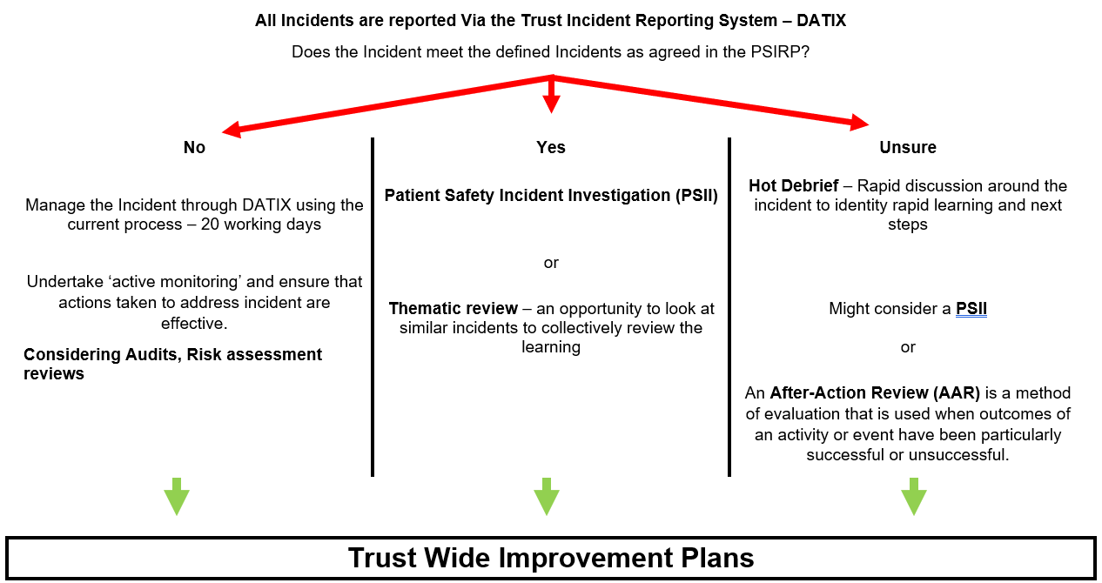

Slide 10
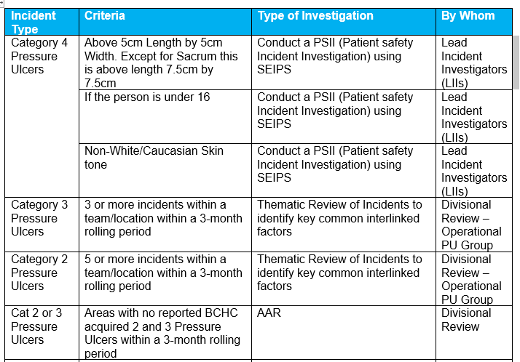

Slide 11
Hot Debrief and SEIPS
A Hot Debrief is designed to start as soon after a patient incident occurs, its an opportunity to quickly analyse what happened and how it happened. It looks at what can be done to reduce the risk and taking onboard everyone’s insights and reflections can generate prompt learning.
Step 1 - Introduce all participants so everyone knows who each other’s name and their role in the Hot Debrief.
Step 2 - Create a safe and ‘brave’ space by reassuring participants that the purpose of the Hot Debrief is to identify what happened and why by exploring the systems and contexts in which patient care was being delivered (ie work as done).
Step 3 - Replay the events that led to the Hot Debrief.
Step 4 - Explore what happened and why, through the lens of the SEIPS framework.
Step 5 - Identify where else in the organisation the learning from the Hot Debrief may be relevant.
Step 6 - Identify safety actions, and where feasible, assign specific deliverables and completion dates to leads.

Slide 12
Thematic Review
A valuable and thorough way of accomplishing thematic analysis of incidents is to select a few (three to six) recent and very similar incidents and investigate each individually with skill and rigour to determine the interconnected contributory and causal factors.
The findings from each individual investigation are then collated, compared and contrasted to identify common causal factors and any common interconnections or associations upon which effective improvements can be designed.
Importantly, investigation of recent incidents allows more accurate information gathering from properly specified detailed analysis of the system as it currently stands.

Slide 13
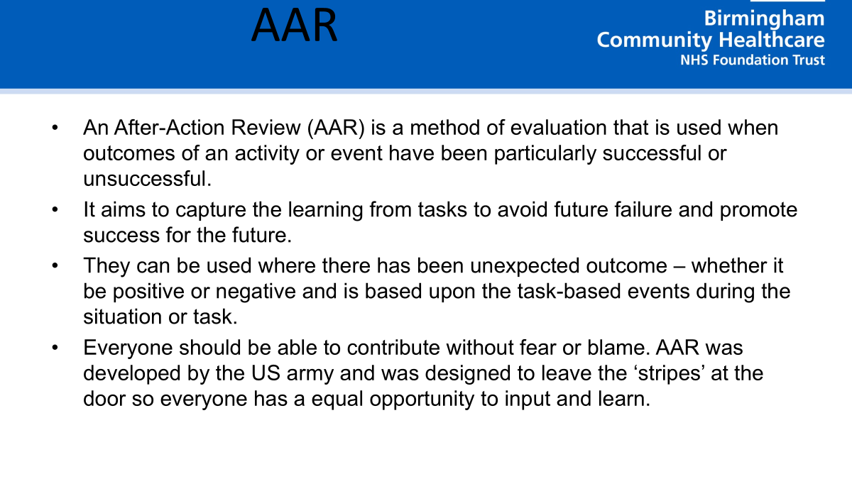

Slide 14
