Slide 1

What is EICT/ TH?

Slide 2
WELCOME!
1.What is EICT
2. When to refer
3. When not to refer
4. DVTs
5. Overview of therapy hub

Slide 3
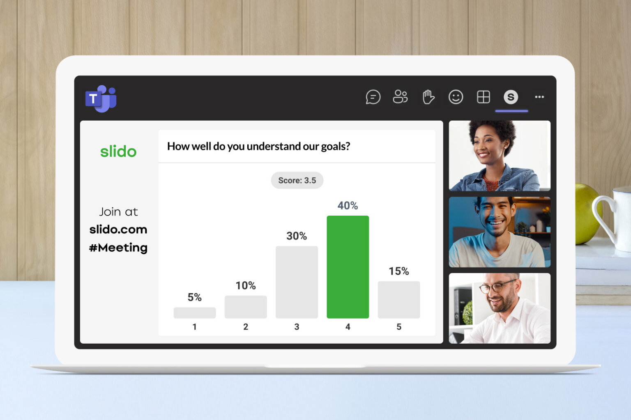
EICT Activity: Do you know What EiCt stands for?

Slide 4

Common misconceptions/ What we are not!
Nursery rythmes (E-I-E-I-OOOO!)
Earned income tax credit (EITC)
Early intervention foundation (childrens development)
Mental health- people coming to interview for MH jobs with teams!

Slide 5
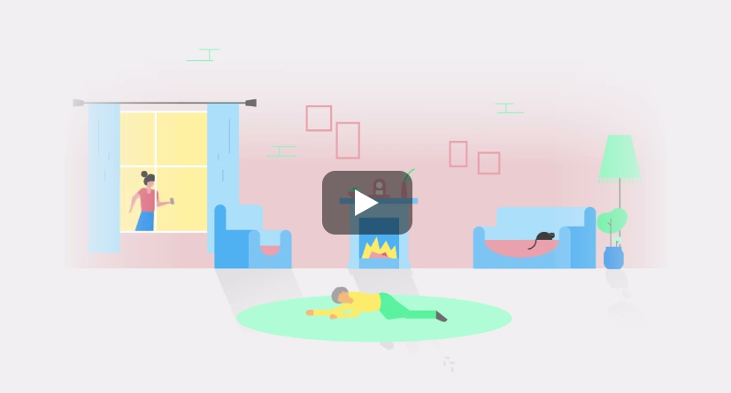
WHAT is EICT?
https://youtu.be/bHV7RG4Fwws

Slide 6

EICT: The service in a nutshell
‘Step Down’ Facilitated discharges
-Supports all acute discharges from acutes that require either care or therapy
-Care for these patients is provided by Sevacare
-Ax by one of the MDT- RN, OT, PT.
-Team also made up of SWs, TSWs, RAs, Admin
‘Step up’ admission avoidance
-Anyone can access this referral route from any NHS profession to patients or relatives.
-Care can be delivered by in house RAs with longer term care planned directly by EICT.
-Can also support patients through acute episodes, crisis where social services not already involved or palliative patients that are deteriorating.
-Follows community nurses lead when supporting EOL patients through agreed care call visits

Slide 7
Scenarios- when to refer to EICT
88 year old lady whose husband was the main carer but was admitted to hospital after a fall and she is struggling without his support
63 year old patient who has a terminal diagnosis and is currently palliative with a slow deterioration in functioning.
70 Year old man who is having recurrent falls and utilizing a stick but would benefit from alternative mobility aids, adaptations and a period of rehabilitation
57 year old patient who was recently admitted to hospital with a CAP and is discharged on ABX- requiring support to administer this 7 day course of treatment orally and monitor his response to treatment.
Does anyone have any other queries re: referral?

Slide 8
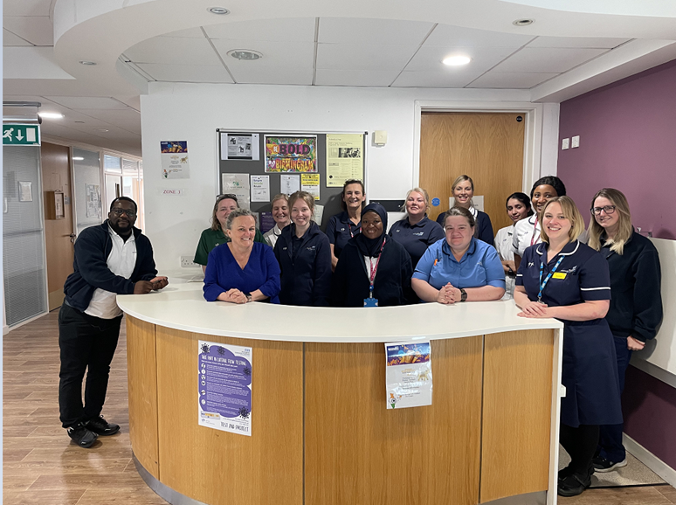
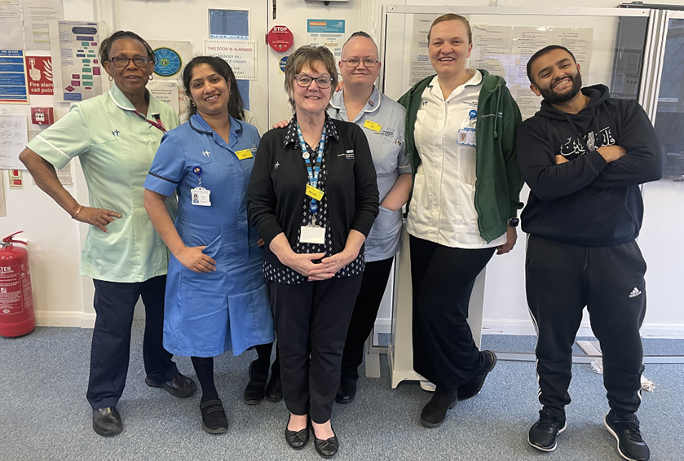
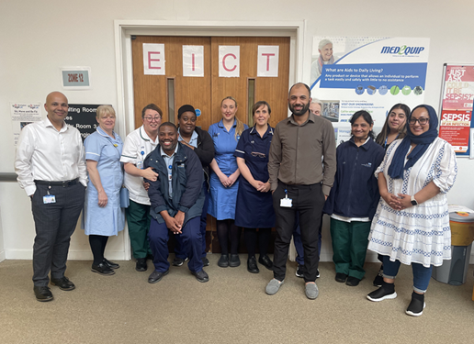
The Criteria.
8am-10pm service. Mon-Sun & BHs
At risk of hospital admission without EICT input
In need of short term therapy intervention to facilitate them to remain at home
Medically fit for discharge
17 years of age or above.
Living within Birmingham Local Authority Residency/Registrant
Living within Birmingham Local Authority and be registered with SWB or BSOL CCG

Slide 9
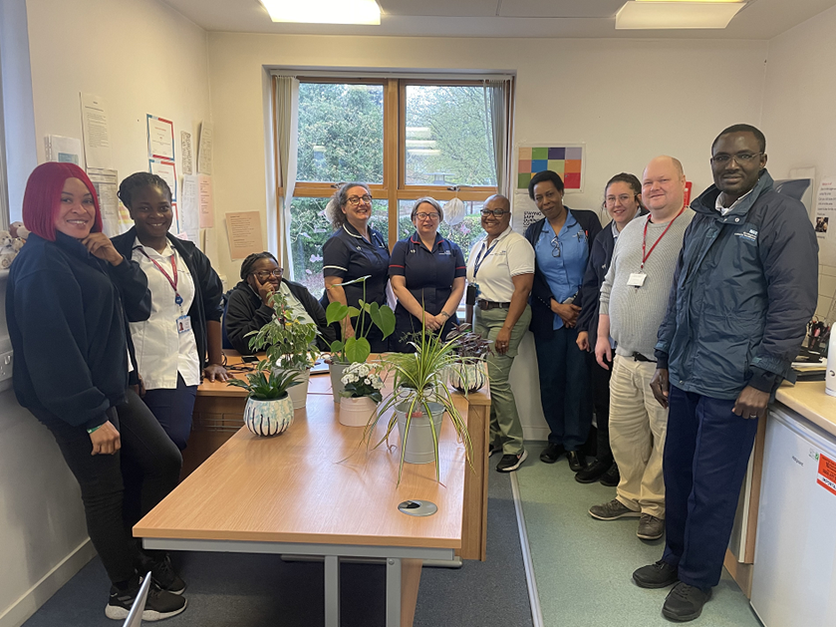
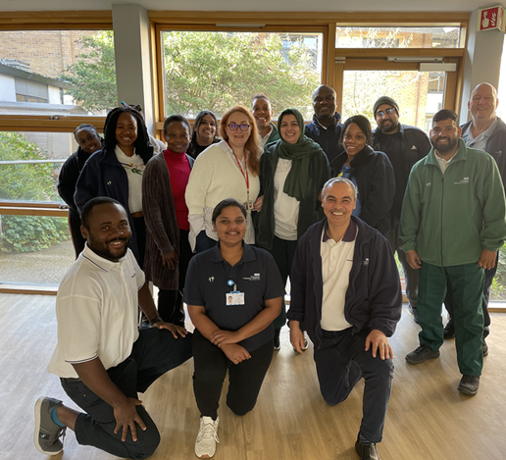
Exclusions
Identified as Continuing Health Care (CHC) Fast Track End of Life pathway at point of referral.
Safeguarding risk and is without appropriate support and plans to mitigate. Once plan is in place can accept
Experiencing an acute mental health crisis- EICT can see patients who have stable MH concerns.
Requiring medical intervention not provided by EICT. Such as:
Presenting with altered airway
Presenting with altered level of consciousness.
Requiring overnight care in the absence of family/home support.
Referrals from Constituency Social Work team, without therapy goals, and only requires package of care

Slide 10
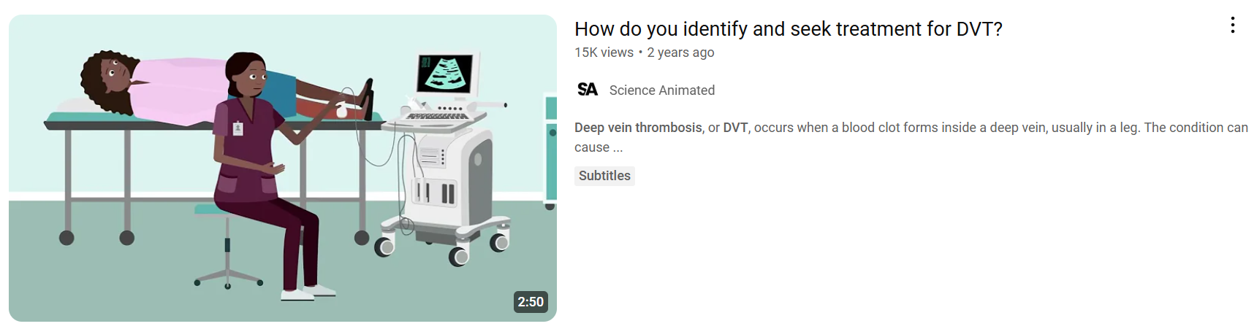
DVTs
https://youtu.be/I0RUK1eEaJQ?si=8orABoGzqFz0vnXP

Slide 11
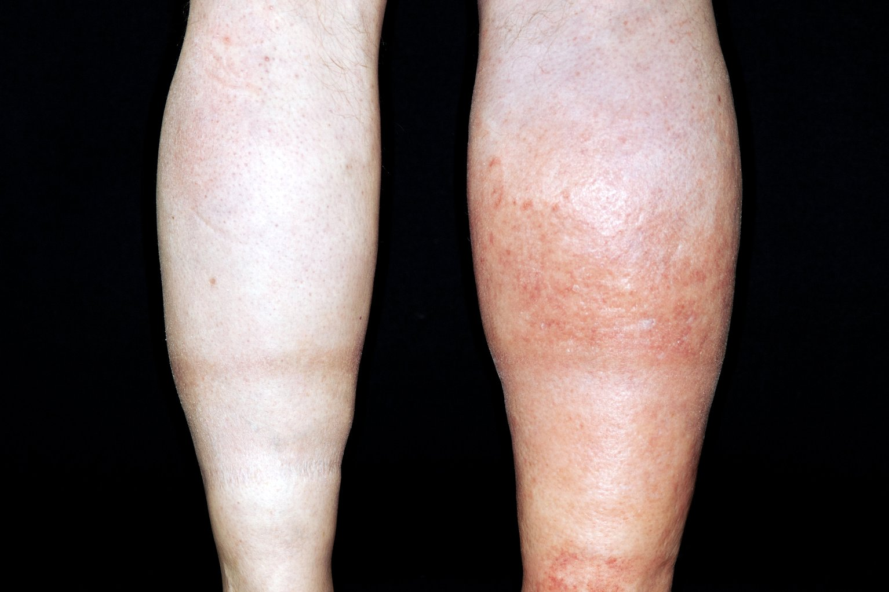
DVTs- symptoms & how to refer
Symptoms
throbbing pain in 1 leg (rarely both legs), usually in the calf or thigh, when walking or standing up
swelling in 1 leg (rarely both legs)
warm skin around the painful area
red or darkened skin around the painful area – this may be harder to see on brown or black skin
swollen veins that are hard or sore when you touch them
What you can do
  Refer to UCR or GP to complete a modified wells score.
  All DVT referrals into EICT use Wells score to determine treatment

Slide 12
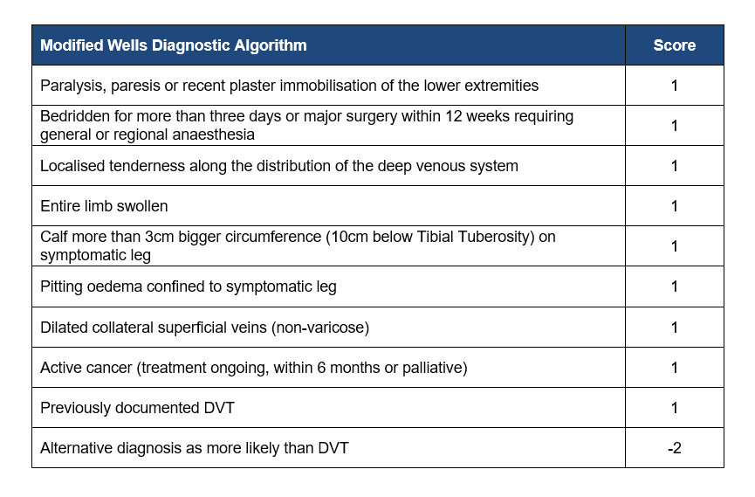
Wells scoring
Based on risk factors/ patient symptoms of DVT.
A score of less than two indicates unlikely or low risk of DVT, and above two indicates likely or high risk of DVT based on symptoms & risks.
Treatment delivered by EICT is dictated by this score.

Slide 13
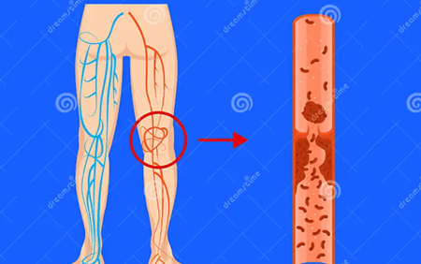

EICT DVT pathway
Full ax is completed, and bloods taken to determine a baseline pretreatment.
Instant D-dimer is performed with a positive result if above 400.
Treated with Apixaban (10mg BD), which patient is assessed to self admin or be supported with
Apixaban is given against a Patient group directive with a strict community based criteria
Common exclusions (NSAIDs, anticoags, Significant Renal or Liver damage).
EICT arrange USS scan to determine if patient has a DVT or not & then either FU scan completed or D/C to care of GP/ Acute hospitals.

Slide 14
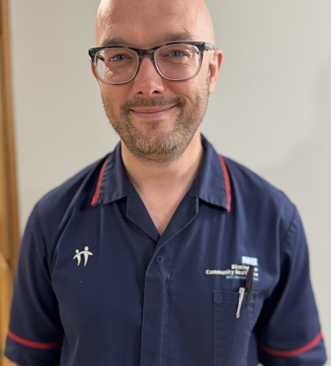
EICT Contact details & Referrers info
If unsure if EICT is appropriate- give one of the teams a call to discuss!
EICT Central 01213038930
EICT East 01213030190
EICT North 01213035444
EICT South 01213038920
EICT West 01213038273
Referrals can be made to EICT
via CCC 0300 555 1919 Option 2.
Luke Butler
Clinical Service Manager
EICT
Luke.butler3@nhs.net
07547655794

Slide 15
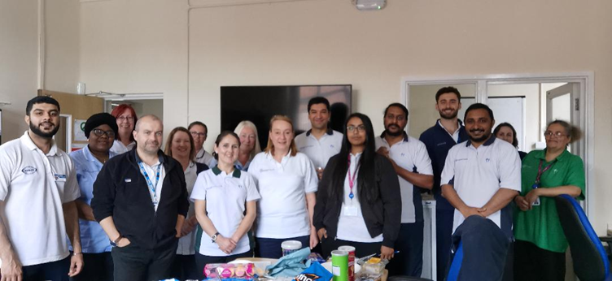
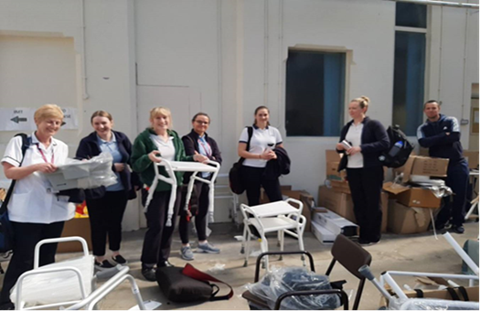
Therapy Hub Service: overview
Team: Occupational Therapists, Physiotherapists, Rehab Technicians, Rehab Assistants and admin support
Provide Physiotherapy and/or Occupational Therapy assessment, treatment and advice to predominantly housebound patients in Birmingham, with Birmingham GP.
Work jointly with patients to rehabilitate them to meet patient-centered goals within an identified time frame
Long-term rehabilitation service integrating patients back into the community
Support Physio and OT apprentices and students from various Universities
Hours of service provision 0800-1800 Mon-Fri

Slide 16
Therapy hub services: what they can offer.
Bespoke equipment for functional/rehabilitation need
Transfer assessment/practice
Personal and domestic activities of daily living
Fatigue Management
Cognitive assessment and management strategies
*Can also access neuro & falls therapy but TH will signpost as necessary
Anxiety management in relation to physical diagnosis
Functional assessment/rehabilitation
Postural support assessment
Falls assessment/intervention

Slide 17
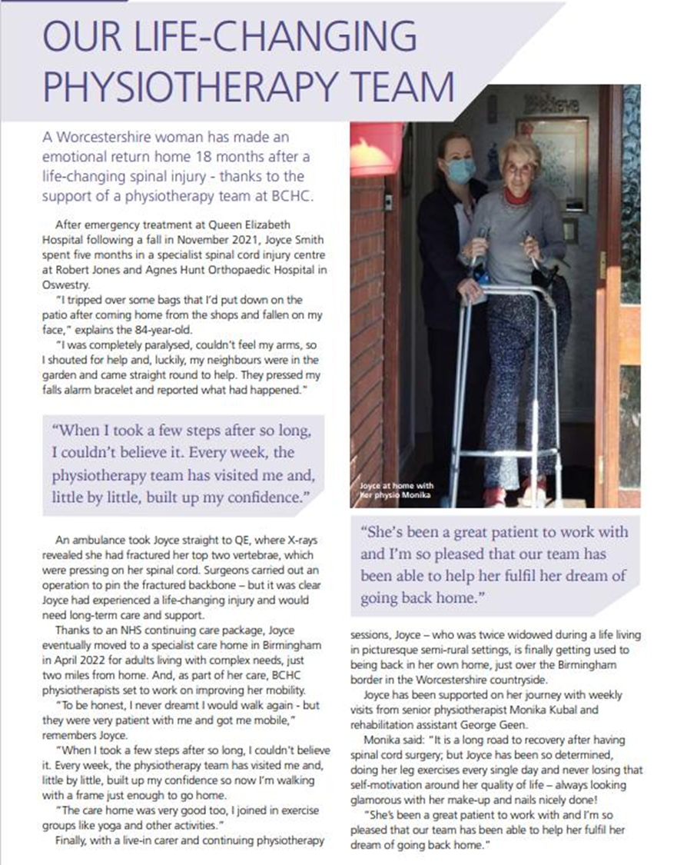
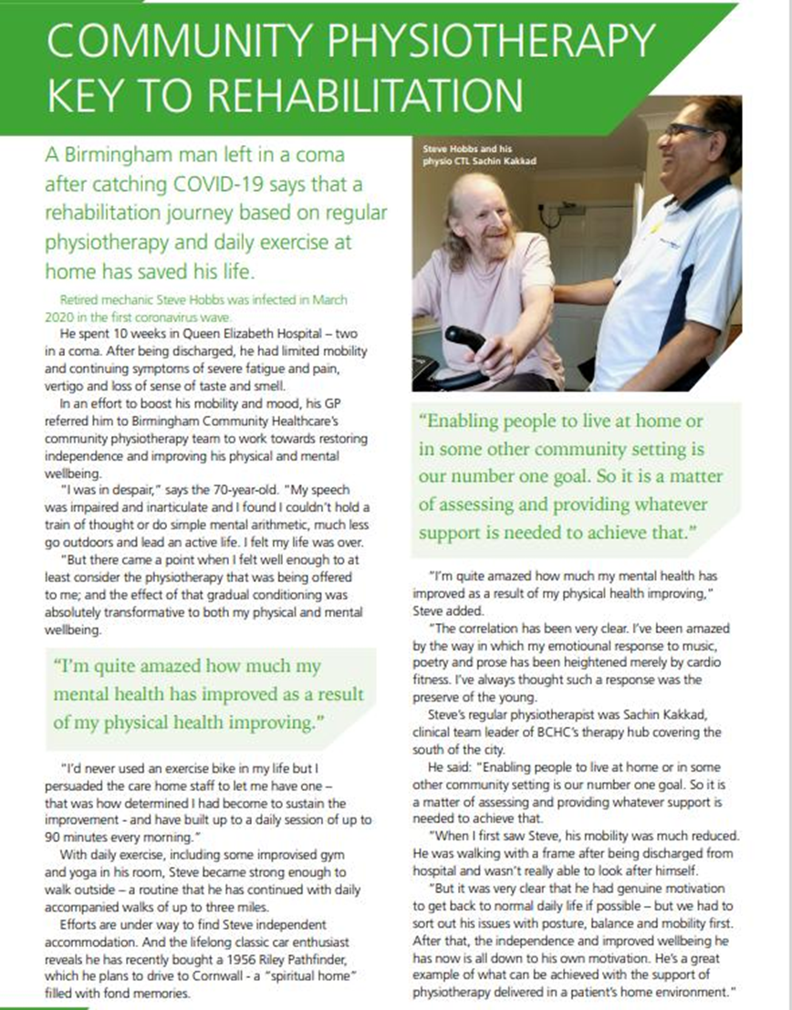
TH Success stories

Slide 18
TH- contact numbers & referral process
Central & West Therapy Hub:
0121 466 6625
East Therapy Hub:
0121 466 4855
North Therapy Hub 0121 466 4478
South Therapy Hub:
0121 466 4162
Falls
0121 466 4854
Referrals from Healthcare Professionals via referral form only – faxed or emailed to SPA
Fax: 0121 615 2963 Email: bchnt.imtreferral@nhs.net
Electronic referral form can be found on the BCHC intranet:
https://www.bhamcommunity.nhs.uk/community-therapy-service

Slide 19
Resources
Useful links:
E-learning for healthcare free VTE modules
https://portal.e-lfh.org.uk/Search
Clinical assessment of suspected DVT (nursing times, 2021)
Clinical assessment of the leg for a suspected deep vein thrombosis | Nursing Times
EICT DVT guidelines
eict-deep-vein-thrombosis-guidelines-v11.pdf

Slide 20
Thank you!!!

