Slide 1



Symptom management
Common palliative symptoms and pain assessment
Cohort 1

Slide 2
Aims
Introduction to the most common symptoms in palliative care
How to assess them and offer advice and management
How to assess pain and how to manage with analgesia
Introduction to documentation for symptom management

Slide 3
Discuss in small groups what you think are the common symptoms associated with palliative patients?

Slide 4
List of common symptoms
Constipation
Anxiety/ mood
Depression
Fatigue
Cachexia
Oral symptoms
Skin changes
Pain
Nausea
Breathlessness

Slide 5
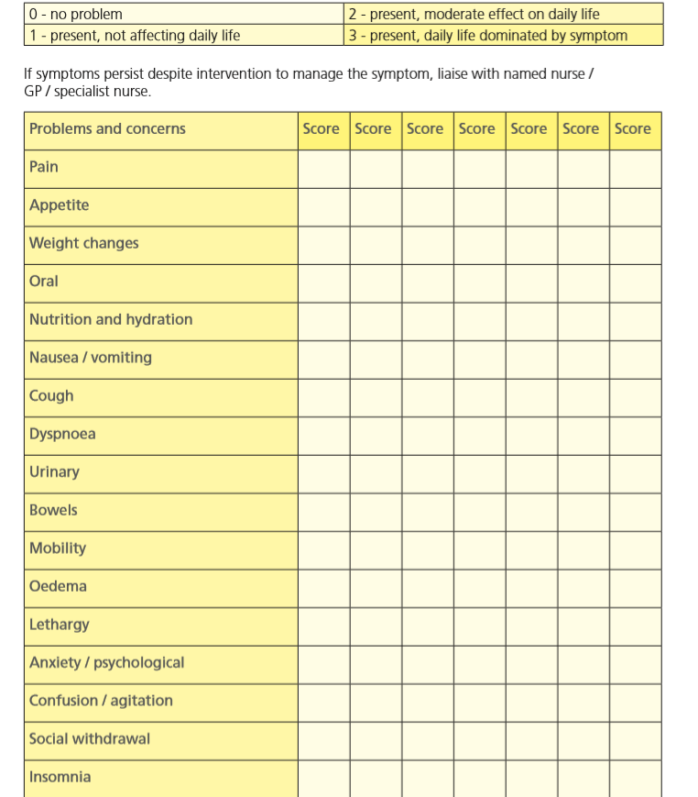
Notes:
Supportive Care Plan (SCP) – Scored 0- 3 needs to be discussed with patient and scored to how THEY are affected by that symptom

Slide 6
Pain
Often peoples biggest fear is dying in pain.
If pain is well managed before EOL then no reason the person should experience increased pain
Start simple, start low and go slow.
Refer to specialist such as hospices if pain is complicated and difficult to manage.
Notes:
30% of people with cancer report to not having pain

Slide 7
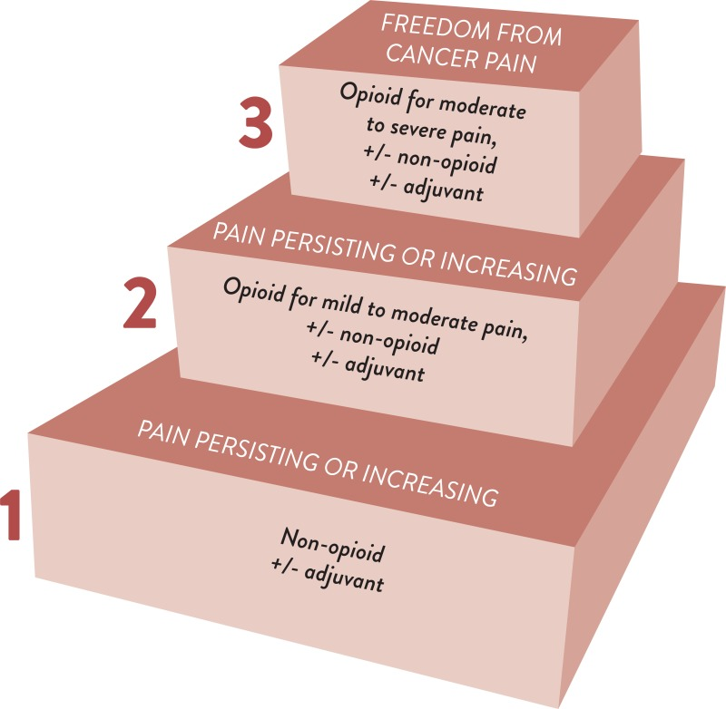
WHO Pain ladder for cancer pain management.
Notes:
Describe the WHO ladder
Starting off with paracetamol can sometimes be the best thing- paracetamol is underestimated
Start low and slow.
Non-opiate eg NSAIDs,
Adjuvants eg Anticonvulsants, antidepressants,
Steroids

Slide 8
Pain assessment
Commonly used in BCHC pain score 0-10, used as part of care plan.
In the SPC it is scored 0-3 regarding the impact on the person life.
Used to assess pain SOCRATES
  Site
  Onset
  Character
  Radiates
  Associations
  Timing
  Exacerbating factors
  Severity
Abbey pain scale can be used in dementia.

Slide 9
Challenges with pain management
Routes to give analgesia
Loss of swallow
Side effects
Preconceived ideas about analgesia
Patches are not the answer to all problems!
Liaise with MDT or Specialist Palliative Care Team.
Notes:
Challenges for community teams
Ask for Side effects of Opiates:
Constipation
Nausea and vomiting (when first taking a strong opioid)
Sedation – first few doses but usually improves provided dose is not too high
Drowsiness – common when commenced or dose increased and generally transient. Persistent drowsiness may indicate opioid toxicity
Dry mouth
Hallucinations
Confusion, sweating, myoclonic jerks
Pruritis
Respiratory depression – rarely seen if opioid doses are titrated carefully
Patches are useful in stable pain but the strength of patches can make titration difficult
What needs to be considered and monitored where patients have any degree of renal impairment in relation to opioids?
Metabolism and excretion of drug may be impaired leading to accumulation and toxicity – need for reduced doses.

Slide 10
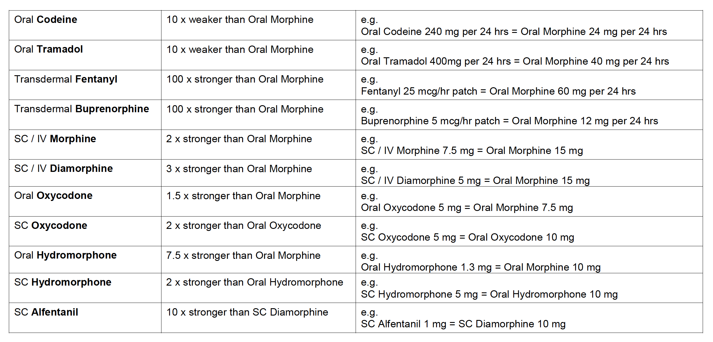
Opiate conversion chart
Relative Doses of Opioids – West Midlands Palliative Care (westmidspallcare.co.uk)
Notes:
Taken from

Slide 11
Non-pharmacological management of pain
Rest
Position
Heat/ cold
OT assessment/ equipment
Relaxation techniques

Slide 12
Constipation
Identify the cause of constipation.
Should always be considered when starting opiates – give verbal advice
Those who are either inactive or have a reduced fluid or dietary fibre intake.
Lack of privacy and pain may be contributing factors.
Do a PR
  Soft stool – use a stimulant
  Hard stool – GS, followed by enema if needed
  Empty – Consider stimulant

Slide 13
Anxiety
Multiple features
When did it start? Was it triggered at a point in time
Open honest discussions
Guided imagery and progressive muscular technique
Medication – benzodiazepines and antidepressants
Referral to specialist services for support such as hospices.

Slide 14
Depression
Signs of depression often common in long term illness such as weight loss and fatigue
Assessment of psychological symptoms
Hospital Anxiety and Depression scale (HADS)
Emotional psychological support
Pharmacological management

Slide 15
Fatigue
Debilitating – impacts each aspect of daily life
Assess using scale – ask to keep fatigue diary
Encourage energy conservation – Naps
Priority
Plan
MDT approach
Notes:
Can be associated with general deterioration
Treatment related
Associated with low mood

Slide 16
Cachexia
Enhance calorie intake
Encourage exercise
Environment
Appetite enhancers – alcohol
Pharmacological

Slide 17
Breathlessness
70% of patients with cancer experience breathlessness in the last 6 weeks prior to death.(WMPCPS,2019),
Oxygen therapy should not be used routinely. It can help with hypoxia but otherwise fan therapy can be just as effective for a person with SATS above 90%.
Notes:
Other non pharmacological measures to try could be, reassurance, open window, calm manner, posture, breathing techniques, relaxation, energy conserving/pacing training.
If using a fan- aim towards mouth and nose aprox 8 inches away
70% of patient in the terminal phase experience bubbly/noisy breathing.

Slide 18
Pharmacological management
Oral immediate release morphine- Oramorph 2.5mg-5mg 4-6 hourly
Consider starting MST
Consider the use of benzodiazepines e.g Lorazepam/ Diazepam
Notes:
MST above 20mg in 24hrs becomes ineffective to manage breathlessness

Slide 19
Nausea
Common in advanced disease
Causes vary making treatment challenging
-constipation
-obstruction
-medication e.g opiates
Multiple antiemetics can cancel each other out for example cyclzine and metoclopramide.
If uncontrolled nausea a syringe driver may be indicated using a broad spectrum medication such as levomepromazine, haloperidol if oral indicated.
If struggling to manage contact specialist services.

Slide 20
Oral symptoms
Significant impact on quality of life
Reduced oral intake
“drying medications” – Anticholgeneric
Low reporting level
Ice chips
Sugar free gum
Petroleum jelly to lip (not with Oxygen)
Soft toothbrush
Chewing pineapple

