Slide 1




COMMUNITY SMALL TALK: SHARING THE LEARNING:
December 2024
PLEASE SHARE THIS LEARNING AND UPDATES WITH YOUR COLLEAGUES & PRINT A COPY FOR THE OFFICE NOTICE BOARD

Slide 2
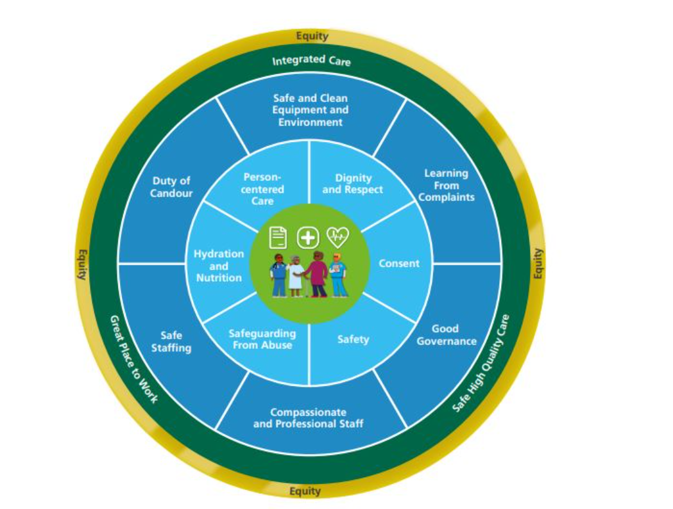


Month : January
Focus : Good Governance
We have systems in place to ensure safe and effective care
Good Governance
Governance is the systems and processes we put into place to ensure services and teams can deliver Safe, high-quality care.
Good principles can include colleagues understanding their roles and responsibilities, effective communication ensuring all team members are heard and contributions valued.
Colleagues knowing how to report incidents and shared learning.
Colleagues having access to policies and guidance documents to support safe and effective care.
Colleagues are provided with an induction and orientation to the service.
Good governance helps us to deliver safe and effective care for patients, for example triaging of referrals in a timely manner, processes in place to review patient alerts.
Risk assessments are completed and updated appropriately. Accurate clinical records are maintained to evidence care delivered.

Slide 3
Month : January
Focus : Good Governance
We have systems in place to ensure safe and effective care
Examples :
How do you monitor the teams mandatory training ?
Do your team members represent at divisional committee meetings ?
Do you feedback key messages form meetings ?
Do you have a local team meeting scheduled ?
How do you share learning from incidents ?
Do your team understand if there are risks on the risk register related to their service area ?
Does you team have access to Small talk ?
3- 5 elements of key information – Think about all the processes in your team
How do your patients provide feedback about their care ?
What patient safety process exist within your team ?
Do staff know how to report concerns and incidents ?
How do we identify high risk patients and ensure the whole team are aware of risks.
How are new colleagues inducted in the services process such as Missing person / lone working are shared.
What are we doing well as a team ?
What can we do better ?

Slide 4
1.0 Incidents
  1.3.1 Top 7 patient incidents
Figures for November 2024 have been provided below compared with an overview of the last three months.
Increase has been noted in non BCHC originated PUs, Medication Administration, non BCHC MASD, BCHC MASD and Treatment, Procedure incidents. There was a decrease in BCHC PUs and Admission/Transfer/Discharge incidents. MASD incidents and Treatment Procedure incidents.

Slide 5


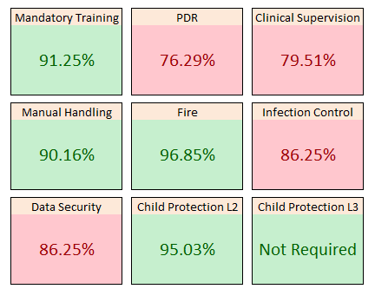
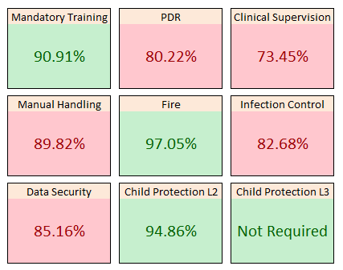



COMMUNITY SMALL TALK: SHARING THE LEARNING: November 2024
Training Compliance Divisional update December- ACS
Divisional Compliance Overview- Comparison from last month
Last months compliance (Oct 2024)

Slide 6
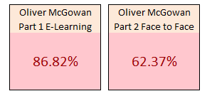
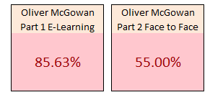
COMMUNITY SMALL TALK: SHARING THE LEARNING: December 2024
Training Compliance Divisional update for November - ACS
Oliver McGowan - Compliance
An Oliver McGowan TNA column has been added, along with the compliance column being expanded into two columns, the first column being for Part 1 E-Learning compliance and the second column being for Part 2 Face to Face/ Virtual training compliance. The TNA column is split between Non Patient Facing (Tier 1) staff and Patient Facing (Tier 2) staff. All staff are required to complete Part 1 E-Learning on the Virtual Campus. The TNA column will advise which element of Part 2 training staff will need to complete.
Part 2
Tier 1 - Non Patient Facing
One-hour online (virtual meeting) learning
Tier 2 - Patient Facing
One day’s offsite training
The Oliver McGowan TNA will need to be reviewed across the Division. Staff within the Administrative and Clerical or Estates and Ancillary staff groups (Non-Clinical) have been noted as requiring Tier 1 and staff within all other staff groups (Clinical) have been noted as requiring Tier 2. Where possible, staff within Administrative and Clerical or Estates and Ancillary staff groups that look to be patient facing (e.g. Receptionists/ Ward Clerks/ Housekeepers/ Kitchen staff), these have been noted as requiring Tier 2.
Following reviews of the Oliver McGowan TNA’s, please send change requests via the usual process of completing the attached form and returning to bchc.learninganddevelopment@nhs.net

Slide 7
COMMUNITY SMALL TALK: UPDATE ON SHORTAGE OF BLOOD GLUCOSE MONITORS: December 2024
.
Update on shortage of Blood Glucose Monitors (BGMs)
Further to the previous update in September 2024 referring to this subject, the division is currently going through a final stage of preparation for implementation of new Blood Glucose Monitors. A new contract has been fully signed and approved by the Trust with a new supplier - Menarini Diagnostics.
Training and replacement of BGM devices took place over October and November 2024. Next steps of this project have been captured below. Further guidelines referring to operational element for implementation of this programme will be provided to teams in January 2025 by their Group Managers/Service Managers. Implementation of new devices is planned for second part of January to mid-February 2025.
To prepare to the final stage of implementation the following actions have been identified for service groups:
All services to reduce future orders of currently used Abbott consumables within their teams (glucose/ketone testing strips and testing solutions) to minimise wastage and financial pressures for their service. New devises will require different consumables.
If some teams within Localities have excessive numbers of Abbott consumables, consider re-distribution to other teams where stock of consumables is low, to prevent unnecessary ordering of additional products and to avoid unnecessary cost pressures.
Appropriate service/group manager from each service group to confirm with Professional Lead Nurse and Divisional Governance Lead proposed date for roll out of new devices across each service group. (Dates shared via separate email.)
Appropriate service/group managers to confirm accuracy of inventory spreadsheets including confirmation if all staff names have been captured correctly. (Information to be send for a review w/c 23/12/24 by the Governance Team).
Services to establish a robust sign in and out process for usage of spare BGMs by Bank and Agency workers and “floating” devices allocated to teams to manage effectively allocation of these devices within the new contract. Service/group manager to ensure that above process is in place and uniformed across each service group. Draft process shared with service/group managers – process to be reviewed and confirmed if suitable for each service group. (Information sent for a review via a separate email).
Service/group manages to consider planning for provision of train-the-train training to staff who could not attend F2F sessions around time of roll out of devices across teams/services.

Slide 8
COMMUNITY SMALL TALK: UPDATE ON SHORTAGE OF BLOOD GLUCOSE MONITORS: December 2024
.
Other associated actions supported by other parties involved in this project:
Procurement/Supplier to arrange delivery of new devices and initial consumables to Divisional Management Building FAO Governance Team (planned for mid-January 2025). Please do not place orders with the Governance Team for new BGMs - this is not required.
Governance Team/Administrative Team to allocate/assign devices to appropriate teams/staff as per requirements confirmed by teams/services within inventory spreadsheets.
Medical Devices Team to support with delivery of new devices/initial consumables/and box with training/useful resources pack to each appropriate team/service across the division as per agreed schedule. Schedule for roll out to be confirmed with each team/service by service/group managers in January 2025.
Medical Devices Team/locality drivers to support with collection of old Abbott devices from teams/services. Details to be confirmed closer to the roll out date.
Medical Devices Team to assist with comms to Trust Bank Office to support communication with Bank and Agency staff RE roll out of new devices and new process in place for allocation of BGMs/other medical devices to Bank and Agency staff.
Divisional Diabetes Lead has reviewed and updated the Management of Capillary Blood Glucose and Blood Ketone Monitoring in Adults Procedure document to capture changes in contract and procedure. Once revised procedure will be approved, this will be them shared across the division.
Pharmacy is preparing order details for supplies (glucose/ketone strips and testing solution for new BGMs) and this information will be shared with teams/services shortly. Process for ordering of consumables remains the same and should be requested via Pharmacy.
Medical Devices Team to support all divisions with future management of replacement devices – process to be confirmed.

Slide 9
COMMUNITY SMALL TALK: UPDATE ON SHORTAGE OF BLOOD GLUCOSE MONITORS: December 2024
.
RECOMMENDATIONS
Do:
Continue reporting shortage of BGMs across your services to your Service Clinical Manager/Group and Service Manager/Group Clinical Managers
Escalate identified issues to divisional Governance Lead (paulina.kasinska@nhs.net and Professional Lead Nurse (natasha.jones52@nhs.net)
Report on Datix occurred incidents associated with shortage of BGMs
Request number of BGMs required for your service from the divisional Governance Team (bchnt.acsgovernance@nhs.net). Please not, as of 20/12/24 there are no spare Abbott devices available, however requirements for BGMs still should be flagged to divisional Governance Team and Service Managers before roll out of new devices will be implemented.
Follow up on actions flagged for service groups in Slide 1
Don’t:
DO NOT order excessive amount of Abbott consumables (testing glucose/ketone strips and testing solutions).
DO NOT purchase BGMs devices on your own – each medical device used across the Trust must meet appropriate standards and be compliant with a number of regulations. All medical equipment must be approved by the Trust before it can be used across the Trust/division. At present Birmingham Community Healthcare NHS Foundation Trust (BCHC) approved only two different types of BGM devices – Freestyle Optium Neo H and GlucoMen Areo 2K as per the Procedure for the Management of Capillary Blood Glucose and Blood Ketone Monitoring in Adults (CH465).
DO NOT purchase approved by the Trust devices (Freestyle Optium Neo H and GlucoMen Areo 2K) on your own via alternative suppliers (like local Pharmacy, internet) – this poses an additional risk due to unclear source of devices and does not align with the Trust Procurement process
DO NOT use BGMs owned by patients to take blood glucose readings on a regular basis – those devices are not calibrated in line with the Trust procedure and may result in incorrect clinical readings being taken, which may negatively impact on decision taken by clinicians for appropriate clinical treatment or intervention. This approach is only recommended where patients are independent with taking their own blood glucose monitoring.
More information and guidance on management of BGMs across the division and update on the current replacement project can be provided by the Professional Lead Nurse and divisional Governance Team. Telephone: 0121 466 6128 Email: bchnt.acsgovernance@nhs.net

Slide 10
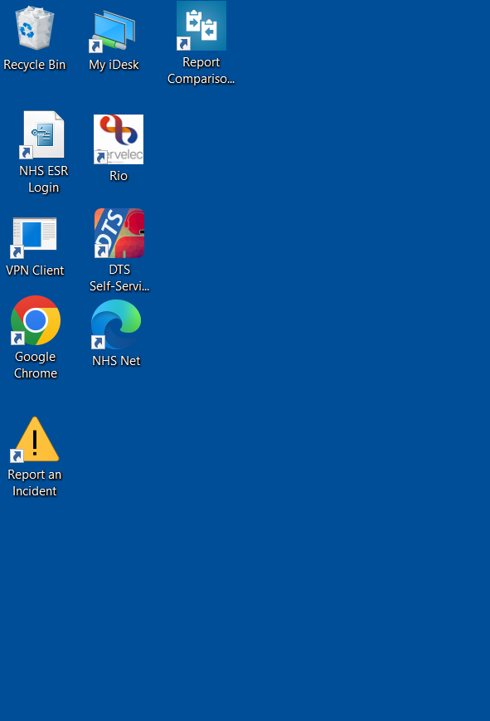


Report an Incident on Datix
Dear Colleagues
A new and easily accessible way to report an incident on Datix has been now made available through your computer/laptop desktop. This is identified as an amber triangle with an exclamation mark in the middle.
To report an incident, patient safety event, near miss or never event, simply click twice on this desktop icon. This will take you directly to an online incident reporting form on Datix. You need to be connected to BCHC network to access this website effectively. Proceed with completion of the form as usual.
Please Note
If you wish or consider submitting a risk, contact your divisional Governance Team or Risk Management Team for guidance and advise on how to complete this. Consider discussing an intention of reporting a risk with your line manager.
Remember, incidents and risks are different modules on Datix and reporting both in a correct format in the first place is crucial to address identified issues accurately and without unnecessary delays.
ACSD Governance Team: bchnt.acsgovernance@nhs.net
Risk Management Team: bchc.riskmanagement@nhs.net

Slide 11
COMMUNITY SMALL TALK: SHARING THE LEARNING: December, 2024
Clinical Record Keeping Audit 2024
Well Done to all of ACS!
ACS was successful in completing the Clinical Record Keeping Audit 2024 within the deadline FOR ALL services.
This is a great achievement considering the challenges we have faced over the last couple of months. Not only did you complete the audit, the CRK committee agreed for more accurate results and representation and to reduce bias we would ask you to double the number of records to audit and to audit a neighbouring team, rather than your own and you achieved this.
I will keep you up to date with the results and any actions plans as they are produced.
Well done and Thank you ☺
Results for ACS |  |  | Response Percent | Response Total
1 | North Locality IMTs |  | 8.93% | 41
2 | West Locality IMTs |  | 7.41% | 43
3 | East Locality IMTs |  | 8.71% | 40
4 | Central Locality IMTs |  | 9.80% | 45
5 | South Locality IMTs |  | 9.37% | 43
6 | Virtual Wards |  | 2.40% | 11
7 | Continence - Bladder & Bowell |  | 2.18% | 10
8 | Diabetes and CKD |  | 2.18% | 10
9 | Lymphoedema |  | 2.18% | 10
10 | Respiratory |  | 2.18% | 10
11 | Tissue Viability |  | 2.18% | 10
12 | Cardiac Service |  | 2.18% | 10
13 | Early Intervention Community Team West |  | 1.74% | 10
14 | Early Intervention Community Team East |  | 2.61% | 12
15 | Parkinson's Team |  | 2.40% | 11
16 | Early Intervention Community Team South |  | 2.18% | 10
17 | Therapy Hub |  | 20.04% | 92
18 | Early Intervention Community Team Central |  | 2.61% | 12
19 | Falls Service |  | 2.18% | 10
20 | Early Intervention Community Team North |  | 2.18% | 10
21 | IV Therapy Service |  | 2.18% | 10
22 | Urgent Community Response |  | 2.18% | 10
.

Slide 12



SMALL TALK: SHARING THE LEARNING: December 2024
LFE nominations: Total number of submitted Learning from Excellence nominations received in November 2024 is 96 and all have been shared with the divisions. 23 are for ACS
Roots are the general ‘thank you’ and ‘well done’, which are wonderful to receive and act as a morale booster.
Branches are those areas of learning that can be adopted and adapted at a local level
Apples being the work that has far-reaching Quality Improvement (QI) potential.
(ID: 135979) XXXX supported one of our patients to get back to her own home. Patient was transferred to a temporary accommodation from Moseley Hall hospital while social services were getting deep cleaning done in her own home. Patient was unable to transfer back to her own home due to deteriorated mobility while she was in the temporary accommodation. We have contacted non urgent patient transport to arrange transfer and transportation, but they have refused. XXXX along with one of our therapy support workers put extra effort in arranging a temporary wheelchair on loan and assisted the patient to transfer back home. I would like to thank you and appreciate both of my colleagues for their hard work and dedication.
(ID: 135972) A patients daughter asked to speak to myself as Service Manager to provide feedback on their experience liaising with the Central Unplanned Team regarding her Mother's care. The daughter has experienced frustrations in relation to care following discharge from hospital and acknowledged her frustrations when speaking with both XXXX as Deputy Team Manager and XXXX as Triage Nurse. The feedback received was how both XXXX and XXXX remained calm, professional and caring throughout ensuring the patients daughter felt valued and listened to. The patient’s daughter found both nurses to be extremely supportive and helpful and described them both as a 'breathe of fresh air'. Both nurses demonstrated our trust values of caring through compassionate communication with a patients relative ensuring safe high quality care for the patient remained at the heart of all discussions. Well done both!

Slide 13
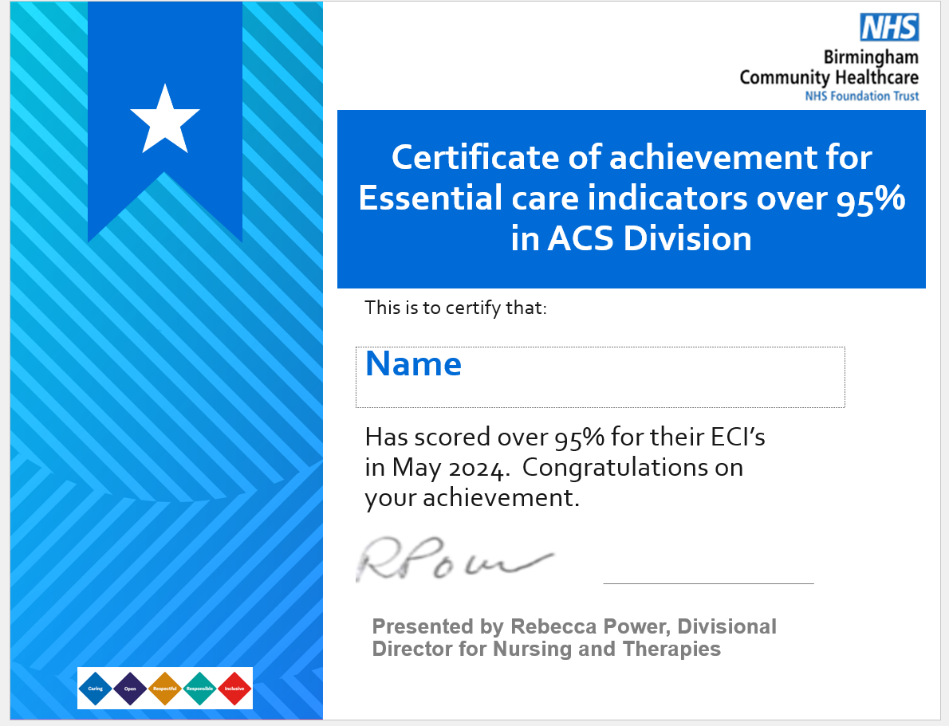

COMMUNITY SMALL TALK: SHARING THE LEARNING: December 2024
Celebration – All teams who score over 95% on ECIs will now receive a certificate in recognition of their hard work !
IMT Planned - Bracebridge
IMT Planned - Brookvale
IMT Planned - Langley
IMT Planned - Longmoor
IMT Planned Central - Bournville
IMT Planned Central - Swanshurst
IMT Planned East - Meadway
IMT Planned East - Swan
IMT Planned South - Victoria
IMT Planned South - Westley
IMT Planned South - Woodley Oak
IMT Planned West - Trinity
IMT Planned West - Hawthorns
EICT - Central
EICT - East
EICT - South
UCR
Therapy OT C and W
Therapy OT East
Therapy OT North
Therapy OT South
Therapy PT Central and West
Therapy PT East
Therapy PT North

Slide 14

COMMUNITY SMALL TALK: SHARING THE LEARNING: December, 2024
.

Slide 15
COMMUNITY SMALL TALK: SHARING THE LEARNING: December 2024
Equality Impact Assessment Assessments
An Equality Impact Assessment (EIA) is a process of analysing a new or existing service, policy, or major decision. The aim is to identify the likely effect of implementation on diverse groups in our workforce and population. An EIA is a way of considering the impact that a decision, policy, strategy, project, process, or service change may have on different groups within the community including staff, service users and carers as a result of their Protected Characteristics. This requirement is known as having to pay “due regard” to the Protected Characteristics.
BCHC is working to create services and workplace practices that are more inclusive by proactively taking steps to advance equality of opportunity, eliminate discrimination and engage people with protected characteristics.
The most important outcome of this process is ensuring that groups and individuals who face disadvantage and under representation are visible in the decisions that that affect them.
The toolkit provides guidance on how and when to complete an EIA and offers a stepped process and template to record an EIA.
Equality Impact Assessments (EqIA) | Intranet
Equality Impact Assessment Toolkit – Getting it Right First Time
Launch Event: 3 December, 1pm -2pm at Priestly Wharf
We are pleased to be launching our refreshed Equality Impact Assessment (EIA) toolkit to enable us to improve equality and inclusion in how we make decisions and do things.
The new EIA toolkit is designed to make it easier for anyone working on a policy or service change, to determine and understand how and what we do may affect people differently. The most important outcome of this process is ensuring that groups and individuals who face disadvantage and underrepresentation are visible in the decisions that affect them.
Join us at our launch event on 3rd December taking place at 1 – 2pm at Room G01, Priestly Wharf or join virtually: Microsoft Teams Join the meeting now (Meeting ID: 313 723 080 386 / Passcode: Q5mcfk ), to hear more about the toolkit, what this means for you, and our future plans. The Equality Diversity and Inclusion Team will also be running a roadshow at local centres in early 2025.
Visit our webpages for further details https://intranet.bhamcommunity.nhs.uk/equality-eqia
If you have any queries, please contact the Equality Diversity Inclusion team at bchc.equalityteam@nhs.net
.

Slide 16

COMMUNITY SMALL TALK: SHARING THE LEARNING: December 2024
Equality Impact Assessment Toolkit Road Show
The Equality Diversity and Inclusion Team will be running a roadshow at local centres to staff with more information about the toolkit, how to apply it, and answer questions. It will be an informal and interactive session with practical tips and tools. The roadshow will be running at the following dates and times, and all staff are welcome to join.
.
Centre | Date | Time | Room
Priestly Wharf | Tuesday 3 December 2024 | 12 – 1pm | G01, Ground Floor
Moseley Hall Hospital | Monday 13 January 2025 | 12 – 1pm | G02, Seminar Room, Ground Floor
West Heath Hospital | Monday 27 January 2025 | 12 – 1pm | G24, Welfare Room, Ground Floor
Gee House | Monday 3 February 2025 | 12 – 1pm | Meeting Room2, First Floor
Lansdowne Health Centre | Monday 10 February 2025 | 12 -1pm | Ground Floor, Group Room 9
Jaffray Resource Centre | Monday 3rd March 2025 | 12 – 1pm | Room RG8, Ground Floor

Slide 17
COMMUNITY SMALL TALK: SHARING THE LEARNING: December, 2024
Registration Open!!!
BCHC Safeguarding Conference 2025
“Developing effectiveness, competence, and confidence in
safeguarding practice”
Thursday 30th January 2025 - Birmingham City Football Club, Small Heath, B9 4RL
09:00 – 16:45 (Registration from 08:15)
‘Domestic Abuse’
Join us in our 2nd Annual BCHC Safeguarding Conference
Guest speakers will include
Birmingham Children’s Trust, West Midlands Police, Sikh Women’s Aid, Cranstoun, Black Country Women’s Aid, Richmond Fellowship & Expert by Experience
Workshop Programmes
Management support for staff victims of domestic abuse
Risk assessment and safety planning
Domestic Abuse and the adolescent
Domestic Homicide Review’s
Impact of Domestic Abuse on Children
*Refreshments & sandwich lunch to be provided
Booking your place:
Complete the Booking Form below & email the form to:
bchc.safeguarding@nhs.net
.

Slide 18

COMMUNITY SMALL TALK: SHARING THE LEARNING: December, 2024
.

Slide 19

AHP Career Conversation Sessions
ADULT COMMUNITY SERVICES
Are you thinking about new opportunities or next steps in your career? Are you curious about options available? If the answer is yes or even not sure, then why not come along to a career conversation drop-in session. Sessions will be facilitated by Pam Ricketts (AHP Professional Lead) and will last no more than two hours.
Sessions are open to all and there is no need to book.
Friday 22nd November 2024 – 09:00 to 11:00
Therapy Hub Office, Moseley Hall Hospital
Tuesday 3rd December 2024 – 08:30 to 10:30
West Heath Hospital
Wednesday 8th January 2025 – 09:00 to 11:00
Ann Marie Howes
Monday 3rd February 2025 – 11:00 to 13:00
Norman Power Centre
Wednesday 12th March 2025 – 09:00 to 11:00
Sutton Cottage Hospital

Slide 20


COMMUNITY SMALL TALK: SHARING THE LEARNING: December 2024
.

