Slide 1



Safeguarding Boot Camp
ACS Division
Cathy Knox

Slide 2
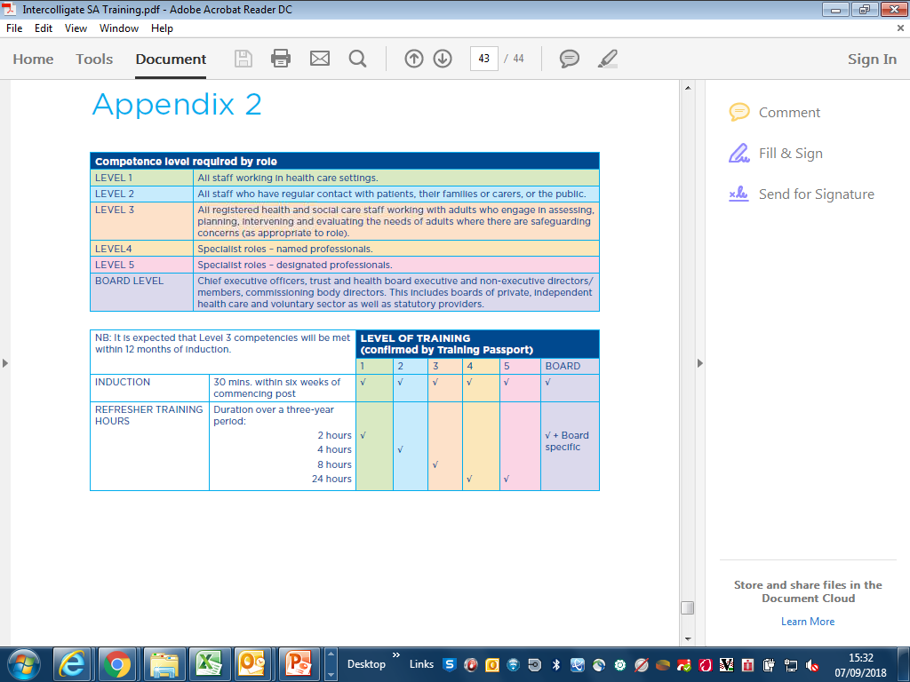
Safeguarding adults
Safeguarding Adults Training & Competence.

Slide 3
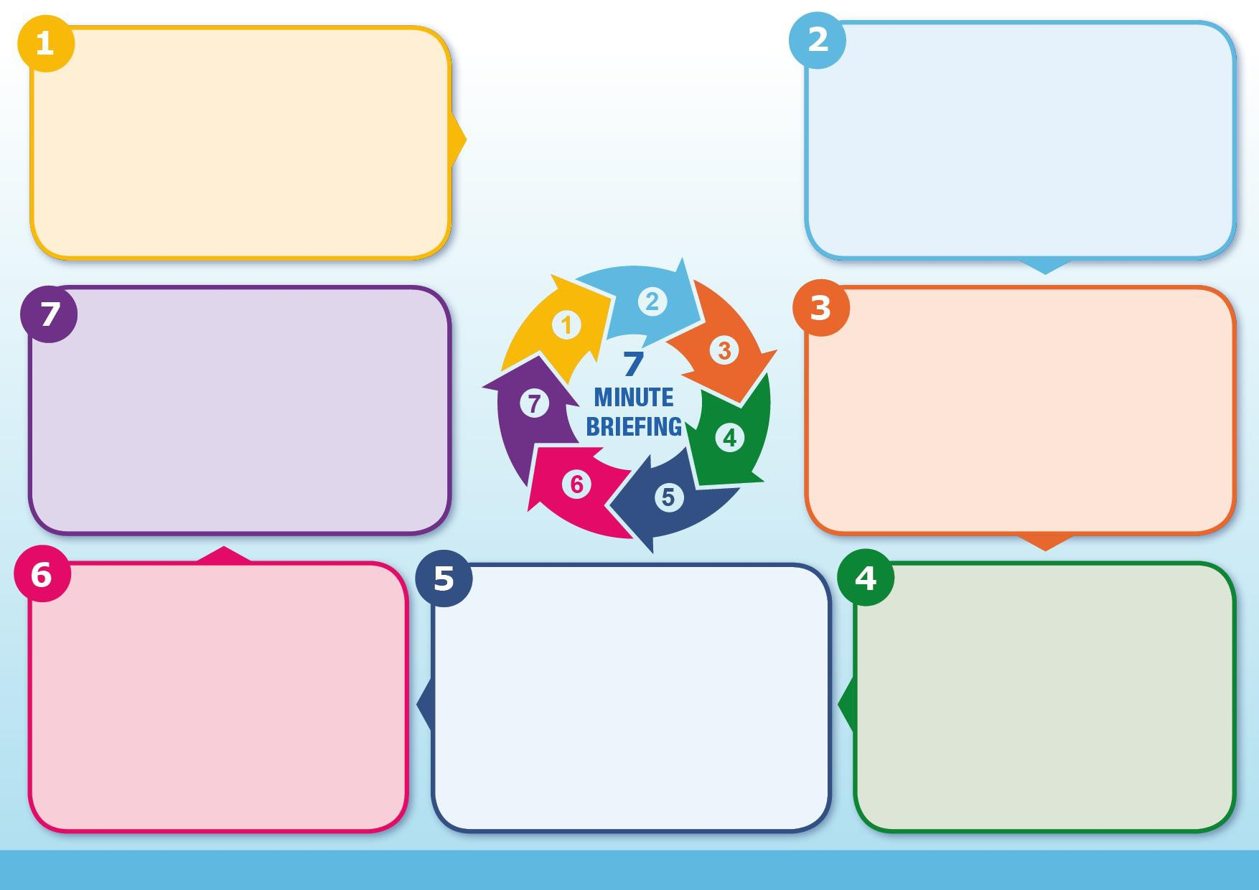

Safeguarding applies to an adult who:
Has care & support needs and
Is experiencing, or is at risk of, abuse or neglect and
As a result of their care and support needs is unable to protect themselves from either the risk or experience of abuse or neglect. (Care Act 2014)
Identification of Abuse in Adults:
Physical * Psychological
Neglect * Self-neglect
Financial * Sexual
Domestic Abuse
Modern Slavery
Organisational
Discriminatory
Safeguarding is everyone’s business, regardless of role or seniority.
Safeguarding Team
How to raise Safeguarding Concerns for an adult in Birmingham
For advice & support contact
BCHC Safeguarding Adults Team Mon – Fri 09:00 to 17:00:
Tel: 0121 4667118 Email: bchc.safeguardingadults@nhs.net
In an emergency contact West Midlands Police: 999
Making Safeguarding Personal:
Discuss with the patient what outcome they want if they are deemed to have capacity.
Be honest
Understand the adult’s wishes
Respect the adult's choices
Consider whether the adult’s decisions negatively affect their wellbeing – seek advice as appropriate.
It is your responsibility to follow up on the Safeguarding concerns that you have raised.
Contact the Local Authority:
Tel 0121 3031234
Email:
CSAdultSocialCare@Birmingham.gov.uk
Out of Hours Access Point:
0121 464 9001
Complete the Birmingham City Council Safeguarding Adults online referral via the portal:
https://www.birmingham.gov.uk/safeguardingadults
Save a copy to the patient’s records and email a copy to Safeguarding Duty:
bchc.safeguardingadults@nhs.net
DATIX report that Safeguarding Concerns have been raised.
Abide by the Safeguarding Principles:
EMPOWERMENT PREVENTION
PROTECTION PARTNERSHIP
PROPORTIONALITY ACCOUNTABILITY

Slide 4

A Patient’s Journey

Slide 5
Concordance, Capacity & Consent
Who feels confident & competent to assess mental Capacity?
Who seeks informed Consent when working with patients?

Slide 6


Consent
If Consent is to be valid it must be:
Informed and
Given freely without coercion or pressure.
Consent can only be deemed informed if the patient has received information about the care, treatment or investigation that they are able to understand, retain and weigh up to make their decision.
Notes:
Ask about documentation regarding consent. HOW? WHY? WHERE?

Slide 7
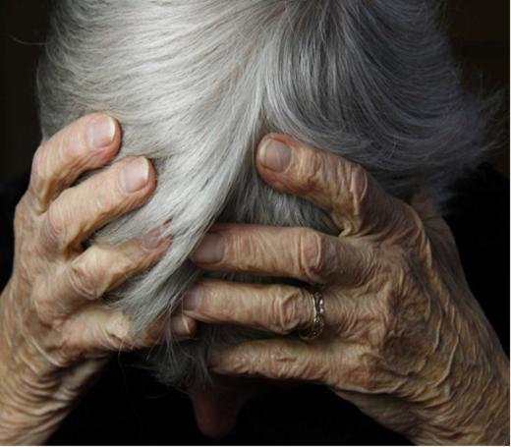
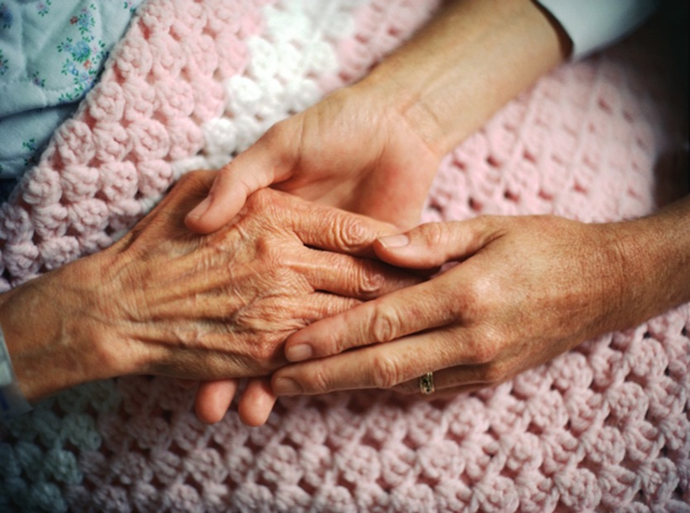
Concordance.
An agreement reached after negotiation between a patient & healthcare professional that respects the beliefs & wishes of the patient in determining whether, when and how their care will be delivered.
‘No decision about me, without me’
Notes:
Remember that the patient must always be central to the decisions about their care & treatment.
Before moving on to the next slide ASK: What legislation (laws) must we observe in our care of patients?

Slide 8




Legislation that protects vulnerable adults:
Human Rights Act (1998) Article 8:
Notes:
Ask: what do you know about these laws? How do they support & protect the patient?
How would you feel if your rights were not upheld?

Slide 9

Mental Capacity Act (2005)
Principles:
1. Assume capacity
2. Maximise potential
3. Unwise decisions
4. Best interests
5. Less restrictive
Capacity Assessment
Diagnostic Test: Is there an impairment of, or disturbance in, the function of the person’s mind or brain?
Functional Test: Does the impairment or disturbance cause the person to be unable to make the decision in question?
Understand, Retain, Weigh up, Communicate
NMC Code of Practice: ”keep to all relevant laws about mental capacity that apply in the country in which you are practising, and make sure that the rights and best interests of those who lack capacity are still at the centre of the decision-making process.”
Notes:
At the title & before exposing The Principles of the MCA ask staff if they know what they are!
Then work through each of the 5 Principles with examples.

Slide 10


Human Rights Act (1998)
Sets out the fundamental rights and freedoms that everyone in the UK is entitled to.
Human Rights include the right to life & liberty, freedom from slavery & torture, freedom of opinion & expression, the right to work & education & more - - - - - -
These basic rights are based on shared values like dignity, fairness, equality, respect & independence & protected by law.

Slide 11
Human Rights Act (1998) Article 8:
The right to respect for private and family life
Everyone has the right to respect for his private and family life, his home and his correspondence.
There shall be no interference by a public authority with the exercise of this right except such as is in accordance with the law and is necessary in a democratic society in the interests of national security, public safety or the economic well-being of the country, for the prevention of disorder or crime, for the protection of health or morals, or for the protection of the rights and freedoms of others.
Article 8 rights are qualified rights; this means that in certain circumstances they can be interfered with by the state.
Notes:
Open up to discussion.

Slide 12


The Care Act (2014)
Statutory Safeguarding responsibilities only apply where an adult:
Has care and support needs
&
Is experiencing, or at risk of, abuse or neglect
&
As a result of those care and support needs is unable to protect themselves from either the risk of, or the experience of, abuse or neglect.
https://www.birmingham.gov.uk/info/20018/adult_social_care_and_health/111/report_possible_abuse_or_neglect_of_an_adult_with_care_and_support_needs/1

Slide 13
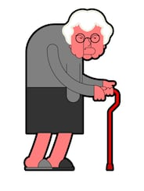
My bottom is feeling really sore. The skin on my legs feels tight and uncomfortable and my ankles are swelling. It is getting more difficult to get around the house and I am frightened of falling down the stairs. I have a toilet downstairs which is easier to get to than the bathroom, which is upstairs. The nurse was not happy when I told her I’m sleeping in my chair.
Beryl has extensive MASD, bilateral lower limb oedema & is refusing to go to bed, spending days & nights in her chair.
I advised her to go to bed at night & during afternoon.
She will not listen to advice.
Notes:
Two opposing views!
Consider concordance, capacity & consent.
Identify risks. Consider alternatives, effective communication, humanistic approach.
Extrapolate a compromise?
Contemporaneous documentation>

Slide 14

I have lived on my own with this for years. I enjoy getting out of this place to go to work. They want me to stay at home & go to bed all day. That wouldn’t do me any good. The GP asked them to visit after a recent infection & bout of diarrhoea. They say I have a sore area, but I don’t know what all the fuss is about.
Tom has a progressive neurological condition, requiring use of a wheelchair. Which he is spending more than 15 hours a day in. He’s also losing weigh. He has evidence of MASD, shear, friction & ungradable skin damage to his sacrum.
He declines equipment & advice to return to bed in the day & he is unable to take time off work as he is concerned about losing his job.
He gets agitated & angry when we visit , tells us to leave & not bother returning.
You are unable to gain access to Tom’s home & he isn’t answering his phone.
Notes:
Two opposing views!
Consider concordance, capacity & consent.
Identify risks. Consider alternatives, effective communication, humanistic approach.
Extrapolate a compromise?
Contemporaneous documentation.

Slide 15
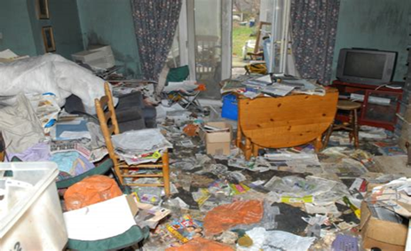
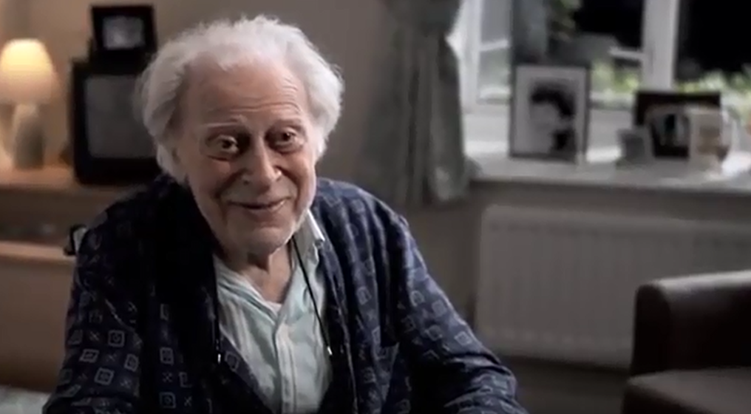
It’s the patient’s right to live like this!
Isn’t it?

Slide 16
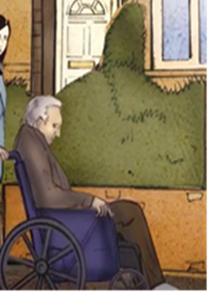

My decisions, my rights. Leave me alone!
Its MY choice:
Where I live
How I live my life
The environment
To decline health or social support
To accept, decline interventions, treatments, equipment etc
What If the decisions an adult is making, negatively impact on their wellbeing?

Slide 17
Self-neglect
What does that mean to you?
Not taking care of themselves or allowing others to provide care.
Declines treatment or surgical interventions. Stops taking medication.
Dirty, smelly environment. Dirty, urine soaked, faeces smeared clothing & linen.
Declines visits.
Won’t allow us in.
Missed appointments.
Infestations – rats, maggots, flies etc.
Hoarding Including animals!
Sleeping in a chair – causing physiological problems.
Notes:
Ask group to explain what Self-neglect means to them. Ask for examples.
Explain that a case study will be presented that relates to a patient in BCHC care, that the patient died resulting in LeDeR

Slide 18
Birmingham Safeguarding Adults Board (BSAB) latest Guidance:
BSAB has produced Guidance and self-neglect risk assessment to support the process:
BSAB_Self_Neglect_Guidance_and_Process_Nov_21.pdf
See page 46 for the assessment which must be completed on all cases
Notes:
71 page guidance. There is information about all types of Self-neglect & Hoarding behaviour & useful agencies that can be referred to for support.

Slide 19

Duty of Care & Risk Enablement:
Managing the balance between protecting adults at risk from self-neglect against their right to self-determination is a serious challenge for all services and agencies.
Using an objective assessment tool will support problem solving objectively.
Notes:
Self-neglect can be difficult to manage in the community.
It is sometimes difficult to balance the patient’s rights with what they are identified as needing.
Always consider whether the patient has capacity to make decisions that negatively impact on their wellbeing.

Slide 20

Self-neglect Risk Assessment
Within the BSAB Guidance there is a Self-neglect Risk Assessment which can be found here:
https://www.bsab.org/downloads/file/175/self-neglect-risk-assessment
Notes:
Show the Risk Assessment on screen & talk through the categories from low, medium to high RISK.
An objective assessment tool supports clarity in identifying problems & risks.
Discuss with team members & become confident in using the Self-neglect Risk Assessment

Slide 21
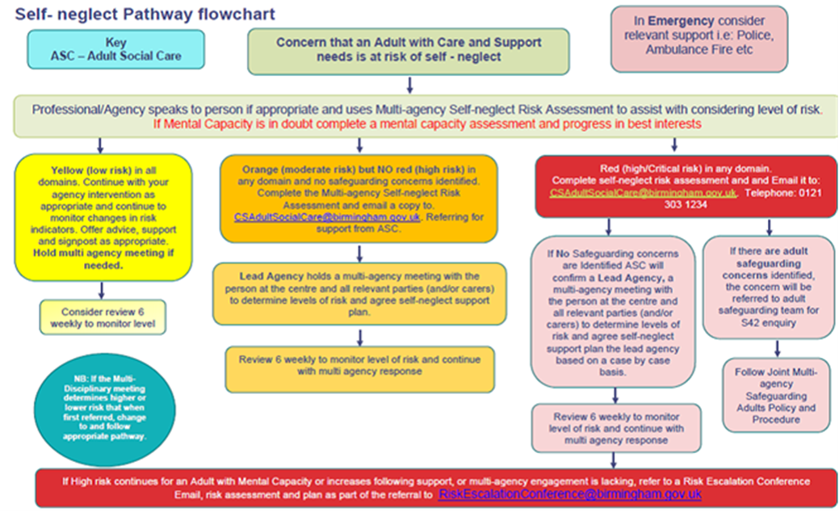
BSAB Self-neglect Pathway:
Notes:
Talk through the PATHWAY Step by step yellow – Orange – RED

Slide 22
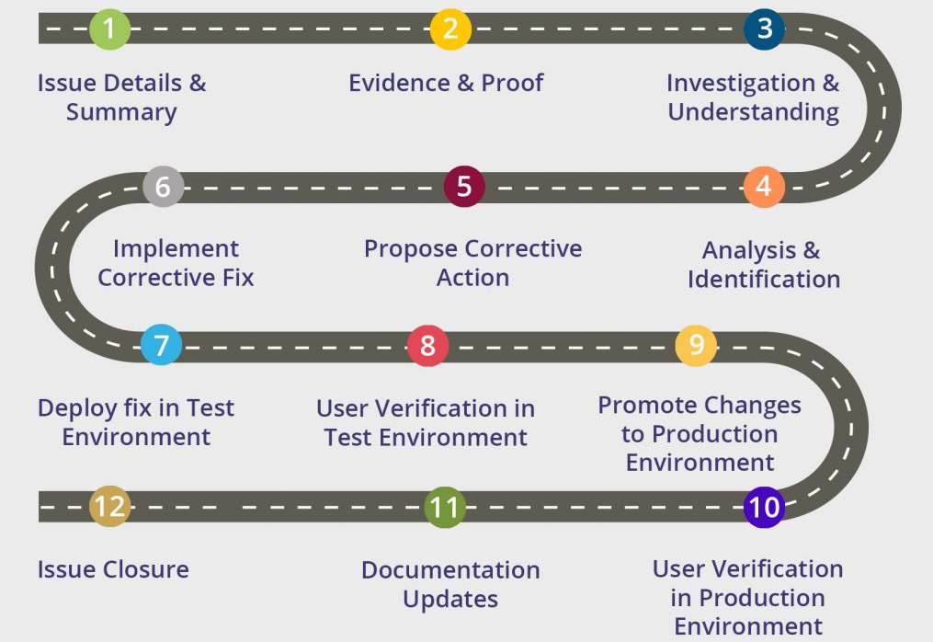

Born 1973. X lived downstairs in a three bedroom house with his mother and younger brother. His brother worked full-time, and his mother was his carer.
2001 diagnosed with seronegative rheumatoid arthritis, pyoderma gangrenosum & venous leg ulcers.
Mild LD/MH was noted in records, however GP notes no LD. Referrals to LD 2011, 2013 & 2018. One inpatient stay notes Newbridge House
2010 referred to DNs for care of feet & legs; applying creams and dressings.
Visits were several times per week. Despite this wounds to feet & legs did not heal & Pressure Ulcers developed
Over the years the wounds improved then deteriorate with non-concordance a factor for periods
Self-neglect & Neglect evident.
2013 Social Worker assessed that client has capacity for DN input.
2014 BCHC clinicians assessed that patient has capacity. Between 2014 & 2021 no further capacity assessments.
Loved going on family holidays & to the football. Annually renewed his season ticket.
Mum may have had some difficulties with caring duties as her son would be clear in what support he did & did not want.
07/12/2021 22:00 Admitted to hospital following cardiac arrest. Safeguarding concern raised by hospital staff due to concerns about his condition, including multiple, infected Pressure Ulcers & being covered in urine & faeces.
Our patient died 08/12/2021.
07/12/2021 GP contacted – home visit completed; patient was vomiting & in pain. Self-neglect & neglect evident. Admitted to hospital.
He was seen infrequently by staff during the COVID 19 pandemic & not at all for eight months prior to his death. This meant that the deterioration that led to his death was not identified until a few hours before.
Notes:
Consider the patient’s journey & how the Risk Assessment could support improved Problem Solving.

Slide 23
Learning from LeDeR
Professional curiosity: what does Learning Disability or Mental Health mean & how does this impact on our patients’ lives?
How do other people &/or the environment impact on our patients’ lives?
Escalation when staff are prevented from seeing the patient.
Prescribing for patients who are not seen.
MCA – Assess capacity & review – CONFIRM & CHALLENGE at Handover
Self-neglect – BSAB Guidance & Risk Assessment.
Carers’ Assessment
THINK! Does the patient have Capacity to Consent to care?
Notes:
Before delivering the session read the LeDeR Action plan. – Explain BCHC & particularly the Division’s responsibility to meet the required Actions decided by the CCG & LeDeR panel.
Discuss each point with clarity & detail from the LeDeR Action Plan.
1) Professional curiosity: explore diagnosis & labels to establish fact. Challenge labels that have bee applied to patients without any formal diagnosis process. Explore & understand how this impacts on the patient & their life 2) Consider more than formulaic treatment plans. The diversity of patients & their needs & the people in their lives can impact on their behaviours, particularly if they have neurodiversity, LD or mental illness.
3)When either a patient or someone in their life prevents you from seeing them & there is no reasonable explanation escalate to your manager & Matron.
4)Question whether prescriptions should be provided when the patient is not being seen by the nurse. How does this meet the NMC requirements of a Nurse Prescriber & Trust policy. Escalate & seek support.
5)During every assessment process consider whether the patient has Capacity to Consent to the plan of nursing care. If this is doubted complete & document a Capacity Assessment – It’s one page of A4. Remember that Capacity can fluctuate & change – re-assess Capacity when indicated. Discuss, CONFIRM & CHALLENGE at Handover. Seek support from senior staff & the Safeguarding team can be contacted 09:00 to 17:00 Mon – Fri: bchc.safeguardingadults’nhs.net
6)Reflect on what has already been delivered on Self-Neglect Guidance & Risk Assessment.
7)Offer Carer’s Assessment in accordance with the Care Act (2014)
TEAM MANTRA: Does the patient have Capacity to Consent to Nursing Care?

Slide 24

Decision making!
There is a need to explore the adult’s understanding of the identified risk of harm from self-neglecting behaviour.
Does the adult have capacity regarding the decisions they are making that are neglectful?
Has the adult been provided with all the information, that they are able to understand, to realise risk of harm?
Is there catastrophic risk of harm?
Identify and work with other services
Notes:
Discuss the need for professionals to have courageous conversations.

Slide 25

Ask yourself !!
Do the decisions that the adult makes negatively affect their wellbeing?
If the answer is YES, consider:
Whether the adult has any unmet health or social care needs.
What else could services provide to meet those needs and support the adult?
Collaboration, communication & co-ordination as an MDT with the adult.

Slide 26

THINK!!
What are the RISKS of doing nothing ?
Is there a RISK of catastrophic harm ?
Can the adult understand the RISK ?
Does the patient have Capacity to consent to care?
Concordance/non-concordance only applies if the patient has capacity.
Are there any other agencies or professionals that could support the adult? Utilise early support of the wider MDT.
Notes:
Remember – if you are unsure you can seek support from the Safeguarding team: bchc.safeguardingadults@nhs.net

Slide 27
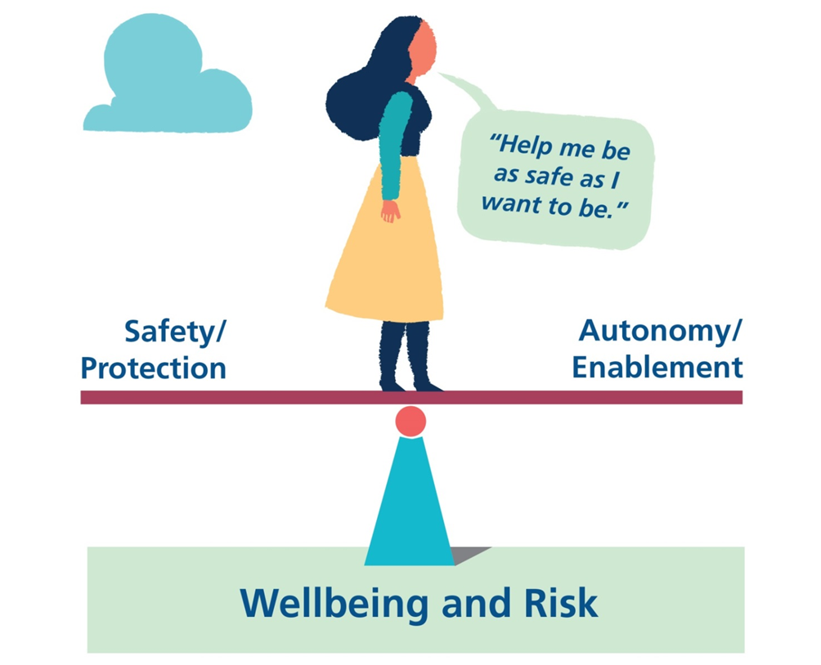
Risk Enablement
Recognise the tension at the heart of adult safeguarding; balancing risk and autonomy
https://www.bsab.org/download/downloads/id/35/risk-enablement-balancing-wellbeing-and-risk.pdf
Notes:
It is difficult sometime to balance Risk & autonomy. The Self-neglect Risk assessment will support the process.
If unsure seek support from your manager & the Safeguarding Adults team: bchc.safeguardingadults@nhs.net

Slide 28



Identify what aspect of Self-neglecting behaviour causes concern: Environment (clutter/hoarding etc.) Personal care & hygiene. Medication &/or clinical care concordance. DNA appointments.
How to support adults who self-neglect. Follow BSAB Guidance:
https://www.bsab.org/downloads/download/58/self-neglect-and-hoarding-birmingham-multi-agency-guidance-and-procedure
Safeguarding Team
If the patient’s self-neglecting
behaviour negatively impacts their wellbeing – Safeguarding concerns could be raised – discuss with Safeguarding.
Remember to keep the patient central to the process.
THINK! Capacity. Risk of harm.
THINK FAMILY
Express your concerns with patient
and seek their consent to complete assessment.
Assess patient’s capacity regarding the decisions they are making that constitute self-neglecting behaviour.
Does the patient understand the RISK?
If assessment identifies HIGH risk; discuss concerns further with the patient. Plan MDT meeting with all appropriate professionals & agencies in accordance with Self-neglect Pathway and Guidance.
Complete Self-neglect Risk assessment fully & identify whether: Low, Medium or High Risk. Share document with Safeguarding Adults Duty: bchc.safeguardingadults@nhs.net
Identify other professionals &/or agencies involved in the adult’s care & complete BSAB self-neglect risk assessment with them.
If unable to gain collaboration with others complete risk assessment alone.
.

Slide 29

In addressing patient non-concordance or disengagement, we first need to walk in their shoes to understand.
Consider a Trauma Informed approach.

Slide 30

Any Questions?

