Slide 1



Quality Improvement and Learning from Excellence
Clare Cooksey
Deputy AHP Professional Lead OT

Slide 2


Quality
What is Quality ?
What does it mean to you ?
What do we mean by Quality in the NHS?

Slide 3
Quality Improvement (QI)
What is NHS quality improvement?
Improving quality is about making healthcare safer, effective, patient-centred, timely, efficient and equitable

Slide 4

QI
Improving 2Gether
The approach taken in the organisation for QI is branded BCHC Improving 2Gether.
BCHC Improving 2Gether brings together learning from previous improvement initiatives under one single programme, building on the good practice and benefits of the Listening into Action and Learning from Excellence approaches and the existing expertise within the organisation.
The approach is structured to support colleagues through every stage of their improvement project with appropriate training and resources, leadership and peer support as well as opportunities to share learning
Improving 2Gether forum is held virtually First Tuesday of the month 11am – 12pm

Slide 5
QI
Improving 2Gether
https://vimeo.com/859680157

Slide 6

QI Huddles
QI Huddles are held within teams to identify areas for improvement.
Can be done weekly / monthly / as a part of team mtg.
Led by a QI trained staff member.
Use BCHC Huddle board
Can be addressed either:
Within the team for quick wins
Escalated to higher management or
Contact QI buddy or the QI team for further support
This Photo by Unknown Author is licensed under CC BY

Slide 7
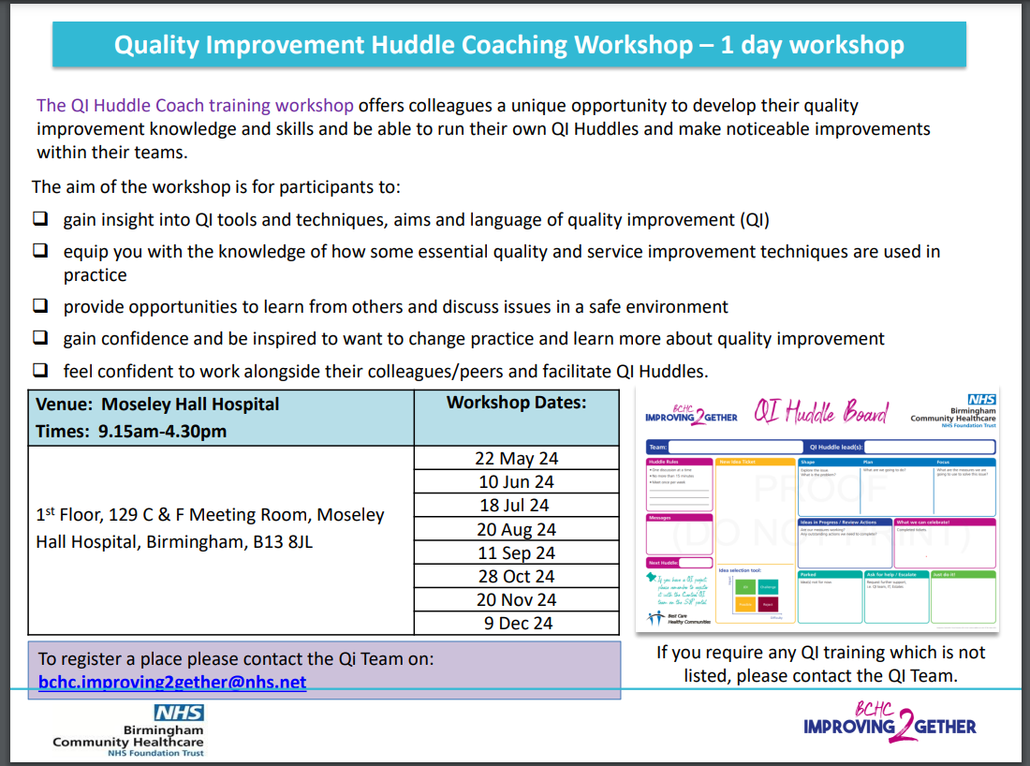

Slide 8
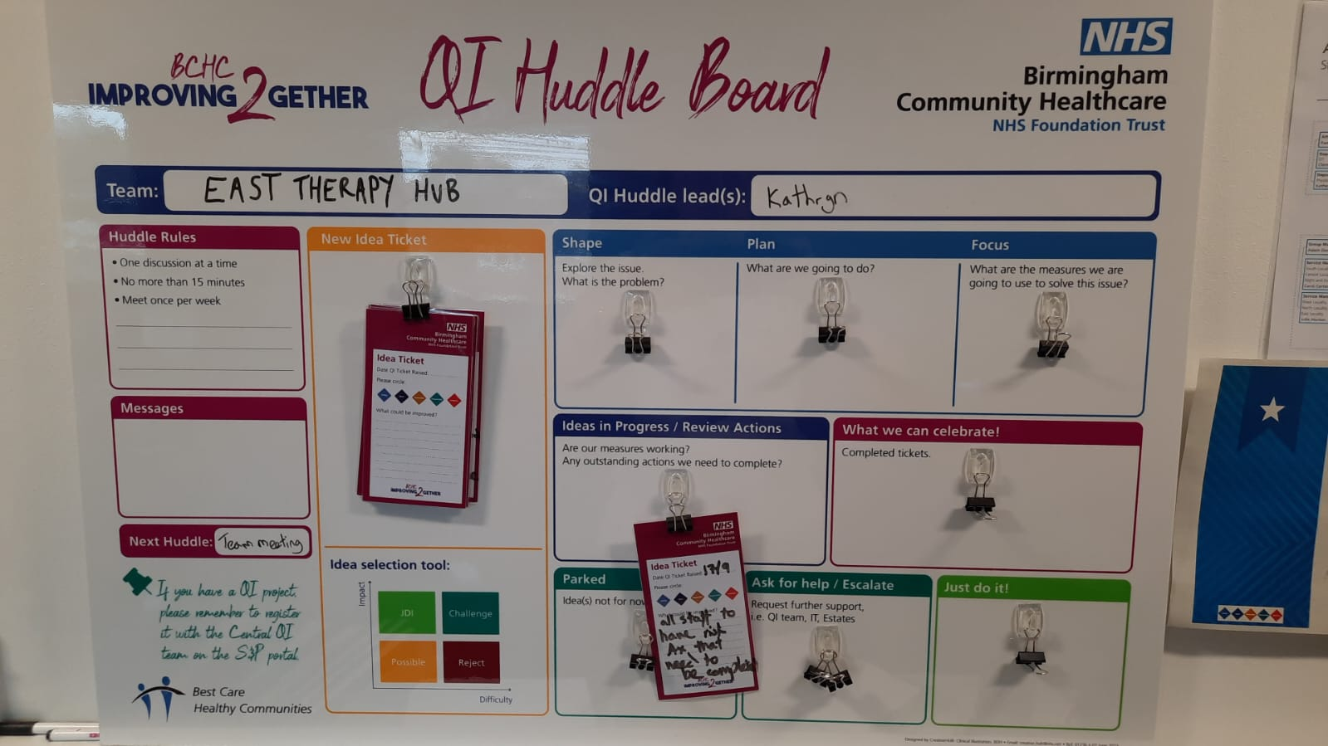

Slide 9

QI Buddy
Quality Improvement Buddy
QI Buddies are Patient Safety Ambassadors who can provide advice and support to colleagues on improvement projects which they are working on.
A directory of QI buddies across the organisation has been created to support colleagues who are embarking on Qi initiatives to enable them to tap into local support in their own area or division
This Photo by Unknown Author is licensed under CC BY-SA

Slide 10

QI Examples
South Therapy hub – appointment card for OT and Physio
ASR – noisy bin on the ward
North Therapy Hub – OT referral triage

Slide 11
QI Examples
East Therapy Hub Completed QI Improvement
Access to test patient Rio ID 1041989 for testing purposes
Critical waiting list process is now on Rio
East WhatsApp group for communication.
Tai Chi for 10 minutes before the weekly meeting
Care home visits are booked in bulk for joint OT/PT visit – at least 4 patients in one day.
Projector is now working in large meeting room.
The referral rejection letter template has been updated with up-to-date signposting information for the council.
Virtual assessments have been rolled out to the whole team and training provided for the process. It is now part of standard delivery of care.
Up to date nutrition info sourced and shared with the team

Slide 12
QI and Essentials of care
https://vimeo.com/868670728

Slide 13
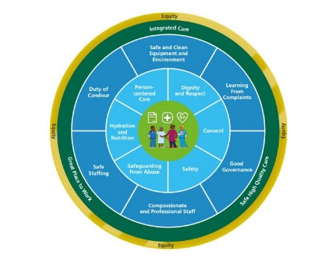
Essentials of care
‘The way we care matters to patients’
.

Slide 14

Trust Values
BCHC have created a ‘Living the Values’ framework to outline the behaviours we would all like to see displayed towards our colleagues and patients, associated with our five values.
You will have your own ideas and interpretations of what the BCHC values mean to you in your role – and that’s why we want your feedback.

Slide 15
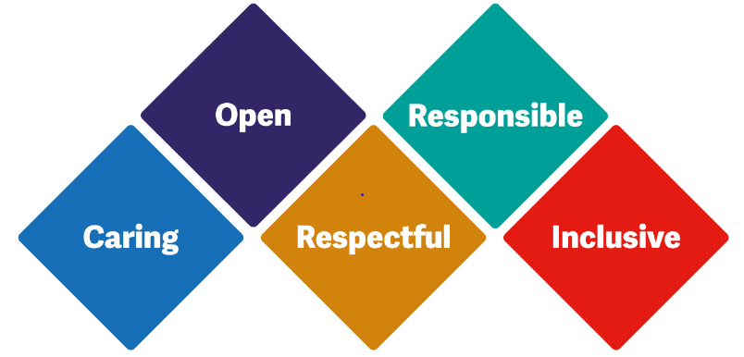
Trust Values
BCHC TRUST VALUES
What do these mean to you ?

Slide 16
Learning from Excellence ( LFE)

Slide 17
Learning from excellence
‘We aim to help people Learn from Excellence’
Established since 2014
Safety in healthcare has traditionally focused on avoiding harm by learning from error. This approach may miss opportunities to learn from excellent practice. Excellence in healthcare is highly prevalent, but there is no formal system for capturing it. We tend to regard excellence as something to gratefully accept rather than something to study and understand. Our preoccupation with avoiding error and harm in healthcare has resulted in the rise of rules and rigidity, which in turn has cultivated a culture of fear and stifled innovation. It is time to redress the balance. We believe that studying excellence in healthcare can create new opportunities for learning and improving resilience and staff morale.
Adrian Plunkett – LfE Founder

Slide 18
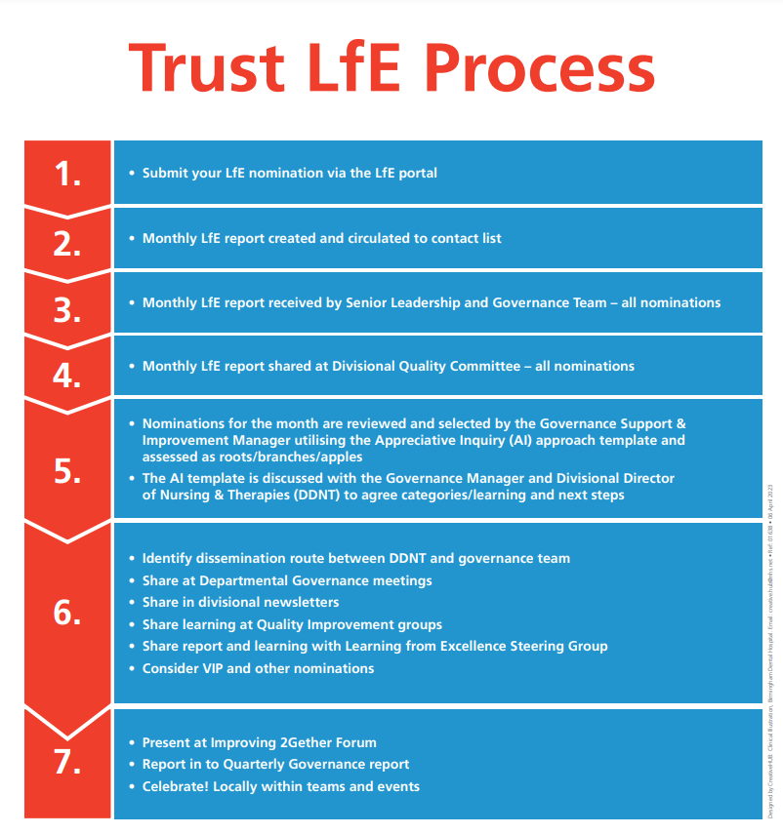

Slide 19
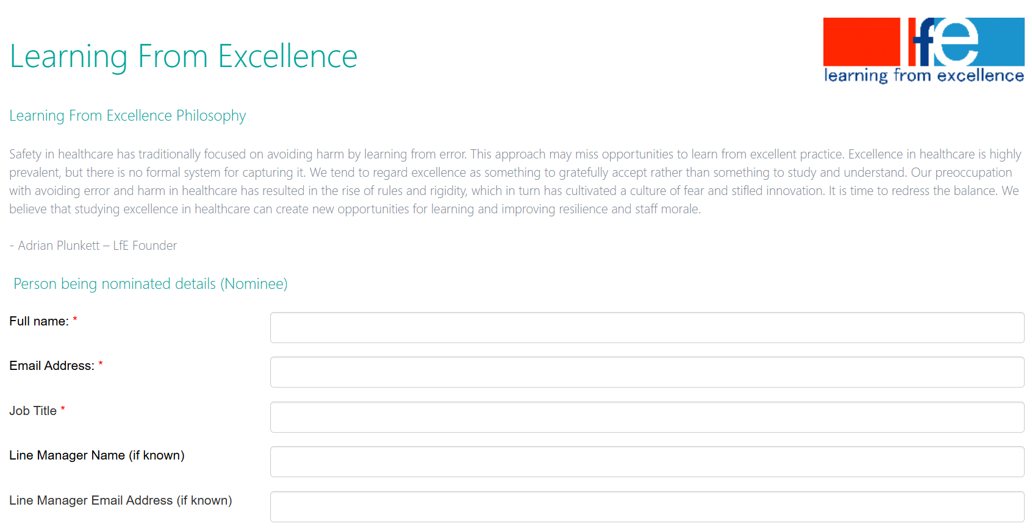

Slide 20
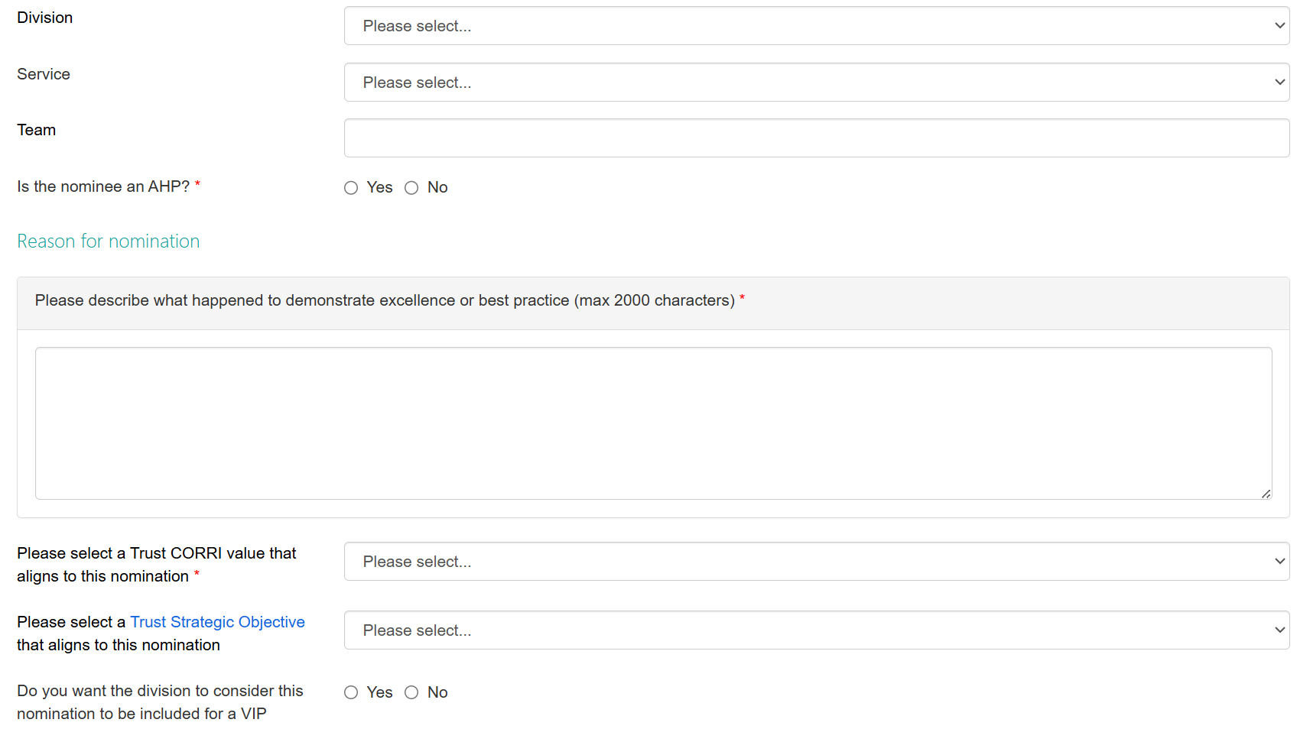

Slide 21
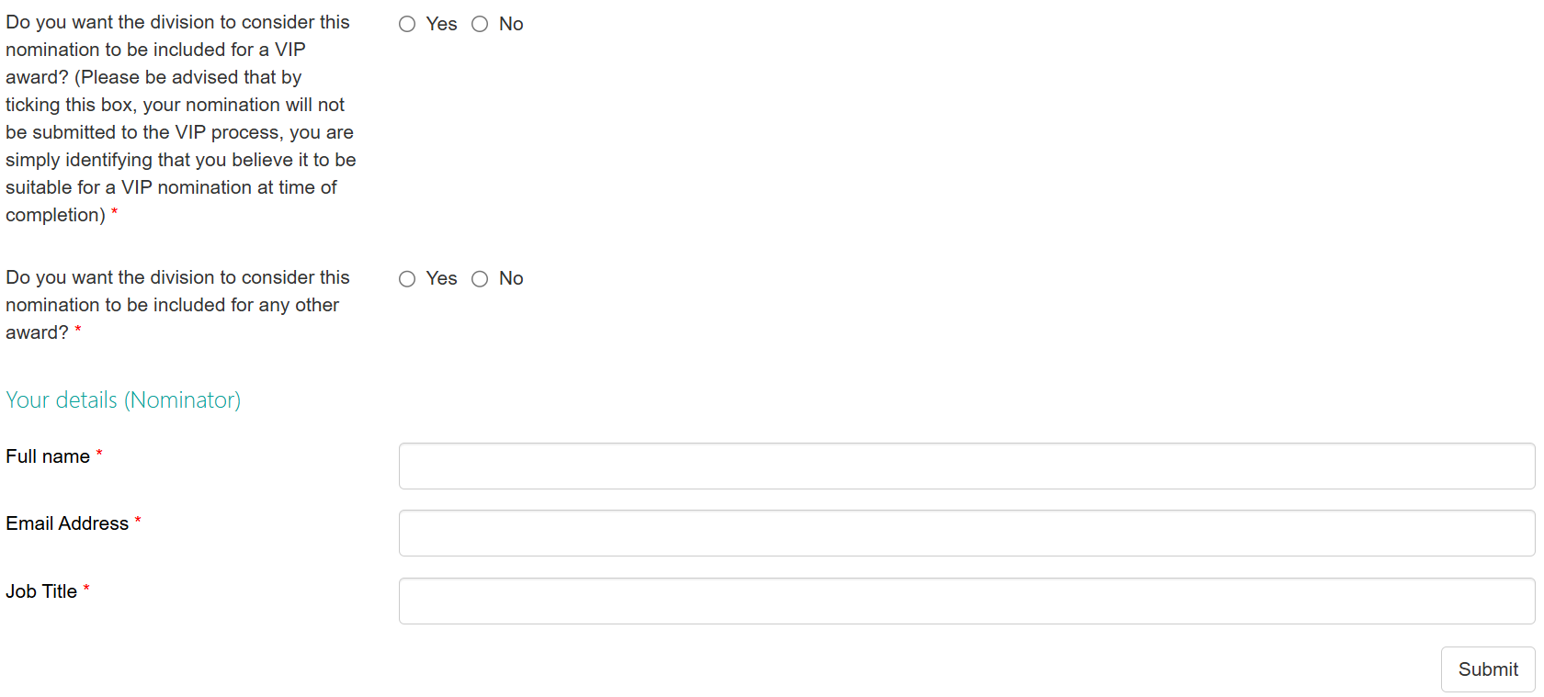

Slide 22

Nominations

Slide 23
Therapy hub – Patient experience
(ID: 135790) XXXX was referred a patient who was originally housebound. On the first session she was able to mobilise short distances outside. XXXX did 5 weekly sessions and the patient is now able to mobilise moderate distances outside, she is no longer housebound, she uses the local bus network to visit friends and family. The overall wellbeing and quality of life for this Lady has improved and XXXX should be acknowledge for the hard work she continues to do every day with her patients.

Slide 24
Tissue Viability - QI
(ID: 135802) XXXX has been leading on a fantastic piece of Quality Improvement in Tissue Viability here at BCHC and she presented this at a National conference. This was XXXX's first time presenting at a national conference and she embraced the opportunity to showcase the successes she has achieved whilst leading the Wound Hygiene Challenge for BCHC District Nurses. XXXX is really excelling with this project and her passion, motivation and dedication are shining through she should be really proud of all that she has achieved leading this piece of valuable work.

Slide 25
Community Nursing – Family feedback
(ID: 135748) I went to a patient home to complete a verification of death and care for the deceased. The patient was under the care of the Langley and north unplanned team. While at the property the patient wife express her gratitude towards all the nurses involved in the patient care. Her words were " the nurses had really supported her and her husband through this difficult journey, they were all professional, showed compassion and all caring she could not find any fault and wanted to say a big thank you as a team". Well done and thank you as you have made a deference during this patient end of life care

Slide 26
Estates – Thank you !
(ID: 135789) XXXX is always the person who comes to the office when we need estates work doing. He is great! No job too big or small. Very friendly, efficient and always responds quickly. He completes the jobs with a smile and it is always good to see him. A big thank you from the Langley team

Slide 27

Golden Apples

Slide 28
DN team and Evening /Night service were nominated by Palliative lead for Learning for Excellence, also discussing the learning to share - this was then nominated as a Golden Apple by Chief of Nursing and Therapies.
The reasons for this:
  Positive end of life experience for a young patient and his family including patients own children aged 2, 4 and 6yrs
  Interprofessional working between teams – Day , evening , night and palliative services
  Learning for the division and wider Trust colleagues around: patient experience, multi-disciplinary team working;
  The teams actively demonstrated our values of caring, open, respectful, responsible and inclusive.

Slide 29
District Nurse Team demonstrated excellent holistic and compassionate palliative care for a young gentleman when providing end of life care. Patient presented with very complex needs requiring support from the Hospice Clinical Nurse Specialist and Palliative consultant to manage uncontrolled pain and agitation resulting in the patient requiring 3 syringe drivers in use, to manage symptoms. The patient lived with his wife and small children where the nurses were very mindful and respectful in the home adhering to patient wishes to stay at home for end of life. The team received multiple call outs and attended in a timely manner to optimize comfort and maintain pain management, going above and beyond to ensure privacy and dignity was maintained. The nurse working the weekend requested an overnight sitter to stay with the patient so his wife could get some rest anticipating the patient may pass overnight. The patient peacefully passed away that night with the Marie Curie night sitter supporting the wife, this was very much appreciated by the family. The team worked incredibly hard to support the patient and worked collaboratively with the palliative services, so the patient was able to fulfil his dying wish to stay at home surrounded by his family. Well done to the team for outstanding work and prioritizing patient care.

Slide 30
Both Evening service and Night service nurses delivered exceptional care to a young gentleman with very complex needs. The nurses attended multiple calls outs throughout the evenings and overnight to administer medication for uncontrolled pain and agitation and monitored 3 syringe drivers running towards the end of the life. The nurses were described as compassionate and caring maintaining privacy and dignity towards the patient, his wife and young family at all times. The hospice involved provided feedback on the quality of care the District Nurses provided for this gentleman given the complexity of the patient’s disease and knowing the patient’s wishes to remain at home surrounded by his family. The team worked incredibly hard to support the patient and worked collaboratively with the palliative services so the patient was able to fulfil his dying wish to stay at home surrounded by his family. Well done to the team for outstanding work and prioritizing patient care.

Slide 31
Demonstrated collaborative working and excellent care provision within current climate of staffing and service pressures.
Next steps to share learning:
Attend and share at Team Brief;
Sharing in ACS CCE and QSB;
Sharing in ACS Small Talk Newsletter;
Sharing in other Trust communications channels.

Slide 32



Learning from Excellence – Golden Apple
A 72 year old UK patient visited her sister in Australia and became unwell, needing to be hospitalised twice. Patient's sister contacted BCHC PALS, trying to make UK health staff aware before patient was repatriated home and what needed to be in place. The liaison between PALS, ACS Senior Management, Community nursing and the Early Intervention Community Team, ensured that the right care was in place for this lady when she returned to her home in the UK. A real example of what can be achieved when services work together as a team.
This nomination was made by Samantha Eustace - Head of Patient Experience Feedback

Slide 33
Learning from Excellence – Golden Apple
  Patient and her Sister were having to fly back from Oz a few days apart which made the daughter feel very anxious about her sisters return to the UK.
  Patient had fallen ill whilst visiting her sister and was to be accompanied home by a nurse, however there was no care in place on her return home.
  Patient’s sister contacted BCHCs PALs team who put her in touch with ACS senior management and EICT CSM.
  Communication had to be co-ordinated carefully due to the timezone differences
  Between the two services arranged for EICT to meet the patient on her arrival home so care could start immediately and they could support with her settling back into her home environment and start a programme of rehab.
  Comm nursing prioritized a visit to support with catheter care the same day.

Slide 34
Learning from Excellence – Golden Apple
Both services acted to visit quickly and flexibly so we could provide reassurance to both the patient and the sister that care would be delivered without delay.
Sister was kept up to date with the plan & what to expect on her sisters return home.
Both services worked compassionately to think ‘outside the box’ in response to patient and their relatives anxieties- arranging an immediate response to the patients care needs and ensure a smooth transition back home.
good communication between the teams and follow up to ensure all was in place that closed the loop with the patient experience team

Slide 35
Learning from Excellence – Golden Apple
Shared with-
-teams involved (EICT Central, ….)
-Patient experience committee
-CCE/ DQSB
Next steps to share learning:
- attend and share at Team Brief;
- sharing in ACS Small Talk Newsletter;
- sharing in other Trust communications channels.

Slide 36

Any Questions ?
This Photo by Unknown Author is licensed under CC BY-NC

