Slide 1
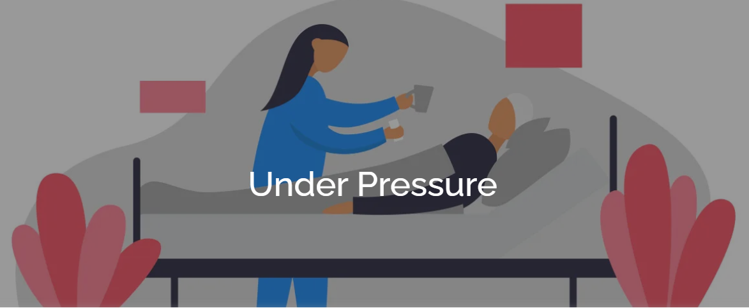
Pressure Ulcer Prevention
Tissue Viability

Slide 2
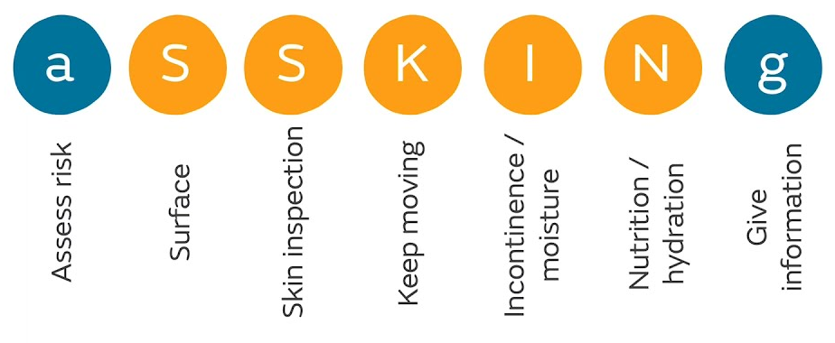

Slide 3
Definition
A Pressure Ulcer is localised damage to the skin and/or underlying tissue, usually over a bony prominence (or related to a medical or other device), resulting from sustained pressure (including pressure associated with shear).
The damage can be present as intact skin or an open ulcer and may be painful

Slide 4
Cost
Guest et al (2020) identified 0.4% of the total adult population have a pressure ulcer.
NHS spends more than £3.8 million every day, with an estimated cost of about £2 billion per annum
Litigation linked to pressure ulcers was reported to have increased by 43% in the NHS in 3 years (Stephenson, 2019). The cost of claims alone for 2017 –2018 was identified as over £20.8m.
Global incidence of pressure ulcers has increased by 42% since COVID

Slide 5
Prevention is everyone’s business
Nurses
Therapists; Physio seeing a pt post CVA
OT doing a seating assessment
Dietician
Primary Care most pts can get to the GP
Falls Service
111 giving advise
Paramedics

Slide 6
Risk Factors
Notes:
Skin changes with ageing, poor posture, poor mobility, devices such as tubing and splints, poor circulation, poor sensation, contractures, poor nutrition and hydration; COVID, Incontinence, chronic diseases, concordance

Slide 7
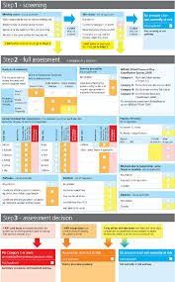
Risk assessment tools
Purpose T
Screen all patients within 6 hours for inpatients.
On first contact in the community.
Notes:
Develop a care plan based on the level of risk

Slide 8
Skin inspection

Slide 9
What to look for

Slide 10
Skin Inspection
Identifying Pressure Ulcers
History Sustained pressure
Location Bony prominence or under a device
Appearance Circular or oval shaped
Caucasian skin Dark toned skin
Persistent blanching erythema
redness from pressure should
resolve within 20 minutes of
off-loading
Non-blanching erythema = category 1 PU
Maroon discolouration
Purplish/violet, bluish discolouration
Grey discolouration
Taut, shiny skin

Slide 11

Pressure Ulcer Categories

Slide 12
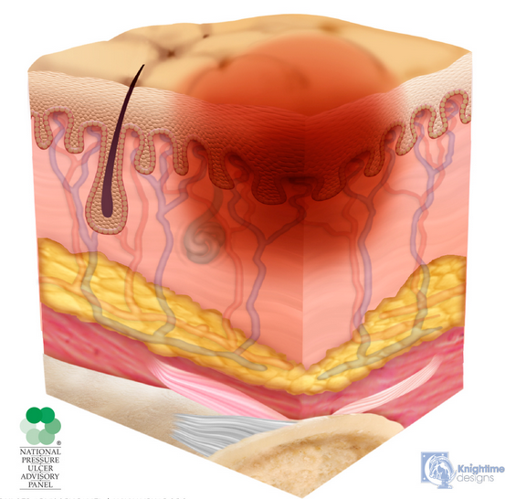
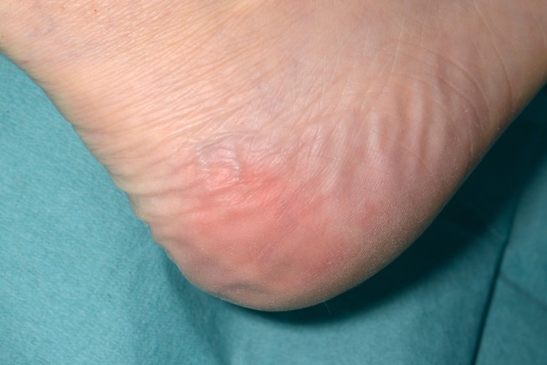
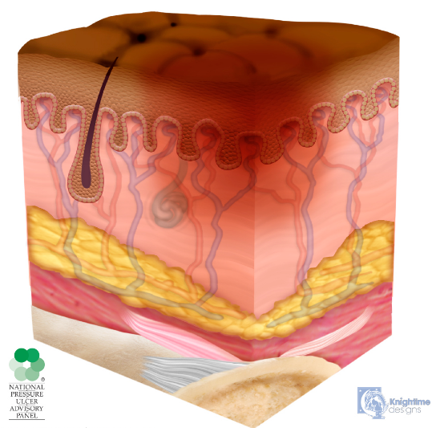
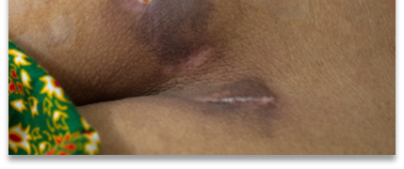
Category 1
Non-blanchable erythema of intact skin
Intact skin with a localized area of non-blanchable erythema
Presence of blanchable erythema or changes in sensation, temperature, or firmness may precede visual changes.
Oedema
In darker skin tones, look for purplish, bluish discolouration, taut shiny, abnormal hard/soft skin, reports of discomfort
:
European Pressure Ulcer Advisory Panel，National Pressure Injury Advisory Panel，Pan Pacific Pressure Injury Alliance．Prevention and treatment of pressure ulcers /injuries: clinical practice guideline［S］．EPUAP /NPIAP /PPPIA: 2019.
Dark toned skin

Slide 13
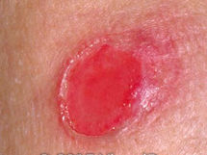
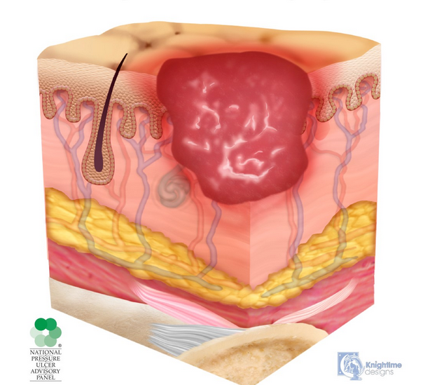
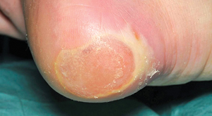
Category 2
Partial-thickness skin loss with exposed dermis
The wound bed is pink or red, moist, and may also present as an intact or ruptured serum-filled blister.
  Often red shiny, taut shallow looking
  Epidermis & Dermis only 2 mm thick!
  Adipose (fat) is not visible and deeper tissues are not visible.
  Slough and eschar are not present.
These ulcers commonly result from adverse microclimate and shear in the skin over the pelvis and shear in the heel.
This stage should not be used to describe moisture associated skin damage (MASD) including incontinence associated dermatitis (IAD), intertriginous dermatitis (ITD), medical adhesive related skin injury (MARSI), or traumatic wounds (skin tears, burns, abrasions).
:
European Pressure Ulcer Advisory Panel，National Pressure Injury Advisory Panel，Pan Pacific Pressure Injury Alliance．Prevention and treatment of pressure ulcers /injuries: clinical practice guideline［S］．EPUAP /NPIAP /PPPIA: 2019.

Slide 14
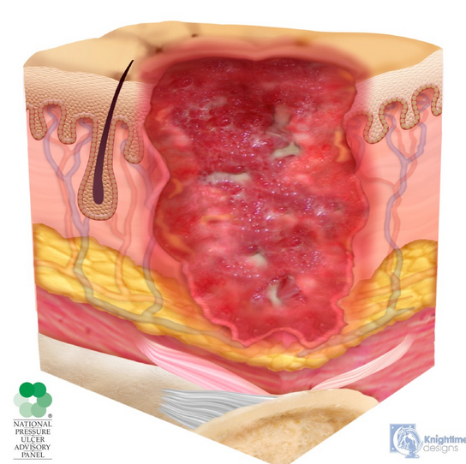
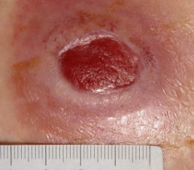

Category 3
Full-thickness skin loss
Full-thickness loss of skin, in which adipose (fat) is visible in the ulcer and granulation tissue and epibole (rolled wound edges) are often present.
Slough and/or eschar may be visible.
The depth of tissue damage varies by anatomical location; bridge of nose, ear, occiput and malleolus do not have subcutaneous tissue and category 3 ulcers can be shallow. Areas of significant adiposity can develop deep wounds.
Undermining and tunnelling may occur.
Fascia, muscle, tendon, ligament, cartilage or bone are not exposed.
:
European Pressure Ulcer Advisory Panel，National Pressure Injury Advisory Panel，Pan Pacific Pressure Injury Alliance．Prevention and treatment of pressure ulcers /injuries: clinical practice guideline［S］．EPUAP /NPIAP /PPPIA: 2019.

Slide 15
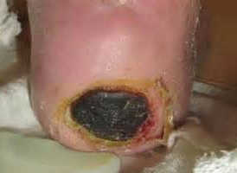
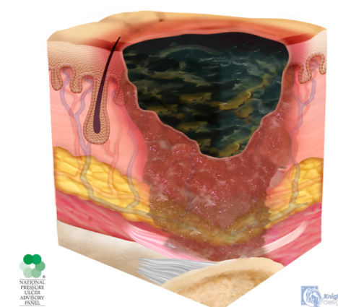
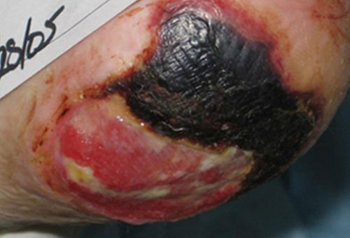
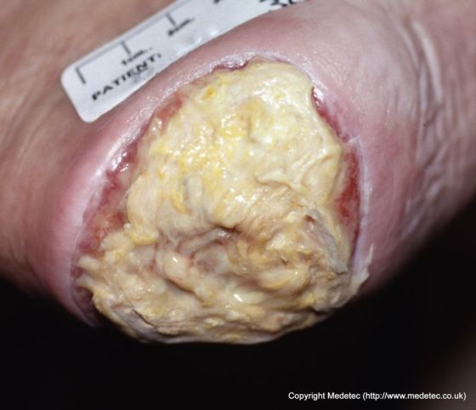
Formally Unstageable
Now initially recorded as category 3 pressure ulcers.
The wound bed is not visible due to slough or necrosis. Full thickness skin and tissue loss.
.
Recategorise if debridement reveals a category 4 pressure ulcer.
Stable eschar (i.e. dry, adherent, intact without erythema or fluctuance) on an ischemic limb or the heel(s) should not be softened or removed
:
European Pressure Ulcer Advisory Panel，National Pressure Injury Advisory Panel，Pan Pacific Pressure Injury Alliance．Prevention and treatment of pressure ulcers /injuries: clinical practice guideline［S］．EPUAP /NPIAP /PPPIA: 2019.

Slide 16
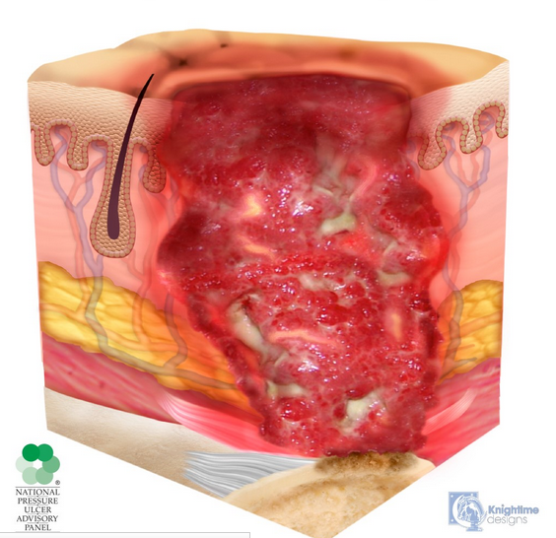
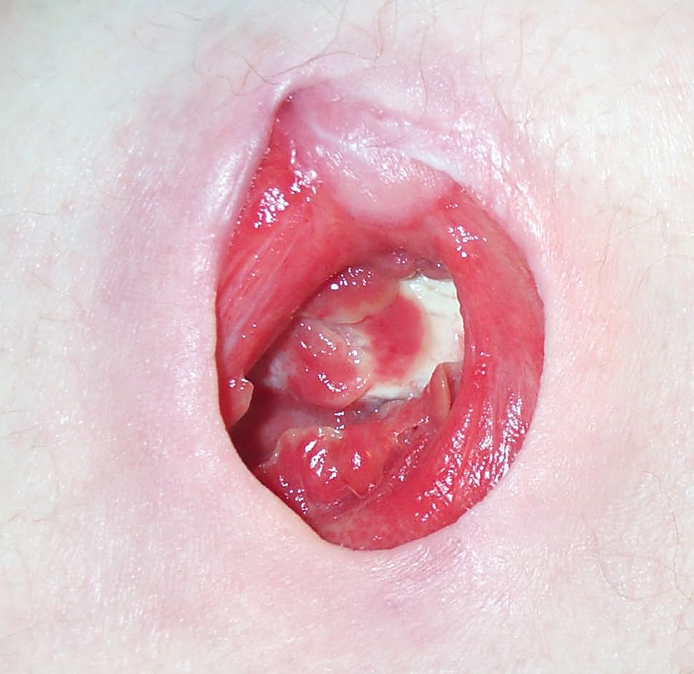
Category 4
Full-thickness skin and tissue loss with exposed or directly palpable fascia, muscle, tendon, ligament, cartilage or bone in the ulcer. Slough and/or eschar may be visible.
Epibole (rolled edges), undermining and/or tunnelling often occur. Depth varies by anatomical location.
Full-thickness loss of skin and tissue
:
European Pressure Ulcer Advisory Panel，National Pressure Injury Advisory Panel，Pan Pacific Pressure Injury Alliance．Prevention and treatment of pressure ulcers /injuries: clinical practice guideline［S］．EPUAP /NPIAP /PPPIA: 2019.

Slide 17
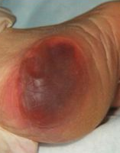
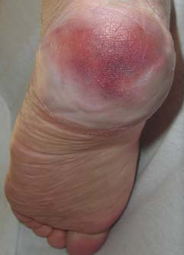
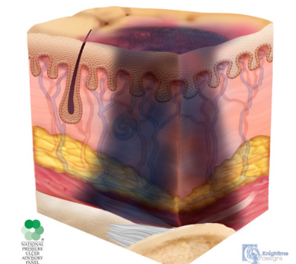
Deep Tissue Injury (DTI)
DTI no longer reportable as a pressure ulcer. Only categorise when the skin breaks, in which case category 2, 3 or 4.
Intact skin with localized area of persistent non-blanchable deep red, maroon, purple discoloration or epidermal separation revealing a dark wound bed or blood-filled blister.
Pain and temperature change often precede skin colour changes.
Discoloration may appear differently in darkly pigmented skin.
This injury results from intense and/or prolonged pressure and shear forces at the bone-muscle interface.
The wound may evolve rapidly to reveal the actual extent of tissue injury or may resolve without tissue loss.
Persistent non-blanchable deep red, maroon or purple discoloration
:
European Pressure Ulcer Advisory Panel，National Pressure Injury Advisory Panel，Pan Pacific Pressure Injury Alliance．Prevention and treatment of pressure ulcers /injuries: clinical practice guideline［S］．EPUAP /NPIAP /PPPIA: 2019.
Notes:
Slide 19 next

Slide 18
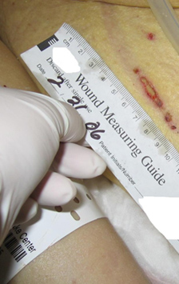
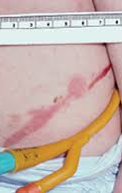
Device Related Pressure Ulcer
Describes aetiology
Result from the use of devices designed & applied for diagnostic or therapeutic purposes e.g., O₂ related equipment, catheters, plaster casts, splints
The resultant pressure damage often conforms to the pattern or shape of the device
Category 1 – 4, (DTI not reportable unless skin broken, then categorise).

Slide 19
SURFACE

Slide 20
Support Surface
Check equipment regularly to ensure it remains clinically fit for purpose
Pressure redistributing equipment does not replace the need for repositioning
Risk Level
Acceptance
Compatible
Patient
Comfort
Impact on Care
Ease of Use

Slide 21
Pressure Reducing

Slide 22
Pressure relieving

Slide 23
KEEP MOVING
Reposition regularly to relieve pressure.
Every 2 –4 hours is often recommended, less if sitting out.
Chair tilts to reduce pressure
Use a slide sheet to reduce shear & friction.
Consider the 30 degree tilt
Document that you have moved the patient on the repositioning schedule

Slide 24
INCONTINENCE (MASD)
Moisture Associated Skin Damage (MASD)
Inflammation or erosion caused by prolonged exposure to a source of moisture, such as urine, stool, sweat, exudate, saliva or mucous
Skin damage from incontinence (urine / stool) changes the PH of the skin, soap changes the PH all contributes to removing the acidic film
Often confused with pressure ulcers

Slide 25
Pressure or moisture?
-or combination
Differentiated by:
Identifying cause –prolonged pressure or moisture
Location –if over a bony prominence suspect pressure & step-up pressure relieving strategies. Damage from moisture occurs in skin folds & near sources of moisture
Appearance–defined & regular (pressure ulcers) or non-uniform or irregular (moisture)

Slide 26
Types of MASD
Notes:
IAD, Interigo, secretions, peristomal, maceration

Slide 27
Management requirements
Continence assessment is required.
Find out cause.
Encourage visiting the toilet. pH Cleanser, an appropriate Skin Barrier & Containment products are essential.
Monitor & report back on effectiveness of regime

Slide 28
Pressure or Moisture

Slide 29
Top Tips
After any episodes of incontinence
The skin should be cleansed with a product that will remove urine/faeces without harming the skin (pH similar to skin = 5.5).
Do not use wet wipes, including baby versions for the perianal area & buttocks
Soapless, non-irritating perineal cleansers such as Prosheild are formulated for the delicate perianal area. They gently dissolve & remove faeces & urine.

Slide 30
If incontinent, protect the skin using a specialized skin barrier product
Cavilon Cream (Purple for Protection of non broken skin)
Cavilon No Sting Barrier Film (Blue for Broken Skin)
Prosheild Cream (for very severely broken skin) – reapply after cleansing for every episode of incontinence – apply liberal amount

Slide 31
Nutrition and Hydration
Fluids are essential for maintaining skin integrity and have a huge role to play in prevention of pressure ulcers. Fluids keep the skin supple and less likely to break down and hydrates the tissue so that the fatty padding can protect bony prominences.
A well balanced diet is often associated with healing pressure ulcers rather than prevention. However, diet is essential in maintaining skin integrity. Diet gives us the ability to reproduce cells, make collagen and elastane's which give the skin its suppleness. The fatty layer that protects the bony prominences needs to be maintained with dietary intake

Slide 32
Nutrition
Good nutrition is essential for maintenance & repair of cells & organs, & energy to support daily functioning
Malnutrition impairs processes & leads to reduced tissue tolerance to pressure
Unintentional loss of weight & age-related loss of muscle mass, strength & function (sarcopenia), wasting (cachexia) occurring as a consequence of illness or from neurological diseases can result in less protective padding over bony prominences
In anaemic patients, the oxygen carrying capacity of blood is reduced & there is decreased supply of oxygen to the tissues. The effects of pressure are more likely to precipitate tissue necrosis because of this

Slide 33
Hydration
Dehydration & risk of pressure ulcers
Poorly hydrated individuals are twice as likely to develop pressure ulcers because dehydration reduces the padding over bony points
Dehydrated skin becomes inelastic, fragile and more susceptible to breakdown
Dehydration can also reduce tissue perfusion at a wound site by reducing the blood volume, limiting the supply of oxygen and nutrients.
Drainage from a wound (exudate) can be a major source of fluid loss, thus further compounding the problem

Slide 34
Top tips
Screen the patient & ascertain cause/reason
Weight history
Assess oral intake
Observe for signs of unintentional weight loss & dehydration
Ability to eat & drink
Hydration matrix
Introduce high energy snacks between meals
Encourage nourishing drinks such as milk or hot milky drinks
Provide encouragement with diet and fluids
Consider cutlery & vessels
Provide food fortification& supplements as advised by specialists
Refer to dietitian
Monitor & repeat screening regularly

Slide 35
Obesity can increase the risk of developing a pressure ulcer.
The low density of blood vessels in fat tissue leads to compromised circulation.
Obesity can also limit mobility, and these factors, together with the added pressure of extra weight, can lead to pressure damage
Consider need for bariatric equipment

Slide 36
Give Information
Anyone who is assessed as being at risk of developing pressure ulcers should be given information on how to prevent them by a healthcare professional
The information should be given in a way that the person can understand and should cover:
What causes pressure ulcers
Early signs to look out for
How to prevent them:
Repositioning
Equipment
Good skin care & protection from moisture from incontinence
Good nutrition & hydration
The effect of having a pressure ulcer on the person’s health

Slide 37
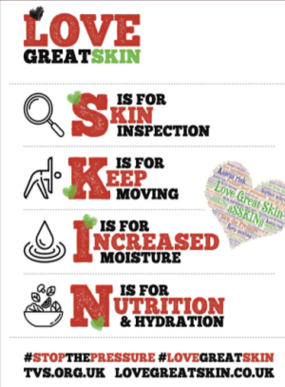
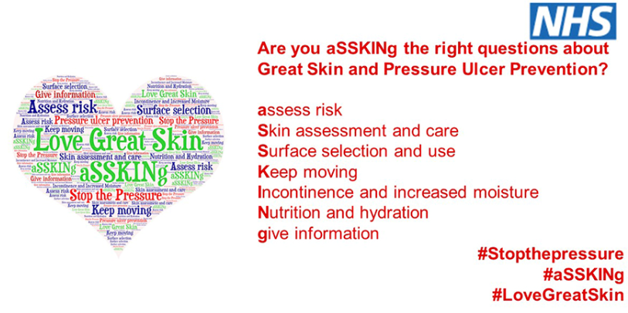
Thanks for listening

