Slide 1



How to look after your Personal Equipment

Slide 2
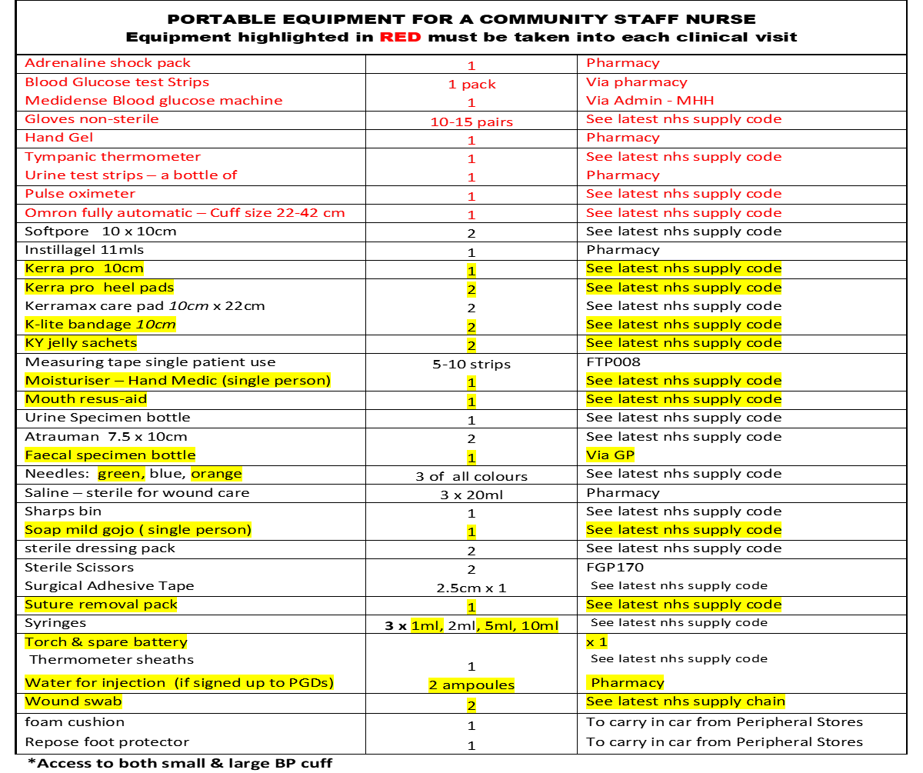



Slide 3
PORTABLE EQUIPMENT FOR HCA’s Equipment highlighted in RED must be taken into each clinical visit
Nursing documentation – spare core documents
Aprons – disposable | 4 | BTB272 £0.04
Blood Glucose test Strips | 1 pack | Via pharmacy
Blood Glucose unistick lancets | 10 | Via pharmacy
Blood Glucose Machine | 1 | Via admin
Gloves non-sterile | 10-15 pairs | See latest nhs supply code
Hand Gel | 1 | £3.00 – pharmacy
Omron – fully automatic –cuff size (22-42cm) | 1 | See Latest nhs supply code
Tympanic thermometer (annual calibration req’d) & sheaths | 1 thermometer & 1 box of sheaths | Therm’- approx. £25.00 Sheaths £3.25
Pulse Oximeter | 1 | See latest nhs supply code
Urine test strips – a bottle of | 1 | Pharmacy £7.80
Clinell – wipes | 1 pack | See latest nhs supply code
Softpore 10x10cm | 2 | See latest nhs supply code
Faecal specimen bottle | 1 | Via GP
Kerra pro 10cm | 1 | See latest nhs supply code
Kerra pro heel pads | 2 | See latest nhs supply code
Kerramax care pad 10cm x 22cm | 2 | See latest nhs supply code
K-Lite bandage 10cm | 2 | See latest nhs supply code
Moisturiser – Hand Medic (single person) | 1 | See latest nhs supply code
Mouth resus-aid | 1 | See latest nhs supply code
Atrauman 7.5 x 10cm | 2 | See latest nhs supply code
Needles: green (for taking catheter specimens of urine) | 3 | See latest nhs supply code
Saline – sterile for wound care | 3 x 20ml | £0.63 - pharmacy
Sharps bin | 1 | See latest nhs supply code
Soap mild-Gojo (single person) | 1 | See latest nhs supply code
sterile dressing pack | 2 | See latest nhs supply code
Sterile Scissors | 2 | FGP170 £3.08
Surgical Adhesive Tape | 2.5cm x 1 | See latest nhs supply code
Syringes (for taking catheter specimens of urine) | 3 x 1ml | See latest nhs supply code
Torch & spare battery | 1 in car | Torch x 1
Urine Specimen bottle | 2 of each | Via GP
Wound swab | 2 | Via GP
Modular foam cushion | 1 | To carry in car from Peripheral Stores
Repose foot protector | 1 | To carry in car from Peripheral Stores

Slide 4
-You will be provided with a bag by your team, this is a contents list.
-Everything highlighted in red must be carried into your visits to patients and includes observations equipment, hand gel etc.
-Your team will provide you with a blood pressure machine, blood glucose machine, pulse oximeter and thermometer, these will be datixed with the serial numbers in the team's equipment list and you will be responsible for looking after them.
-The Equipment is calibrated annually to ensure the equipment is working correctly and this will be your BP machine, pulse oximeter and thermometer and each piece of equipment will have a date with when that piece of equipment requires servicing, and this is usually arranged by the team administrator/manager.
-Your equipment should be cleaned with cliniwipes after each patient use so you should ensure they are cleaned for infection control.

Slide 5
-Your teams stores will have the majority of you items you require, and the team regularly order items from stores to keep it well stocked.
-It is advised to carry a foam cushion and repose foot protector; this saves any delay in patients receiving equipment. You must then re-stock once you have allocated it to patient and inform your team administrator so they can re-order further supplies against the patient's name.
-The recommended amounts are also on the list as you do not want to carry too much as you must think about how much you are carrying and the expiry dates of some of the items.
-Wound swabs, some GP practices use different swabs so you must make sure you are aware of your surgeries you cover and what they use.
-Carry some spare batteries for your equipment.
-Also make sure you carry some spare paperwork; we are moving towards electronic records, but some patients will still have some paper records.

Slide 6
-Blood glucose machines requires to be calibrated daily, each team will have control solutions, they should be in date, and you need to check how long the solution has been opened so this should be recorded on the box.
-You need to test the target blood glucose range for the solutions to check they are working correctly and keep a record of your calibration dates and results.
-When you have completed your shift, your equipment should be taken into your home and not left in the vehicle as staff have had vehicle thefts, and also the temperature with the weather effects the equipment.
-Also, equipment has been condemned due to smoke damage which results to a cost for the trust but also it is not appropriate for patient care using equipment that can smell of cigarettes.
-Any dressings or anything with an expiry date needs to be checked regular to ensure they are in date.

Slide 7
-The Equipment is calibrated annually to ensure the equipment is working correctly and this will be your BP machine, pulse oximeter and thermometer and each piece of equipment will have a date with when that piece of equipment requires servicing, and this is usually arranged by the team administrator/manager.
-Your equipment should be cleaned with cliniwipes after each patient use.

