Slide 1
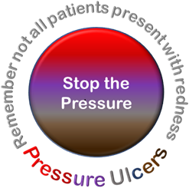
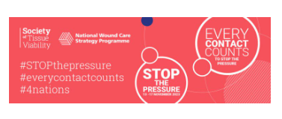
PURPOSE TT
Tissue Viability Service

Slide 2
Group Work
What is a wound?
What is a pressure ulcer?
What happens if someone gets a pressure ulcer in our care? Do you know the process?
Is it ok for a patient to develop a pressure ulcer in our care?
Why do we assess risk for pressure ulcers?

Slide 3
Definition and cost
A Pressure Ulcer is localised damage to the skin and/or underlying tissue, usually over a bony prominence (or related to a medical or other device), resulting from sustained pressure (including pressure associated with shear). The damage can be present as intact skin or an open ulcer and may be painful
Guest et al (2020) identified 0.4% of the total adult population have a pressure ulcer. This was a 32% rise since their previous study between 2012 –2013 (published 2015)
NHS spends more than £3.8 million every day, with an estimated cost of about £2 billion per annum
Litigation linked to pressure ulcers was reported to have increased by 43% in the NHS in 3 years (Stephenson, 2019). The cost of claims alone for 2017 –2018 was identified as over £20.8m.
Global incidence of pressure ulcers has increased by 42% since COVID

Slide 4
Prevention is everyone’s business
Nurses
Therapists; Physio seeing a pt post CVA
OT doing a seating assessment
Dietician
Primary Care most pts can get to the GP
Falls Service
111 giving advise
Paramedics

Slide 5
Risk Factors
Notes:
Skin changes with ageing, poor posture, poor mobility, devices such as tubing and splints, poor circulation, poor sensation, contractures, poor nutrition and hydration; COVID, Incontinence, chronic diseases, concordance

Slide 6
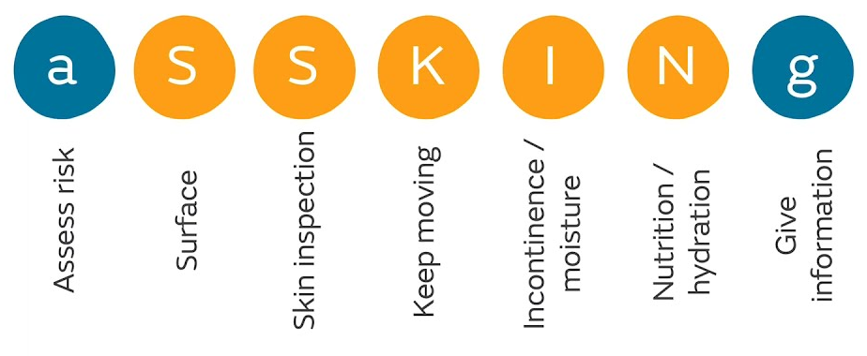

Slide 7
PURPOSE T
Pressure Ulcer Risk Primary or Secondary Evaluation Tool
The tool was developed as part of a research programme for pressure ulcers funded by the National Institute for Health Research
It consists of a 3-step process:
  Screening
  Full assessment
  Assessment decision
It uses colours to indicate the most important risk factors and uses a three-step assessment process

Slide 8
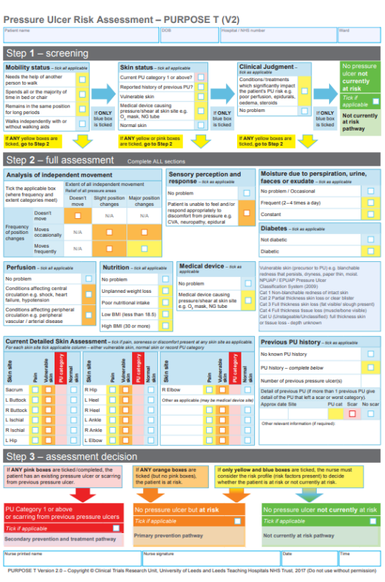
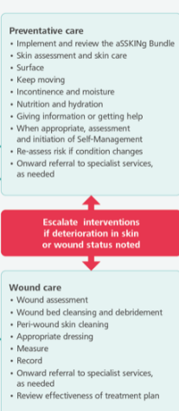
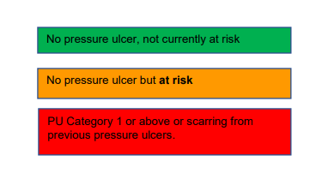
PURPOSE T Risk Assessment
Screen everyone receiving care from a health or care professional using the PURPOSE T tool
If identified at risk following screening, a full risk assessment must be completed
  Within 6 hours for any inpatient.
  On first contact which can be face to face or virtual for community
Dependent on outcome of assessment, follow the correct management pathway:
Document and give self management advice

Slide 9
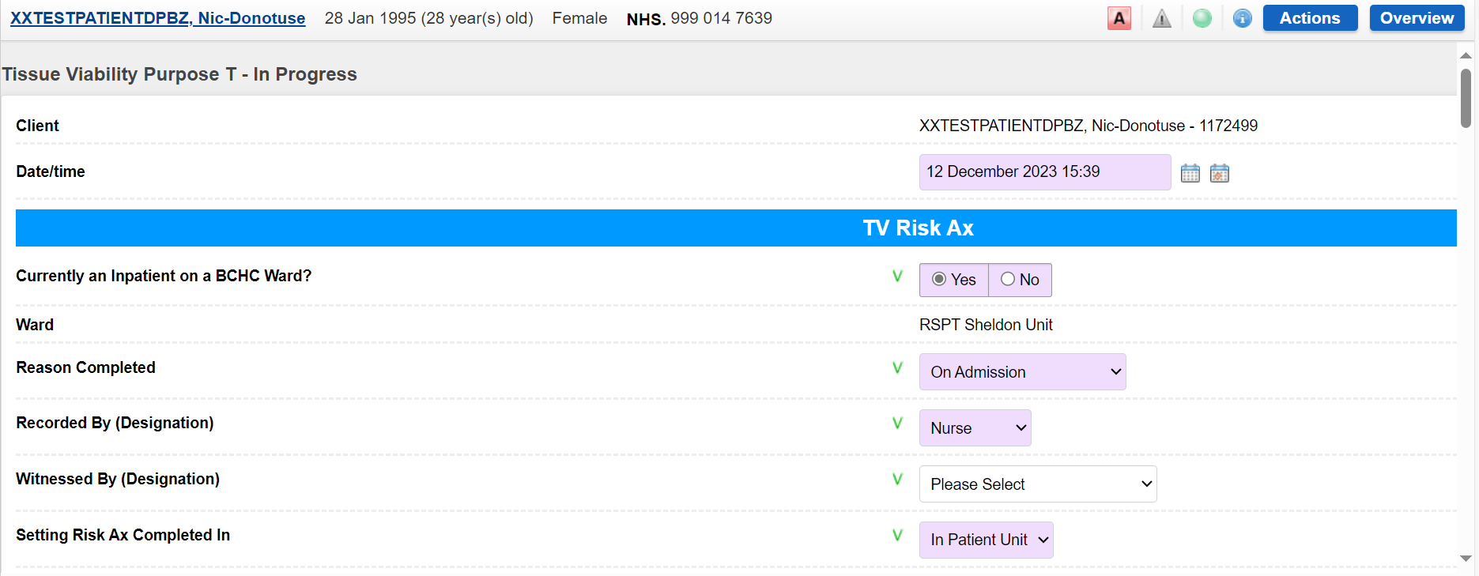
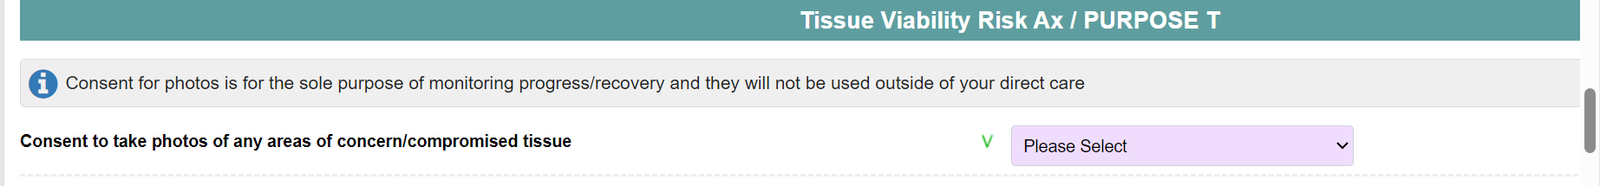
PURPOSE T in RIO

Slide 10
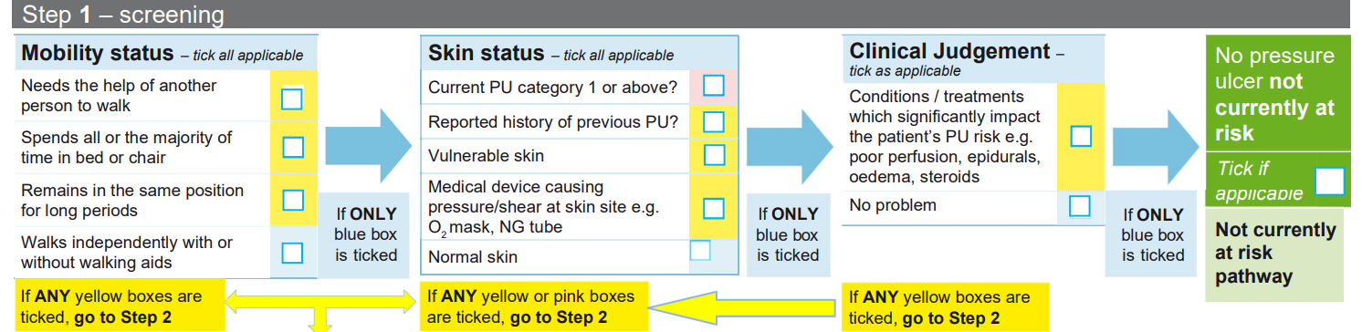
Step 1
Screen those who are & are not at risk
Captures the assessment of mobility & skin status & encourages nurses/healthcare staff to use their clinical judgement
If the patient does not trigger in this section, the assessment is complete

Slide 11
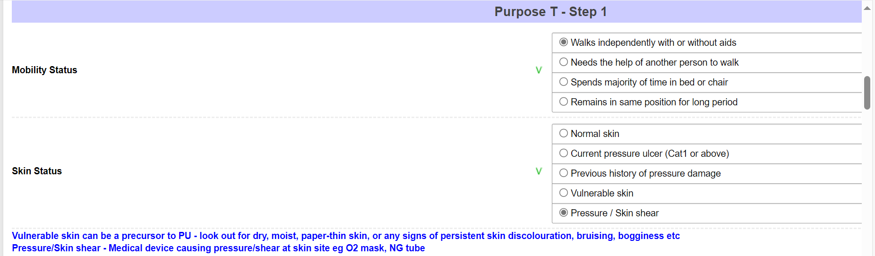

Slide 12
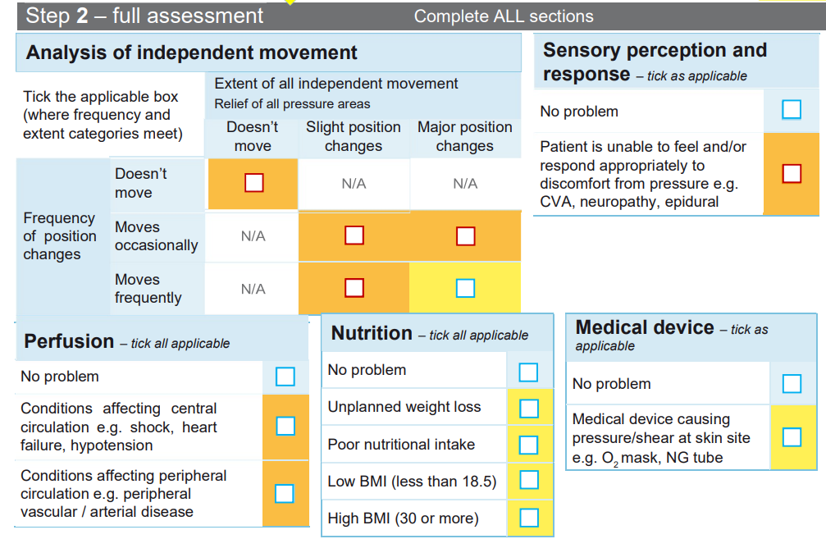
Step 2
This second step incorporates a multiple evidence-informed items

Slide 13
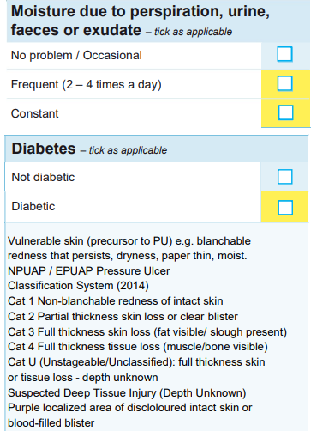
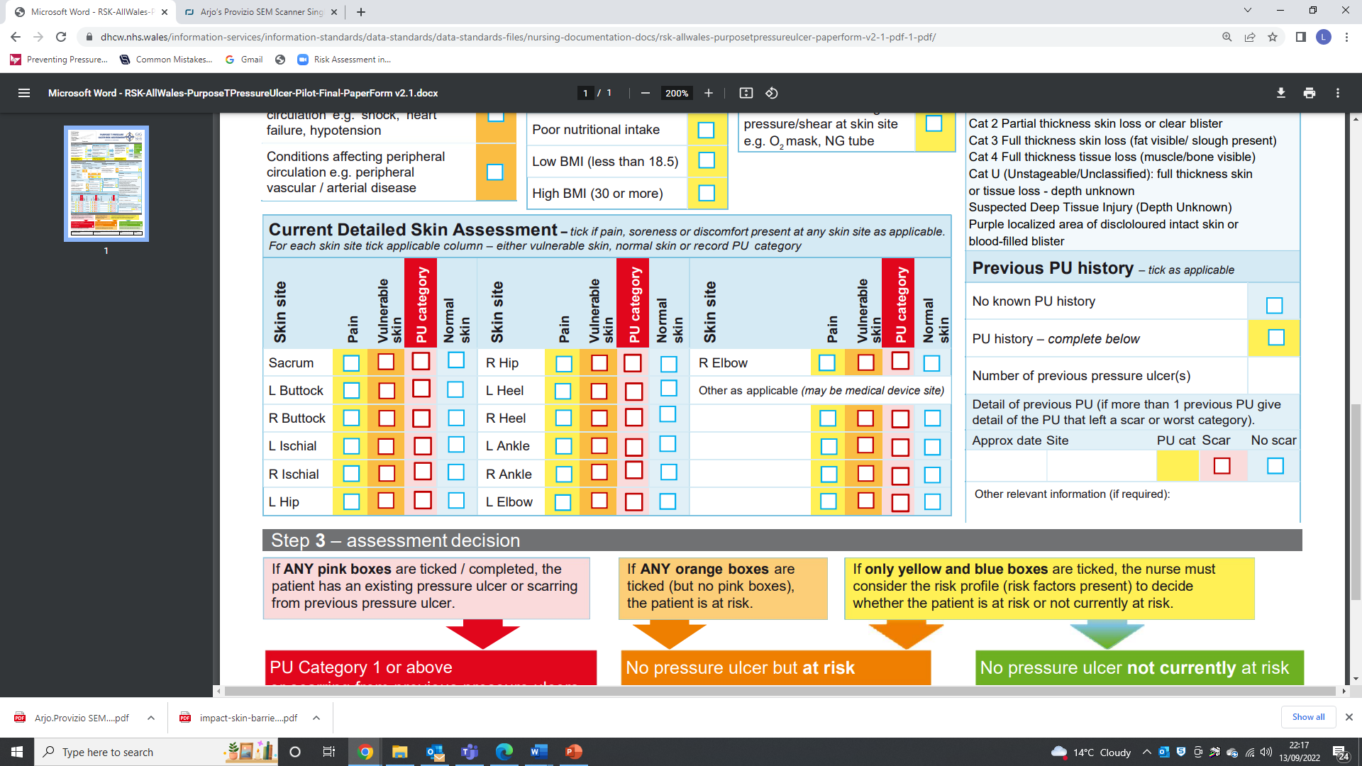
Step 2 cont
To add in MASD
Dark tone skin
DTI & Unstageable to change to cat 3

Slide 15
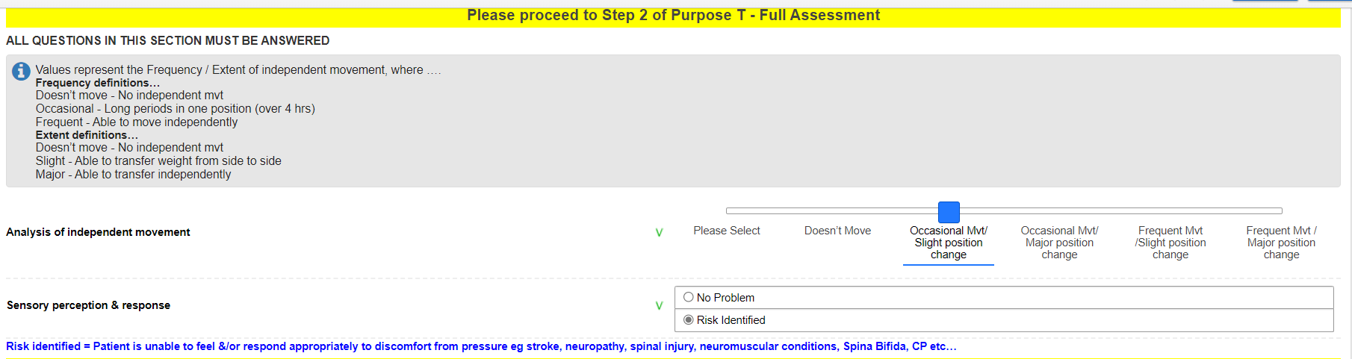
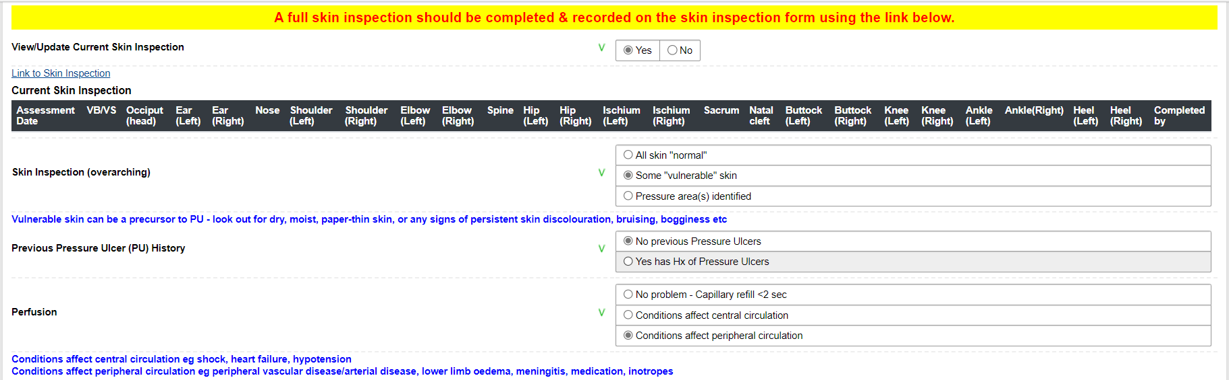
Step 2

Slide 16
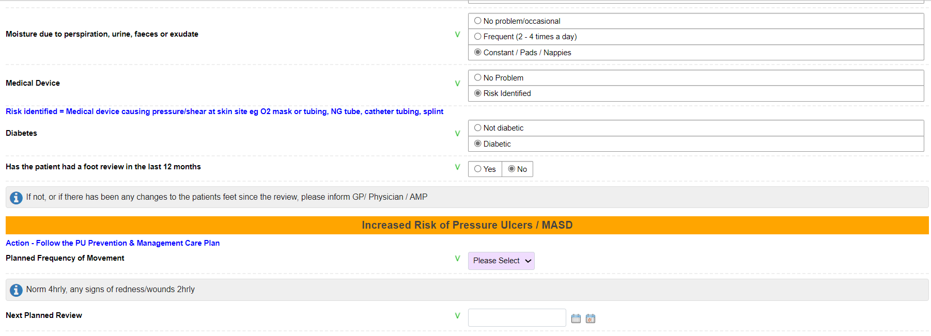
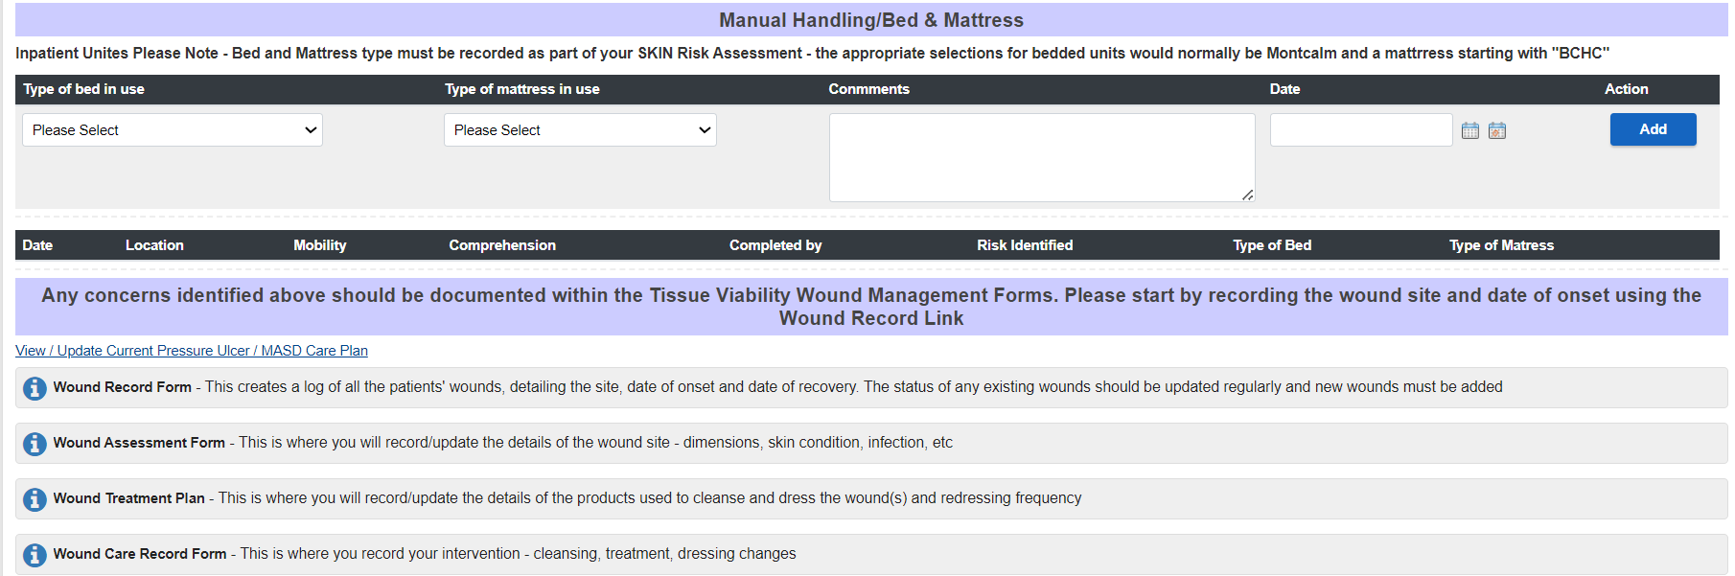

Slide 17
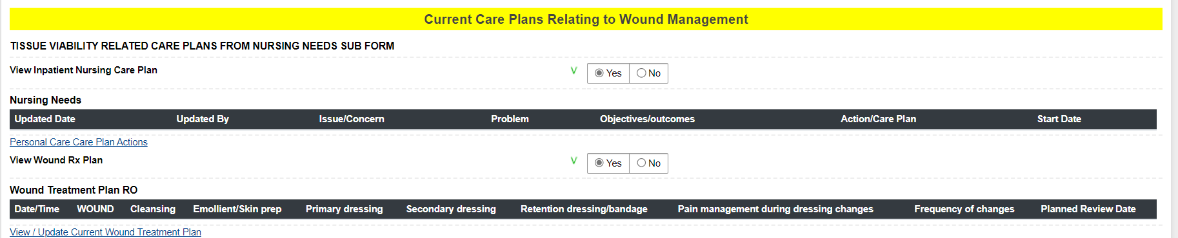

Slide 18
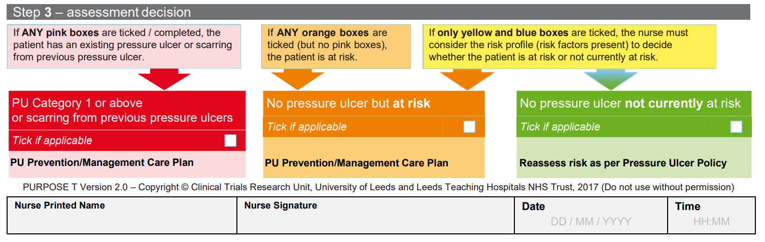
Step 3
The final step determines the assessment decision based on the previous steps and uses colours to categorise the decision:
Red: Existing pressure ulcer, Category 1 or above or scarring from previous pressure ulcers
Orange: No pressure ulcer but at risk
Green: No pressure ulcer not currently at risk

Slide 19
