Slide 1

Michael Morgan-Bullock
Head of Information Governance & Legal Services /
Data Protection Officer

Slide 2
Record - keeping
Increasing external (legal) exposure to your notes in patient records:
  Coroner
  NMC
  Civil actions / 3rd party disclosure
  Section 49 MCA Reports
  Subject Access Requests (DPA)
Assume your notes are likely to be forensically examined at least once in your career…!

Slide 3
NMC Code
The Code – https://www.nmc.org.uk/standards/code/record-keeping/
  2nd Principle: Practise effectively
  Standard 10. Keep clear and accurate records relevant to your practice

Slide 4
10. Clear and accurate records
10 Keep clear and accurate records relevant to your practice This applies to the records that are relevant to your scope of practice. It includes but is not limited to patient records.
To achieve this, you must:
10.1 complete records at the time or as soon as possible after an event, recording if the notes are written some time after the event
10.2 identify any risks or problems that have arisen and the steps taken to deal with them, so that colleagues who use the records have all the information they need

Slide 5
10. Clear and accurate records
10.3 complete records accurately and without any falsification, taking immediate and appropriate action if you become aware that someone has not kept to these requirements
10.4 attribute any entries you make in any paper or electronic records to yourself, making sure they are clearly written, dated and timed, and do not include unnecessary abbreviations, jargon or speculation
10.5 take all steps to make sure that records are kept securely
10.6 collect, treat and store all data and research findings appropriately

Slide 6
Purpose of good record-keeping
Primary purpose – for effective clinical practice and safe continuity of care.
“Would the profession (i) understand and (ii) endorse what I have done as recorded?”
Secondary purpose –
  To assist in audits
  To provide evidence in legal proceedings

Slide 7
“SOAP” approach
Subjective
Objective
Assessment
Plan

Slide 8
“SOAP” approach
Subjective – patient complaint / feelings / medical or family history (or HPI if subsequent visits)
Objective – clinical observations, skin condition, test results
Assessment – how is patient progressing? does treatment plan need to be updated?
Plan – implement current / new treatment plan / review intervals / any other next steps

Slide 9
Coroner
Current Senior Coroner – Louise Hunt, appointed in 2014. Former nurse and solicitor.
9 Area and assistant coroners
Inquest – fact-finding exercise into cause of death
Purpose is not to apportion blame!

Slide 10
Giving evidence at Inquest
Prior to the Inquest:
  Witness statement
  Records
At inquest:
  Questions led by Coroner
  Family and interested parties can ask questions
  No cross-examination!

Slide 11
Inquests / Adult Community Services
The Trust attends an average of 18 inquests every year.
Many of these concern wounds from a pressure related injury and require district nurses to attend to give evidence.

Slide 12
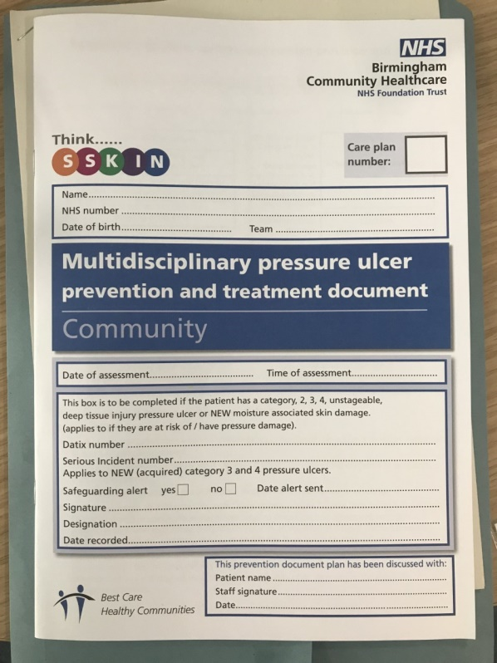
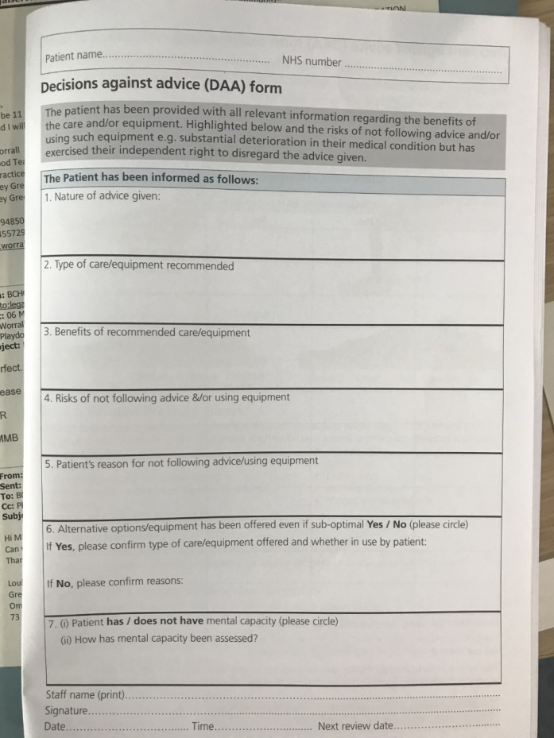
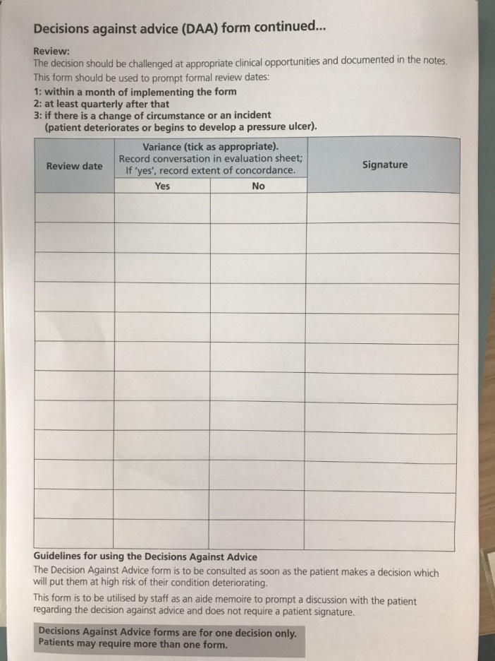
Decisions Against Advice

Slide 13
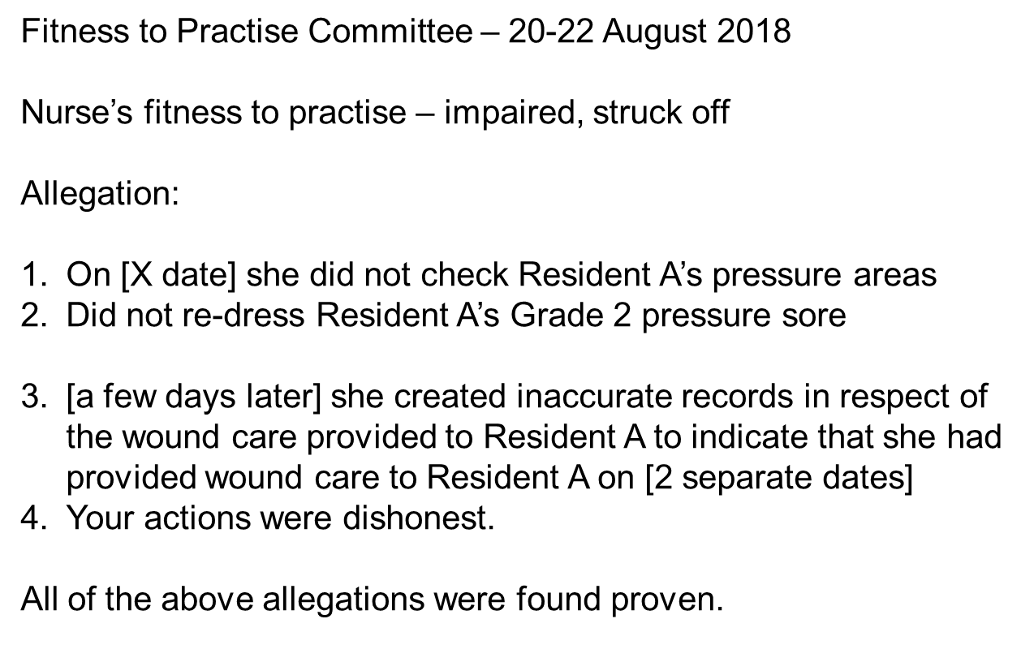
NMC case – Patricia Hamilton

Slide 14
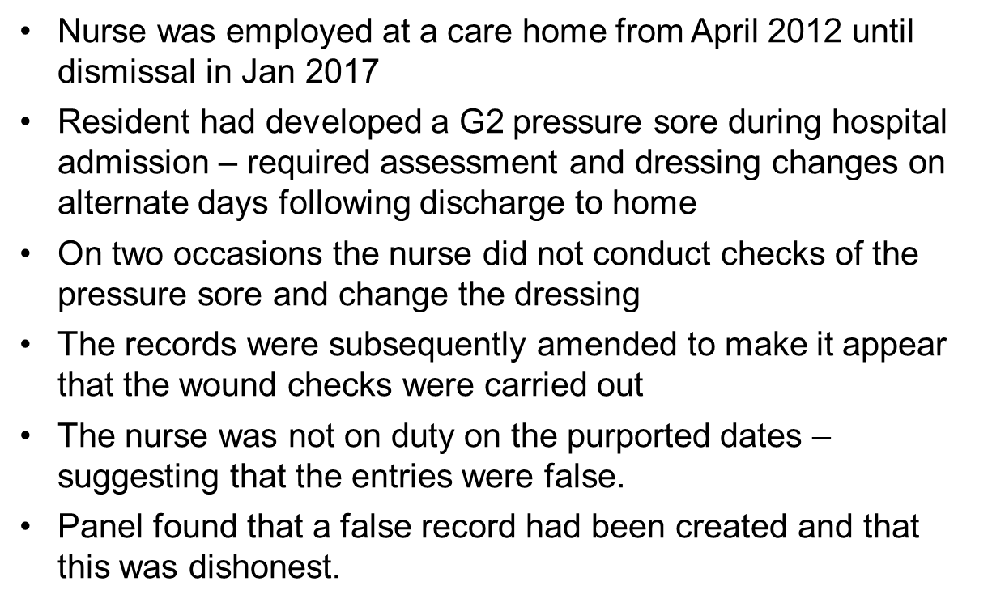
Facts of case

Slide 15
Suggestions
Missing entries looks like it wasn’t done!
  Eg. Skin inspection – if not in the record, it will be assumed it wasn’t done.
Failure to complete re-assessments when clinical condition changes – e.g. not updating mental capacity assessment
If need to update retrospectively – make this very clear in the record

Slide 16
Suggestions (2)
Evidence your advice and any non-concordance
  Alternating mattress advised [and why explained]. Patient understands but wants to remain in own bed – DAA completed. Reasons for non-concordance explored (if appropriate) – brief summary. Patient has capacity and expressed views clearly.
  Referral to GP advised – patient agrees [or declined as appropriate]
  Skin inspection done as per policy.

Slide 17
Suggestions (3)
Avoid simple phrases without context :
  “Pressure areas intact”
  “to discuss treatment with team”
Clinical quality –
  are you there to redress the wound? Or to make a clinical assessment? Mindset change in approach
  360 degree assessment, not tunnel-visioned
  Are decisions at handover recorded anywhere? Is there a way of getting this into the patient’s notes?

Slide 18
Skin inspection
Your first line of defence against that unforeseen wound –
“Can I have a look at your skin?”
  Patient says yes – document Visual Inspection
  Patient says no – document patient has refused Visual Inspection, advised that no soreness, etc.
  You have NOT CONFIRMED their pressure areas are intact…
  Patient continues to refuse - raise with team leader
  Repeated refusal– complete DAA form

Slide 19
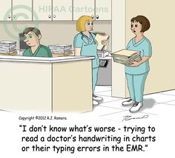
Any questions?

Slide 20
Contact Details
Michael Morgan-Bullock
Head of Information Governance
& Legal Services
Data Protection Officer
Corporate Governance Division
Birmingham Community Healthcare NHS Foundation Trust
3 Priestley Wharf, Holt Street, Aston, Birmingham B7 4BN
Tel: 0121 466 7054
Email: legalservices.bchc@nhs.net

