Slide 1



Missing Person Process

Slide 2


To access all the Trusts Policies and standard operating procedures (SOP) then please visit the intranet home page and click on the policies tab and you will be able to access the policy you wish to look for.
If you cannot find the document, you are looking for you can contact smallwood.library@nhs.net

Slide 3
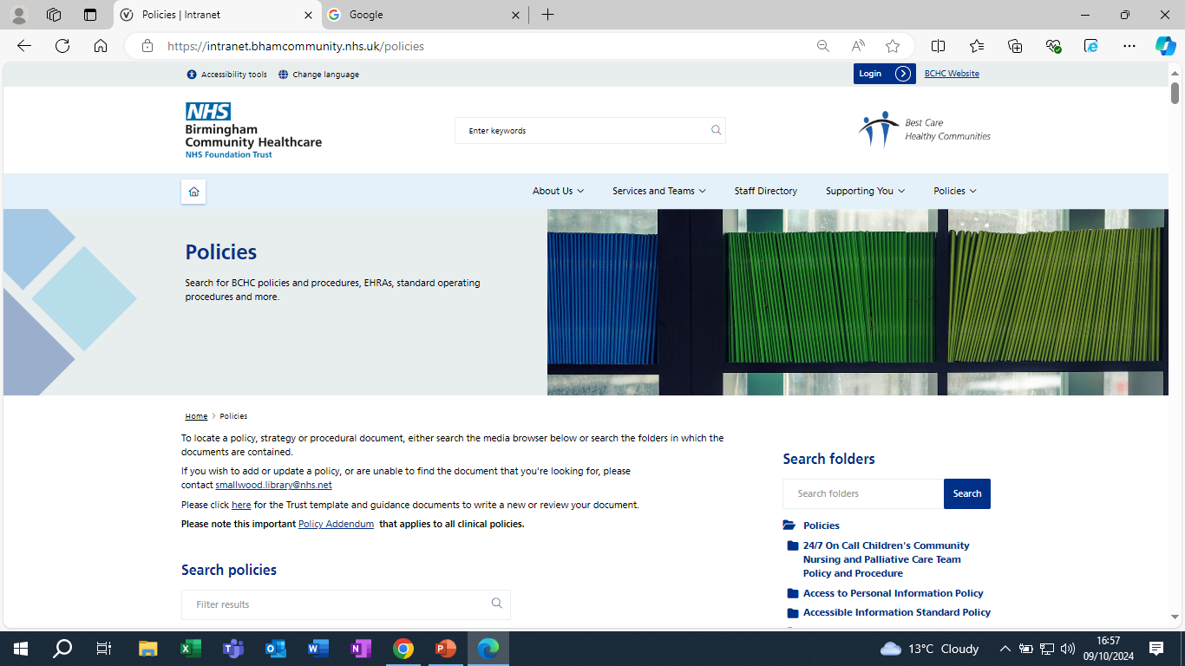

Slide 4
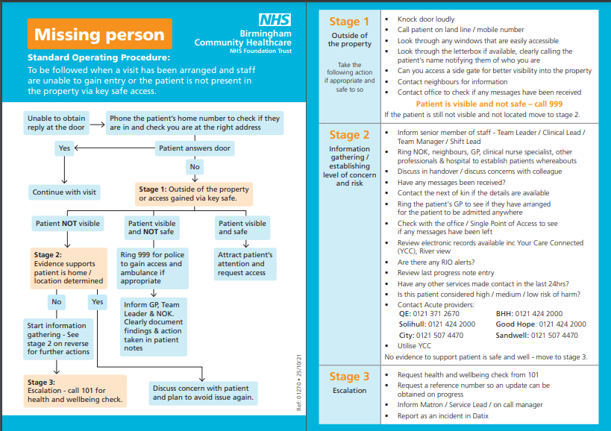

Slide 5

A copy of the missing person SOP should be carried by all staff and temporary staff members in the team.
There are 3 stages of the missing person SOP.
Stage 1 you have a planned visit, and you are outside the property and unable to gain access. This could involve ringing the patient, looking through the window, speaking to neighbour etc.
Stage 2 information gathering/establishing level of concern and risk. This can involve contact NOK, contacting patient locator services from the hospital to check if the patient may have been admitted, checking shared care records on RIO, contacting GP, liaising with team leader etc.
Stage 3 Escalation- if you have tried to locate the patient and have been unsuccessful then a health and wellbeing check needs to be requested by ringing 101, also it needs to be escalated to your SCM or on call manager and a Datix needs to be completed

Slide 6
If the missing Person has been found an incident still should be reported as a Near Miss to identify any potential lessons learnt.
Document in progress notes the steps you have taken, also any log number from health and wellbeing checks so that any updates can be followed up.

Slide 7
Any Questions?

