Slide 1

Mental Capacity Act Workshop

Slide 2




Legislation that protects vulnerable adults:
Human Rights Act (1998) Article 8:
Notes:
Ask: what do you know about these laws? How do they support & protect the patient?
How would you feel if your rights were not upheld?

Slide 3
Concordance, Capacity & Consent
Who feels confident & competent to assess mental Capacity?
Who seeks informed Consent when working with patients?

Slide 4


If Consent is to be valid it must be:
Informed and
Given freely without coercion or pressure.
Consent can only be deemed informed if the patient has received information about the care, treatment or investigation that they are able to understand, retain and weigh up to make their decision.
Notes:
Ask about documentation regarding consent. HOW? WHY? WHERE?

Slide 5

Five Principles of the MCA
What are the Five Principles of the MCA?
This Photo by Unknown Author is licensed under CC BY-NC
Notes:
Group exercise: Ask the group to share the five principles. If they can't answer share the principles. Go over each principle giving clarity as to what they mean.
Principle 1 - a person must be presumed to have capacity
Principle 2 - individuals must be supported to make their decisions
Principle 3 - a person should not be treated as unable to make a decision because they make an unwise decision
Principle 4 - any decisions that are made for a person lacking capacity must be done in their best interests taking into account their wishes, values and beliefs
Principle 5 - in making best interest decisions aim for the option that is less restrictive of the person’s rights
10 minutes

Slide 6

Mental Capacity Act (2005)
Principles:
1.Assume capacity
2.Maximise potential
3.Unwise decisions
4.Best interests
5.Less restrictive
Capacity Assessment
‘a person lacks capacity in relation to a matter if at the material time he is unable to make a decision for himself in relation to the matter because of an impairment of, or a disturbance in the functioning of, the mind or the brain’
(MCA Code of Practice 2013)
Can the person:
Understand, Retain, Weigh up, Communicate
Notes:
Go into each principle and allow participants to question/challenge. Diagnostic Test: Is there an impairment of, or disturbance in, the function of the person’s mind or brain?
Functional Test: Does the impairment or disturbance cause the person to be unable to make the decision in question?
Principle 1 - a person must be presumed to have capacity
Principle 2 - individuals must be supported to make their decisions
Principle 3 - a person should not be treated as unable to make a decision because they make an unwise decision
Principle 4 - any decisions that are made for a person lacking capacity must be done in their best interests
Principle 5 - in making best interest decisions aim for the option that is less restrictive of the person’s rights
Apply each of the Principles to real/case scenarios:
REITERATE: Understand, retain, weigh up & articulate decision.
Take 10 minutes.

Slide 7
What does ‘Best Interests’ mean?
Best interests encompass not just a person’s medical interests, but also their social, cultural and psychological needs
Best interest decision making needs to start with identification of what options are available
Identify the issues and compare the options under consideration
Weigh up the benefits and risks/disadvantages of each option
Set out a conclusion about which option is in the patient’s best interests and why
Best interests’ meetings are useful in contexts where the decisions are complex or involve serious consequences

Slide 8

Decision maker
Court of Protection
Court appointed deputy/LPA
Nurse, Social Worker, Care Assistant etc.
Advanced Decision
Person
Notes:
In Group discussion explore the range of decision makers in relation to MCA starting with the Patient. This slide enables the group to explore the rights of the patient, the power of Advanced Decisions, LPA and the process of the Court of Protection. Allow the group time to question and consider how this process works in practice. The presenter can reiterate that MCA is Decision Specific. Consultation with others is important ie family, relevant others. 8 minutes

Slide 9

Concordance.
An agreement reached after negotiation between a patient & healthcare professional that respects the beliefs & wishes of the patient in determining whether, when and how their care will be delivered.
‘No decision about me, without me’
Notes:
Remember that the patient must always be central to the decisions about their care & treatment.
Before moving on to the next slide ASK: What legislation (laws) must we observe in our care of patients?

Slide 10
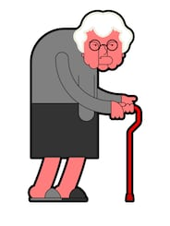
My bottom is feeling really sore. The skin on my legs feels tight and uncomfortable and my ankles are swelling. It is getting more difficult to get around the house and I am frightened of falling down the stairs. I have a toilet downstairs which is easier to get to than the bathroom, which is upstairs. The nurse was not happy when I told her I’m sleeping in my chair.
Beryl has extensive MASD, bilateral lower limb oedema & is refusing to go to bed, spending days & nights in her chair.
I advised her to go to bed at night & during afternoon.
She will not listen to advice.
Notes:
Two opposing views!
Consider concordance, capacity & consent.
Identify risks. Consider alternatives, effective communication, humanistic approach.
Extrapolate a compromise?
Contemporaneous documentation>

Slide 11
I have lived on my own with this for years. I enjoy getting out of this place to go to work. They want me to stay at home & go to bed all day. That wouldn’t do me any good. The GP asked them to visit after a recent infection & bout of diarrhoea. They say I have a sore area, but I don’t know what all the fuss is about.
Tom has a progressive neurological condition, requiring use of a wheelchair. Which he is spending more than 15 hours a day in. He’s also losing weigh. He has evidence of MASD, shear, friction & ungradable skin damage to his sacrum.
He declines equipment & advice to return to bed in the day & he is unable to take time off work as he is concerned about losing his job.
He gets agitated & angry when we visit , tells us to leave & not bother returning.
You are unable to gain access to Tom’s home & he isn’t answering his phone.
Notes:
Two opposing views!
Consider concordance, capacity & consent.
Identify risks. Consider alternatives, effective communication, humanistic approach.
Extrapolate a compromise?
Contemporaneous documentation.

Slide 12
It’s the patient’s right to live like this!
Isn’t it?

Slide 13
THINK!!
What are the RISKS of doing nothing ?
Is there a RISK of catastrophic harm ?
Can the adult understand RISK ?
Does the patient have Capacity to consent to care ?
Concordance / non-concordance only applies if the patient has capacity.
How do I manage non-concordance?
Notes:
Remember – if you are unsure you can seek support from the Safeguarding team: bchc.safeguardingadults@nhs.net

Slide 14
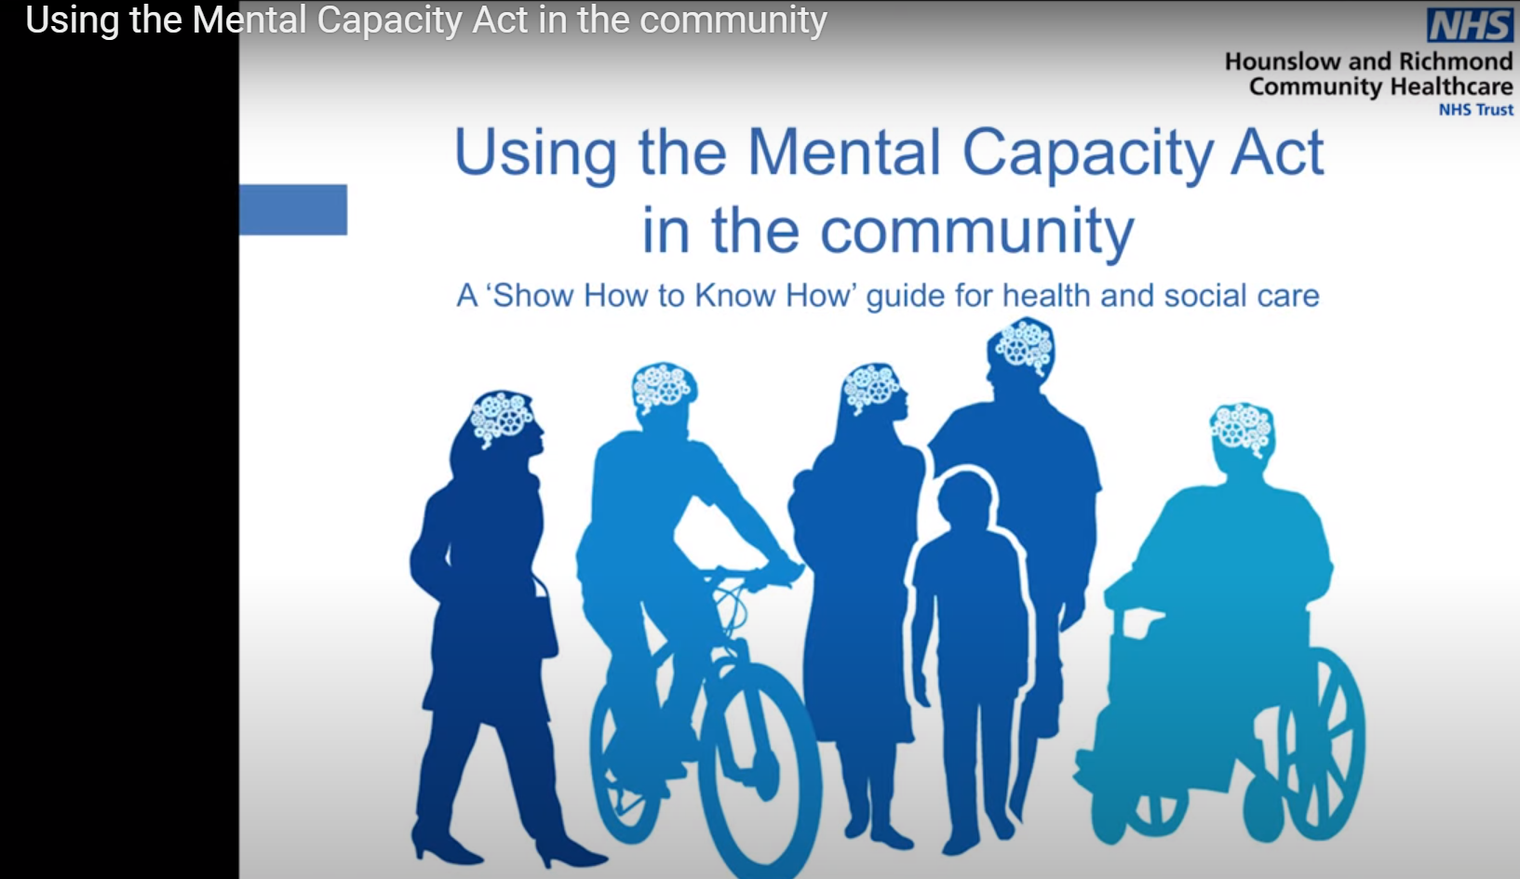
MCA In the Community Video
https://www.youtube.com/watch?v=yglaLGl3Rxw
Notes:
This Video relates to assessing capacity in the community.
It can be used in it’s entirety or parts selected to play.

Slide 15
How to complete the assessment?
What is the decision to be made?
Has information been provided in a way that the patient understands?
Who is the decision maker?
Have you considered LPA, Advanced Decisions?
Don’t complicate the assessment by expecting the Patient to be an expert.
Is this the right time/Day?
Is the person comfortable?
Are the right people here?
Notes:
Ask the group for thoughts on how to complete a capacity assessment. Then reveal each of the bubbles.
Use an example from the group of choices you have and share the example
Talk through each point of the example
Reflect on practice to bring the capacity assessment to life.
Give time for questions
Reiterate that Record keeping, and contemporaneous documentation is important.
30 -50 minutes

Slide 16
Mental capacity Act (2005) Capacity Assessment
Is the person unable to make a decision?
The person is unable to make a decision for themselves if they are unable to:
Understand
Retain
Use or weigh that information
Communicate their decision
(2) Is there an impairment or disturbance in the functioning of the person’s mind or brain? - If so:
(3) Is the person’s inability to make the decision because of the identified impairment or disturbance?
Notes:
Have I been clear and concise?
Have I provided opportunity for the person to take on board the decision, options, benefits and burdens?
Are my questions relevant to the decision?
Have I respected the principles?
Have I explained to the person all the pieces of information identified as being relevant to the decision?
EVIDENCE CAPACITY AS WELL AS INCAPACITY
Think about the questions you may need to ask if undertaking a capacity assessment for a decision that needs to be made – What are they?
Reasons why Diagnosis is important early on

Slide 17
Completing the assessment
Have I been clear and concise?
Have I provided opportunity for the person to take on board the decision, options, benefits and burdens?
Are my questions relevant to the decision?
Have I respected the principles?
Have I explained to the person all the pieces of information identified as being relevant to the decision?
EVIDENCE CAPACITY AS WELL AS INCAPACITY
Reasons why Diagnosis is important early on
This Photo by Unknown Author is licensed under CC BY-NC
Notes:
Barriers to assessment.
Think about the questions you may need to ask if undertaking a capacity assessment for a decision that needs to be made – What are they?

Slide 18
Contact details:
Notes:
Show Intranet page Final Questions
Seek evaluation forms
5 Minute

Slide 19
References
Human Rights Act (1998). https://www.legislation.gov.uk/ukpga/1998/42/contents.
Marriage and Civil Partnership (Minimum Age) Act (2022). https://www.legislation.gov.uk/ukpga/2022/28/enacted.
Mental Health Act Code of Practice (2015). https://www.gov.uk/government/news/new-mental-health-act-code-of-practice.
Mental Capacity Act (MCA) Code of Practice (2013). https://www.gov.uk/government/publications/mental-capacity-act-code-of-practice.
UK Government. Mental Health Act (1983) as amended by the Mental Health Act (2007). https://www.legislation.gov.uk/ukpga/2007/12/contents.
UK Government. The Mental Capacity Act (2005). http://www.legislation.gov.uk/ukpga/2005/9/contents.
UK Government. The Care Act (2014). http://www.legislation.gov.uk/ukpga/2014/23/contents/enacted.
UK Government. Mental Capacity (Amendment) Act 2019. http://www.legislation.gov.uk/ukpga/2019/18/enacted.
United Nations Convention on the Rights of the Child (UNCRC). https://www.unicef.org.uk/what-we-do/un-convention-child-rights/.

Slide 20

Notes:
Share evaluation forms by hand or email. Provide handouts and capacity assessment examples.
15 minutes

