Slide 1

LYMPHOEDEMA MANAGEMENT

Slide 2
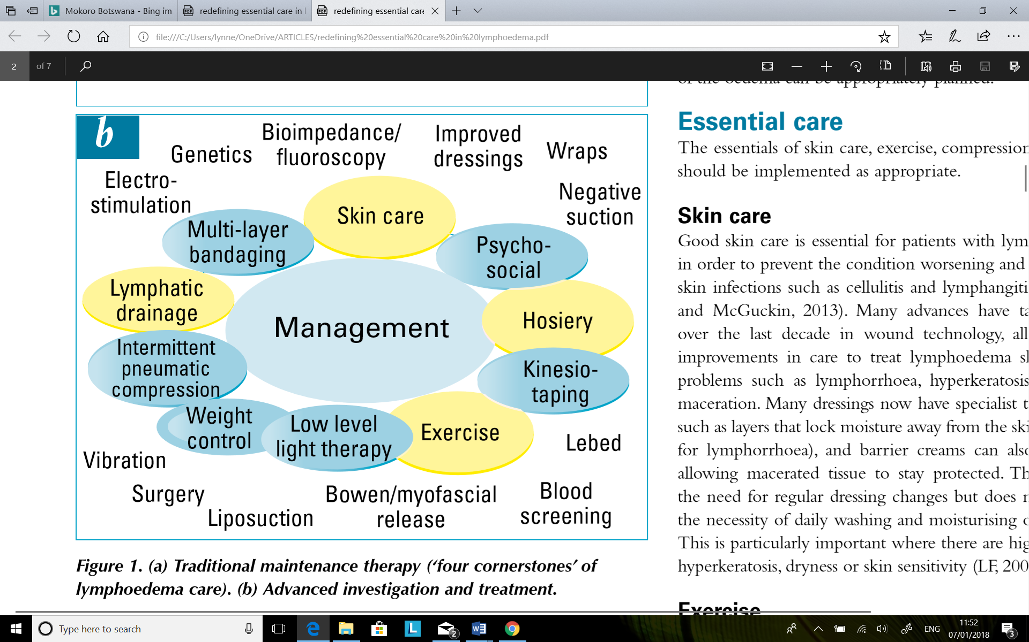
LYMPHOEDEMA MANAGEMENT
Skin Care Exercise
Compression Manual Lymphatic Drainage

Slide 3
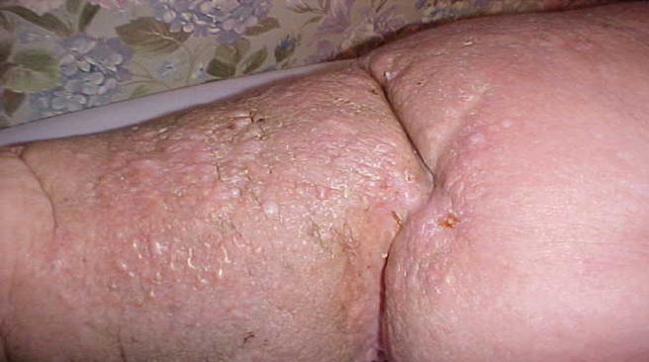
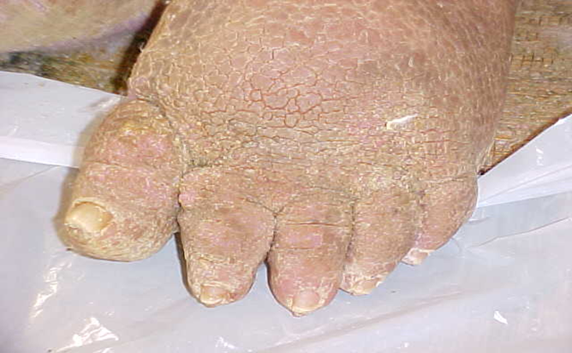
Skin Care
Reduces the risk of cellulitis, lymphangitis
Treatment for cellulitis. Antibiotics. Antimicrobials
Reduces skin related problems: hyperkeratosis, lymphorrhoea, skin maceration
Daily washing, inspecting the skin; attention between skin folds

Slide 4
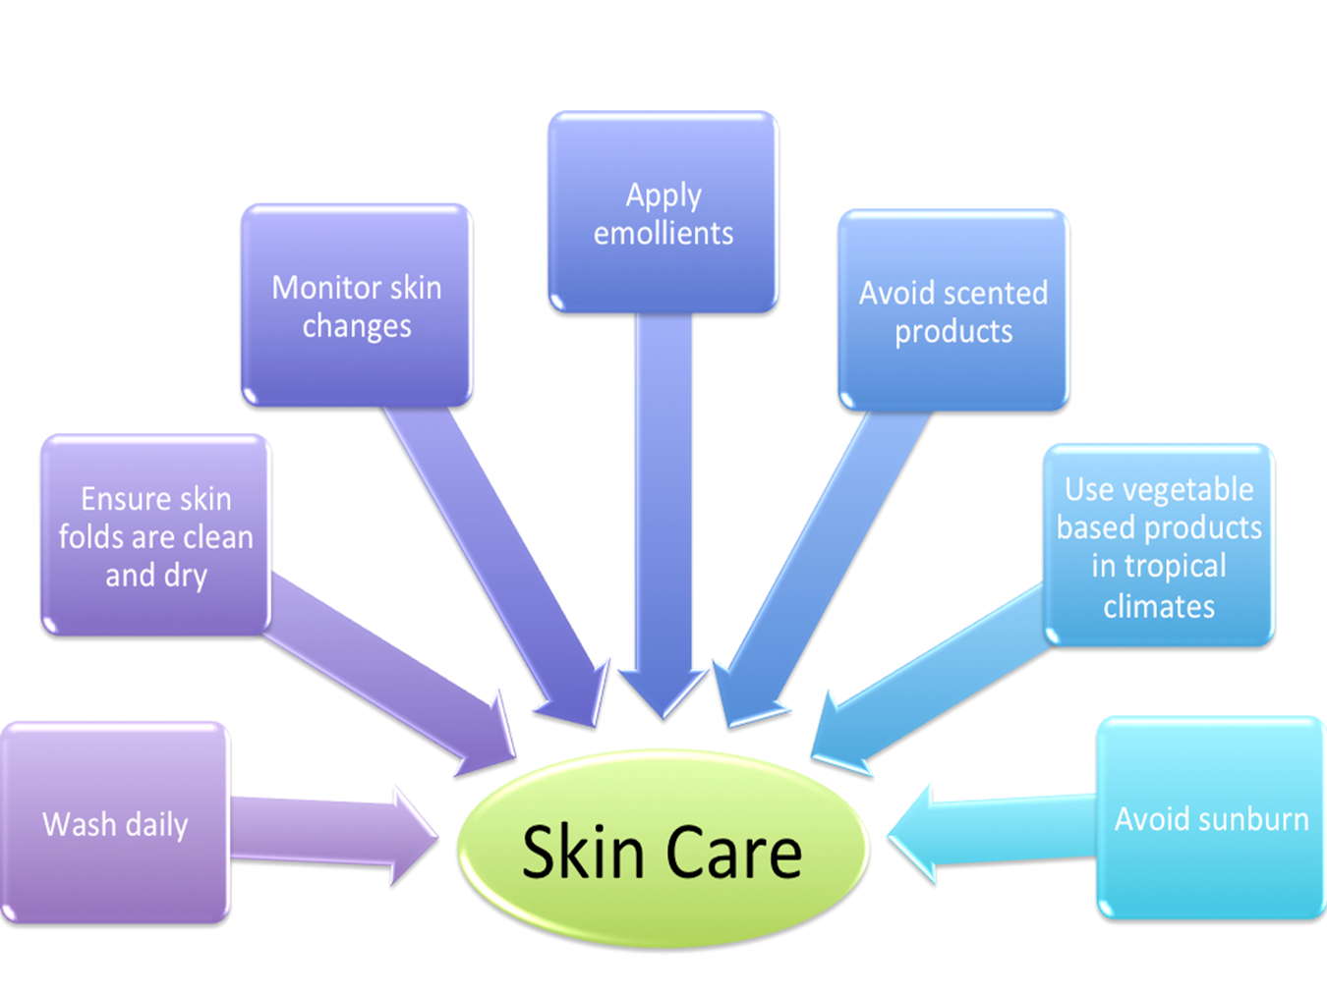
Skin Care

Slide 5
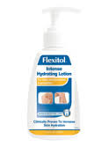
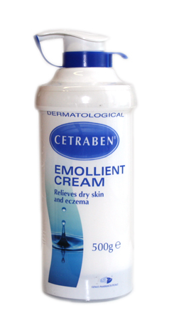
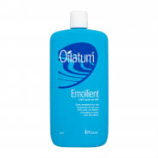
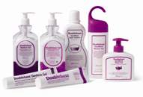
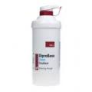
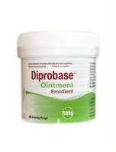

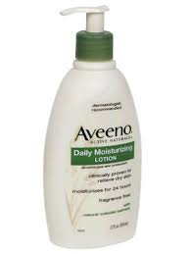
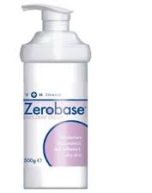
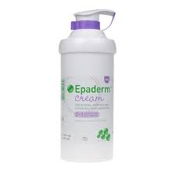

Skin Care

Slide 6


Exercise
Increases muscle pump encouraging venous return and improves lymphatic drainage.
Lebed method, (Healthy Steps).
Improves QoL
Improves mental state.

Slide 7
Compression therapy
Reduction of capillary filtration
Shift of fluid into non-compressed parts
Increases lymphatic absorption in the capillaries
Improvement of venous pump therefore reduction in venous filtration in the interstitium
Reduction in inflammation

Slide 8
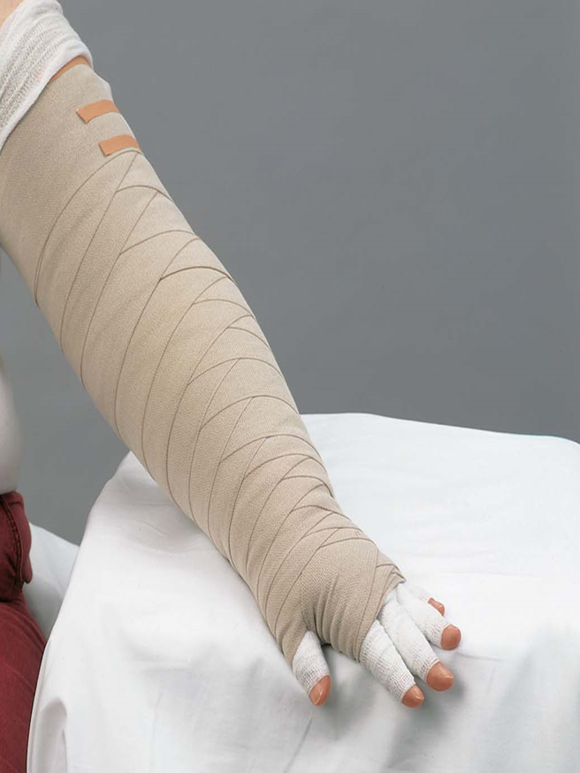
Compression Bandaging
Laplace's Law - width over circumference divided by layers
Padding and shaping of the limb is essential prior to bandaging.
Short stretch bandages need to be reapplied daily to maintain compression as the swelling reduces..
Toe/finger bandaging will be required for lymphoedematous digits to encourage drainage of lymph fluid.

Slide 9
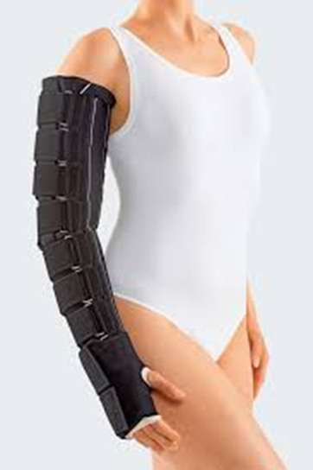
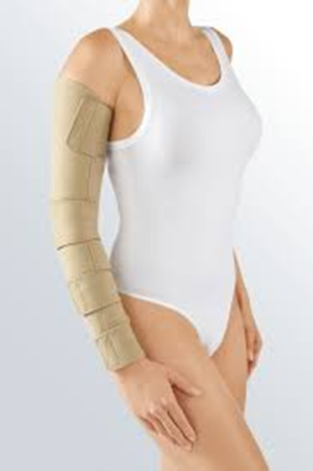
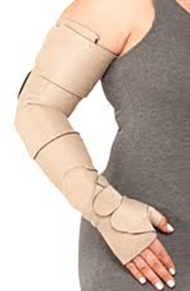
Compression therapy

Slide 10
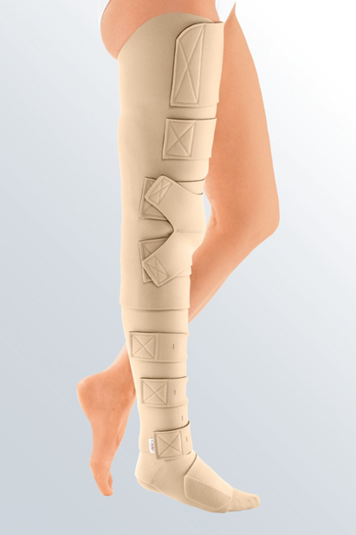
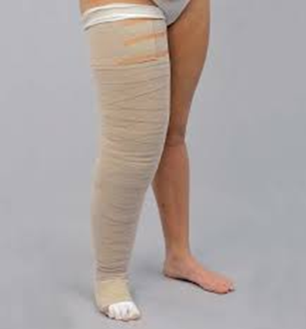
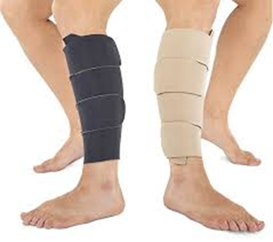
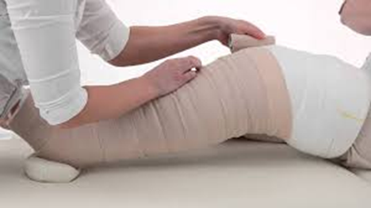
Compression therapy

Slide 11
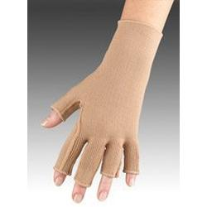
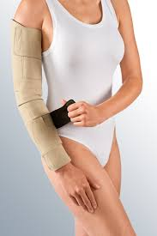
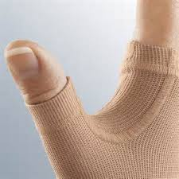
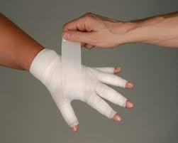
Compression therapy

Slide 12
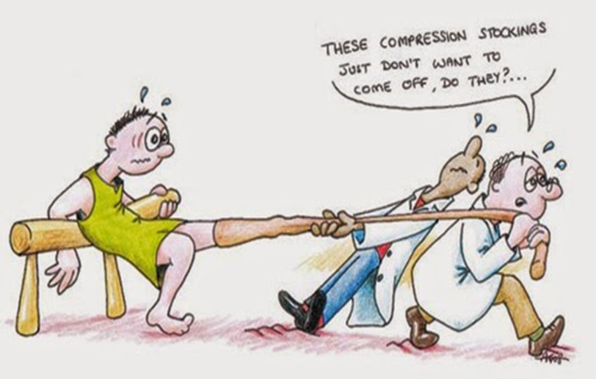
Compression Hosiery maintenance

Slide 13
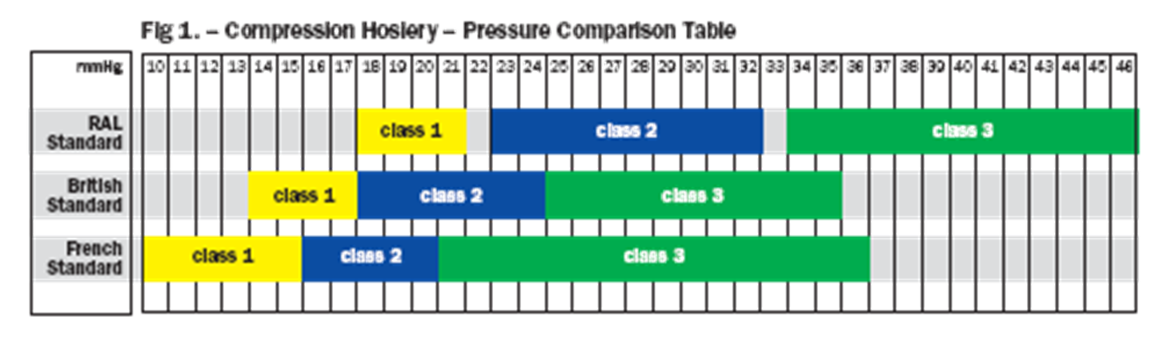
Compression Hosiery class

Slide 14
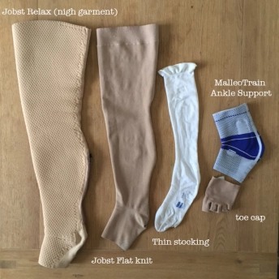
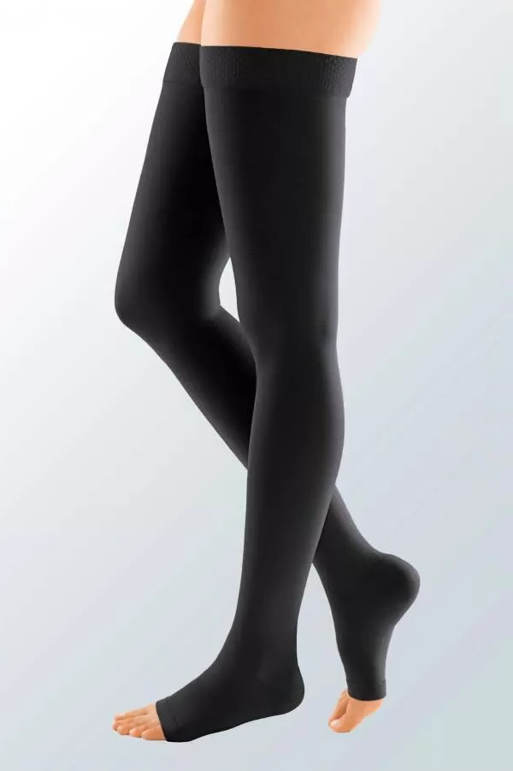
Compression Hosiery

Slide 15
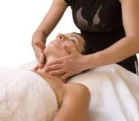

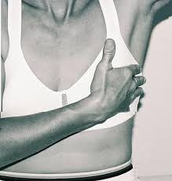
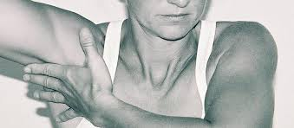
Manual/Simple Lymphatic drainage

Slide 16
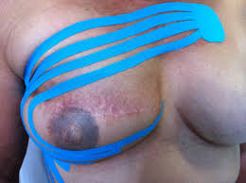
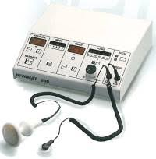
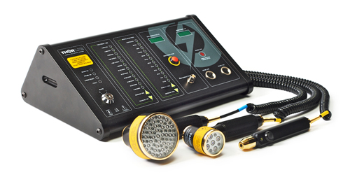
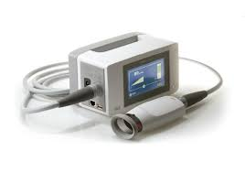
Other treatment options
Deep oscillation
Kinesio Tape
Low level light therapy
Lymphatouch

Slide 17
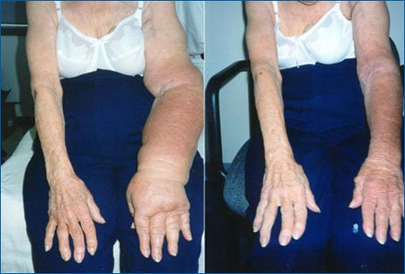
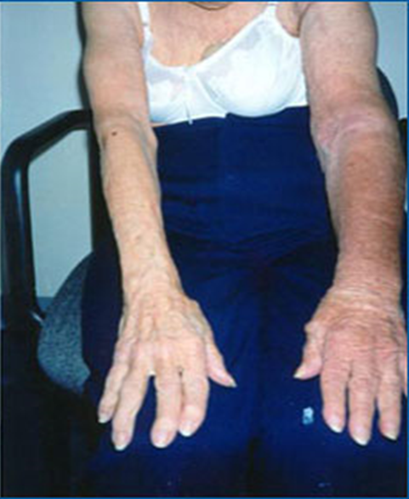
Pre & Post treatment

Slide 18
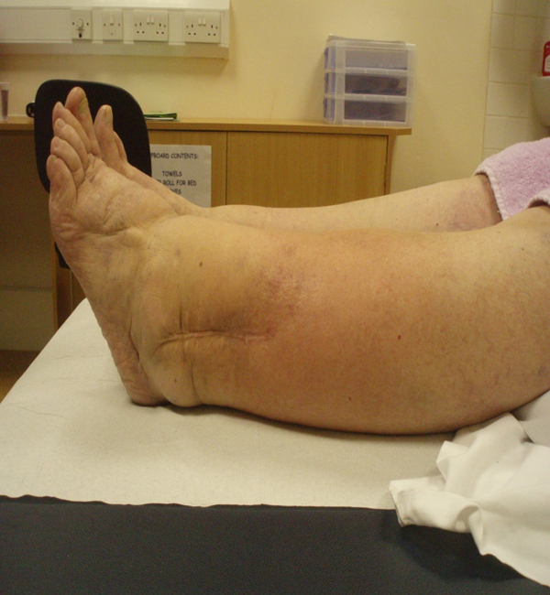
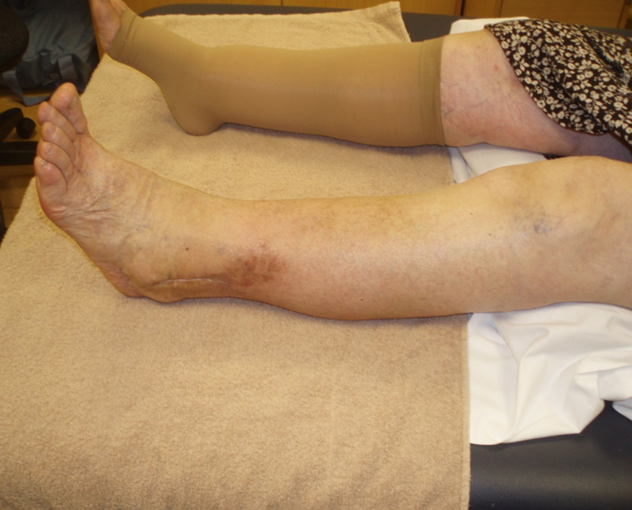
Pre & Post treatment

Slide 19
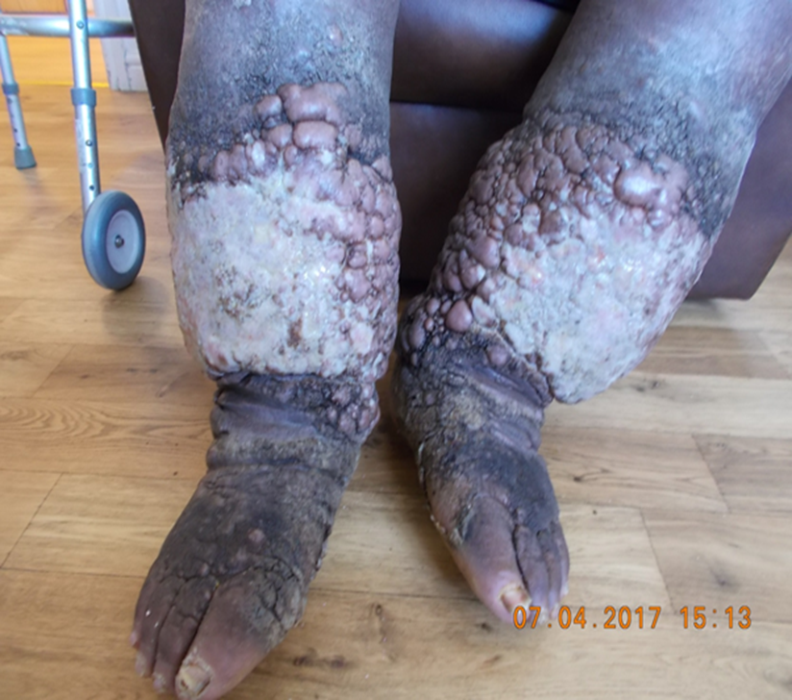
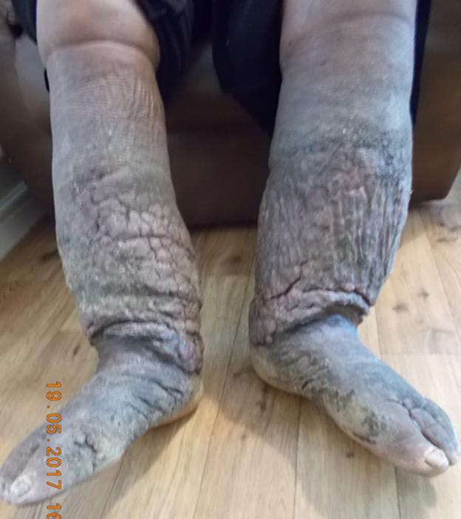
Pre & Post treatment

Slide 20
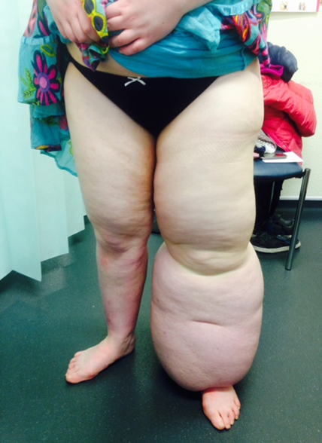
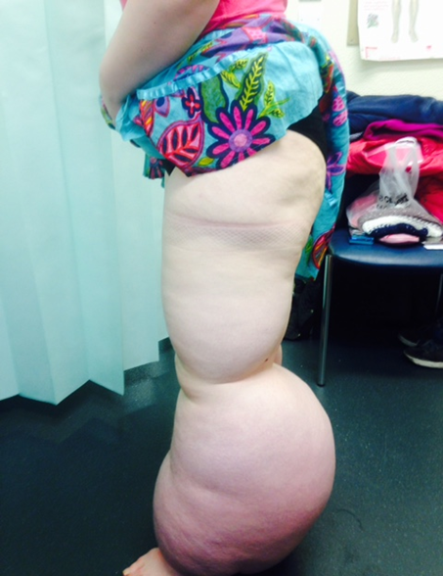
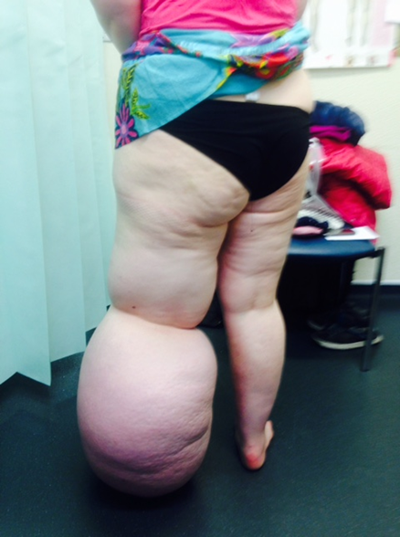
Pre-Surgical & DLT management
Primary lymphoedema

Slide 21
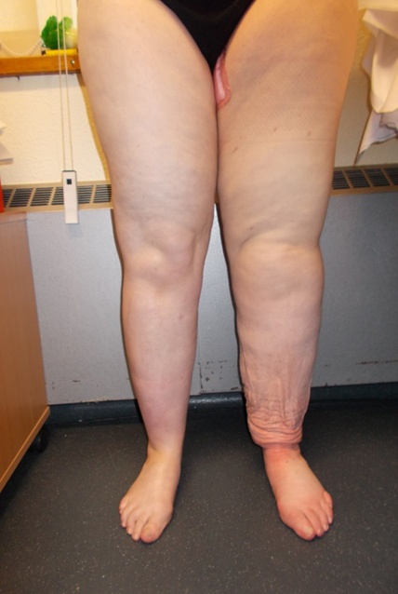
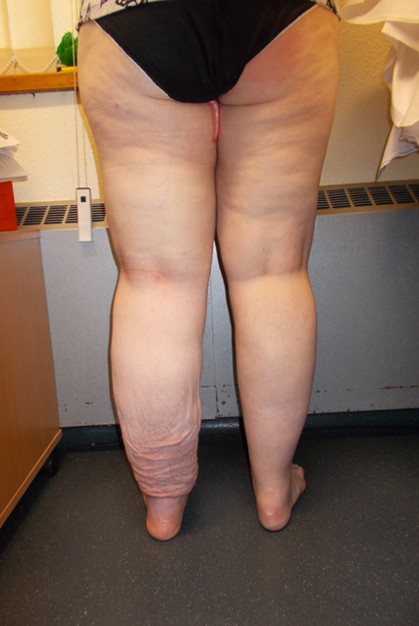
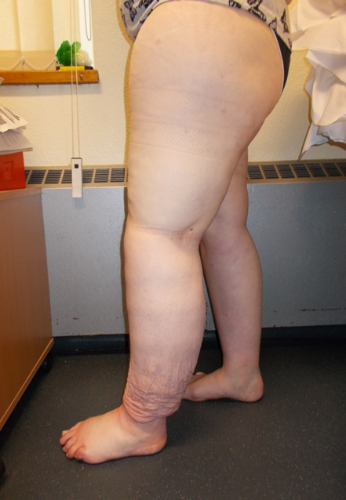
Post-Surgical & DLT management
Post liposuction and DLT

Slide 22
Quiz
Go to play.blooket.com
and enter Game ID:

Slide 23

QUESTIONS

Slide 24
BCHC Lymphoedema Service
Thank you

