Slide 1

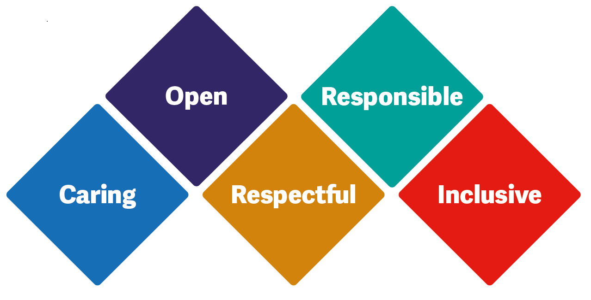

Lone Working
Maintaining Staff Safety

Slide 2
Aims of the session
To raise awareness of the lone working policy.
To raise awareness of the hazards of lone working throughout BCHC.
Understanding that all employees of the Trust are protected as reasonably practicable. Managers responsibilities in lone working.
To give guidance on assessing and controlling associated risks and ensuring all associated risks are minimised as much as possible and how to achieve this.
Ensuring you feel safe and secure when at work.
Raising awareness that there are effective systems in place and management support in any instance that may require help.
The “Red Folder” process.

Slide 3
Lone Working Policy
Located on trust intranet - Policies | Intranet (bhamcommunity.nhs.uk)
Last updated on Feb 2023 and due review September 2026.
Policy Lead – David Ore, Local Security Management Specialist.
Working alone is a daily reality for (BCHC) staff. It is recognised that those staff working in such situations may face increased risks to their safety and security. This policy aims to give guidance to all staff regarding working alone and ensure that safe systems of work are in place.

Slide 4

Hazards of lone working…
Using mentimeter tell me the hazards you think you may encounter while being a lone worker?
https://www.mentimeter.com/
Mentimeter code =

Slide 5
Hazards of lone working…
Accidents or emergencies arising out of the work and the lack of first aid equipment.
Driving alone.
Inadequate provision of rest, hygiene, and welfare facilities.
Lack of peer support.
Manual handling.
Night work or unsocial hours.
Not receiving enough rest.
Poor or lack of communication.
Potential violence from patients or the public.
Problems with access/egress.
Sudden illness.
Visiting high-risk locations or patients.
Vulnerability of travelling alone.
Working alone in buildings and working in confined spaces.
Personal safety/security.
Allegations against a lone worker (because there are no other witnesses).

Slide 6
Minimising Risk
Dealing with aggression and disruptive behaviour
Be aware of changes in the behavior in the person you are with, especially if you are discussing something that could result in an angry or irritated response. It is very rare for aggression or violence to come from nowhere.
Try to use your own communication skills to defuse a difficult situation early on, thinking about tone, volume and body language can help to create a calming atmosphere.
If the person you are with is getting angry, try to remain calm. It is best not to meet aggression with aggression.
Remember:
Trust your instincts,
Never underestimate a threat
If you feel uneasy or alarm bells start ringing — act right away.
If you cannot de-escalate the situation:
Get away from the aggressor.
Remember, the earlier you spot a potential problem arising the more choices you have to avoid it.
When travelling between sites or patient’s homes
Keep your car in good working order
Ensure you have break down cover
Always have the necessary directions so that you don’t have to stop
Make sure you have a charged phone or change to call in an emergency
Keep doors and windows locked Always lock anything valuable in the boot or remove it from the car completely
Lock your car even if you have to leave for a minute
When you park in the daylight, think what it will be like at night
Before you get in the car check the back seat
Reporting and recording
If something happens to you, tell your employer, Report it as an Incident. It is important to report near misses as well as actual incidents. Document on Rio and raise alerts!

Slide 7
Responsibilities of the Trust and managers
The Chief Executive -
The Chief Executive holds the overall responsibility on behalf of BCHC as the Accountable Officer to ensure that this policy is adhered to and appropriately resourced.
Chief Governance Officer -
The nominated Board Member with special responsibility for health and safety management issues is the Chief Governance Officer which includes the safeguarding of lone workers.
Local Security Management Specialist (LSMS) –
Identify and develop processes to improve safety and security of all staff. Are able to advise and assist managers in carrying out risk assessments.
Health and Safety Manager –
Ensuring the Trust’s upholds its statutory responsibility in safeguarding its staff and that the Trust adheres to best practice principles in protecting staff. Liaising with the LSMS to ensure safe systems of work are used. They monitor lone working related incidents and assist managers to undertake a root cause analysis of significant incidents.
Directors/Operational Managers/Service Managers –
Managers or anyone with a supervisory role –
Managers are responsible for all staff in their area of responsibility. They must ensure that their staff are appropriately protected before entering a lone working situation. Managing and maintaining all team risk assessments.

Slide 8
Staff Responsibilities
All staff must take reasonable care for the health and safety of themselves and of others and cooperate with their employer in ensuring safety. They are responsible for:
Maintaining their own personal safety and following appropriate instruction, information and training. This includes knowing what to do in the event of an emergency.
Undertaking a risk assessment prior to visiting new service user’s homes or unfamiliar locations and document this where required on the Home Visit checklist. This includes raising alerts on Rio.
Ensuring that any device or mobile phone system that is provided for their safety when lone working is utilised whilst on duty at all times. This is includes, where assessed, the issue of lone worker devices/mobile phone systems. Failure to use these may lead to disciplinary action being taken against individuals and they are to be treated as personal protective equipment (PPE).
Providing their line manager with up to date personal details, personal contact numbers, including vehicle details and next of kin contact details.
Reporting all incidents, difficulties or concerns raised from lone working however minor to their line manager, even if he/she does not wish further action to be taken. Failure to report an incident may put others at risk.
Ensure that all relevant information about service users or relatives referred from other agencies is passed on (subject to rules of confidentiality and professional judgment). If you have any safety concerns you must raise these, particularly if there is a known risk or previous history of violence or aggression.
Always comply with signing in/out arrangements.
Must attend the Trust Conflict Resolution Training if appropriate to their role. (Refer to CH 408 Mandatory Training Policy for further guidance/information)
All staff must undertake Dynamic Risk Assessments DRA - The importance of dynamic assessment is that it enables lone workers to anticipate and recognise the early warning signs of suspected risks and enables safe early interventions to minimise or negate the risk to themselves and others. It recognises that situations change rapidly as do associated risks and that dynamic risk assessment should be an ongoing process. Dynamic risk assessments should be conducted as necessary in the circumstances in place at the time. The process involves assessing risk before, during and after a home visit, potentially hazardous appointment or working period. The benefits of proceeding with a task must be weighed carefully against the adverse risk posed to the lone worker
Under no circumstances, should staff compromise their own personal safety. If they feel unsafe at any point, while in a lone working situation, they should remove themselves from the situation immediately and report their concerns to their manager.

Slide 9
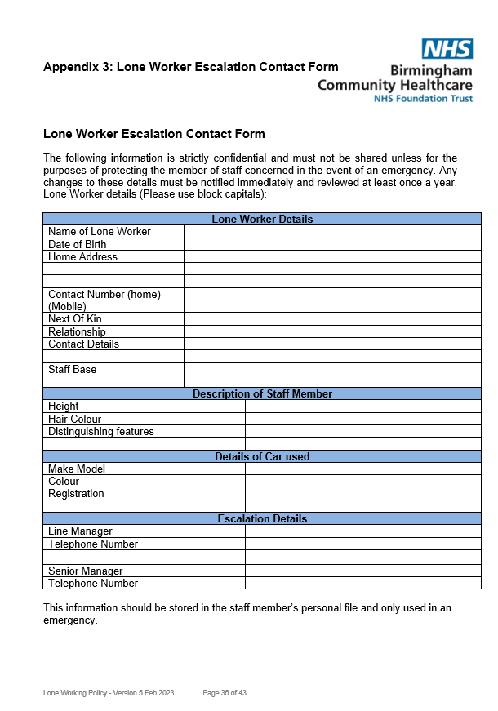
Lone Worker Escalation Contact Form
Every staff member should have completed a “Lone Worker Escalation Contact Form”.
This information is stored securely within the office base (personal file or lone worker folder) or remotely.
It enables the trust to provide the best description to emergency services if ever necessary and provides contact details for NOK if they ever needed to be contacted.
This information is only to be used in an emergency and should be updated at least once per year.

Slide 10
Lone Working and Buddy Systems
All teams have different ways/forms of maintaining staff safety. This is usually in the form of a buddy system or (the current trend) is a Lone Working Whatsapp Group!
To operate the buddy system, an organisation must ensure that the lone worker nominates a buddy. This is a person who is their nominated contact for the period in which they will be working alone. There should be a contingency plan if the buddy is not on duty.
Lone Worker Whatsapp team group’s. This group should be only used for signing in and out of work, informing colleagues that you have either commenced your shift and/or you have finished your shift and have returned home safe.
Whatsapp groups should never be used to discuss patient’s – only in 2023 the ICO (information commissioners office) reprimanded NHS Lanarkshire for sharing patient data via WhatsApp.

Slide 11
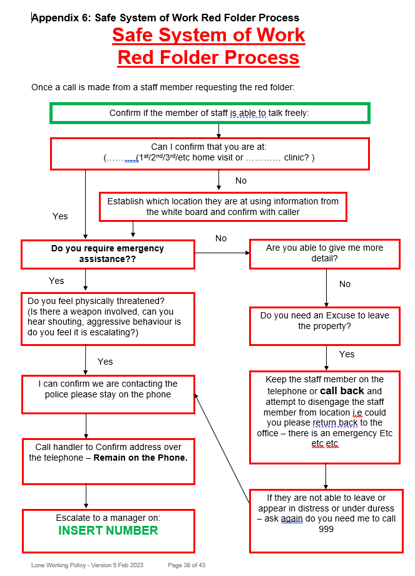
The Red Folder Process
The Red Folder process is a commonly used term throughout BCHC. If a staff member requires assistance and is unable to freely communicate then they can call the office and ask for the ‘Red Folder’.
All staff who receive this call must be familiar with the phrase and answer a set of predefined questions.

Slide 12
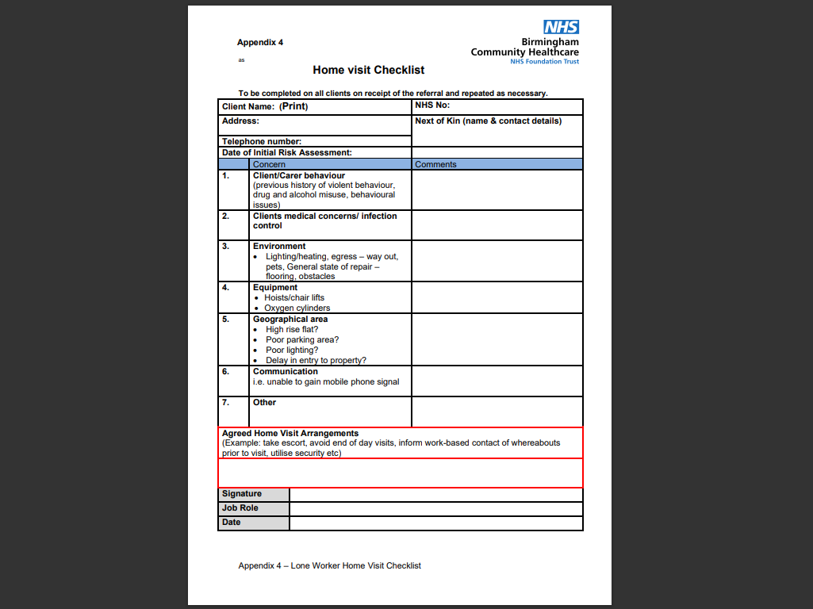

Slide 13
Any questions?

