Slide 1

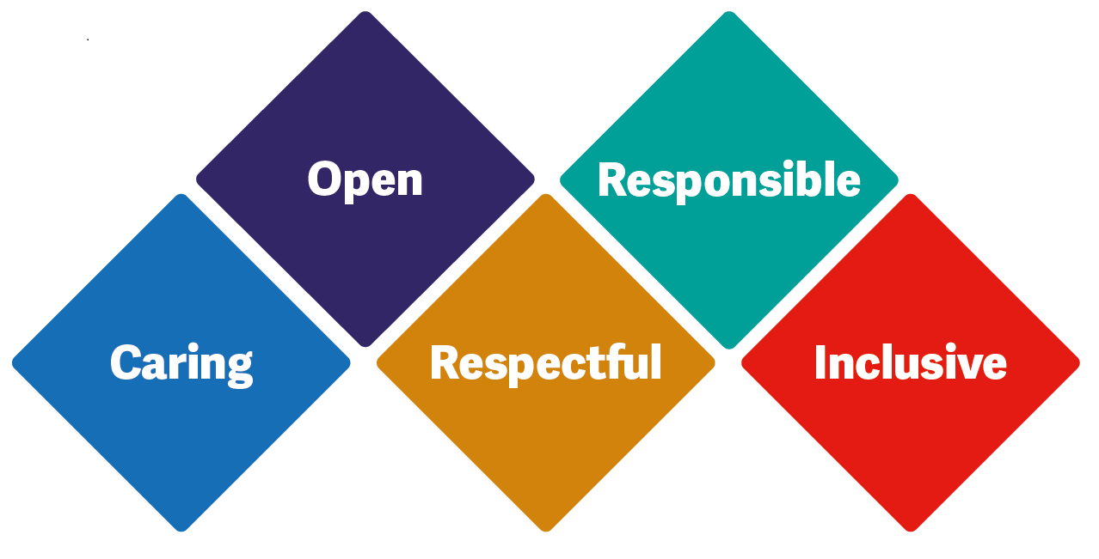

Introduction to Palliative care
Clinical Practitioner Palliative care
Cohort 1 October 2024

Slide 2
Clinical Practitioner Palliative care
One working in each locality – 5 in total
We work Monday – Friday and not on bank holidays or weekends
Support each locality with the quality of palliative care it delivers.
Work with all staff – new starters/ students/ low confidence
Help deliver the trust palliative and End Of Life (EOL) strategy.
Education
Jane Gardiner Central, Sylvia Ferron North, Kirsty Hodson East, Lisa Kennedy South and Kate Pritchard West.

Slide 3
Aims and Objectives
What is palliative care and associated myths.
Who’s involved?
Recognising the deteriorating patient
Please look after yourself in these sessions

Slide 4
What does palliative care mean to you?

Slide 5
Palliative care – World Health Organisation
Palliative care is an approach that improves the quality of life
of patients and their families facing the problem associated with
life-threatening illness, through the prevention and relief of
suffering by means of early identification and impeccable
assessment and treatment of pain and other problems,
physical, psychological and spiritual.”
Notes:
Approach
Life threatening
Prevention
Impeccable assessment- Braoder HOLISTIC ASSESSMENT
Physical may include N/V, constipation, lethargy
Psychological may include anger, regret, fear
Spiritual- meaning of life, faith, hopes, ‘why me?’ What happens when I die?

Slide 6
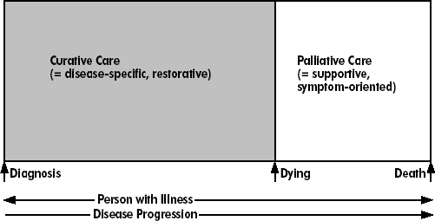
Is Palliative care giving up?
Notes:
So 50 YEARS AGO Palliative care was all about care being given when there was no longer a cure and when patient was deemed to be actively dying. So this is when palliative care stepped in and patients deemed this as ‘giving up’ and was not welcomed. This is NOT palliative care of today- this is a myth!!

Slide 7
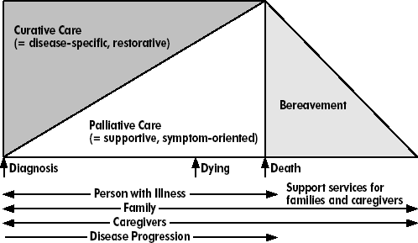
What palliative care is
Notes:
This slide/diagram is a much better representation of palliative care. It shows palliative care spliced alongside disease modifying and restorative care. It is involved with symptom management and care and needs of the whole person- physical, psych, emotional and spiritual.
It also focuses on the family and care givers and not just during the dying phase but before and beyond into bereavement care

Slide 8
What is a good death?
Notes:
What does it feel like? What does it sound like and what does it look like?

Slide 9
Identifying the deteriorating patient.
General expected deterioration
Surprise question
Difficult
Notes:
General deterioration- Very much person centred, not everyone you care for with the same condition will have the same symptoms or die in the same way. There maybe lots of similarities but still could be very different.
Surprise question- ask yourself………Would I be surprised if this person was to die within the next year? If the answer is no you need to make sure everything is in place for this person. ACP, anticipatory meds
Difficult- recognise it is difficult to diagnose and needs to be a multidisciplinary approach

Slide 10
First Steps
It is important that the patient is known to have advanced disease, and that reversible causes of deterioration have been excluded such as; infection, hypercalcaemia or medication changes. ( Watson & Lucas.2008)
Notes:
By addressing all reversible causes you are providing the best possible care for your patient, and helping to confirm this person is entering the last phases of their life

Slide 11
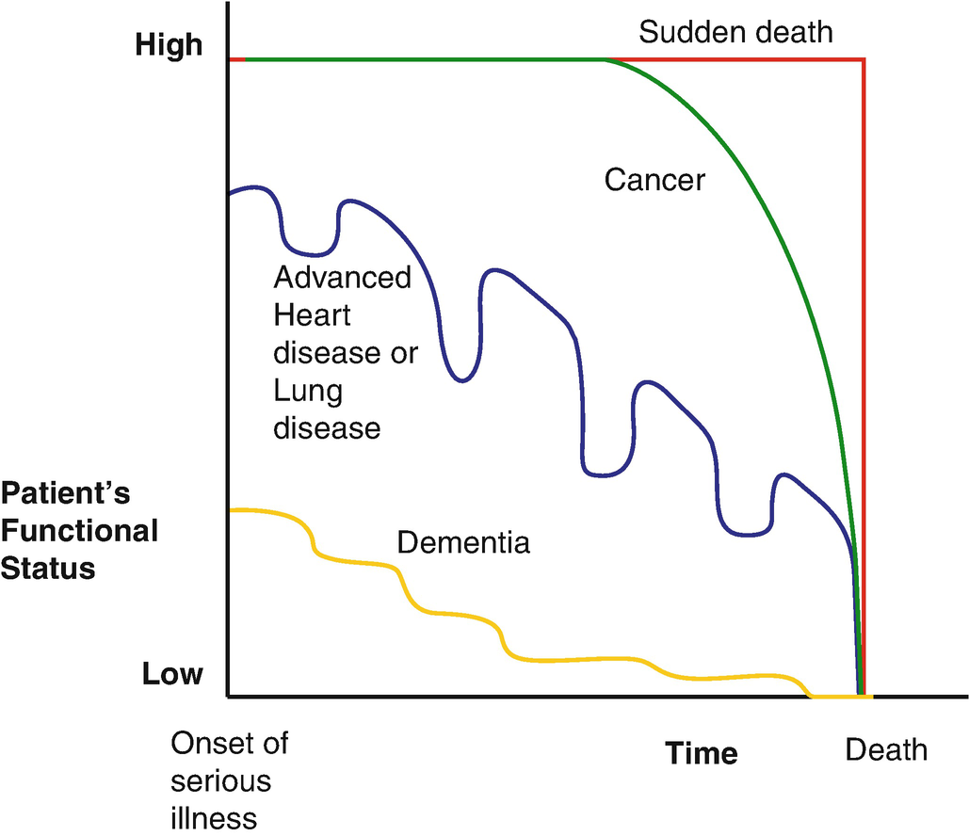
Notes:
This is why it can be so difficult as dying isn’t linear and can be as individual as the person.
Organ failure- each dip in the graph shows a deterioration in the persons condition, possible hospital admission or course of ABX. Each time the person does not recover as well as the last time, meaning that anyone of those dips could be their last.
Frailty/Dementia- difficult as they appear to follow a very steady slow decline
Highlight early ACP – we will discuss at greater length this pm

Slide 12
What indicators shows someone is deteriorating?
Notes:
What things do you look out for/ or what changes do you see?
Warning flags?

Slide 13
Indicators
  The patient becomes bedbound
  The patient is semi-comatose
  The patient is able to take only sips of fluid
  The patient is no longer able to take oral drugs
  Repeated unplanned hospital admissions
  Advance disease
  Multi-morbidities
  Decreasing response to treatment/ reversibility
  Recurrent falls
  Family and other HCP instincts
Notes:
These are general indicators of a person showing signs of deteriorating
Difficulty swallowing is a common indicators of a person deteriorating., and should send alarm bells rings for HCP
it is a good time to start discussions with the patient and their family if they haven’t been started before hand
Mom/dad is struggling to swallow their medications now, this can be a sign that mom/dad is getting more unwell………… what we are going to do is…………..try liquid medications …………we may need to use a syringe driver.
Instinct- if someone has not seen the person for a while and can notice a change. This should be noted.

Slide 14
How do you recognise the deteriorating phase?
When we see someone deteriorating from week to week we are often talking in terms of weeks; when that deterioration is from day to day then we are usually talking days BUT everyone is different. (Watson & Lucas, 2008)

Slide 15
Last 12 months of life
RAG rating green
On the GSF
Multiple comorbidities
Increasing Clinical Frailty Score
Malignancy with a less than 12 month prognosis

Slide 16
Prognosis months/ weeks
May still be able to function independently
May need walking aid or start to need help with ADLs
Increasingly tired
Poor appetite
Reduced interest in social activities
Oncological treatment usually stopped
Increasing Clinical Frailty score
Notes:
Weight loss
Increased frequency of hospital admissions
Re-current falls
Re-current infections

Slide 17
Prognosis – days/ weeks
Reducing mobility
Increasing fatigue
  Sleeping more and more during the daytime
  Reduced engagement in conversation
Progressive global weakness
  Struggling with more basic tasks (feeding, washing etc)
Reduced oral intake
Needing help with ADLs
Notes:
Increased lack of concentration
Withdrawn

Slide 18
Prognosis – hours/ days
Unresponsive
Bedbound
Unsafe/ unable to swallow
Cheyne-stoke respiration
Cold peripheries
Weak, thready or absent radial pulse
Terminal restlessness
Notes:
Mottled skin
Changes to rhythm of breathing
Hallucinations
Terminal restlessness can usually be relieved by reassurance but may sometimes require medication.

Slide 19
Signs Imminent
Non reactive pupils
A decreased response to verbal stimuli
A decreased response to visual stimuli
Inability to close eyelids
Hyperextension of the neck
Involuntary grunting
Notes:
Change in breathing pattern- faster, slower or irregular and may seem to pause at times.

Slide 20
https://www.bbc.com/ideas/videos/dying-is-not-as-bad-as-you-think/p062m0xt
Notes:
Short video clip from Dr Kathryn Mannox a palliative care consultant.
Kathryn Mannox book- With the end in mind, How to live and die well.

