Slide 1
Induction training – enteral feeding tubes
Lesley O’Meara and Trish Finnegan
Community Nutrition Nurses

Slide 2
Objectives
Understand different types of feeding tubes
Know how to provide PEG tube care
Understand your role in prevention of buried bumper syndrome
Know how to provide balloon gastrostomy tube care
Be aware of nasogastric tube care, and how to provide safe care
Know how to seek support, training

Slide 3
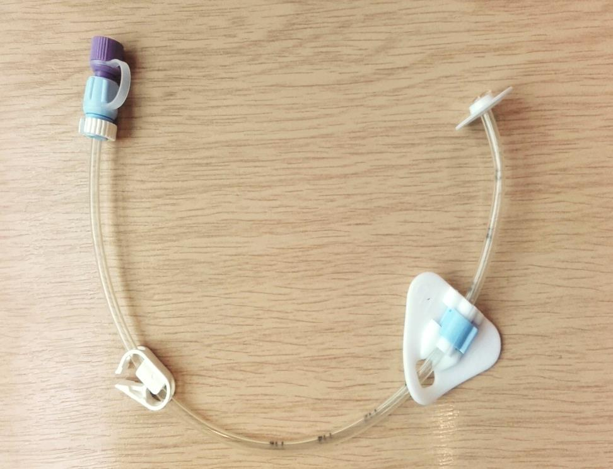
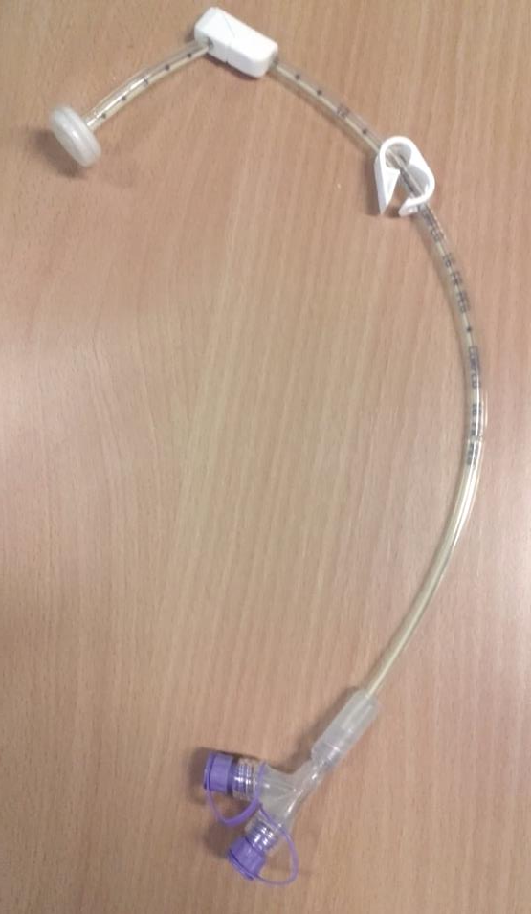
PEG Tube
(Percutaneous Endoscopic Gastrostomy)
15Fr Freka PEG
16Fr Corflo PEG

Slide 5
Buried Bumper Syndrome
This is where the internal disc embeds in the gastric mucosa
Usually results from neglectful care
Triggers datix, safeguarding alert, MHRA report & more
Usually requires hospital intervention to excise bumper and insert new feeding tube

Slide 6
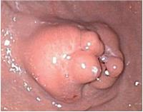
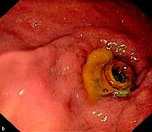
Buried Bumper

Slide 7
Is it a Buried Bumper?
Inability to advance or rotate the Peg tube
Stiffness or difficulty in performing the task
‘Corkscrewing’ of the tube when trying to rotate
Unexplained difficulty flushing the tube/pump occlusion alarm
Discharge/inflammation at the site
Call Nutrition Nurses if concerned if any of the above
If you note any of the above, contact nutrition nurses immediately

Slide 8
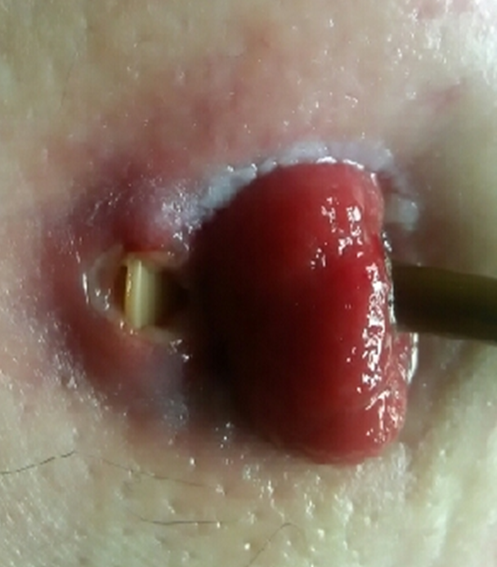
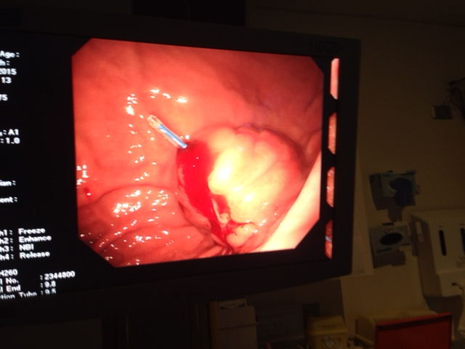
Bumper eroding through skin
Extension tube into stomach via the PEG tube

Slide 9
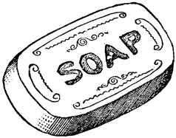
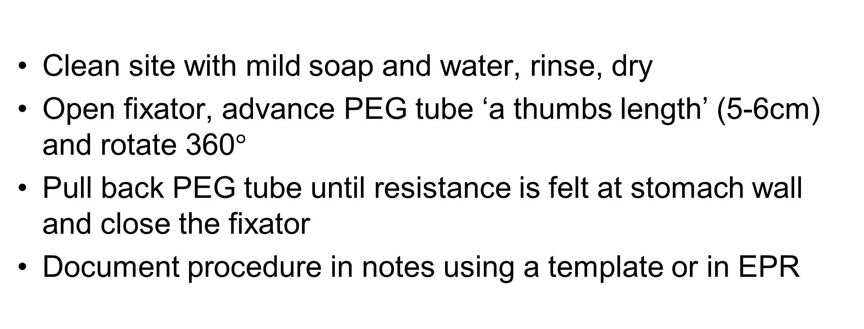
Routine Daily PEG care
Clean site with mild soap and water, rinse, dry
Open fixator, advance PEG tube ‘a thumbs length’ (5-6cm) and rotate 360$°$
Pull back PEG tube until resistance is felt at stomach wall and close the fixator
Document procedure in notes using a template or in EPR

Slide 10
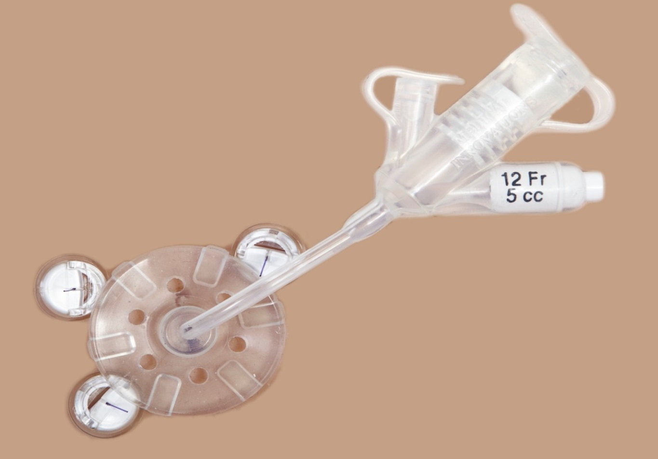
Balloon Gastrostomy Tube (RIG)
Inserted under radiology imaging
Gastropexy discs not attached to tube
Site care as for PEG
Weekly balloon water check
Tube routinely changed 4 monthly

Slide 11
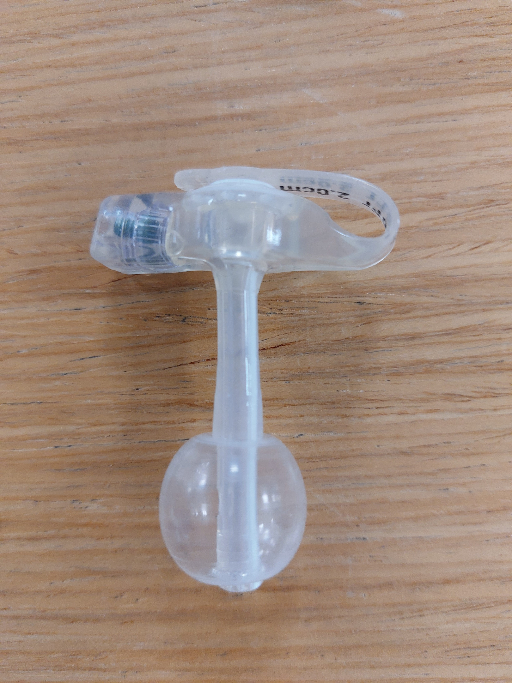
Button – low profile device
Individually sized to patient
Skin care as for PEG
Weekly balloon water check
4 monthly change of tube
Tube is accessed via specific extension device

Slide 12
Medications
All medications must be in liquid/dispersible preparation
where possible – consult pharmacist/medicines
management/Nutrition Nurses for advice.
Nutrition nurses will assess for provision of syringes.
  Flush tube with 30-50ml water
  Prepare each medication separately– dilute if necessary
  Administer using a 60ml purple enteral syringe
  Flush tube with 10-15ml water between medications
  Final flush with 30-50ml water

Slide 13
Common Problems
Tube blockage
Tube damage
Infection
Overgranulation
Tube falls out

Slide 14
Tube blockage
Can be due to feed/medication generally because of poor
tube management.
Attempt flush with warm water using a push/pull action with a 60ml purple enteral syringe.
2. If no success, massage external tube.
Repeat steps 1 and 2 above several times
– may take up to an hour-be patient.
3. Contact Nutrition Nurses for advice. If out of hours, and patient is nil by mouth/needs medication arrange attendance at A&E department.

Slide 15
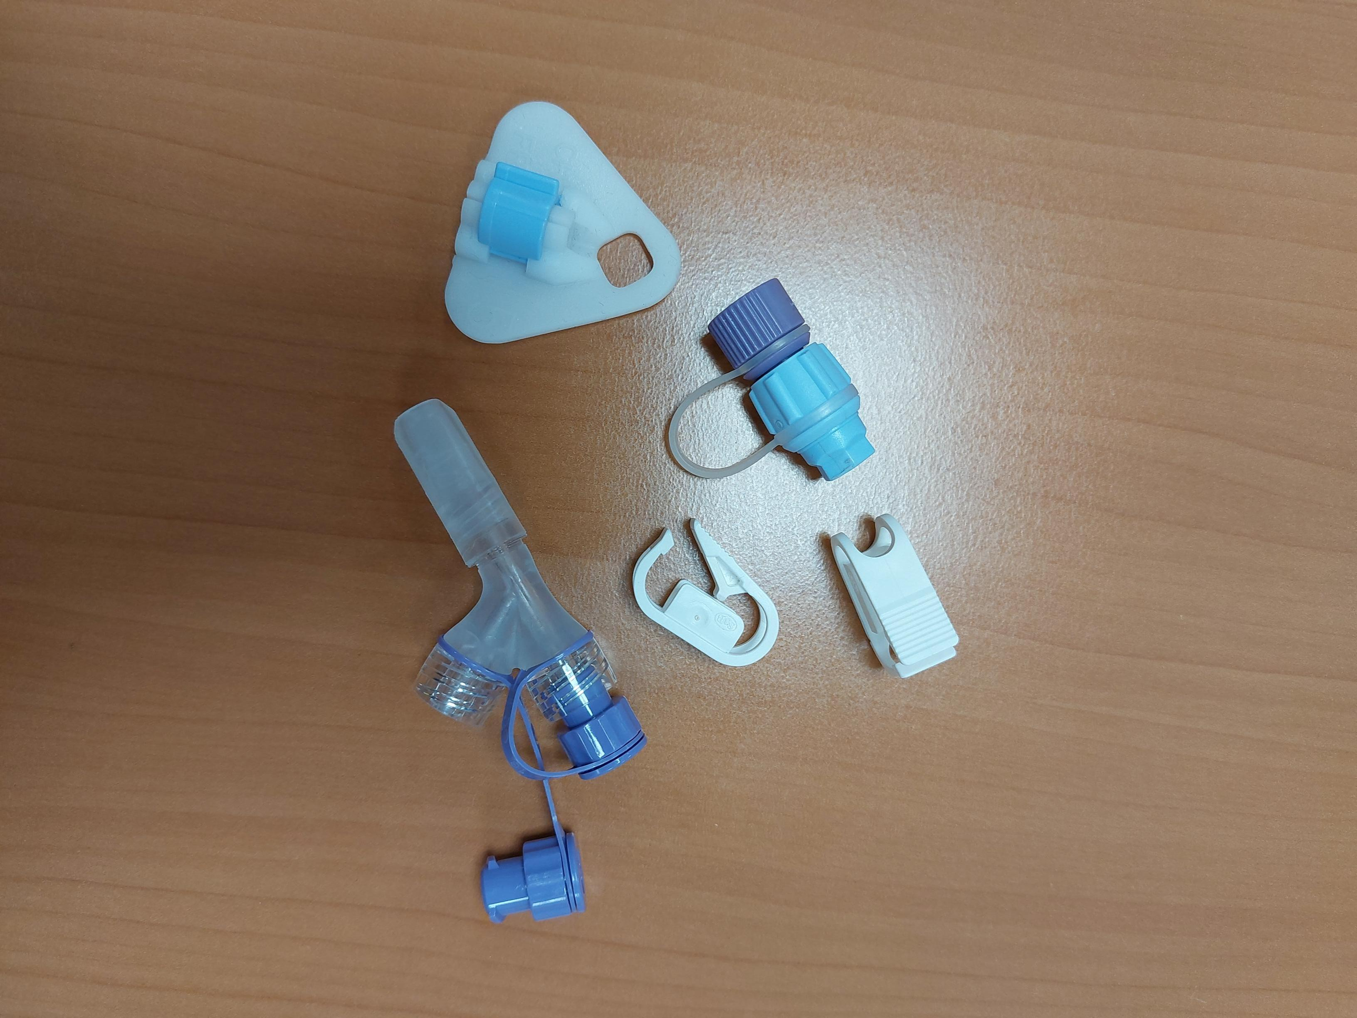
Tube damage
All parts of the PEG tube are replaceable. Spare from nutrition nurses
If tube becomes flattened/twisted/split, please seek advice from Nutrition Nurse Team.
NB - Discolouration of tube is a normal occurrence over time.

Slide 16
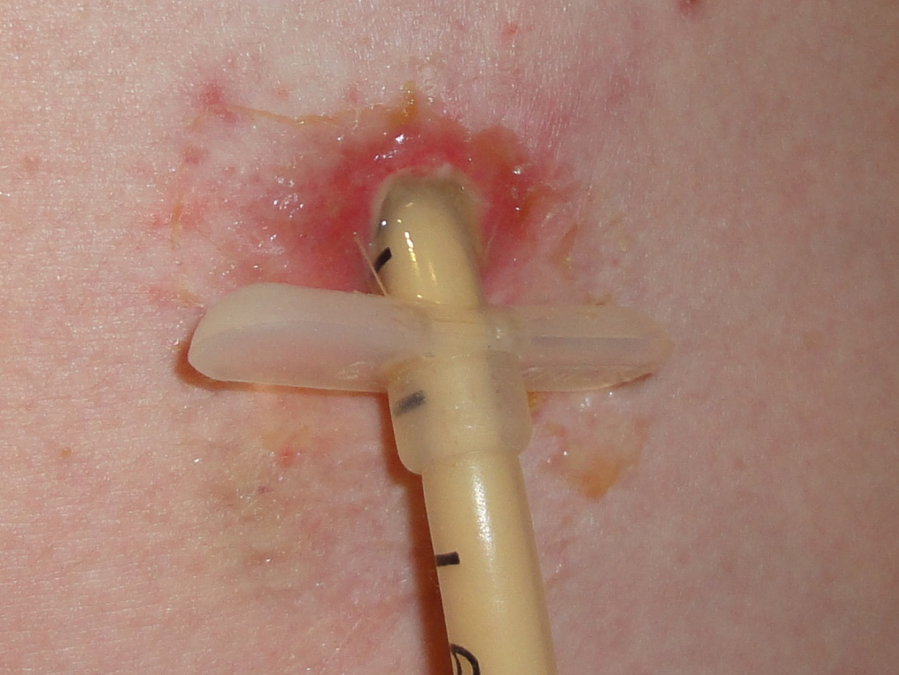
INFECTION
Redness, inflammation radiating from stoma
Can occur at any time during the life of the feeding tube
Assess
Swab (MC&S, spores, candida)
Systemic /Topical antibiotics. Consider antifungals.
Appropriate dressings may be required

Slide 17
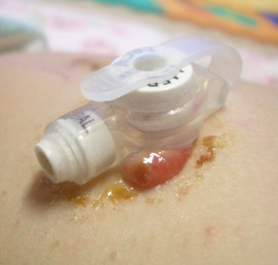
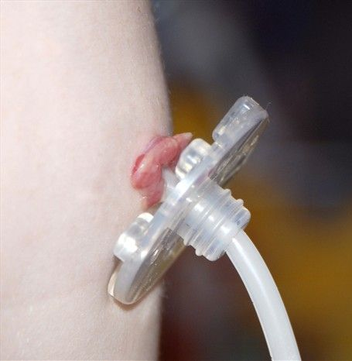
Over-granulation
Causes:
- Poor stoma hygiene
- Incorrect position of fixation disc
- Infection bacteria/yeasts
- Trauma
- Patient predisposition

Slide 18
Overgranulation
Management:
- Ensure stoma site is cleaned using an
un-perfumed soap, rinsed well and dried
thoroughly.
- Correct positioning of fixation disc.
- Eliminate infection as a cause ? swab
- Seek advice
- Treatment options are: creams, dressings,
silver nitrate, antibiotics, antifungals.

Slide 19
Tube falls out
Day 1-28
Do not attempt to insert anything into the tract which has not fully formed.
Cover site with dressing and arrange for A&E attendance immediately
Day 28 onwards
Objective is to preserve tract
Attempt to insert enplug or sterile tube of same Fr size
If none available, consider inserting the old tube.
DO NOT USE THE TUBE
Contact nutrition nurses
If out of hours, send patient to A&E

Slide 20
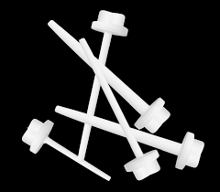
Enplugs (stoma preservation device)
Used to stop stoma tract from closing
Different FR size and 2 lengths
Given to patients following first uncomplicated tube change
Inserted gently into tract and secured with dressing pending specialist input

Slide 21
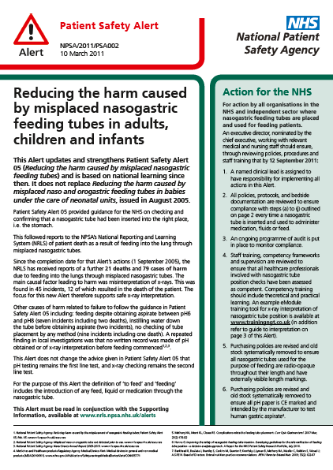
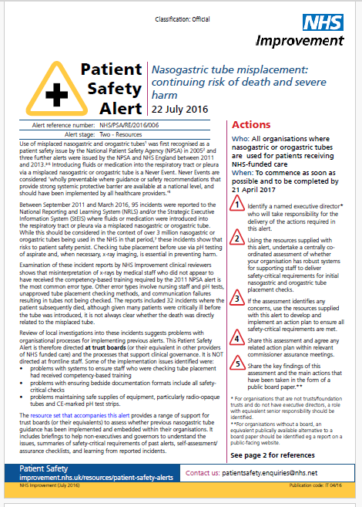

https://www.networks.nhs.uk/nhs-networks/southern-west-midlands-newborn-network/documents/NPSA%20NRLS-1253-Nasogastric%20Alert-08.03.2011-v1.pdf

Slide 22
Why would a patient have a Naso Gastric Tube?
NGTs allow for fluids, feeds and medications to given directly to the stomach if patient is unable to maintain their own nutrition and hydration.
Short-term feeding plan/awaiting long-term feeding tube.
When PEG/RIG is not possible eg Anatomy.

Slide 23
Daily NGT Care
Check NEX and cm marking at nostril.
Change NGT dressing as required (at least weekly) observing skin integrity.
Check pH before tube is used for flushing, feed or medication administration if feed not in progress.
Once tube position has been verified the tube should be flushed with freshly drawn tap water.
Document using paper template or EPR

Slide 24
NEX Measurement
Importance of checking NEX measurement prior to each use.
Troubleshooting e.g if numbers rub off
Tube movement (+/-2cm in adults) must complete aspirate and obtain pH
If tube has moved AND unable to aspirate – DO NOT USE. Contact Nutrition Nurses.

Slide 25
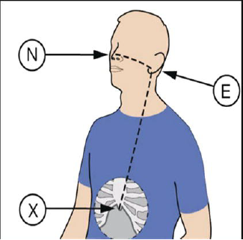
NEX Measurement

Slide 26
NGT pH check procedure
Check pH prior to Each and Every Episode of use.
Check pH sticks are:
In date
CE marked
For human gastric aspirate
Be aware of different brands

Slide 27
There is a risk that an NG tube can become misplaced whilst in use.
An NG tube can become misplaced whilst in use following episodes of vomiting, retching, sneezing or episodes of coughing.
The presence of any new, unexplained respiratory symptoms or reduction in oxygen saturations may indicate tube misplacement. STOP FEED IMMEDIATELY, SEEK MEDICAL ADVICE.
Gastric position must be reconfirmed –
Recheck NEX Measurement AND pH.
NB The absence of respiratory distress does not rule out misplacement or migration eg silent aspiration.
If in doubt DO NOT use the tube.

Slide 28
Other Troubleshooting
NGT is blocked – never attempt to unblock
NGT falls or is pulled out
NGT is broken
NGT is displaced and visible in mouth
Call Nutrition Nurses

Slide 29
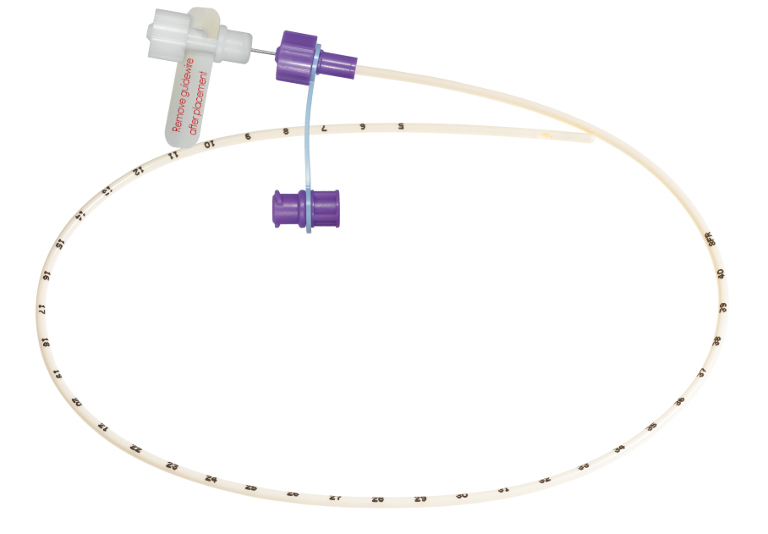
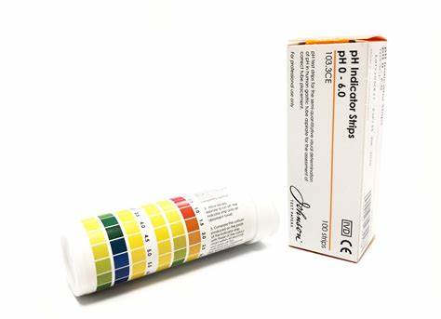
NGT Practice
Time to meet the mannequins

Slide 30
Other tube types
Button (Low Profile Device)
Monarch (Capsule Gastrostomy)
NasoJejunal Tubes (NJT)
Jejunostomy tubes (Surgical Jej) *
* Tubes placed directly in the jejunum should NOT BE advanced or rotated due to the risk of perforation or twisting of the jejunum (small intestine)*
PEGs placed into Jej - PEJ tubes

Slide 31
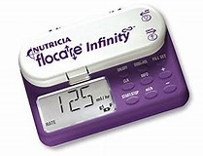
ON LINE PUMP TRAINING:
Link for pump training
https://www.nutriciaflocare.com

Slide 32
Ancillaries
Feed and giving sets last for 24hours
Ensure feed is checked against the feed regime
60mls syringes last for 1 week in the community
Tap water is fine unless patient has jejunostomy or is immunocompromised.
Nutrition nurses will arrange the provision of medication syringes

Slide 33
Prior to undertaking the care/management of any Enteral Feeding tube always check:
Guidance from your line manager on your role
What type of tube is it?
When was the tube placed?
Where is the tube placed (stomach or jejunum)?
If in doubt …. stop & contact the
Nutrition Nurses: 0121 683 2300

Slide 34
Contacting nutrition nurses
BCHC nutrition nurses 0121 683 2300
Monday to Friday 09:00 – 16:45
Nutricia Homeward 03452 501059
Monday to Friday 08:00 – 20:00
Saturday & Sunday 09:00 – 17:00
24 hour advice line 08000 933672

Slide 35
Training
DATES NOW AVAILABLE TO BOOK
Monday 2nd December 2024 – 10:00 – 12:00
Thursday 16th January 2025 – 10:00 – 12:00
Monday 3rd February 2025 – 10:00 – 12:00
Monday 10th March 2025 – 14:00 – 16:00
Venue: Training Room, Ward 4 Moseley Hall Hospital
For training related to a specific patient in care of district nurses please contact the nutrition nurses
To book your place on one of the sessions:
Log onto Virtual Campus and book a place directly via the link in the
Clinical Training Section Course List (bchceducation.co.uk)
Email your Name, ESR Number, Job Title, Base, Contact Number and Line Manager’s Name to bchc.clinical.training@nhs.net

Slide 36
Community referrals
For nutrition nurse or dietetic referral complete referral form website bhamcommunity.nhs.uk/nutrition
Send to referrals.nutrition@nhs.net

Slide 37

Any Questions?

