Slide 1

Frailty
Bhap Guru – Practice Teacher, D/Nursing
bguru@nhs.net
07515 070 201

Slide 2
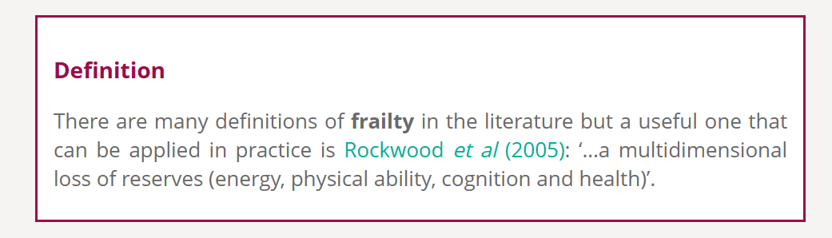





Slide 3
What is frailty ?
Frailty is a long term condition related to the ageing process in which multiple body systems gradually lose their in-built reserves. It is now widely recognised as a state of reduced resilience and increased vulnerability, which results in some older people becoming more vulnerable to relatively minor changes in their circumstances which can lead to a deterioration in their health and/or ability to live independently.

Slide 4
The ‘Person in the Patient’
Every person living with frailty has his or her own unique background, culture, values and experiences, which will in turn influence their personal preferences, needs and priorities in all aspects of their life. Taking a person-centred approach to care, which recognises, values and builds upon this individuality, is essential in helping to achieve the best outcomes for people living with frailty
When assessing – be ‘curious’

Slide 5
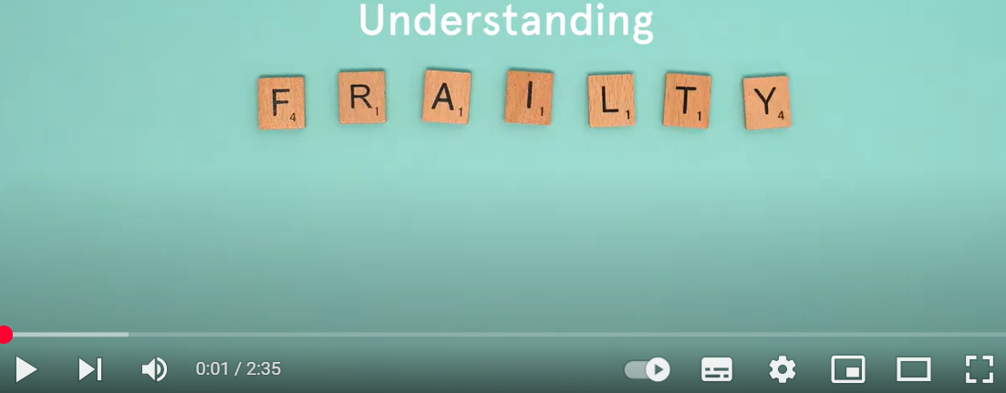
Patient/carer resource: Video link -
Frailty Focus – NHS

Slide 6
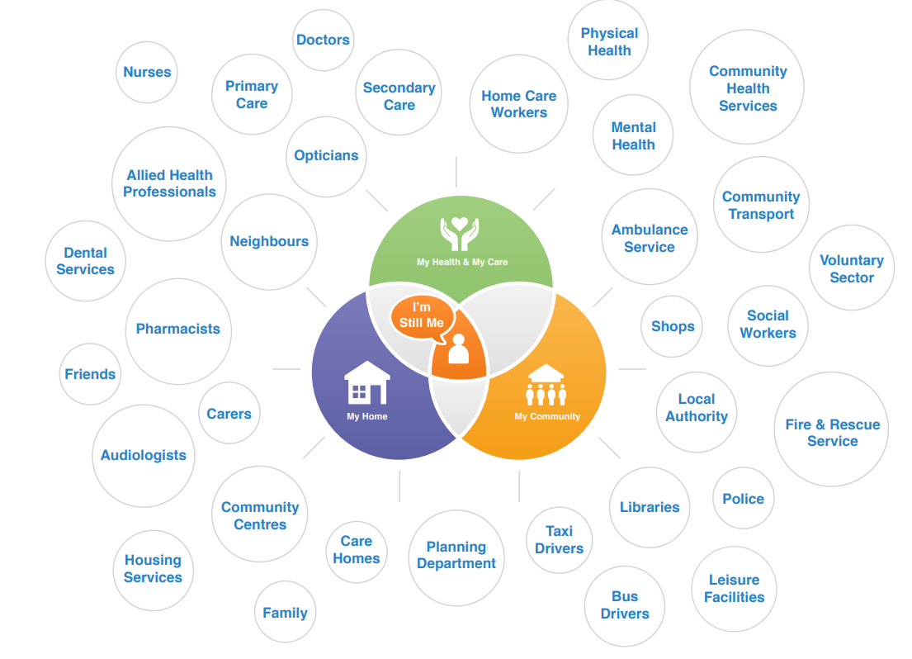
Who does it affect ?

Slide 7
6 core principles of Frailty
1.1 Identifying and assessing social care needs
1.2 Care planning
1.3 Supporting carers
1.4 Integrating health and social care planning
1.5 Delivering care
1.6 Preventing social isolation

Slide 8
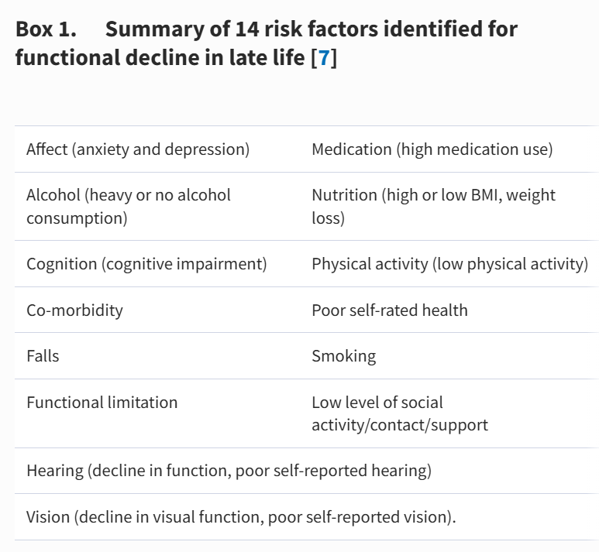
Modifiable risk factors Age and Ageing, Volume 44, Issue 5, September 2015, Pages 732–735,

Slide 9
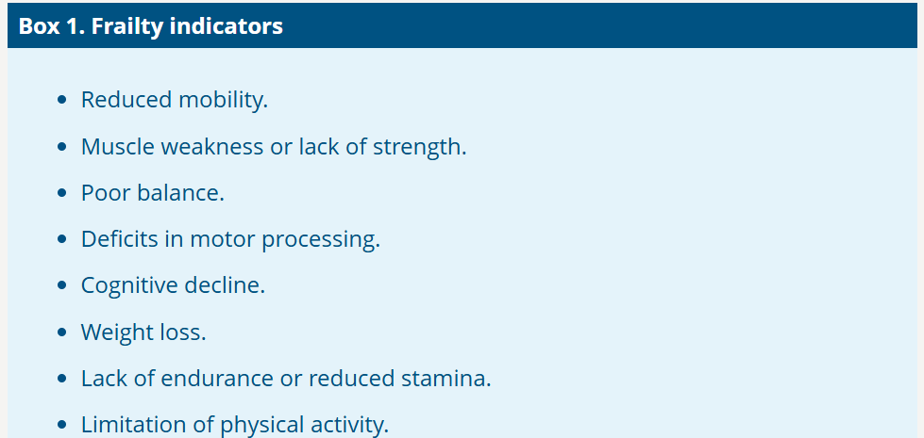

Slide 10
Realistic goals of care and Ceiling of care
What is the intervention/support plan/prevention = what are you expecting ?
Looked at reversable causes ? Eg: high frailty score = high falls risk
Have you had a realistic and honest discussion with the patient/carer to the outcome of your intervention ?
Have you agreed a time frame and review date ?
Do you need to discuss your idea (plan) with a disease specific specialist first (Heart failure team, respiratory, medic)
Is a palliative team already involved
Who else is involved (carer, S/Worker, GP, pharmacist, D/nurses, specialist nurse)
Consider an MDT if different teams are involved to establish 1:Who else needs to be involved (carer/family ?) 2: agree a plan as a team 3: a review date
Avoid repetition…be realistic….empower Pt and carers (resources/signposting)
Unsure ?? Bring back to the wider team for discussion

Slide 11
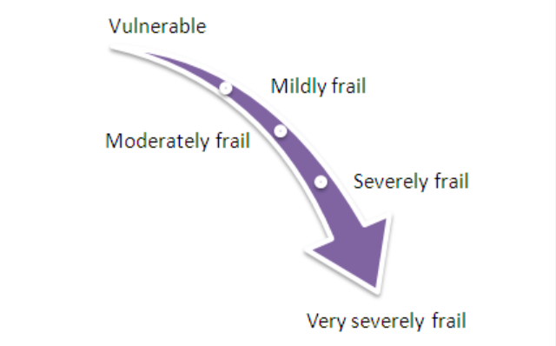
The categories of frailty are (Rockwood et al 2005):

Slide 12
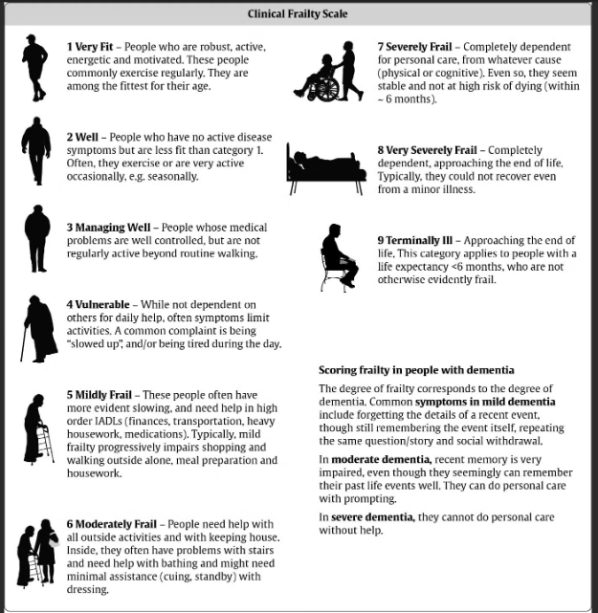





Slide 13
Frailty is a ‘continuum/spectrum’
About 25-50% of people over 80 years of age are frail (Collard et al 2012).
It progresses over five to 15 years.
It has episodic deteriorations.
Early signs of frailty can be detected from mid-life, with decline in cognitive functions such as memory, reasoning and verbal fluency by the age of 45 and age-related decline in walking speed after 30.
Older people often do not engage with the language of frailty and articulate their physical and mental wellbeing in terms of being able to complete everyday tasks independently or not. Good history taking is vital to understand what the patient is telling you.
Ask yourself: would this patient still be alive in 12 months ?

Slide 14
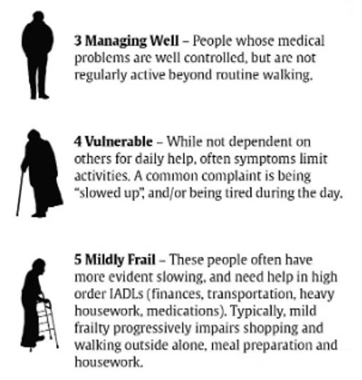
Reversing frailty
Reversible…at what stage?

Slide 15
What is Sarcopenia ?
Sarcopenia is a Greek term meaning ‘poverty of the flesh’. It is the progressive loss of muscle mass that often leads to diminished strength and decreased activity levels, which can then contribute to mobility issues, osteoporosis, falls and fractures.
Sarcopenia is intricately linked with frailty, loss of physical function and the ability to do daily activities, and ultimately a poorer quality of life and even death.
5 Factors responsible for Sarcopenia:
Ageing – Atrophy of muscles related to poor diet and inactivity
Hormone changes (testosterone imbalance) – loss of muscle mass and increased fat reserves
Diseases – acute episodes of poor health have an accumulative effect on reduced muscle mass
Inactivity – sedentary lifestyle
Malnutrition - next slide. ‘Sarcopenic obesity’ - reduced muscle mass due to excess body fat

Slide 16
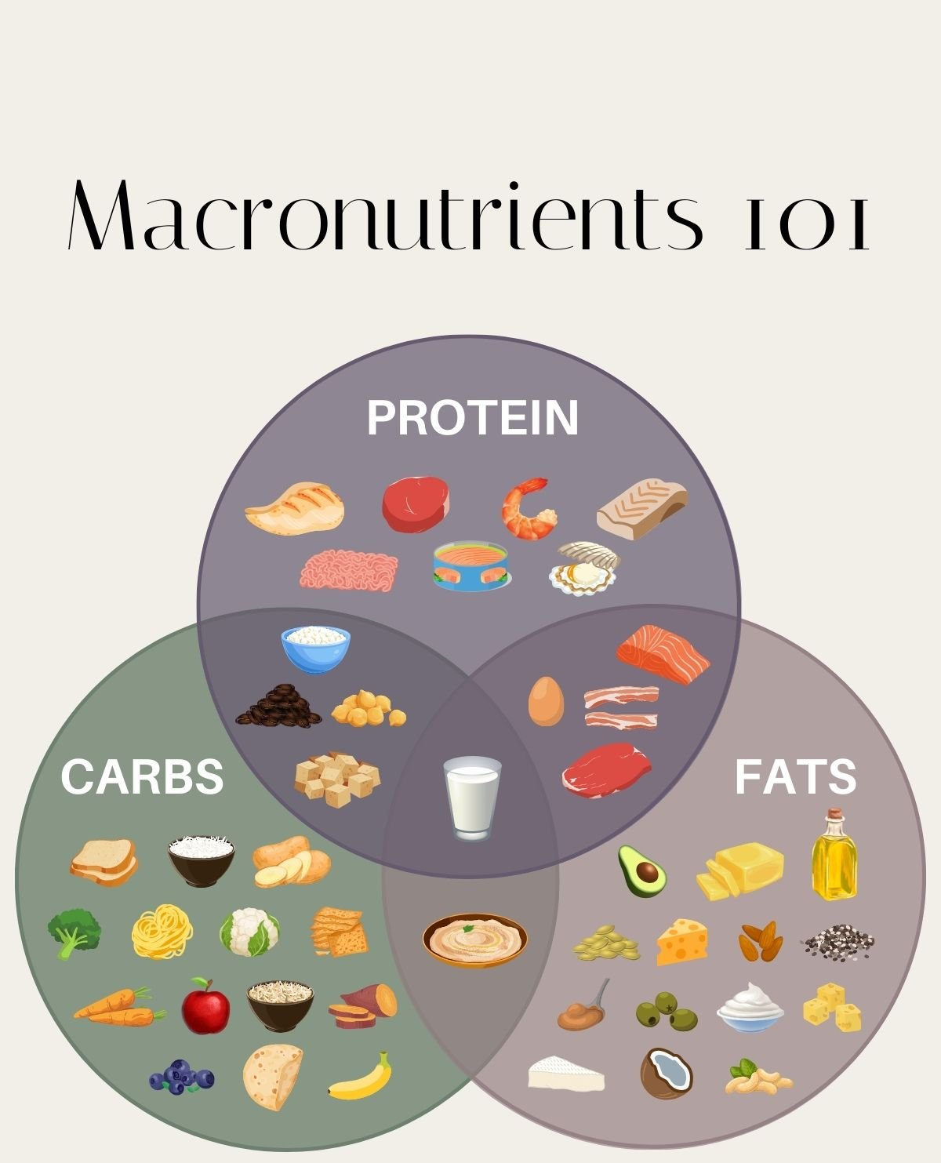
Protein and Ageing linked to Sarcopenia
‘More than half of older people don’t consume enough protein to stay healthy’ -Geriatrics 2020, 5(1), 6; https://doi.org/10.3390/geriatrics5010006 (study group: Aged between 65 -89, participants: 256, Location: south Yorkshire)
Recommendation: older adults need to consume 25-30 grams of protein at each of their three daily meals to stimulate muscle protein synthesis.
What is the balance ? Protein, fats and carbs and ‘Micronutrients’ (Vitamins and minerals)

Slide 17
Reversibility – How ?
Excess alcohol intake. Nutritional compromise….MUST, Hydration, detox
Physical inactivity….social prescriber, carer involvement, physio, OT
Polypharmacy….review, concordance
Smoking…..refer/support
Social isolation and loneliness….social prescribing, care package review.
Vision/hearing problems…..reversable, home visit

Slide 18
Reversibility – How ?
Cognitive impairment……Cognitive impairment tool (tests + diagnosis, treatment ?) Multi-morbidity….managed ? Bloods, meds review Falls…..FRAM (prevention), OT/Physio ass’t, rehab (muscle/bone health, adaptations) Functional impairment….as above, reversable ? Hearing problems….assess/refer/adaptations/home visit ? Mood problems… PHQ9, clinical depression

Slide 19
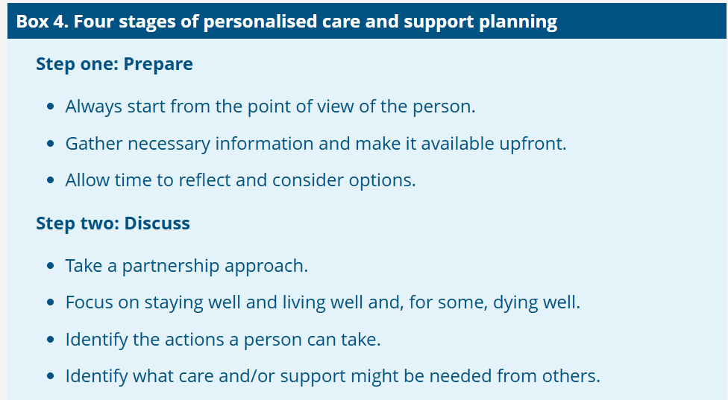

Slide 20
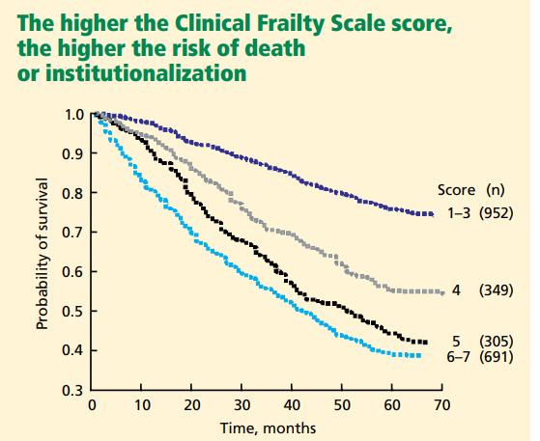

Frailty: Palliative or End Of Life
Frailty has important implications for the care needs of older adults and how those needs are met. By recognizing frailty and measuring it objectively, clinicians can better engage patients and their loved ones in difficult discussions about treatment plans and prognosis, and ultimately deliver better palliative care.
Frailty in older adults: implications for end-of-life care, 2013
Katalin Koller ¹, Kenneth Rockwood

Slide 21
Frailty: Palliative or End Of Life
‘Frailty’ is a palliative diagnosis
Is the patient on the GSF register ? (Gold standards framework) re: blue, Green, Amber, Red – EOL stage. D/W GP if unsure
Be realistic to intervention/adaptations etc if End of life as this stage would be ‘comfort and care’
If palliative – may still benefit from therapy/adaptations, equipment and escalation for treatment so offer RESPECT form to record advanced care planning, wishes etc
DN’s would usually be involved but not always Hospice (for more complex Pts)

Slide 22
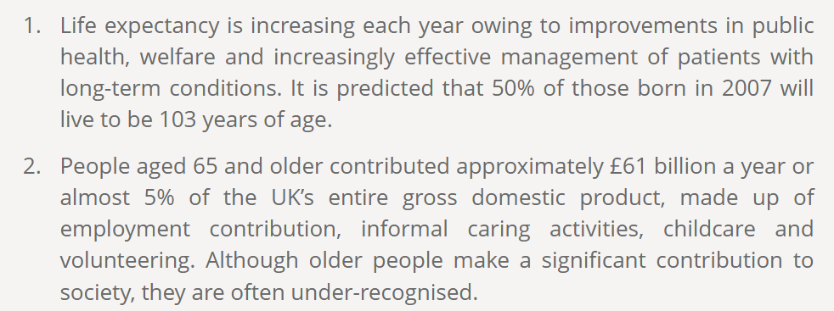

Key facts

Slide 23
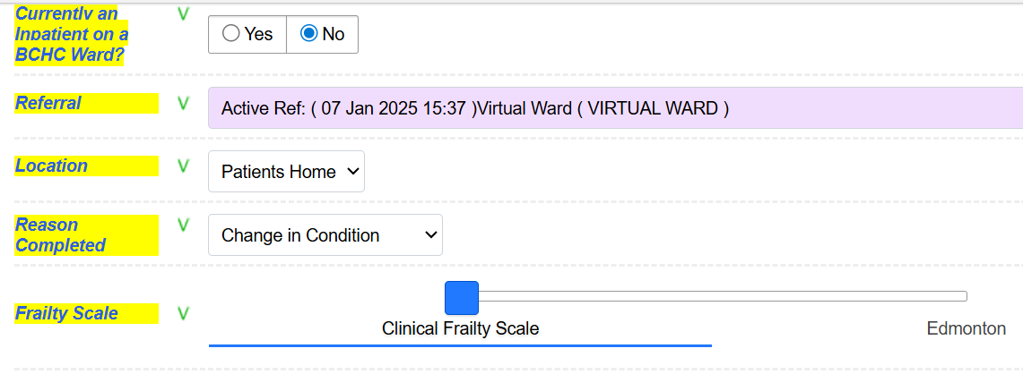
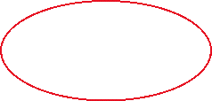

Total Mobile – Frailty Assessment Select CFS not ‘Edmonton’

Slide 24
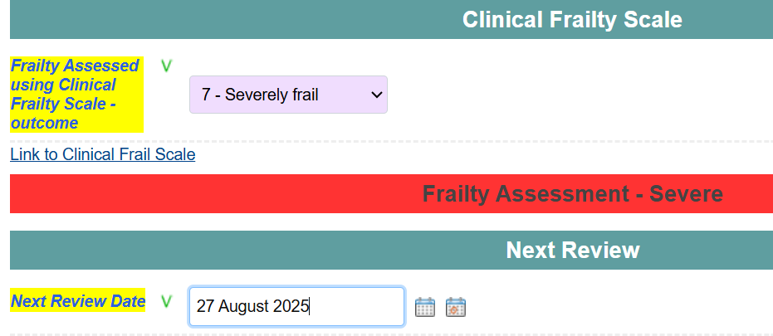

Total Mobile – Frailty Assessment - Score from 1 – 9 (RAG rated), add review date and any additional notes in ‘progress notes’ - The ‘link to CFS’ takes you to the actual tool so you can see the guide for scoring

Slide 25
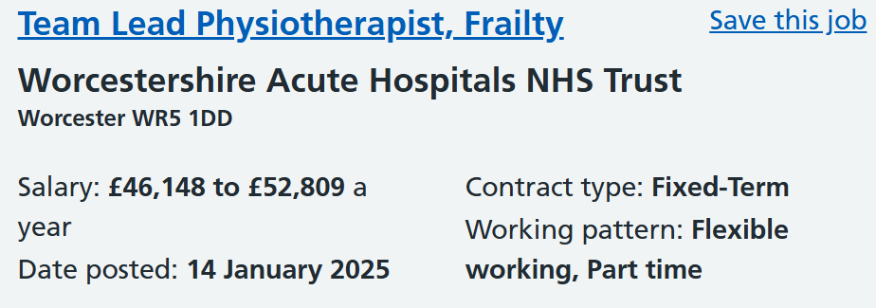
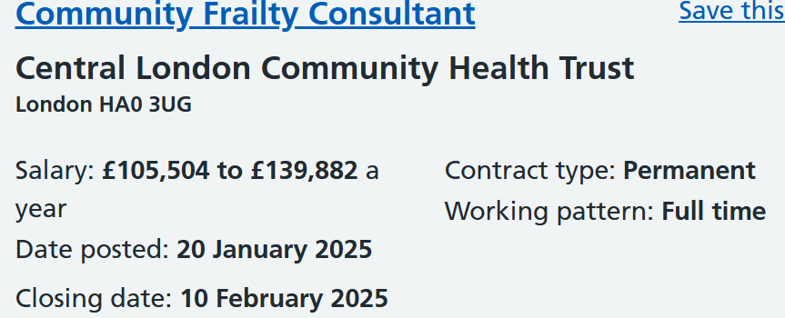
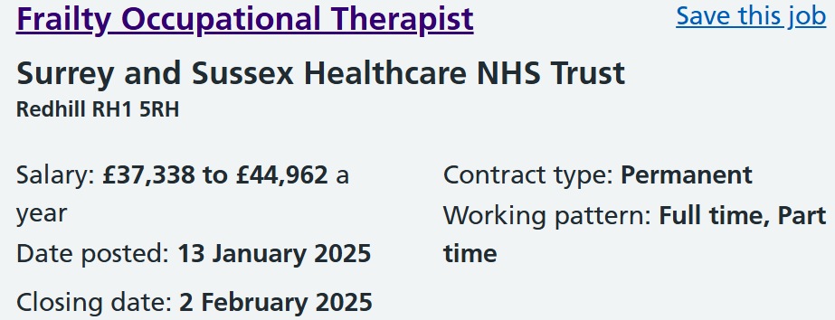
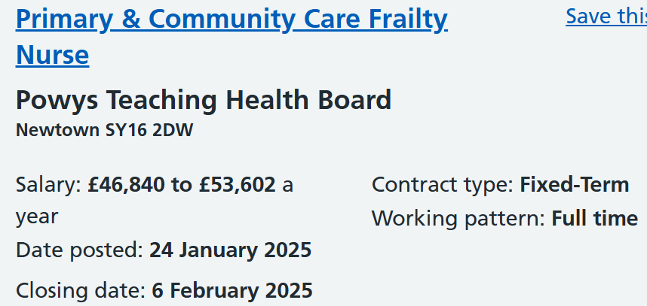
Frailty – is the future !

Slide 26
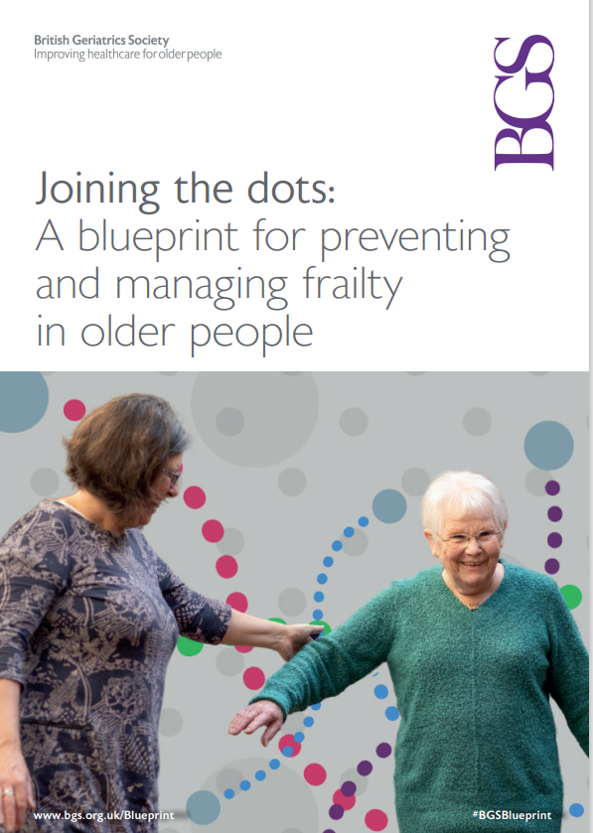
Further reading
British Geriatric Society – see references

Slide 27
Questions ?

Slide 28
References
Skills for health: Frailty framework.pdf
Youtube video: Frailty Focus – NHS
Elearning via Virtual Campus: ‘Reframing frailty as a long-term condition’
, Managing frailty as a long-term condition | Age and Ageing | Oxford Academic -Age and Ageing, Volume 44, Issue 5, September 2015, Pages 732–735
Rockwood frailty scale, Canadian medical association journal, 2005: A global clinical measure of fitness and frailty in elderly people | CMAJ
Frailty in older adults: Implications for end-of-life care Katalin Koller ¹, Kenneth Rockwood
Joining the dots: A blueprint for preventing and managing frailty in older people | British Geriatrics Society
‘Pro-active approach’ - Be proactive: Evidence supporting proactive care for older people with frailty | British Geriatrics Society
GSF Register: Welcome to Gold Standards Framework
Cont……….

Slide 29
References
Frailty in Aging: Biological, Clinical and Social Implications (ISSN Book 41) 1st Edition, by O. Theou (Editor), K. Rockwood (Editor) 2015
Living with Frailty: From Assets and Deficits to Resilience
by Shibley Rahman, 2024
Frailty: A Multidisciplinary Approach to Assessment, Management, and Prevention
by Jorge G. Ruiz and Olga Theou | 29 May 2024

