Slide 1

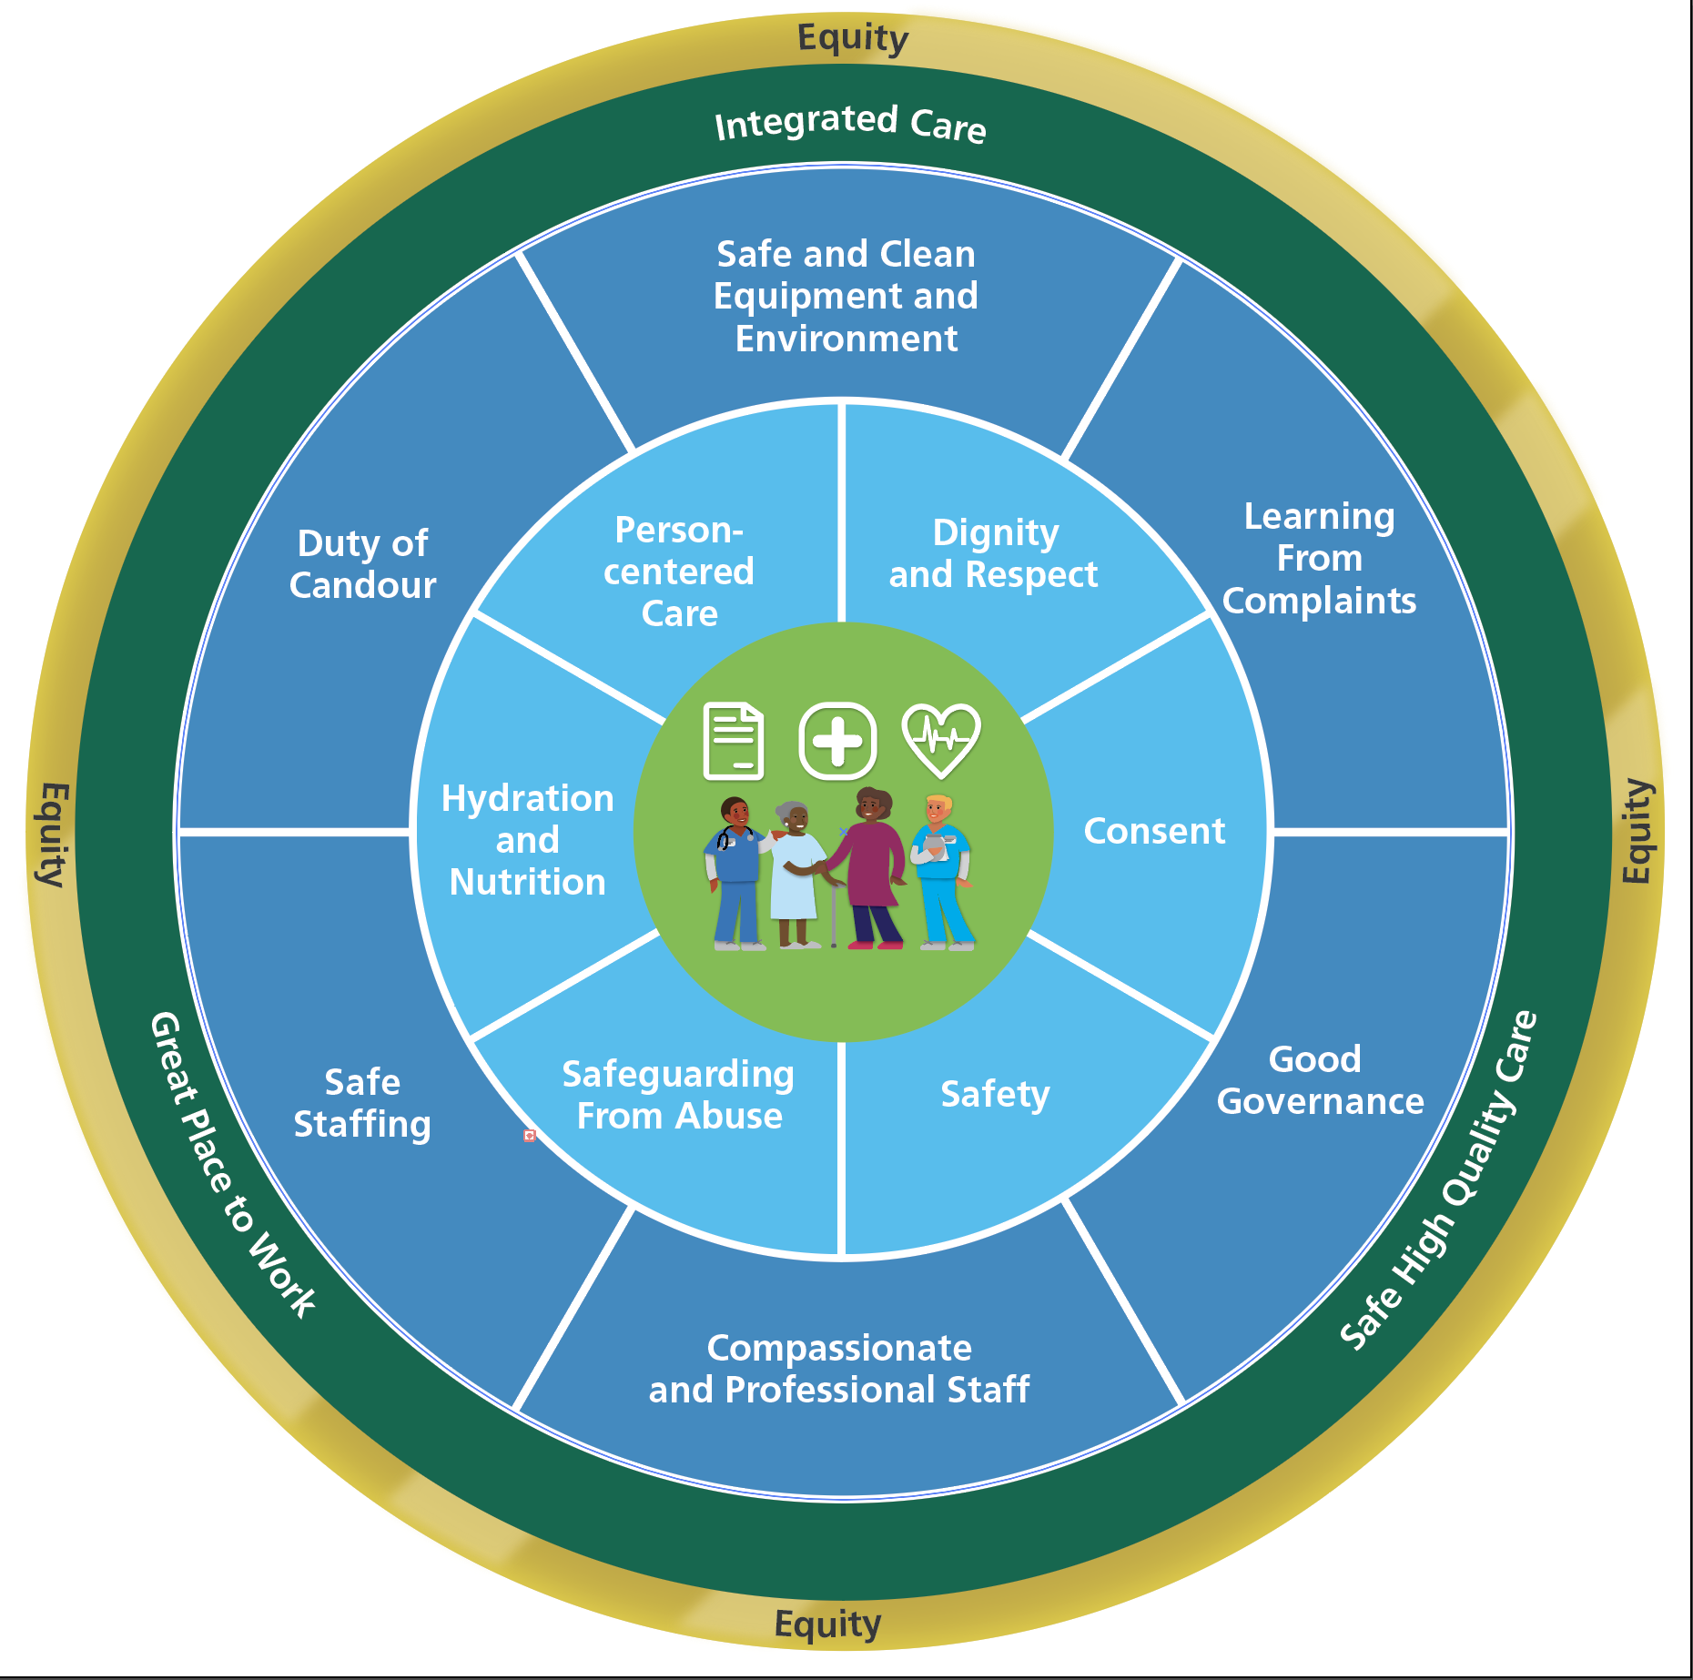

Essential Care Champion Forum
We Care, We Listen, We Act

Slide 2
2
Essential Care Framework
What do we mean by Essential Care?
The essential standards are the standards below which your care must never fail our patients.
What is an Essential Care Framework?
BCHC have developed a set of tools that enable teams to have an Essential Care reflection exercise.
Why is this important ?
Time to reflect on practice helps clinicians assess their achievement and successes as well as identify areas for improvement
What do we hope to achieve?
Essential care becomes the focus of all we do every day, and we can see it, measure it and talk about areas to improve where needed
Notes:
Guidance document
Essential care video

Slide 3
Essentials of Care Infographic

Slide 4

Ongoing learning process
1. Sharing the Vision - Communication
2. Preparation – Engaging the Teams
Logistics - When, where and how
Reflection - Gathering information about care and culture
Action Planning – priotise and action themes and share successes
Implementation – of actions and identification of further improvement ideas
Re-Evaluation
Sharing the Vision - the framework will be shared across the Trust, underpinned by a full communication plan.
Preparation - preparing the teams about the ask and start developing the template for their area .
Logistics – supporting services to identify the time to complete the work. Information to be collated to support the session and facilitators identified where required.
Reflection to take place across teams. This should include time to focus on what teams are most proud of.
Action Planning – teams to identify actions to be taken forward where improvements may be needed.
Implementation of actions - Identify opportunities to put forward to bid for money – ‘small change, big improvement.
Re-evaluate – this should continue to be revised by the team.

Slide 5
Essentials Care Champion
The Role
The Essential Care Champion role is an opportunity for you to support and promote the practise of Essential Care.
Inspire and recognise great high-quality care
Be a point of contact for colleagues who require support with Essential Care
Share Essential Care information with your colleagues
Support professional leads/DDNTs in recording and monitoring Essential care within the divisions.

Slide 6
Essential Care Reflection
Approach
Protected time: Teams are to ensure protected time is booked in advance to review their practice against the 12 indicators and identify their successes and areas for improvements.
Guidance document: Teams should use guidance documents provided with generic prompts. Team leads will be asked to further develop these to ensure it is bespoke to each service.
Information: Ensure information is provided before the session to enable a robust conversation to take place. Identify your facilitator and notetaker, external facilitation support can be requested should team require this.
Reflection: Opportunity to put forward ideas for improvement
Each team will generate an overview of their success story and any areas they want to focus on going forward.
Teams will progress improvement ideas/projects through the QI Huddles
Group clinical managers/ Professional leads will gather themes and share with Divisional Directors of Nursing and Therapies for that area.
Reach out to Quality improvement team to support with improvement projects as needed
Notes:
Complaints/ PALS, FFT/ What Matters to Me, Incident Data, Learning from Excellence, Compliments – on datix and patient feedback (thank you cards), Essential Care Indicator Dashboard, Early warning alerts, Quality walks
Patient led assessments of care (inpatients), Safeguarding/ DoLS, Record keeping audit, IPC audit,

Slide 7


Utilising Quality Improvement Huddles for Essentials of Care
Objective: For all staff to be able to put forward ideas for improvement
What is a Quality Improvement Huddle?
1. Sharing the Vision - Communication
2. Preparation – Engaging the Teams
Logistics - When, where and how
Reflection - Gathering information about care and culture
Action Planning – priotise and action themes and share successes
Implementation – of actions and identification of further improvement ideas
Re-Evaluation
Quick, stand up discussion (10-15 mins)
QI HUDDLE
Each of these elements can feed into the Qi Huddle. After reflection, Improvement ideas can be added to the Qi Huddle board, and a team discussion then takes place in how to best take that improvement idea forward.
As improvement ideas are generated, they move around the Qi Huddle Board into corresponding sections as they naturally progress as improvements.
Takes place regularly (once per week suggested)
Essentials of Care Model
Open to all staff, of all roles, bands, professions and specialties
As a group, the team will decide which improvements to take forward
Supported by QI Buddies / QI Coaches to guide on improvement tools and support improvement ideas

Slide 8
Essential Care Video
BCHC Essential Care Framework

Slide 9
Intranet landing page
Essentials of Care | Intranet (bhamcommunity.nhs.uk)

Slide 10
Divisional approach
The new approach we have taken within the division is that we will have a monthly focus on the framework within every team and service. As there are 12 fundamentals of care we have aligned one to every month to allow that focused approach
These have been aligned where there maybe a local or national focus week or month i.e. safeguarding month in November.
To support you and your teams to spend sometime through out the month we will send through a slide each month with some information about that months ECF fundamental to enable you to have those conversations in the team.

