Slide 1
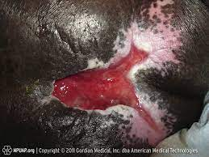
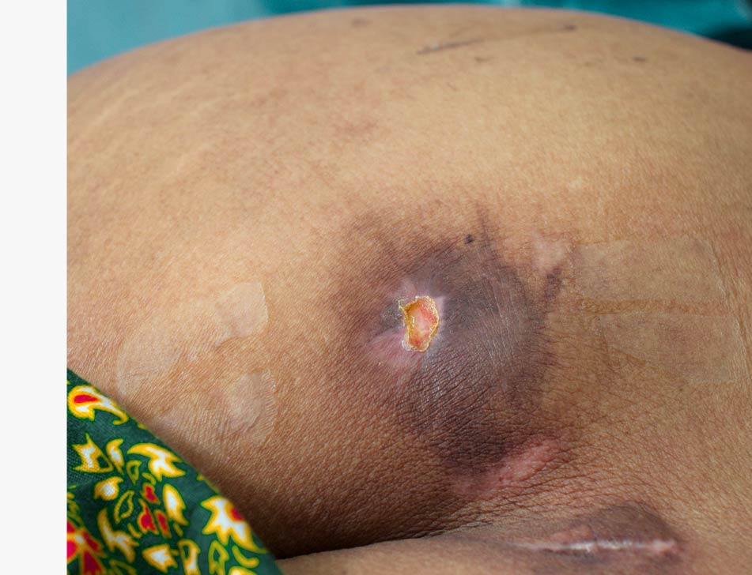
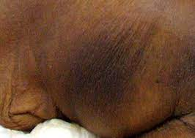
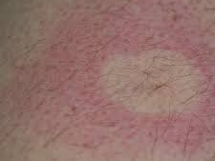
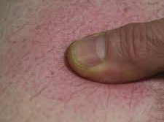
Recognising Skin Changes from Pressure in Individuals with Dark Skin Tones

Slide 2
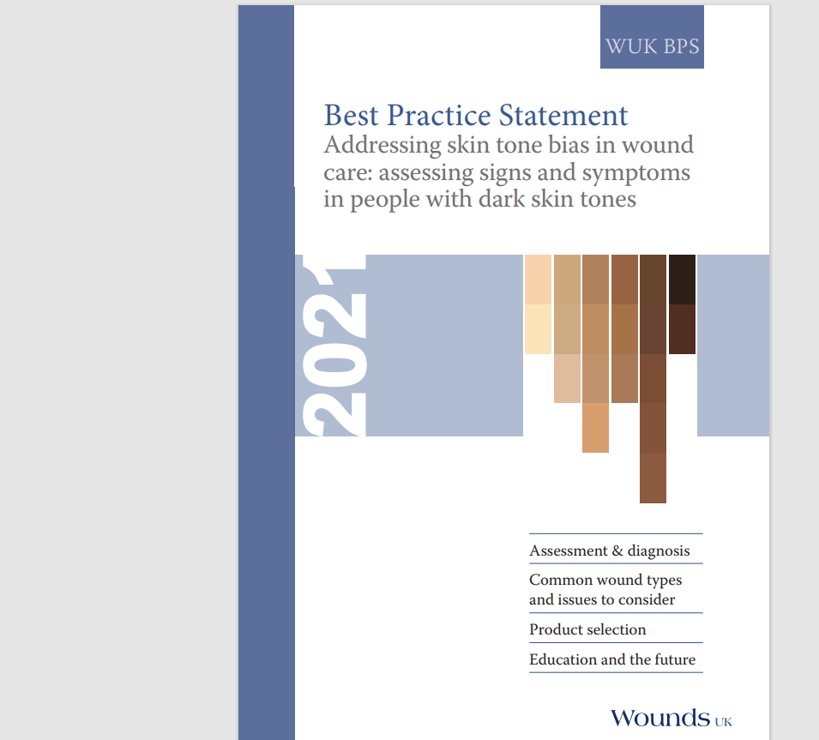

Background
People with dark skin tones are disproportionately affected by more severe pressure ulcers
There is no straightforward way to predict exactly what colour erythema will look like in an individual’s skin. It is dictated by a person’s skin tone
Other signs, which even if not clearly visible may become more obvious upon touching the area in question
https://www.youtube.com/watch?v=9vuV_xiFYoc
Bing Videos

Slide 3




Pressure Ulcer or Something Else –
Ask these questions!
Sustained
pressure
History/Cause
Location
Appearance
Bony prominence or under a device
Circular or oval shaped

Slide 4
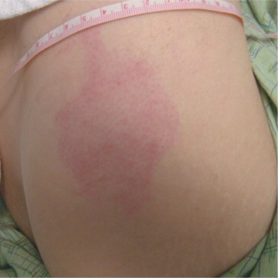
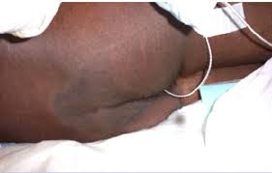
Skin Inspection:
Identifying Early Signs of Pressure Damage
Caucasian skin
Dark toned skin
Persistent blanching erythema – redness from pressure should resolve within 20 minutes of off-loading
Non-blanching erythema = category 1 PU
Maroon discolouration
Purplish/violet, bluish discolouration
Grey discolouration
Taut, shiny skin

Slide 5

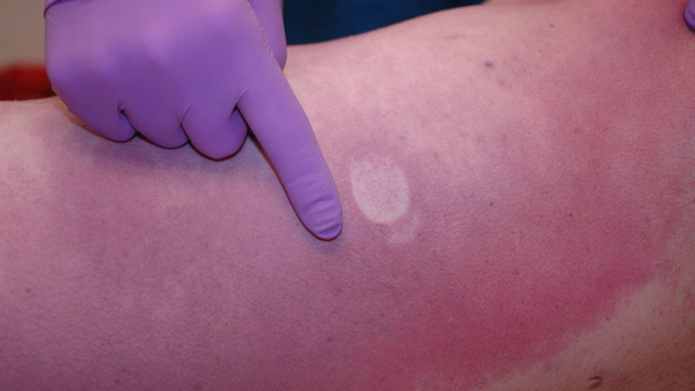
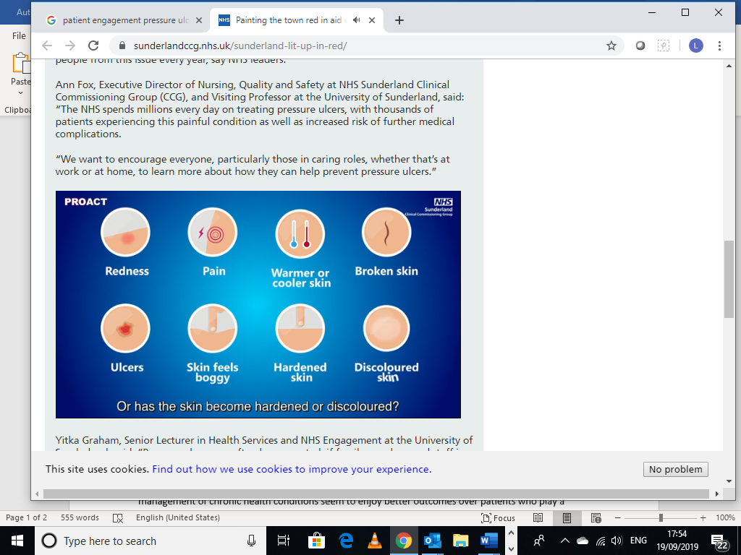
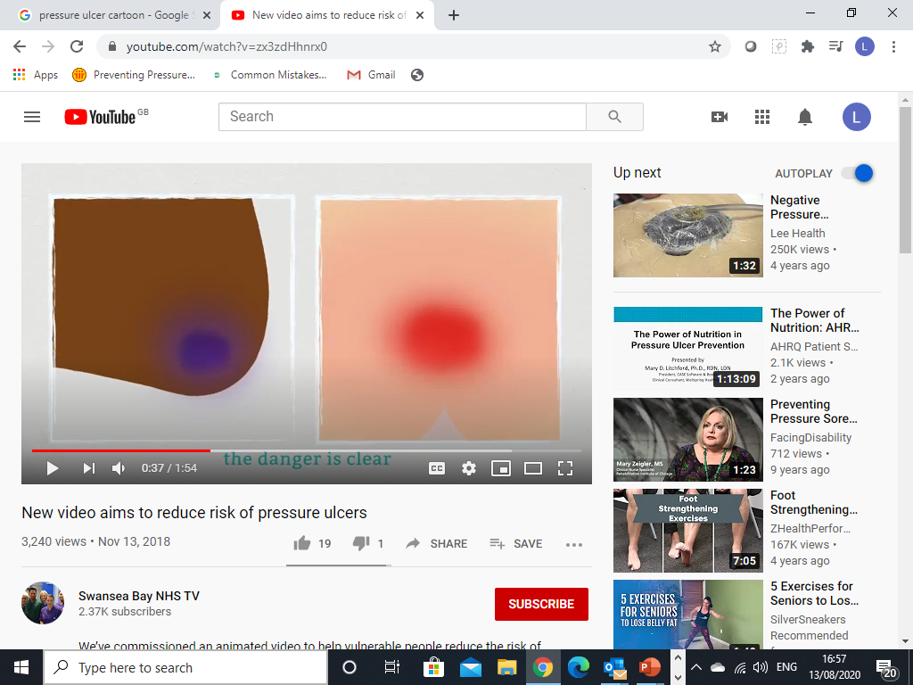
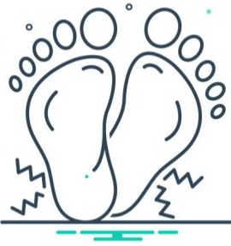

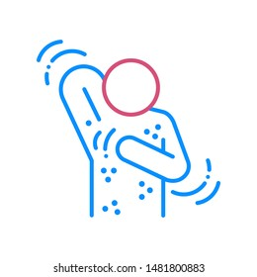
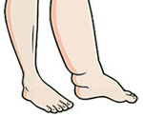
Skin Inspection - What to look for
Persistent Blanching Redness
Hot or Cold Skin
Painful, Sore
Non- Blanching Redness
Spongey, Soft, Boggy
Numbness
Discoloured or Purple
Hardness
Itching
Oedema
Look-Listen-Feel

Slide 6
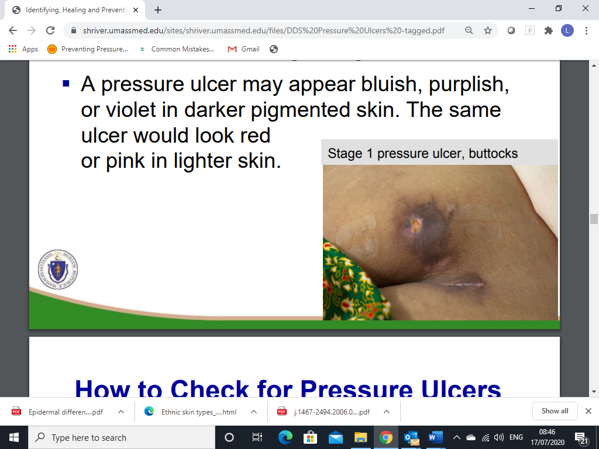
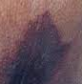
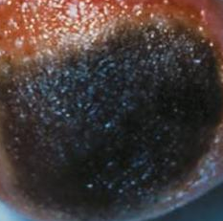
Case Scenario
On discharge from hospital Mrs Charles had a circular area of dark discolouration on her low back, presenting as a darker tone to her own skin. It seemed warmer compared to the surrounding skin.
The community nurses visited 2 days after discharge & found that she had a very dark purple coloured area on her low back, which felt soft & cool to the touch compared to the surrounding skin & was demarcated .
Within a week the area broke down to form a unstageable pressure ulcer

Slide 7

Top Tips for Assessment
Use good lighting to check the skin
  If possible, position the patient so that their skin is in natural light
  A pen torch or mobile phone light might be of help if this cannot be done
  It should be noted that fluorescent light casts a blue tone on darkly pigmented skin & should be avoided
Compare the colour of the affected area of skin (i.e. subjected to pressure) to the adjacent skin to ascertain if there are any changes in pigmentation
Palpate the skin in areas that may have been exposed to pressure to check the skin temperature & for any texture changes. Is oedema present? Use the back of your hand & remove your gloves to feel a change in skin temperature
Be aware of variation in presentation of deep tissue pressure injury (DTI), which can range from maroon, purple, blue, grey, brown & black in darker toned skin
Notes:
Rarely show the blanching response, and erythema may be hard to detect.
Moreover, skin irritation to people with DSTs may cause hyperpigmentation or hypopigmentation with no redness visible

Slide 8
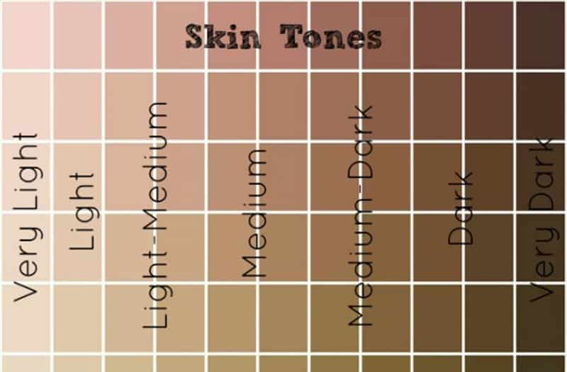

Top Tips for Assessment
https://wounds-uk.com/wp-content/uploads/sites/2/2023/02/191ac9b79f47de2896cf1a30f39037f5.pdf
Describe variations in skin colour using an objective system
Enhance your visual assessment by moistening the skin. Dark toned skin can be dry & ashen-looking. Moistening with tap water will rehydrate the epidermis to improve inspection
Check for pain & discomfort over the suspected area. Is there an alteration in sensation in response to either inflammation or ischaemia?

