Slide 1

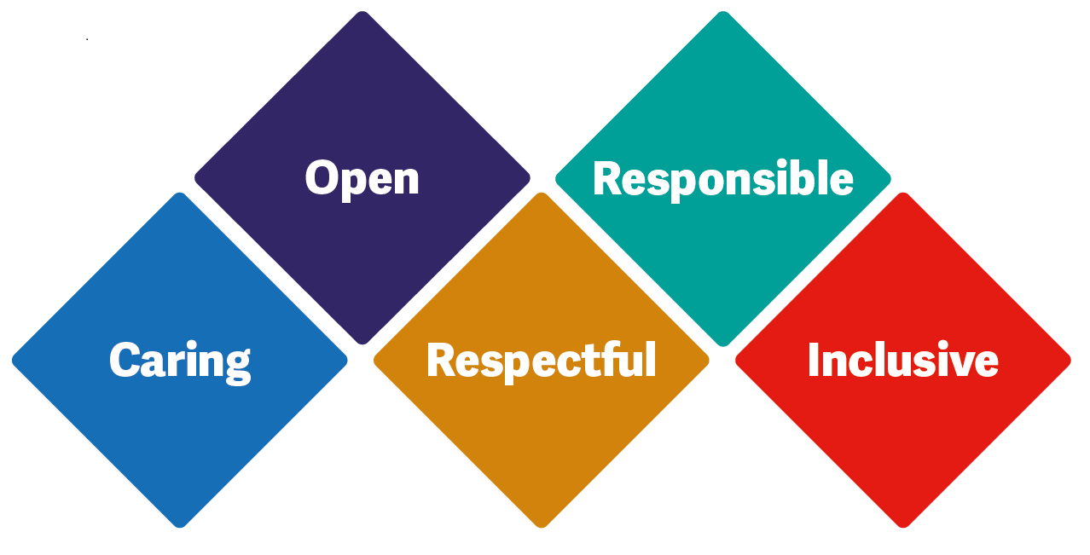

Group work
Case study

Slide 2
Case study
Sally is a 58 year old female, lives alone in a ground floor flat. She is divorced but has a long term partner that she does not live with. She has 3 children aged 35, 32 and 28 and 3 young grandchildren. She works full time in a bank but is currently long term sick.
9 months ago Sally went to GP with nausea, vomiting and difficulty in swallowing. Following a 2 week referral she had a number of tests and on biopsy was diagnosed with Stage 4 Oesophageal cancer. She was offered and accepted chemotherapy for symptom management and in a hope to extend her prognosis. She tolerated 4 cycles of chemotherapy before being admitted with sepsis. Chemotherapy has been stopped and Sally is for supportive care and symptom management. She has been referred to the DN service for palliative care and is green on the GSF.
In groups consider your priorities and what you may consider as part of your assessment.
Notes:
Each group is to move from one flip chart to the next – flip charts to be marked as the following
Initial assessment
2nd visit
3rd visit
End of life care

