Slide 1

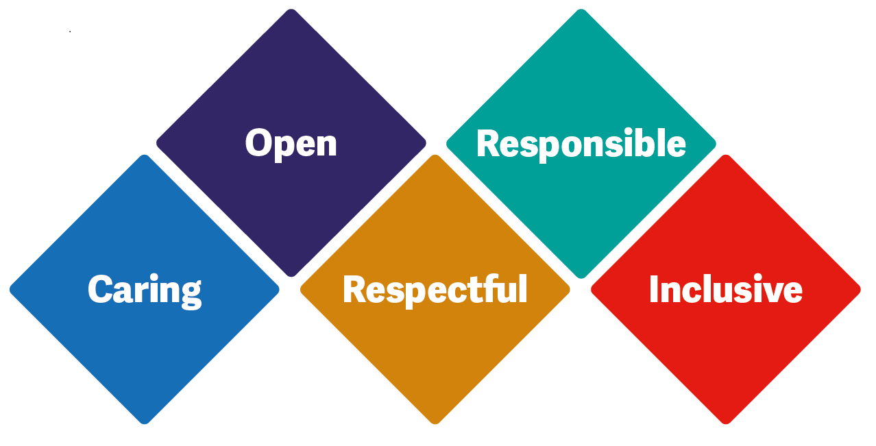

Care of the dying
Symptoms at End Of Life
Cohort 1

Slide 2
Aims
Identify the five priorities for care of the dying person
Recognise the point where the patient may be entering the dying phase
Be able to care for the patient (and carers) holistically in their final days and assess and manage symptoms effectively
Recognise appropriate and inappropriate care pathways and the importance of effective communication and MDT working

Slide 3
Dying phase
Evidence of ongoing deterioration despite active treatment indicative that their condition is irreversible
Profound weakness
Being bed-bound or comatose
Little interest in food/fluids
Unable to swallow tablets
Changes in breathing pattern
Skin changes due to peripheral vasoconstriction
Notes:
The assessment that a patient is in the last days of life should be made by the multidisciplinary team in discussion with the patient and relatives as appropriate.

Slide 4
5 Priorities of Care
Recognise that the person is dying.
Communicate effectively with the dying person and those important to them.
Involve the dying person and those identified as important to them as much as they want to be involved in the decision making.
Support the needs of families and others identified as important to the dying person.
Create an individual care plan.
Notes:
When it is thought that a person may die within the next few days these 5 priorities of care for a dying person should be met.
The 5 priorities of care was Launched by the department of health and welcomed by CQC 2014
5 priorities replaced Liverpool care pathway
Leadership alliance for the care of dying people (LACPD)- one chance to get it right independent review of LCP.

Slide 5
Common symptoms in the last 48hr
Drowsiness
Restlessness and Agitation
Pain
Breathing changes
Breathlessness
Respiratory secretions
Change in swallow
Nausea

Slide 6
Drowsiness
Signs
Withdrawing from conversation
Harder to wake
Management
Manage possible new incontinence
Pressure area checks and regular repositioning
Medications review
Notes:
Medication review- other routes for medications such as morphine- maybe a good time to have conversation regarding possible syringe driver in the future.

Slide 7
Restlessness/ Agitation causes
Adverse effects of medication (e.g. opioids, steroids)
Pain
Constipation
Urinary retention
Hypoxia
Hypercalcaemia
Infection
Uraemia/ hepatic encephalopathy
Primary brain tumour
Cerebral metastases
Spiritual distress
Notes:
When considering whether or not to treat these causes of confusion or agitation, the burdens of treatment need to be weighed up against the potential for improving comfort at the end of life.
It may be difficult to address psychological causes of distress and anguish in the last few days of life. Reliance is placed on
improving environmental factors and appropriately titrating sedation.

Slide 8
Restlessness/ Agitation
Signs
When the person become restless or agitated in a non-specific way as they are approaching death
Management
Reassurance
Rule out common causes
Family/friends being near
Environment
Midazolam 2.5mg
Notes:
Common causes- Pain, constipation, urine retention, infection, cerebral metastasis, spiritual distress, hypercalcaemia
You need to consider whether or not to treat these causes of confusion or agitation, the burden of treatment needs to be weighed up against the potential for improving comfort at the end of life.
Eg, going through a hypercalcaemia treatment regime may not be appropriate in the last 48hrs, however inserting a catheter for urinary retention would be.
Environment- calm, relaxing, soothing music
Can also use lorazepam 0.5mg
haloperidol 0.5mg-2.5mg
Levomepromazine 5mg-25mg

Slide 9
Medication
Midazolam 2.5-5mg is usually first line management for agitation
Haloperidol 1.5-2.5mg - Useful if features of paranoia or psychosis are present. Also useful as an anti-emetic.
Levomepromazine 5-25mg – often used as second line as part of anticipatory medication. Useful if features of paranoia or psychosis are present. Also useful as an anti-emetic. Reduces seizure threshold
Notes:
Patients who are dying with severe agitation may be very resistant to the effects of sedatives and may need repeat doses at 30–60 minute intervals until settled
Occasionally the combined administration of an anti-psychotic and benzodiazepine is required
For patients requiring rapidly escalating doses of sedatives, contact the Specialist Palliative Care Team for advice

Slide 10
Pain
Signs
Moaning/ calling out especially on movement/ repositioning
Facial expressions
Body language-guarding
Management
Convert long acting analgesia into syringe driver when unable to swallow
Morphine 2.5mg-5mg
2 or more doses in 24hrs consider starting a syringe driver – if indicated can be started without PRN
PRN dose 1/6th of 24hr morphine requirement
Patches to remain insitu
Notes:
This is signs and management for pain of someone who is unable to verbalise and not on any regular pain relief. Symptom management session will go over medications and conversions in more details PRN back ground 6th
Oxy ½ morphine
Pain does not necessarily become more severe at the end of life if it was previously controlled.
-non verbal signs- moaning/calling out especially on movement or repositioning
-Facial expressions- grimacing
-Body language- Guarding
If the patient has not required any analgesia MS 2.5mg-5mg should be prescribed PRN
You should adhere to your local policy with regards to using a syringe driver. However clinical judgement is also important as well as personal patient centred care

Slide 11
Breathlessness
For many patients the fear of dying in a state of marked breathlessness with acute anxiety / panic is their biggest, if unspoken, fear.
Explanation of cause/reassurance
Calm manner; fan or open window in acute attack
Posture – ideally upright and leaning forward if possible
Diaphragmatic breathing through pursed lips; visualisation techniques to encourage longer expiratory phase
Use of morphine and midazolam can help with symptom
Notes:
Advance care planning is essential in order to ensure that patients and their family are as well prepared as possible.
For many patients advancing disease is often associated with reduced awareness. However it is usually prudent to discuss the option of sedation should increasing distress become an issue. Most patients are comforted by the knowledge that medication is helpful and available if required.

Slide 12
Oxygen
Breathlessness does not necessarily mean low oxygen
Consider oxygen only if Sats <90% and patient distressed
Often Sats at EOL will be low, so consider how the person is and if actively dying may not be appropriate
Fan therapy can be the most useful thing to use in some people.

Slide 13
Breathing changes
Signs
Normal pattern may change faster/slower/irregular
Long pauses
Noisy secretions- easier to manage early.
Consider – is the patient/ carers distressed
Management
Repositioning
Non- pharmacological measures – fan therapy
Hyoscine Butylbromide
Explanation to carers
Notes:
Noisy secretions Hyoscine stat 20mg Breathlessness, Oramorph 2.5mg
Lorazepam 0.5mg
Syringe driver 60mg-120mg Midazolam 2.5mg
non pharmacological measures to try could be, reassurance, open window, calm manner, posture, breathing techniques, relaxation, energy conserving/pacing training.
Oxygen therapy should not be used routinely, it can help with hypoxia but otherwise fan therapy can be just as effective for a person with SATS above 90%
70% of patient in the terminal phase experience bubbly/noisy breathing. Important to give reassurance to the family
Re-positioning the patient in bed may be very helpful, for example ‘high side lying’ where the patient is positioned more upright with their head tilted to one side to aid drainage of secretions. A fan may also be beneficial.

Slide 14
Hydration
To drip or not to drip?
Notes:
No blanket rule
BCHC has a policy on it and a video on the palliative care page with instruction how to do this
Has to be a clear indication
Reassurance to the carers

Slide 15
May benefit
Hypercalcaemia
Intractable vomiting
Diarrhoea
Risk
Site pain
Increased respiratory secretions
Increased oedema
https://vimeo.com/601835012/4ba454f36c a video that is on the intranet on the Adult palliative care page about how to administer SC fluids
Notes:
Lots of families struggle to understand that when people are actively dying they don’t feel the thirst that we feel.
Encourage oral care

Slide 16
Anticipatory prescribing at End Of Life

Slide 17
What is it?
Adults who are in the last days of life are prescribed medicines in advance for symptoms that might happen in the future. This avoids a delay in getting medicines that might be needed quickly when symptoms develop. These medicines are prescribed based on the individual needs of the person.
Care of dying adults in the last days of life
Quality standard [QS144]Published: 02 March 2017
Notes:
When is the right time to do this? Not too soon as things can change, as we start to recognise deterioration.
Why? Prevents delays to treatments

Slide 18
Medications
Ensure all unnecessary drugs are discontinued, speak to GP
Ensure drugs are anticipated and made available in the person’s home.
Is MASC available in home – is it correct and readable?
Is syringe driver box (or needles, syringes etc) available.
Notes:
Stop non-essential medication e.g.
Cholesterol-lowering agents such as statins
Anti-hypertensive drugs
Levothyroxine

Slide 19
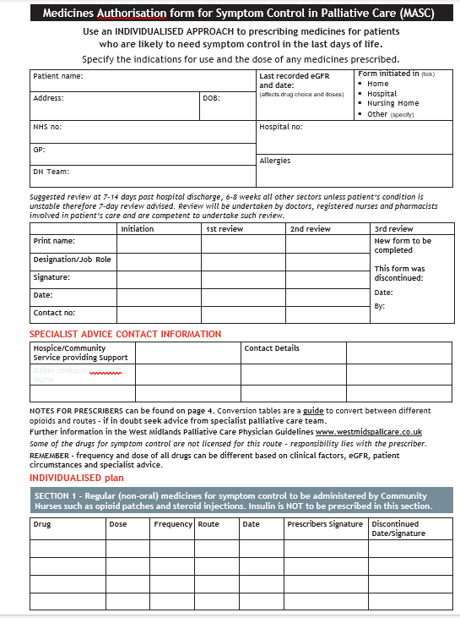
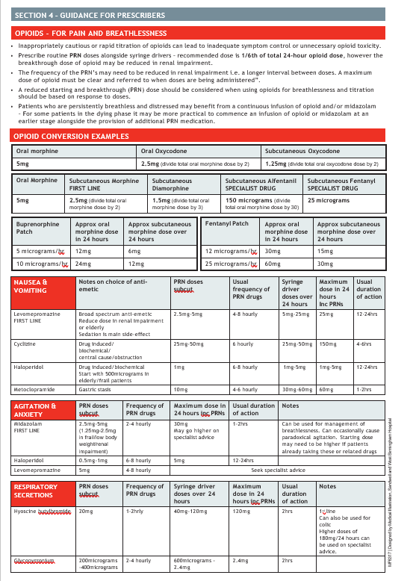
MASC form

Slide 20
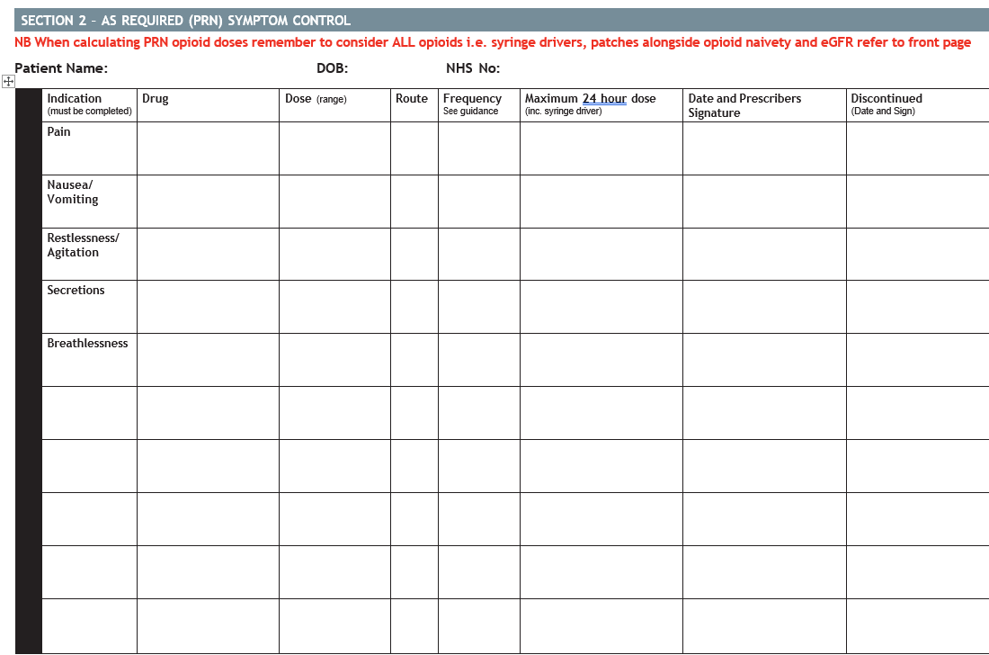

Slide 21
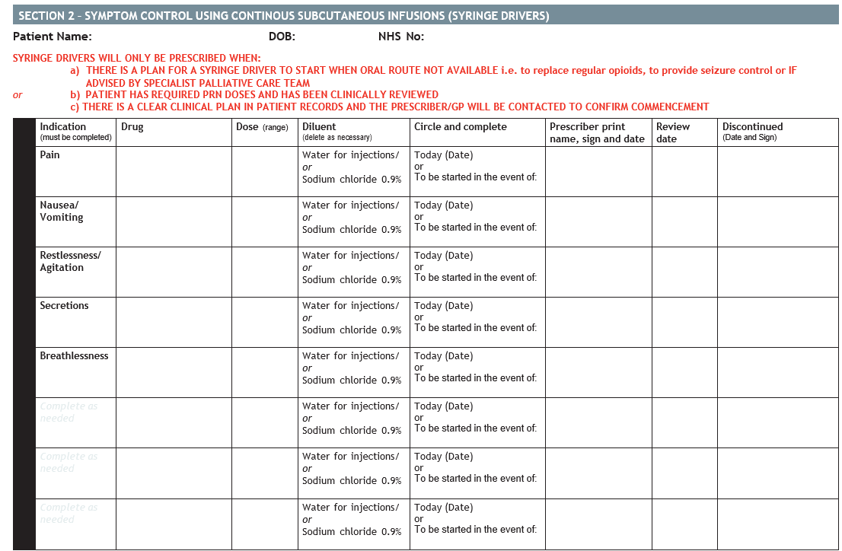
Main text here – ideally using Arial font and recommended minimum 16pt (larger if possible, and 12pt at absolute minimum).
Feel free to add tables, graphs, images, graphic devices.

Slide 22
Other considerations
Urine retention
Carer/ family support
Ensure family know how to contact services
Refer to CHC if appropriate – fast track if EOL
Marie Curie Night sitters
Hospice at home
Willow house
Do family know who to contact when the person dies?
Document that you have discussed next steps with families
What to expect when someone is dying leaflet

Slide 23
Further reading
guide – West Midlands Palliative Care (westmidspallcare.co.uk)

