Slide 1



CHRONIC KIDNEY DISEASE AWARENESS
Marivic Wright
Advanced Clinical Practitioner - CKD

Slide 2
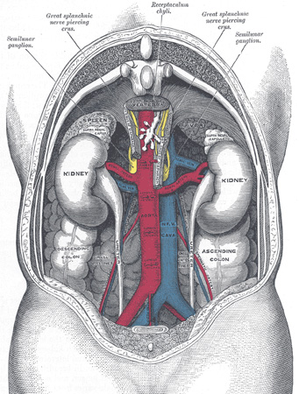

Anatomy of the Kidneys
Part of the urinary system
Bean-shaped, 11cm long, 4 cm thick, 150 grams
Retroperitoneal, posterior part of the abdomen
Approximately vertebrae level
Right kidney is lower than left kidney due to liver size

Slide 3
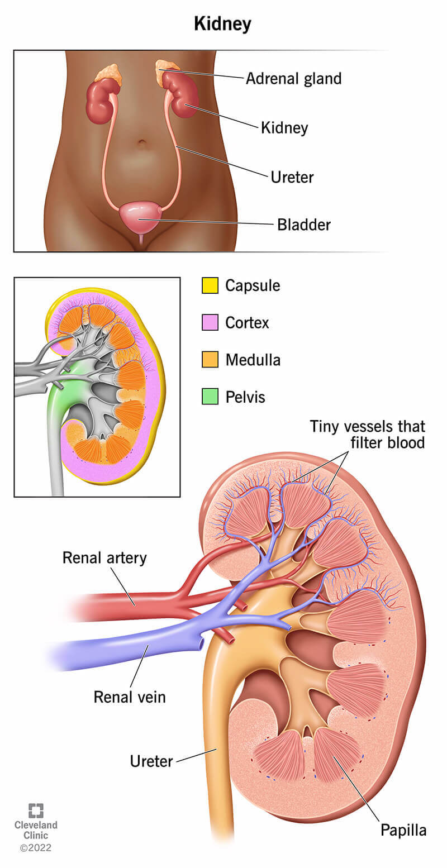

Anatomy of the Kidney
Notes:
Renal artery-The renal artery is a large blood vessel that controls blood flow into your kidneys. For most people at rest, the renal kidneys pump a little over 5 cups (1.2 liters) of blood to your kidneys each minute.
Renal vein- This vein is the main blood vessel that carries filtered blood out of your kidneys and back to your heart. Each of your kidneys has a renal vein.
Renal papilla-These pyramid-shaped structures transfer urine to the ureters. Dehydration and certain medications — especially nonsteroidal anti-inflammatory drugs (NSAIDs) — may damage your renal papilla
Kidney capsule (renal capsule)-The renal capsule consists of three layers of connective tissue or fat that cover your kidneys. It protects your kidneys from injury, increases their stability and connects your kidneys to surrounding tissues.
Renal cortex- The outer layer of your kidney, where the nephrons (blood-filtering units) begin. The renal cortex also creates the hormone erythropoietin (EPO), which helps make red blood cells in your bone marrow.
Renal medulla- The renal medulla is the inner part of your kidney. It contains most of the nephrons with their glomeruli and renal tubules. The renal tubules carry urine to the renal pelvis.
Renal pelvis-This funnel-shaped structure collects urine and passes it down two ureters. Urine travels from the ureters to the bladder, where it’s stored.
How do my kidneys filter blood?
Each kidney contains more than a million filtering units called nephrons. Each nephron consists of:
Glomeruli: Glomeruli are groups of tiny blood vessels that perform the first stage of filtering your blood. They then pass filtered substances to the renal tubules. The name for this process is glomerular filtration.
Renal tubules: These tiny tubes reabsorb and return water, nutrients and minerals your body needs (including sodium and potassium). The tubules remove waste, including excess acid and fluids through a process called diffusion. Your body sends the remaining waste through your kidneys’ collecting chambers. Eventually, it leaves your body as pee.

Slide 4
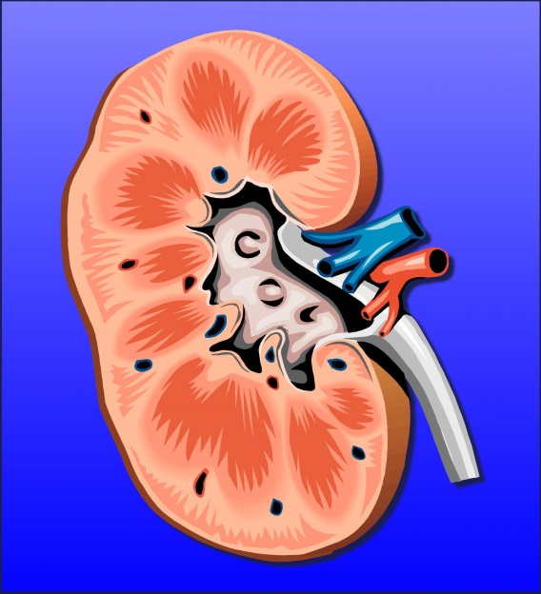
What do Kidneys do?
Removal of
excess fluid
Removal of waste products/filters blood
Regulates salt and water in your body making around 2 L of urine everyday
  Releasing hormone called erythropoeitin
Process Vit D from your diet
  Secretion of hormones such as renin to help regulate blood pressure
Notes:
Approx 170 litre a day to produce 1 to 2 L of urine
Vit D activation - This helps balance calcium and phosphorus in your body by controlling absorption of these minerals from the food you eat and regulates parathyroid hormone (PTH).
PTH - regulates the amounts of calcium, phosphorus and magnesium in the bones and blood. The minerals calcium and phosphorus are crucial for healthy bones.
Renin - helps control your blood pressure and maintain healthy levels of sodium and potassium in your body. Made by special cells in your kidneys, renin is released into your bloodstream when your blood pressure drops too low.

Slide 5
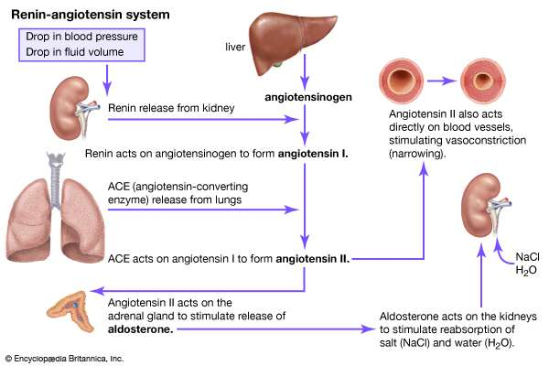

RAAS System

Slide 6
Comparison
AKI | CKD
caused by an event that leads to kidney malfunction, such as dehydration, blood loss from major surgery or injury, or the use of medicines. reversible | caused by a long-term disease, such as high blood pressure or diabetes, that slowly damages the kidneys and reduces their function over time. Abnormalities of function or structure present for more than 3 months (Renal Association 2020)

Slide 7
What is Chronic Kidney Disease (CKD)?
Long term condition where the kidneys do not work effectively.
Caused by long term diseases such as diabetes, high blood pressure that slowly damages the kidneys and reduces its functions over time.
Abnormalities of function or structure present for more than 3 months (Renal Association 2020)

Slide 8
CKD
Around 3 million people in the UK have CKD.
63 thousand people in the UK are being treated for kidney failure.
40, 000 to 45,000 premature deaths in the UK every year.
(Kidney Care 2020)

Slide 9
Causes of CKD
Hypertension
Diabetes
Ageing
Glomerulonephritis
Renal artery stenosis
Polycystic Kidney Disease
Blockages to the flow of urine
Drug-induced and toxin-induced kidney damage
Repeated kidney infections (Pyelonephritis

Slide 10
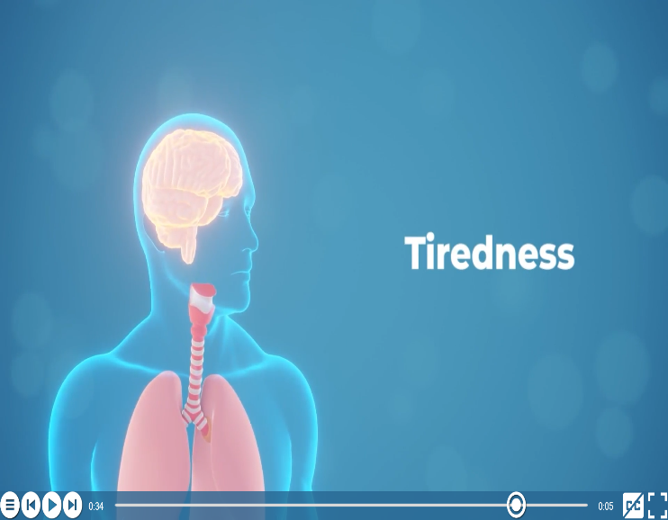
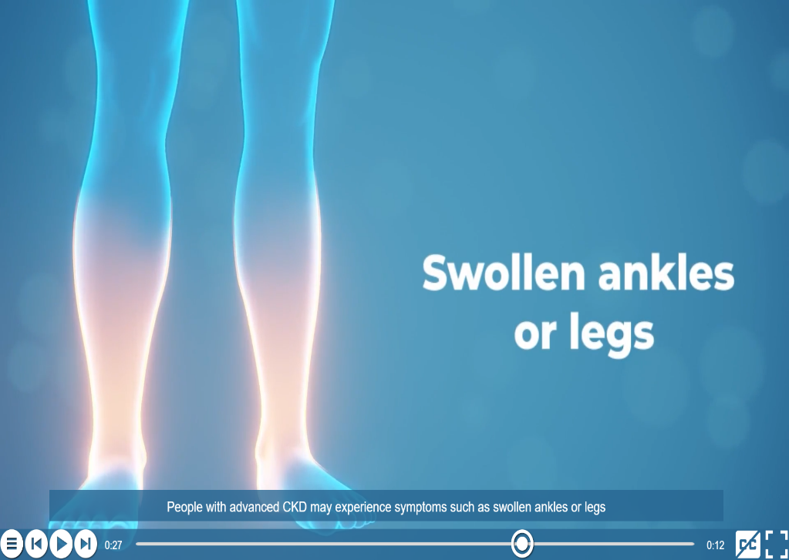
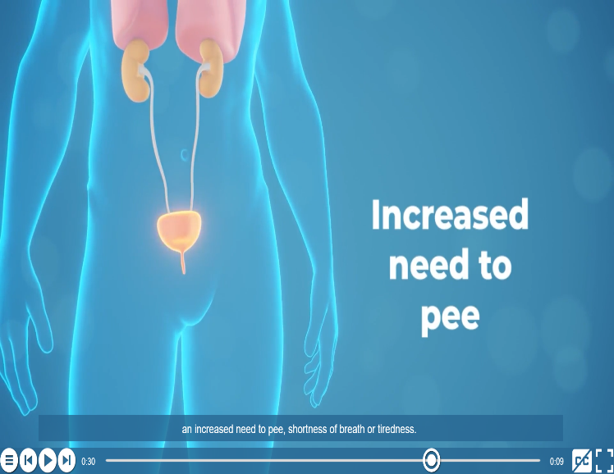
Symptoms of CKD

Slide 11
Symptoms
Changes in urination
Itching
Shortness of breath
Lower back pain
Decreased appetite
Puffiness around your eyes
Abnormal levels of phosphorus, calcium, or vitamin D
Abnormal urine test
High blood pressure
NKF 2014

Slide 12
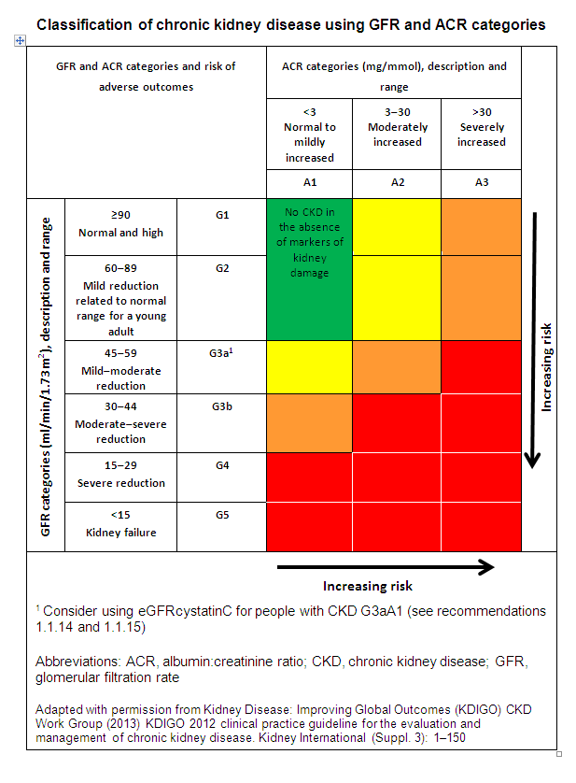
Chronic Kidney Disease
Notes:
CKD is classified based on the eGFR and the level of proteinuria and helps to risk stratify patients.
Patients are classified as G1-G5, based on the eGFR, and A1-A3 based on the ACR (albumin:creatinine ratio)

Slide 13
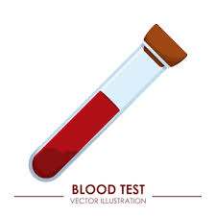
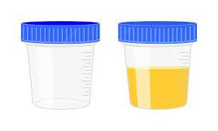
How to detect kidney disease
Blood test – eGFR, creatinine, Hba1c, FBC
urinalysis
Urine test - Albumin Creatinine Ratio (ACR)
Notes:
eGFR mean glomerular filtration rate
Hba1c is a test used for Diabetes to measure the amount of glucose in your blood in a period of 3 to 6 months.
Urinalysis not only use to urine infection but also to detect protein in the urine to confirm that you have kidney disease.
ACR is processed in the lab to determine the exact amount of protein in your urine. There is should be no protein in your urine because the size of protein molecules could not pass though the filters in your kidneys but if you have kidney disease the protein that should be re-absorbed in you blood stream leaks out and excreted in your urine. The filters in your kidneys have been damaged which mostly caused by long term conditions such as diabetes and hypertension.

Slide 14
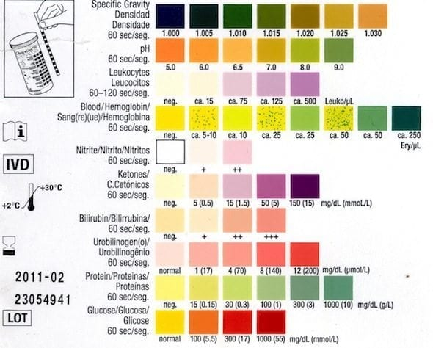
How to detect kidney disease - Urinalysis
Cadogan 2020
Notes:
Normally we perform urinalysis to detect urinary tract infection (UTI). Urinalysis is a part of the routine assessment not only to detect UTI but also to determine the degree of kidney disease by identifying the presence of protein the urine. There are lot of undiagnosed conditions and early detection, and management are paramount in the community. Performing urinalysis can also be used to detect early signs and manage other conditions such as diabetes, cancer screening, sexually transmitted disease, liver disease and dehydration.
specific gravity indicate.s the amount of solute dissolved in the urine. Normal range: 1.002 – 1.035. If you have diabetes insipidus and acute tubular necrosis, your urine may be diluted and resulting to low specific gravity. If you are dehydrated, diabetic and having excess glucose in the urine, your urine will be concentrated which can cause raised specific gravity.
PH represents the acidity of the urine. Normal range 4.5 to 8. Some causes of low ph are starvation, diabetic ketoacidosis and sepsis. Raised ph may be caused by some conditions such as vomiting, urinary tact infection and other medications e.g diuretics.
There should be no red blood cells present in your urine but renal stones, injury to the urinary tract, myoglobinuria (rhabdomyolysis), nephritic syndrome and malignancy of the urinary tract may indicate blood in the urine.
Absence of Nitrates and leukocytes are normal. Nitrates are of breakdown product of gram-negative organisms such as E.Coli. The presence of nitrites and leukocytes in the urine is suggestive of urinary tract infection. Leukocytes indicates the presence of white cells in the urine.
Absence of glucose is normal. The presence of glucose in the urine can be the caused of diabetes mellitus, renal tubular disease and some diabetic medications (e.g. SGLT2 inhibitors).
The presence of bilirubin and urobinilogen in the urine suggests increased levels of conjugated bilirubin, which can occur in conditions such as biliary obstruction (e.g. pancreatic cancer).
The presence of ketones in the urine suggests increased fatty acid metabolism, which occurs during starvation and in conditions such as diabetic ketoacidosis.
The presence of protein in the urine can be caused by nephrotic syndrome and chronic kidney disease.

Slide 15
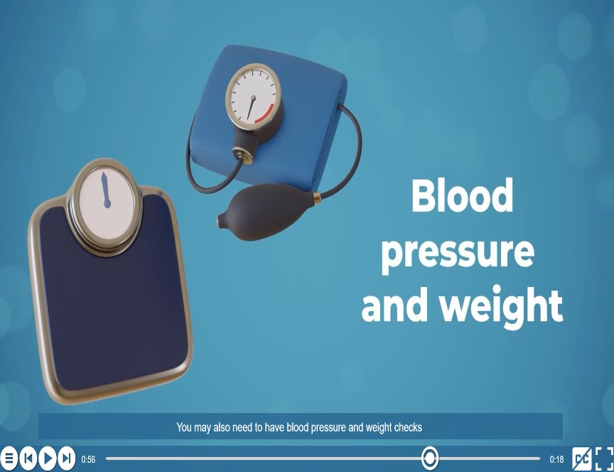
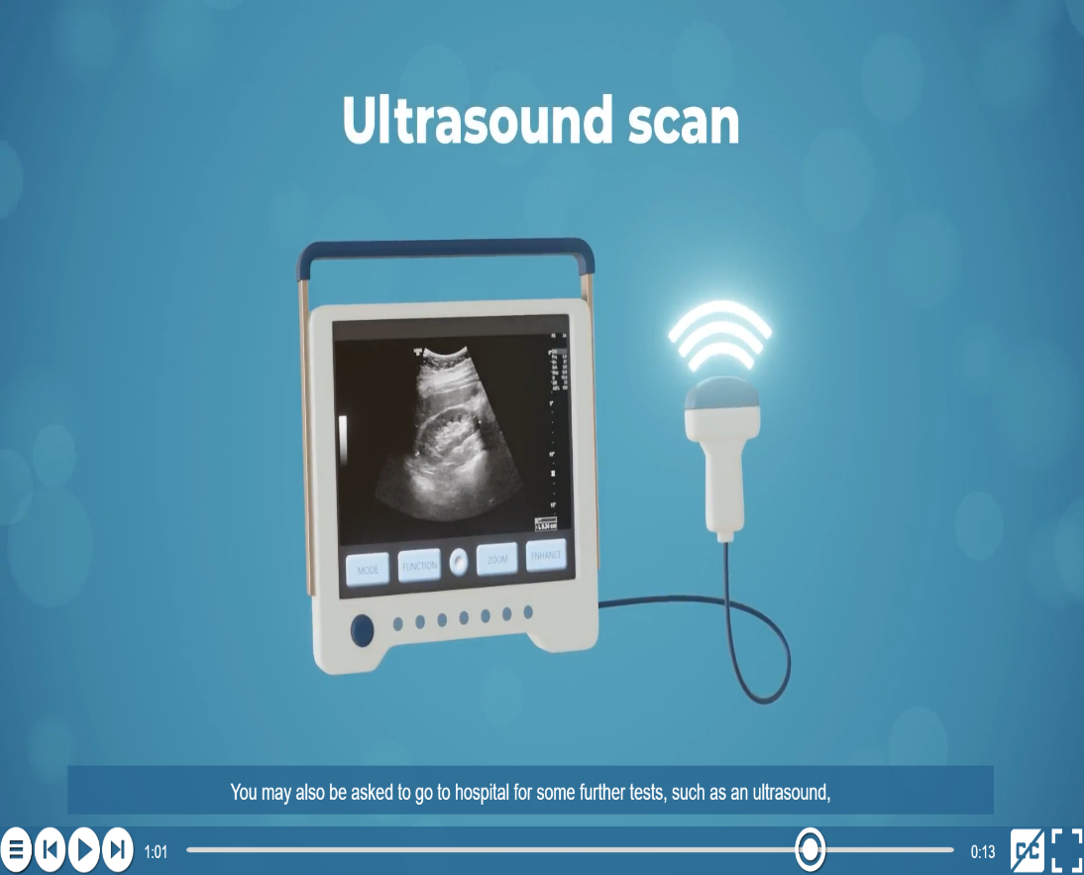
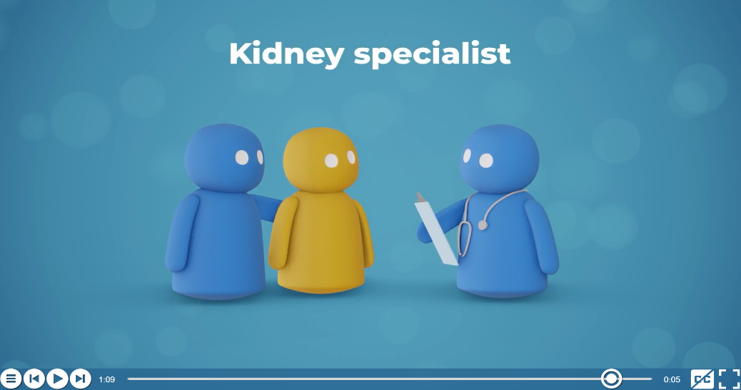
Further Test:

Slide 16
SECOND PART AFTER FIRST BREAK

Slide 17
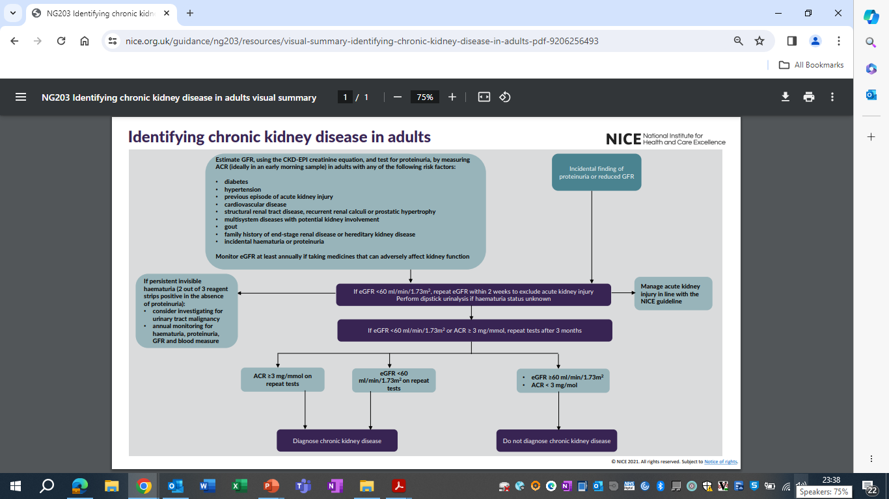

Slide 18
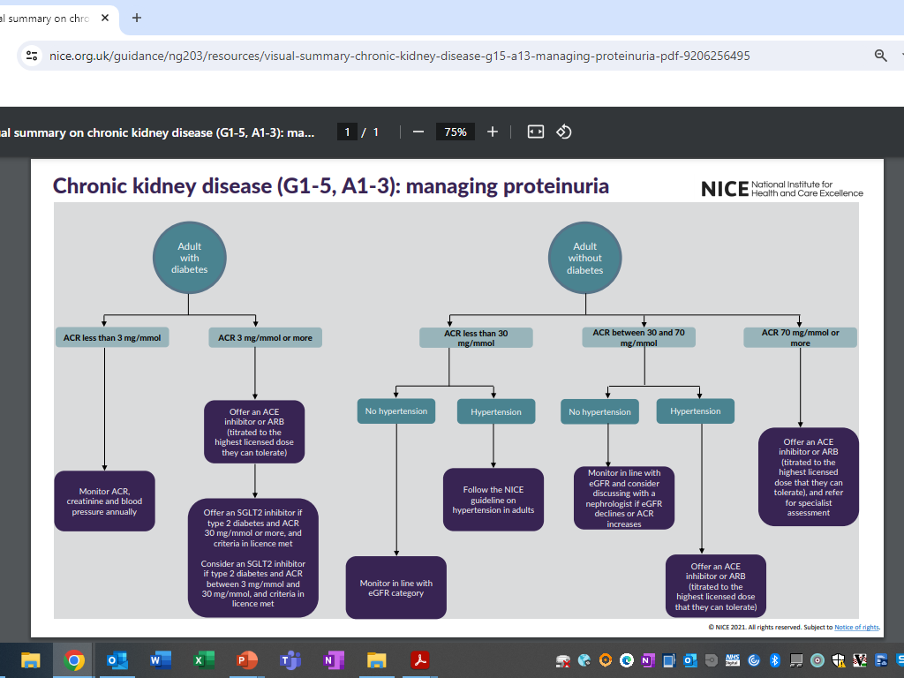

Slide 19
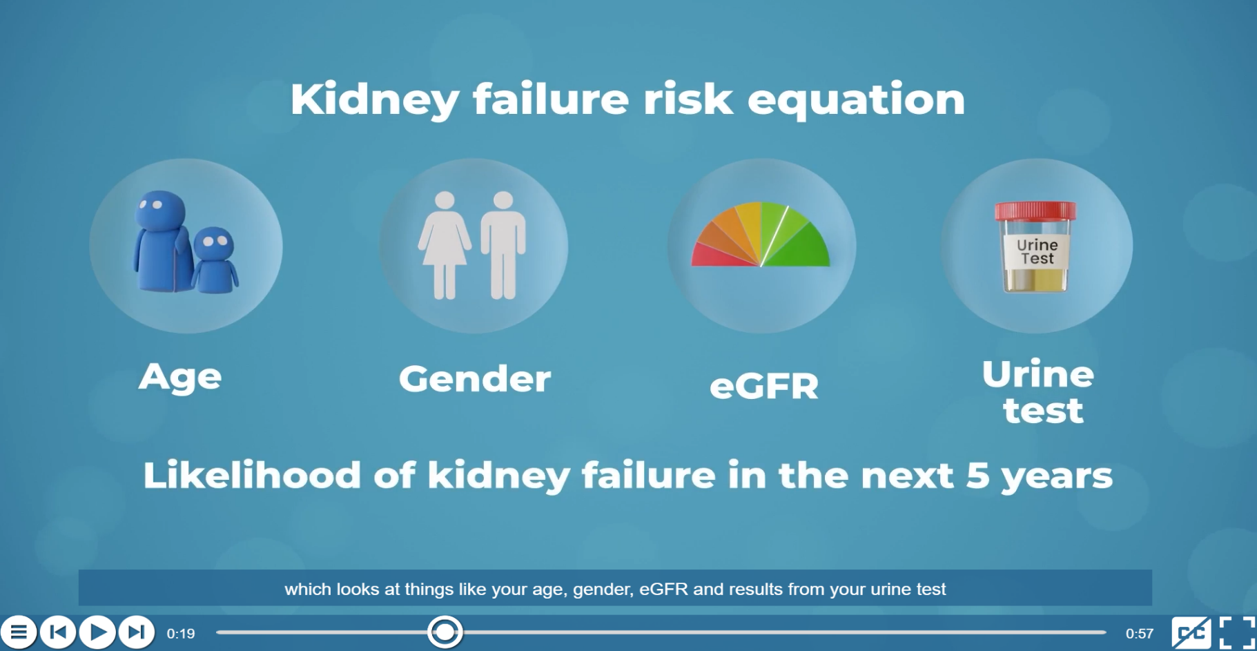
.
The Kidney Failure Risk Equation
Notes:
Kidney Failure Risk Assessment (KFRE) used to determine the risk of patient to kidney failure. It may be low, medium or high risk. You need the age, sex (male or female), the value of eGFR and urine ACR to calculate the risk to kidney failure.

Slide 20

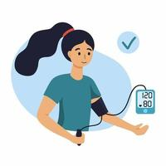
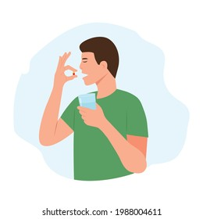
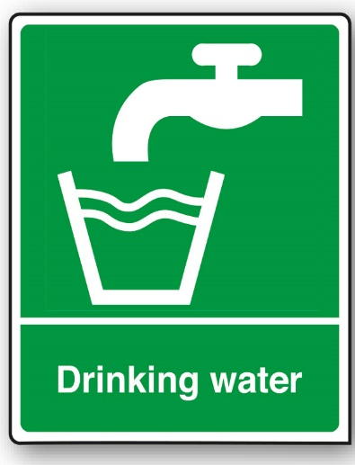




Management of CKD

Slide 21
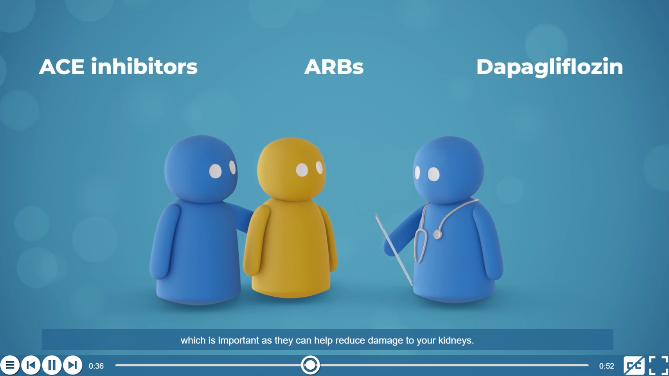

Further management
SGLT2 inhibitor
Statin
Notes:
Angiotensin converting enzyme (ACE) inhibitors and Angiotensin receptor blockers (ARBs) are often used as the first line of treatment to control your blood pressure. Examples of ACE inhibitors include ramipril, enalapril and lisinopril. ARBs medications are irbesartan, valsartan, losartan and candesartan. Good blood pressure control is important to protect your kidneys.
If you also have type 2 diabetes or a high albumin to creatinine ratio (ACR) you may be offered Sodium-glucose co-transporter-2 (SGLT2) inhibitors which are canagliflozin, dapagliflozin, and empagliflozin. These tablets reduce renal tubular glucose reabsorption, producing a reduction in blood glucose by excreting glucose in the urine without stimulating insulin release. This help minimise proteinuria and protect your kidney. Dapagliflozin helps to lower your blood sugar and can reduce damage to your kidneys. Research showed that Dapagliflozin can also be used to treat kidney disease to non diabetic patients.
You may also need to have statin tablet to support for cardiovascular protection. Examples of statin tablets are atorvastatin, pravastatin, rosuvastatin, simvastatin .

Slide 22

Referral received Fax2Mail
CKD - Current Pathway
Citywide referrals from Birmingham GP’s
Specialist Adult Service - Internal
Other multi-disciplinary team - Internal & External
Referral uploaded onto RiO by Admin
E-Triage by Clinician
Book CKD Clinic Appointment F/F or Non F/F
Send PT Appointment letter (Routine).
Urgent Review 2-6 Weeks
Refractory HPN
20% Decline kidney function, 30% increase in creatinine associated w/ the use of ACE/ARB’s
ACR >100mg/mmol without nephrotic syndrome
Proteinuria w/ haematuria
Diabetes w/ increase proteinuria
Oedema , Haematuria repeated 3x
Renal outflow obstruction↗
Accelerated or malignant phase HPN w/ underlying kidney disease (? To see HPN specialist)
Suspected AKI
KFRE moderate to high risk
Nephrotic syndrome
Newly detected CKD Stage 4 &
Multi system disease w/ evidence of kidney disease
Hyperkalaemia
Stage 2 to 3 AKI
ACP Liaise with Consultant
Discharged to Secondary care & Inform GP by letter
Refer to urology (Secondary care)
Assessment
Review HPN meds ,Assess contributory factors
24 hour ABPM if necessary ,Health teaching (modify lifestyles, exercise, weight lost, diet)
Request USS if needed
Follow KDIGO and NICE Guidelines
Education on CKD – Lifestyle, Medications Diet , Risk Factors Prevention & Empowerment
Good Clinical Outcome for PT
Poor Clinical Outcome for PT
Discharged back to GP with advice
Monitor with FU & Reassessment
Good PT Outcomes achieved
Poor PT Outcomes following Reassessment
PT Discharged back to GP
Discharge and inform GP, PT transferred to Secondary Care.

Slide 23

How to refer to CKD team?
Referrals are accepted from GP’s and multi-disciplinary teams e.g., Diabetes Team, Heart Failure Team, District Nurses, and other adult services.
Referral forms can be downloaded from the Birmingham Community Healthcare NHS Foundation Trust website:
https://www.bhamcommunity.nhs.uk/patients-public/adults/chronic-kidney-disease/
Referrals can be posted to the CKD Service, St Stephens Centre, 171 Nineveh Road, Handsworth, Birmingham B21 0SY
Or sent via Fax2Mail :0116 227 3073 or email via bchnt.ckdreferrals@nhs.net

Slide 24
Case study 1
Mr Joe, a 65-year-old retired labourer was referred by GP due to significant proteinuria and declining eGFR. He has a long history of hypertension, and diabetes. eGFR 48 ml/min previously 52 ml/min. Urine ACR 60mg/mmol, Hba1c 68 mmol/mol. Blood pressure158/90.

Slide 25
Questions
What are the risk factors?
Calculate KFRE
Does the patient have CKD?

Slide 26

Summary
    Any Questions

