Slide 1




Self Care Model
Sam Tullett
Service Manager
Culture Change:
Think Self-Care and Supported Self-Care

Slide 2

What is Self-Care & Supported Self-Care?
Defined as ‘the practice of taking action to preserve or improve one’s own health’, selfcare is a proactive, holistic and personalised approach that empowers individuals to actively engage in the management of their own physical and psychological health and wellbeing (Mills et al, 2018)
Self-care is the ability to care for oneself in the presence or absence of healthcare professionals (Martínez et al, 2021)
Self-care focuses on a person’s goals; not what professionals think those goals should be.
Supported self-management is a part of the NHS Long Term Plan and is included in the comprehensive personalised care model, which is a whole-population approach, providing proactive and universal support to people of all ages with long-term conditions
(NHS England 2020)

Slide 3
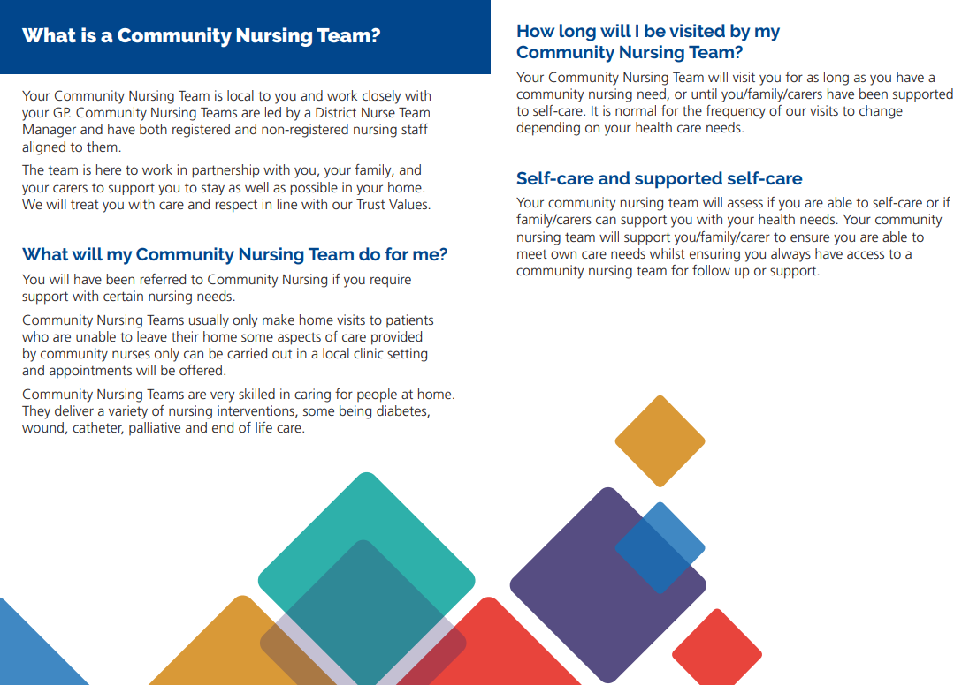
The BCHC Way…
Empower
Educate
Self-Care
Supported Self-Care
Engage

Slide 4
Self-Care Model Overview and Planning (Service Transformation)
‘Educated & Informed Patients Who Can Manage Their Own Health Needs’
Objectives
What we want to achieve
Supported Self-Care focusing on Prevention
And Enablement through:
Engagement
Education
Empowerment
Linking with
BCHC and BSOL Strategic objective
NHS Plan
Trust Values
Essential Care Framework (personalised care)
ACS Areas of Focus
1. Continuity of Care
Consistent Communication and
Self-Care Approach
2. Improved Patient Outcomes and Quality of Care
Prevention and Enablement
3. Improved Satisfaction for
Patients/ Family/ Carer/ Staff
New ways of working
Personalised care to meet individual patient needs
4. Appropriate Community Nursing Team Caseload
Joint working with wider NHS System
Reduction in referrals
Release of capacity to care
Key Stakeholders
Bladder and Bowel
Wound care and Pressure
Medication (including IV Therapy)
Equipment
Self-Care Team
Community Nursing Teams
Wider ACS Division including EICT, Therapy Hubs and Urgent Care
Secondary Care
ICB
Acute Setting

Slide 5
Myth Busting
Encouraging patients to self-care will make clinicians look and feel redundant, less important and uncaring.
Self-care is not about leaving people to cope on their own. Clinicians have an essential role to play in empowering individuals to take control of their treatment and helping patients to nurture positive attitudes towards self-care
A patient can only self-care if they are fully independent.
Anyone can self-care if they have been assessed as being both capable and willing to be involved. Clinicians and patients should be honest and open with each other about what level of engagement in self-care is appropriate, and to be mindful that this can change over time
Self-care means that the patient will never see the clinical team again.
Self-care means that the clinician and patient work in partnership to manage the leg ulcer. Self-care is an approach to encourage patients to engage in their own care with support from the multidisciplinary team, and help to promote a continuity of care between services
Self-care is hard work for patients and clinicians.
It takes time to teach patients how to care for their wound, and to build new habits. However, clinicians should remind patients that caring for themselves can quickly become second nature and a normal part of their everyday routine

Slide 6
Benefits of Self-Care & Supported Self-Care
Patient
Patients feel more positive, empowered and enthusiastic about their care.
Patients gain independence and are able to engage with treatment at a time that is personalised to their needs.
Patient convenience- patients no longer have to wait around for appointments or for a nurse to visit them. They do not need to take time off work for these appointments.
Patients achieve freedom and flexibility – self-care and supported self-care is integrated into daily activities, which is especially useful for patients with multiple family, work and social responsibilities.
Patients save time and money on transport to and from the clinic.
Patients gain autonomy and more control, which can improve their self-worth.
Patient privacy (reduced need for a new nurse to enter their home and examine them at each appointment).
Clinician
Appropriate use of resources- ‘time released to care’ for those with more complex needs who are unable to self-care. Financial saving.
Independent patients/ families/ carers who can manage their own health needs and potential complications. Reducing planned and unplanned demand.
Improves staff morale and reduces stress in clinicians. Improves wellbeing and replenishes clinicians’ capacity to deliver compassion and empathy
Encourages and promotes sustainable practice.
The clinician and the patient have a shared goal, resulting in a stronger relationship and improved health outcomes.
Improved reporting, as the patient understands their condition better and can give more accurate updates to the clinician.

Slide 7

Self-Care and Supported Self-Care Cautions
Does your patient have capacity?
- Does your patient lack capacity but have family or carers who can support self-care?
Is your patient vulnerable with concerns of self-neglect or safeguarding?
Does the patient have symptoms that suggest their condition cannot be managed with self-care?
Does your patient have the dexterity to self-care?
-Does your patient have family or carers who can support self-care?
-Is there equipment that can support self-care or supported self-care?
Some patients/ families/ carers may not want to self-care and may want support offered from regular clinician visits/appointments- BUT WHY???

Slide 8
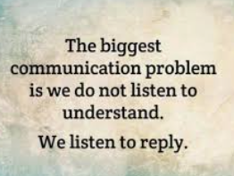
Taking the Time to Understand
It is critical that patients are not labelled or seen as ‘difficult’.
Challenging behaviour from patients can make it hard for clinicians to deliver good care safely; however, these actions are often a sign of fear, anxiety or distress. These patients may not intend to be uncooperative, aggressive or even dangerous- remaining calm, utilising communication skills, compassion and building trust will support clinicians to navigate challenging situations.
‘non- concordant’ and ‘non-compliant’ needs further exploration and understanding.
If a treatment does not work or the patient is unable/ reluctant to engage with their treatment, there needs to be a joint discussion between the clinician and the patient to explore alternatives.
Through meaningful discussions, the clinician should explore why the patient isn’t engaging.
It is helpful to establish what self-care or supported self-care is already taking place.
What is important to the patient? Their family/ carers?
- This will support setting personalised goals.
It is important for everyone’s roles and responsibilities to be clearly communicated and understood.
Patients and their family/ carer must be involved in setting expectations and agreeing treatment goals.

Slide 9
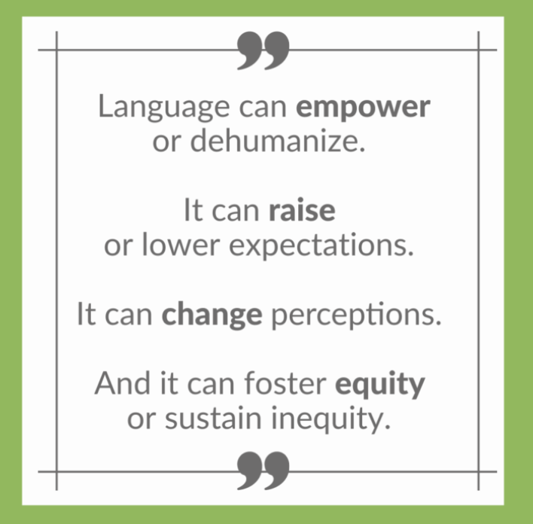
Communication
Effective communication is essential to support self-care/ supported self-care and facilitate better conversations with patients/ families/ carers.
Reflect on own verbal and non-verbal communication
Recognise that some words, phrases and descriptions are potentially problematic.
Setting the right tone from the outset!
This will help patients feel more positive about the outlook of their condition, empowering and motivating them to make positive changes to their behaviour and lifestyle. Supporting them to manage their condition more effectively.
Self-care/ Supported Self-Care can be a daunting concept to some patients/ families/ carers
Clinicians need to frame conversations in a way that prevents patients from feeling overwhelmed.
Clinicians should keep conversations about self-care positive and supportive
Clinicians should be careful not to unintentionally imply that the patient has been ‘lazy’ with taking care of themselves.
Clinicians need to use more inclusive and ensure effective verbal, written and non-verbal language.
Verbal: pitch, tone, speed and content
Written: factual, clear, precise and easy to understand
Non-verbal: facial expressions, posture, gestures and physical touch, and eye contact.
Resources- Leaflets/ Images/ Videos etc

Slide 10
Communication Continued
Be mindful that language, both verbal and nonverbal (body language) can have positive or negative consequences.
Communication should be relatable to the patient/ family/ carer- do not use jargon that they will not understand or feel intimidated by.
Take your time! Understanding takes time.
Recognise that some words, phrases and descriptions are potentially problematic.
Use language that is free from judgement and prejudice and is inclusive, values-based, person-centred and collaborative.
Avoid language which attributes blame or shame.
Avoid language that infers generalisations or stereotypes.
To ensure a collaborative approach, remember to include family and carers where appropriate.
By asking open-ended questions, the clinician can find out what is already knows about self-care/ supported self-care.
Allow time for patient/ family/ carer to raise concerns, ask advice and have any misconceptions corrected by the clinician.
Allow a silence or pause- this enables time to think and reflect.
Clinicians need to emphasise that self-care is a collaboration between the patient/ family/carer and the clinician/ wider MDT
Be clear that the patient will not be left to cope on their own or be made to feel like a ‘burden’.

Slide 11
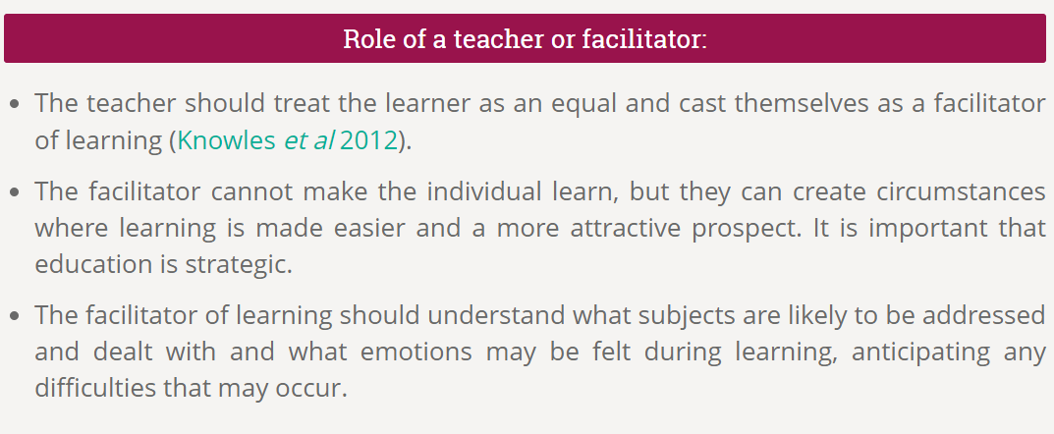
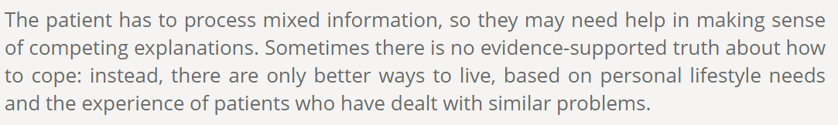
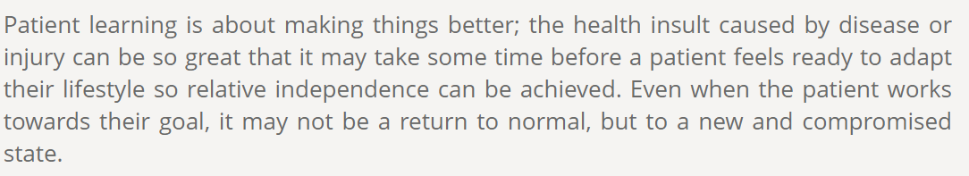

Slide 12
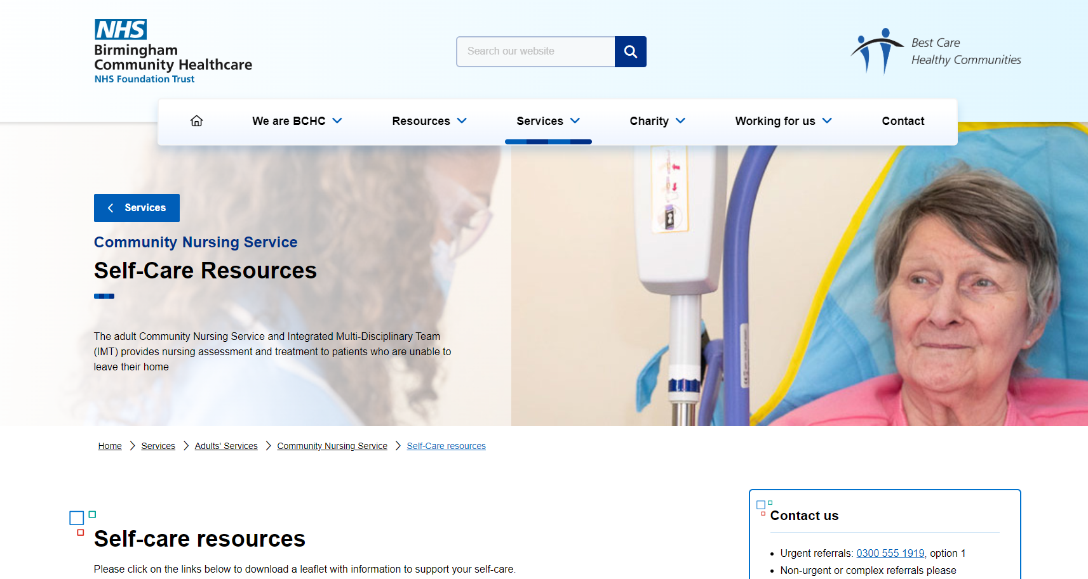
Work to date…
At Risk of Pressure Damage Patients
Standardised process for safe discharge to self-care & supported self-care launched early 2023
2337 pressure area care schedules have been discharged.
That is equivalent to 7011 hours minimum released back into teams (based on schedules being 3 monthly).
Annual Continence Reassessment
Standardised process for safe discharge to self-care & supported self-care launched late 2023
3440 patients fully discharged to self-care or supported self-care.
510 annual continence assessment schedules discharged ( remain on caseloads for other nursing needs)
That is equivalent to 5925 hours minimum released back into teams (based on annual 1.5 hour review).
Insulin Administration
Training around self-care and promotion of management of diabetes, introducing teaching kits.
Eye Drop Administration
Introduction of eye-drop aid kits to support teaching self-care
Use of Technology
Introducing ISLA to support patient/ carer/ family engagement
Patient Information
Intranet and patient info

Slide 13


Pressure Risk Self-Care and Supported Self-Care
Criteria for Inclusion/ Exclusion
Inclusion ‘Low Risk’ for discharge | Exclusion ‘High Risk’ unable to discharge
The patient’s skin is intact and there is no pressure damage. You can still discharge to self-care with scarring as highlighted as risk on Purpose T assessment. | Medical history of concern: such as Dementia, Alzheimer's, or a palliative neurological disorder such as late-stage Motor Neurone Disease or Huntington’s without family/carer support provision who can support self-management of pressure risk and appropriate timely escalation
The patient/carer/family can retain, understand, communicate, and summarise information shared (Think SSKIN) ***This demonstrates capacity*** | Lacking Mental Capacity as determined by an MCA which MUST be documented in patients’ records and no family/carer provision
The patient/carer/family needs to be able to manage the risk of pressure ulcer development through regular skin checks, following repositioning, use of barrier creams as prescribed and ensuring equipment is in place and in working order | Clinical judgement based on Purpose T assessment and patient history. You MUST complete a PAC discharge checklist for any patient identified as at risk that meets the criteria to be safely discharged to self-care or supported self-care
Medical history of concern: such as Dementia, Alzheimer's, or a palliative neurological disorder such as late-stage Motor Neurone Disease or Huntington’s with family/carer support provision.
The patient/carer/family need to know when and how to contact the community nurses

Slide 14
Patient Safety Incidents
After Action Review:
Patient referral for continence assessment.
Full holistic risk assessment.
Purpose T identified risk of pressure.
Discharged to self-care for continence.
Patient developed a Cat 3 pressure ulcer.
Learning identified:
Patient self-care pressure discharge checklist not completed.
Patient/ Family/ Carer not provided education.
Patient / Family/ Carer did not escalate at first signs of pressure
Notes:
Community Nursing Teams have been provided with a screening tool, updated continence assessment and reassessment and a 3 self-care contact personalised care plan (PCP)
The self-care team are currently supporting with review of continence patients. These are patients who have schedules for a reassessment as well as none-active patients on abena

Slide 15

Continence Care
Historic Practice
Referral for continence assessment
Community visit to complete continence assessment
Prescribed products on Abena
Annual reassessment schedule created
Annual reassessment visit for full update of PCP and continence reassessment
Why we needed change…
Inappropriate referrals
Capacity to complete assessments due to service pressures
Additional demand due to patient being active on caseload (e.g., Bloods)
Time it takes to complete assessment to see this patient group once a year
Risk of patient not escalating concerns early as they believe a nurse will be contacting them for a review

Slide 16
Continence Self-Care and Supported Self-Care
Criteria for Inclusion/ Exclusion
Inclusion ‘Low Risk’ for discharge | Exclusion ‘High Risk’ unable to discharge
Patients that are incontinent of urine/ faeces/ both | Cognitive impairment i.e., Dementia, Learning Disabilities, Stroke, Traumatic Brain injuries, Neurological conditions, MS, MND without a carer/ family member who is able to support self-management of continence product provision, recognise red flags and when to initiate PIFU.
Patients who are self-managing and it has been determined that they have full capacity and understands detailed instructions. | Lacking Mental Capacity as determined by an MCA which MUST be documented in patients’ records and no carer/ family support.
Patients who have regular carers, care agencies, supported living etc. | Palliative care/ End of Life Patients. These patients are to remain on the community nursing caseload and to be reviewed 12 monthly. Follow up appointment/ schedule for 12 months’ time to be built into team planner.
Patients who have functional issues i.e., reduced mobility, toileting issues, dexterity problems or are bedbound.
To be able to discharge a patient from the caseload the patient or carer needs to be able to manage the ordering of products and be able to identify when the products are no longer suitable or compromising the patients skin integrity.

Slide 17
Work to date continued …
Eye Drop Administration
Introduction of eye-drop aid kits to support teaching self-care
Insulin Administration
Training around self-care and promotion of management of diabetes, introducing teaching kits.
Use of Technology
Introducing ISLA to support patient/ carer/ family engagement
Patient Information
Intranet and patient info
Community Nursing Service | Website
Clexane Self-Administration
Patient Information Leaflet

Slide 18


What is next…
Clinical Quality Matrons
Culture Change
Shared care of simple wounds
Carer/ Care Home engagement with simple wounds
Self-care of enoxaparin
Patient Information
Consideration of new roles Self-Care Facilitators

Slide 19

ANY
QUESTIONS?

