Slide 1

HYDRATION AND ACUTE KIDNEY INJURY (AKI) AWARENESS
MARIVIC WRIGHT
ADVANCED CLINICAL PRACTITIONER-CKD
Notes:
The aim of this awareness session is to have an overview of the risk factors leading to AKI and how to prevent it. The most common in community is dehydration so we are going to briefly discuss hydration.
Hopefully, at the end of this session you are able to identify the risk and escalate to have early prevention.

Slide 2
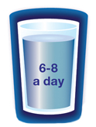
DID YOU KNOW?
The average person in the UK uses 141 litres of water per day for daily tasks including drinking, washing and cleaning. Drink 6-8 glasses per day to stay healthy (1.5 – 2 litres).
Water is a natural resource that is required by every person this includes our body composition, mental focus, sleep and recovery.
Water is one of the key elements responsible for human life on earth and is vital for our survival. The human brain is composed of 95% water, lungs are 90%, blood is 83%, muscles are 76%, and bones are 22% water.
Notes:
About 141,000 ml per day.

Slide 3
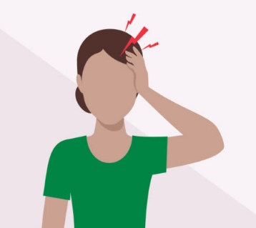

DID YOU KNOW?
Dehydration can cause a variety of symptoms including headaches, fatigue, lack of focus, dizziness, and in some severe cases, fainting.
We can lose around 1 litre of fluids per day through evaporation / sweating.
Notes:
Insensible to loss

Slide 4
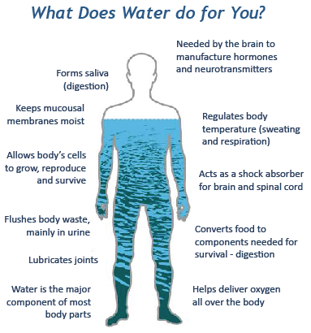
IMPORTANCE OF HYDRATION
Notes:
Optimal function of the organs in your body.
Water makes up a large part of your joint cartilage that helps absorb shock and make bone-against-bone movements smoother
Drinking Water Helps Maintain the Balance of Body Fluids. Your body is composed of about 60% water. ...
Water Can Help Control Calories. ...
Water Helps Energize Muscles. ...
Water Helps Keep Skin Looking Good. ...
Water Helps Your Kidneys. ...
Water Helps Maintain Normal Bowel Function.

Slide 5
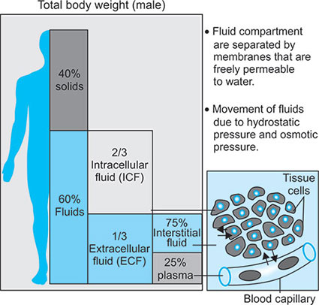
FACT
Approximately 60 %of the total body weight of men and 52 % of women is fluid.
Reduction of 5% body fluids(mild dehydration) causes thirst
Reduction of 8 -10% of body fluid(moderate dehydration) causes symptoms/illness
10 - 15% (severe dehydration) reduction causes death
(Carroll 2000)

Slide 6
Signs of dehydration
Thirst
Dark urine
Sunken eyes
Irritability
Confusion
Cool hands or feet
Low blood pressure
Raised heart rate
Headaches
This may add insult to your kidneys that can lead to AKI. If a person has AKI, they may pass less urine than usual, or pass no urine at all

Slide 7
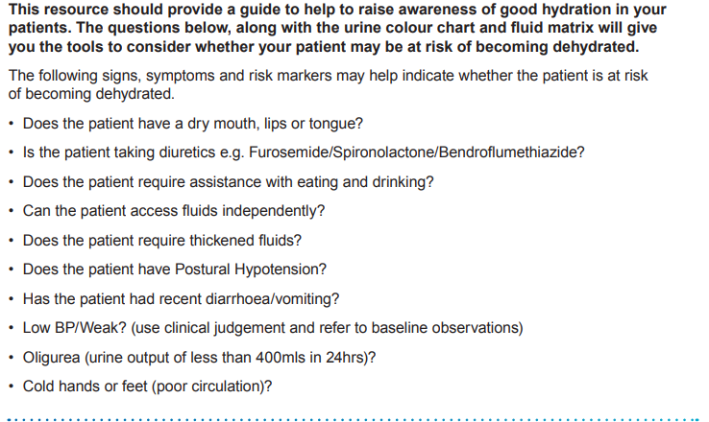
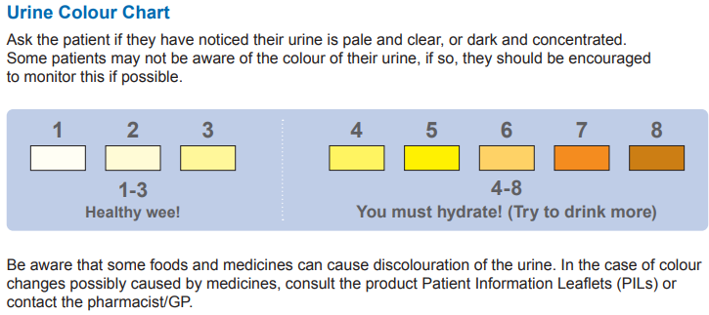
Hydration resource tool

Slide 8
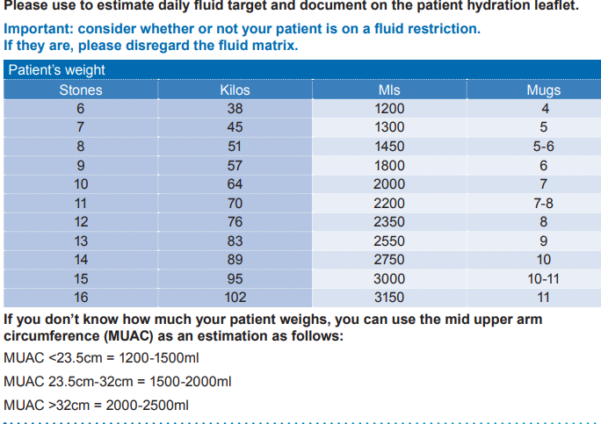
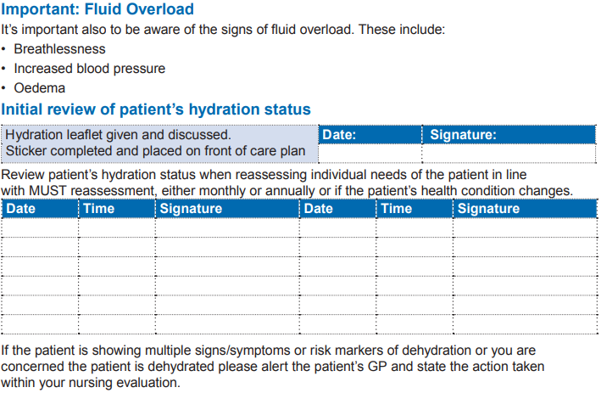
Fluid Matrix

Slide 9
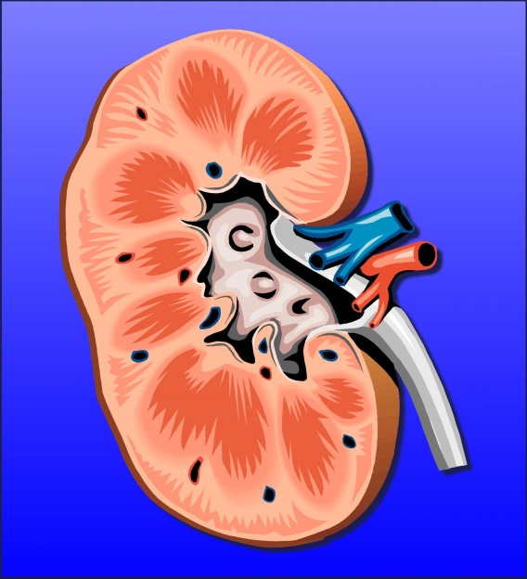
Functions of the Kidneys
Removal of
excess fluid
240-300 pints a day to produce 2-4 pints of urine
Removal of waste products/filters blood
Regulates salt and water in your body making around 2 L of urine everyday
  Releasing hormone called erythropoeitin
Process Vit D from your diet
  Secretion of hormones such as renin to help regulate blood pressure
Notes:
Approx 170 litre a day to produce 1 to 2 L of urine
Vit D activation - This helps balance calcium and phosphorus in your body by controlling absorption of these minerals from the food you eat and regulates parathyroid hormone (PTH).
PTH - regulates the amounts of calcium, phosphorus and magnesium in the bones and blood. The minerals calcium and phosphorus are crucial for healthy bones.
Renin - helps control your blood pressure and maintain healthy levels of sodium and potassium in your body. Made by special cells in your kidneys, renin is released into your bloodstream when your blood pressure drops too low.

Slide 10
Acute Kidney Injury (AKI)
AKI is a sudden reduction in renal function over a short period of time (Think Kidneys 2016).
your kidneys are suddenly not able to filter waste products from the blood. This can happen within a few hours or a few days. For most people, AKI develops within 48 hours, but sometimes it can take as long as 7 days (NKF 2024).
Common causes of AKI are dehydration, hypotension, infection, kidney stones, and reactions to medications (Kidney care 2020).
13.3 million people affected by AKI worldwide and 85% came from
developing countries (Bjornstad et al 2020).
Reversible.

Slide 11
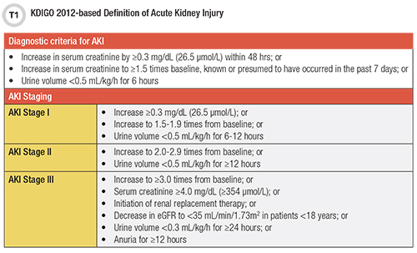
AKI
Notes:
Creatinine, which is a waste product produced by the muscles, gets filtered out by the kidneys.
The diagnosis of AKI and its staging is based on acute changes in serum creatinine and/or a reduction in urine output. Stage 3 might need to be treated in the hospital.

Slide 12
Prevalence of AKI
2009
In UK, 100,000 deaths associated with AKI every year (NCEPOD 2009)
2012
1 to 5 emergency hospital admissions due to AKI with an increase likelihood to death (Wang et al 2012).
2014
NHS cost estimated £179 million post-discharge care for people who had AKI during hospital admission in 2010-11 (Kerr et al 2014).

Slide 13
Causes of AKI
Pre-Renal (before the kidneys)
Most common cause of AKI
Disruption of blood flow to the kidney
Low blood pressure
Heart Failure
Low blood volume (dehydration)
Notes:
Heart Failure - heart failure is a significant risk factor for kidney disease. When the heart is no longer pumping efficiently it becomes congested with blood, causing pressure to build up in the main vein connected to the kidneys and leading to congestion of blood in the kidneys, too. The kidneys also suffer from the reduced supply of oxygenated blood.

Slide 14
Causes of AKI
Intrinsic (inside the kidneys)
Damage to the kidney itself
damage to the tiny filters inside the kidneys (Glomerulonephritis)
Damage to the kidney cells (Acute tubular Necrosis)
Notes:
Glomerulonephritis acute inflammation of the kidney, typically caused by an immune response.
The acute disease may be caused by infections such as strep throat. It may also be caused by other illnesses, including lupus, Goodpasture's syndrome, Wegener's disease, and polyarteritis nodosa. Early diagnosis and prompt treatment are important to prevent kidney failure.
These are the most common symptoms:
Fatigue.
High blood pressure.
Swelling of the face, hands, feet, and belly.
Blood and protein in the urine (hematuria and proteinuria)
Decreased urine output.
Acute tubular necrosis (ATN) is a kidney disorder involving damage to the tubule cells of the kidneys, which can lead to acute kidney failure. The tubules are tiny ducts in the kidneys that help filter the blood when it passes through the kidneys. causes the lack of oxygen and blood flow to the kidneys, damaging them.
Urine sediment showing multiple muddy brown granular casts. These findings are highly suggestive of acute tubular necrosis in a patient with acute k

Slide 15
Causes of AKI
Post Renal (after the kidneys)
Caused by a blockage in the urinary
tract
For example:
Blocked catheter
Kidney stones (renal calculi)
Bladder tumours
Enlarged prostate

Slide 16
Symptoms of AKI
In the early stages there may be no real symptoms or signs. A blood test is needed to detect it.
However, someone with AKI can deteriorate quickly and suddenly experience any of the following:
Changes to urine output, particularly a major reduction in the amount of urine passed
Changes to urine colour/smell
Nausea, vomiting
Abdominal pains and feeling generally unwell, similar to a hangover
Dehydration or thirst
Confusion and drowsiness
Consider urine dipstick to test for presence of blood/protein to inform GP

Slide 17
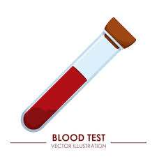
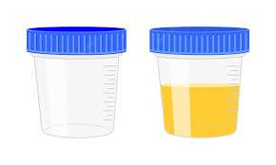
How to detect kidney disease
Blood test – eGFR, creatinine, Hba1c, FBC
urinalysis
Urine test - Albumin Creatinine Ratio (ACR)
Notes:
eGFR mean glomerular filtration rate
Hba1c is a test used for Diabetes to measure the amount of glucose in your blood in a period of 3 to 6 months.
Urinalysis not only use to urine infection but also to detect protein in the urine to confirm that you have kidney disease.
ACR is processed in the lab to determine the exact amount of protein in your urine. There is should be no protein in your urine because the size of protein molecules could not pass though the filters in your kidneys but if you have kidney disease the protein that should be re-absorbed in you blood stream leaks out and excreted in your urine. The filters in your kidneys have been damaged which mostly caused by long term conditions such as diabetes and hypertension.

Slide 18
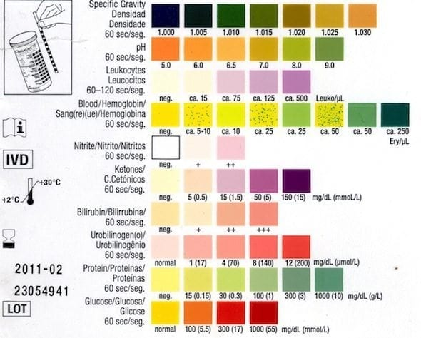
How to detect kidney disease - Urinalysis
Cadogan 2020
Notes:
Normally we perform urinalysis to detect urinary tract infection (UTI). Urinalysis is a part of the routine assessment not only to detect UTI but also to determine the degree of kidney disease by identifying the presence of protein the urine. There are lot of undiagnosed conditions and early detection, and management are paramount in the community. Performing urinalysis can also be used to detect early signs and manage other conditions such as diabetes, cancer screening, sexually transmitted disease, liver disease and dehydration.
specific gravity indicate.s the amount of solute dissolved in the urine. Normal range: 1.002 – 1.035. If you have diabetes insipidus and acute tubular necrosis, your urine may be diluted and resulting to low specific gravity. If you are dehydrated, diabetic and having excess glucose in the urine, your urine will be concentrated which can cause raised specific gravity.
PH represents the acidity of the urine. Normal range 4.5 to 8. Some causes of low ph are starvation, diabetic ketoacidosis and sepsis. Raised ph may be caused by some conditions such as vomiting, urinary tact infection and other medications e.g diuretics.
There should be no red blood cells present in your urine but renal stones, injury to the urinary tract, myoglobinuria (rhabdomyolysis), nephritic syndrome and malignancy of the urinary tract may indicate blood in the urine.
Absence of Nitrates and leukocytes are normal. Nitrates are of breakdown product of gram-negative organisms such as E.Coli. The presence of nitrites and leukocytes in the urine is suggestive of urinary tract infection. Leukocytes indicates the presence of white cells in the urine.
Absence of glucose is normal. The presence of glucose in the urine can be the caused of diabetes mellitus, renal tubular disease and some diabetic medications (e.g. SGLT2 inhibitors).
The presence of bilirubin and urobinilogen in the urine suggests increased levels of conjugated bilirubin, which can occur in conditions such as biliary obstruction (e.g. pancreatic cancer).
The presence of ketones in the urine suggests increased fatty acid metabolism, which occurs during starvation and in conditions such as diabetic ketoacidosis.
The presence of protein in the urine can be caused by nephrotic syndrome and chronic kidney disease.

Slide 19
People at higher risk of AKI
Those aged 75 or over
People with the following:
Heart failure
Diabetes
Chronic Kidney Disease
Dementia
Acute illness (sickness and diarrhoea)

Slide 20
Risk factors of AKI
Certain drugs can affect the kidneys, and these include:
Non-steroidal anti-inflammatory drugs (eg Ibuprofen)
Drugs that lower blood pressure (eg Ramipril)
Drugs used for people with diabetes (eg Metformin)
Drugs used by Mental Health patients (eg Lithium)
The GP may decide that some of drugs need to be stopped for a day or two
The patient might need some more blood tests
The GP might recommend to increase fluids or to send the patients to hospital to have some fluid replacement
Notes:
Avoid non-steroidal anti-inflammatory drugs (NSAIDs), if possible such as ibuprofen, naproxen, diclofenac– these medicines can harm your kidneys if you have kidney disease. These medications prohibit the compensatory vasodilation response of renal prostaglandins to vasoconstrictor hormones released by the body which result in reduced renal blood flow.
Angiotensin converting enzyme (ACE) inhibitors and Angiotensin receptor blockers (ARBs) are often used as the first line of treatment to control your blood pressure. Examples of ACE inhibitors include ramipril, enalapril and lisinopril. ARBs medications are irbesartan, valsartan, losartan and candesartan. Good blood pressure control is important to protect your kidneys.
Afferent arterioles bring blood into your kidney's glomerulus (blood vessels that filter your blood). Afferent arterioles can dilate, or get wider, to allow for more filtration. Efferent arterioles take blood out of your glomerulus.
Metformin - lead to a buildup of lactic acid in the blood referred to as lactic acidosis. This side effect is rare. Lactic acidosis is a type of metabolic acidosis that occurs when lactic acids build up in your blood. Your body produces more lactate when your tissues are deprived of oxygen. Lactate can also build up if your livers and kidneys aren't able to metabolize it efficiently.
lithium accumulating in the collecting renal tubular cells which can cause inflammation of the tubules of the kidneys and (Glomerulosclerosis) scarring of the filtering part of the kidneys (glomerulus)
Vasopressin is known to regulate blood pressure, blood osmolality, and blood volume.

Slide 21
How to assess?
Think Kidneys:
When assessing patients:
Have they passed urine?
Do they show signs of dehydration?
Do they have any risk factors for AKI?
If they are ill with sickness and/or diarrhoea they may need to temporarily suspend some medications
Ask the nurse in charge for a visit from the GP

Slide 22
When the Kidney Fails
Notes:
Snapshot

Slide 23
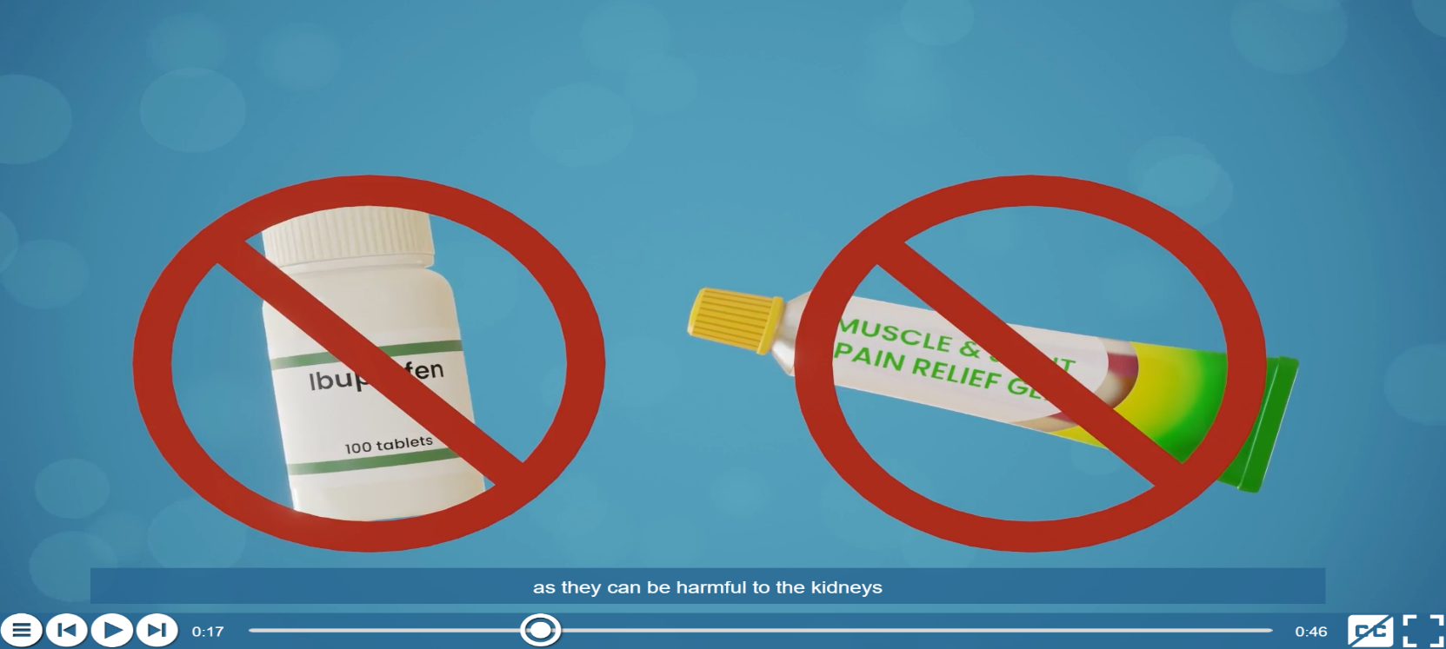
NSAIDS
Notes:
Avoid non-steroidal anti-inflammatory drugs (NSAIDs), if possible such as ibuprofen, naproxen, diclofenac– these medicines can harm your kidneys if you have kidney disease. These medications prohibit the compensatory vasodilation response of renal prostaglandins to vasoconstrictor hormones released by the body which result in reduced renal blood flow.

Slide 24
Preventing acute kidney injury
Staying hydrated
Some patients may need further support to stay hydrated.
For example:
Choose a cup suitable for the patient – they may prefer to use a straw
Support and encouragement to maintain fluid intake throughout the day
It could be as simple as set drink routines rather than relying on thirst alone
Jelly and other food rich in fluid can be offered to increase fluid intake if the resident doesn’t want to drink
Encourage fluids when giving care at night

Slide 25
Preventing acute kidney injury
Fluid balance
Dehydration is the underlying cause of many common conditions including constipation, falls, urinary tract infections, pressure ulcers, malnutrition, incontinence, confusion and pre- renal AKI.
The elderly are more prone to dehydration because:
They may lose the ability to recognise thirst
poor mobility and incontinence may mean a person avoids drinking enough

Slide 26
Fluid Balance
-independent patients
-Relatives give drink to the patient.
Standard Cup = 150mls
Standard Jug = 1000mls
Standard glass = 200mls

Slide 27
Fluid Balance
Incontinent of urine

Slide 28
Case study
Lottie is an 83 year old resident in your care home
Lived in the care home for three years after she fell at home and fractured her hip
She has lost confidence in walking and likes to have assistance to walk around the home
She takes ibuprofen for some pain in her hip and has tablet controlled diabetes
She has some heart failure and takes Furosemide and Ramipril
Do you think she is at risk of AKI? Why?

Slide 29
Answers to Case Study
Lottie is at risk of AKI:
Older people are the group most at risk of AKI
Older patients are especially prone to dehydration – particularly if they also have dementia or frailty, making food and fluid intake more difficult, particularly if they are reliant on others for access to fluids
Patients with heart failure often have an element of Chronic Kidney Disease and are on diuretics and medicines to regulate the blood pressure
Metformin (a diabetes drug) is excreted by the kidneys, and therefore raises the risk of AKI

Slide 30
Case study
Mr R is a 72-year-old man with hypertension, CKD and Type 2 diabetes complicated by peripheral neuropathy. He had a BMI of 29. Mr R lived with his wife and was under regular review. He had been seen 6 months earlier by the practice nurse who had identified no new problems. His blood pressure was noted to be stable and satisfactory at 134/80. An HbA1c was 64 mmol/mol, serum creatinine 144 umol/L (eGFR 44 ml/min/1.73m2) with no microalbuminuria. No changes were made to his medications which included Ramipril, Furosemide, Mixtard-30, Simvastatin, Paracetamol; Tramadol and Gabapentin. Mr R was reassured that his glycaemic control was satisfactory and that the rest of his blood tests were normal for his age.

Slide 31
Case Study
His wife contacted the out of hours GP service via NHS 111, one Saturday afternoon because he had not been himself for a few days and was complaining of fatigue and malaise. He was also off his food. A telephone consultation ensued during which the on-call GP established that he was managing a few cups of tea and some toast and that there was no history of chest pain, palpitations or cough, fever, abdominal pain, diarrhoea or vomiting or urinary symptoms. Blood glucose readings were high at home. The GP thought that a viral illness was the likeliest diagnosis. Rest, fluids and a regular carbohydrate intake were recommended with advice to monitor blood glucose frequently and to contact his surgery if still unwell after the weekend.
Notes:
Malaise is a general feeling of discomfort, illness, or lack of well-being.

Slide 32
Case study
A home visit was requested by his wife on Monday as Mr R remained unwell and lethargic. He was still not eating or drinking very much. He was seen by a GP that lunchtime who noted that he was pale and afebrile with a blood pressure of 92/50. He also noted that Mr R’s right big toe looked infected. A two-week course of Flucloxacillin was prescribed. A district nurse review was arranged in five days with repeat GP review in two weeks. There was no district nurse entry in Mr R’s record.
A further GP home visit was requested by his wife a week later as Mr R had been vomiting for 24 hours and was experiencing hypos. He was seen by another doctor who noted that Mr R was disorientated, agitated and unwell but afebrile and the red toe redness had settled. His blood pressure was 70/40. Urgent admission was arranged.

Slide 33
Case study
On admission he was found to be in hypovolaemic shock with oliguria. His admission serum creatinine was 480 umol/L with accompanying serum potassium of 7.1 mmol/L. He was resuscitated with IV fluids. Ramipril, Furosemide, Tramadol and Gabapentin therapy were temporarily suspended.
Final Diagnosis: Stage three Community acquired Acute Kidney Injury secondary to hypovolaemia
Notes:
Hypovolaemia - a decreased volume of circulating blood in the body.
Oliguria is defined as urinary output less than 400 ml per day or less than 20 ml per hour

Slide 34
Questions:
What are your thoughts?
Is Mr R at risk of AKI?
What are the risk factors present in this situation?
Is the hospital admission can be prevented?
What would you do different in this situation?
Notes:
Risk Factors: elderly, CKD, diabetes.

Slide 35
References:
Birmingham Community Healthcare NHS Foundation Trust. Hydration Resource Tool
Bjornstad, E.C., Muronya, W., Smith, Z.H., Gibson, K., Mottl, A.K., Charles, A., Marshall, S.W., Golightly, Y.M., Munthali, C.K. and Gower, E.W. (2020). Incidence and epidemiology of acute kidney injury in a pediatric Malawian trauma cohort: a prospective observational study. BMC Nephrology, 21(1). doi:10.1186/s12882-020-01755-3.
Cadogan, M. (2020). Dipstick urinalysis • LITFL • CCC Investigations. [online] Life in the Fast Lane • LITFL • Medical Blog. Available at: https://litfl.com/dipstick-urinalysis/.
Carroll H (2000) Fluid and electrolytes. In Sheppard M, Wright M (Eds) Principles and Practice of High Dependency Nursing. Bailliere Tindall, Edinburgh.
Kerr M, Bedford M, Matthews B, O’Donoghue D. The economic impact of acute kidney injury in England. Nephrol Dial Transplant (2014) 29: 1362–1368
Kidney Care UK (2020) Facts and Stats, Available at: https://www.kidneycareuk.org/news-and-campaigns/facts-and-stats/
Kidney Disease Improving Global Outcome (2012). KDIGO Clinical Practice Guideline for Acute Kidney Injury. Available at: Available at: https://kdigo.org/wp-content/uploads/2016/10/KDIGO-2012-AKI-Guideline-English.pdf.

Slide 36
References:
National Kidney Foundation. (2024). Acute Kidney Injury (AKI). [online] Available at: https://www.kidney.org/atoz/content/acute-kidney-injury-aki.
National Confidential Enquiry into Patient Outcome and Death (NCEPOD) 2009. Acute Kidney Injury: Adding Insult to Injury.
National Institute for Health and Care Excellence (NICE) 2013, Clinical guideline 169, Acute Kidney Injury.
https://nutritionandhydrationweek.co.uk/
https://nutritionandhydrationweek.co.uk/resources/
Think Kidneys (2016). Acute Kidney Injury Best Practice Guidance: Responding to AKI Warning Stage Test Results for Adults in Primary Care. Available at: https://www.thinkkidneys.nhs.uk/aki/wp-content/uploads/sites/2/2016/10/RespondingtoAKI-Warning-Stage-Test-Results-for-Adults-in-Primary-Care.pdf
Urine colour chart: http://jbfitnesssystems.com/eddie-vendetta-part-2/
Wang, H.E., Muntner, P., Chertow, G.M. and Warnock, D.G. (2012). Acute Kidney Injury and Mortality in Hospitalized Patients. American Journal of Nephrology, 35(4), pp.349–355.
Welch K (2010) Fluid balance. Learning Disability Practice; 13: 6, 33-38.

Slide 37

Summary
    Any Questions

