Slide 1
Bladder and Bowel Bootcamp
Bowel Management
BCHC Bladder and Bowel Service
^{18th} February 2025

Slide 2
Aims and Objectives
Understanding of the bowel anatomy and physiology.
Confidence in completing a comprehensive bowel assessment and the Bristol Stool Chart.
Be more aware of alternative products to bowel care.
Knowledge and understanding in bowel care, Trans Anal Irrigation and documentation.
Skills and knowledge in identifying Autonomic Dysreflexia and how to treat if required.

Slide 3
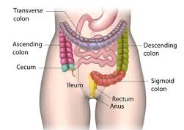

Bowel Anatomy

Slide 4
Unhealthy Bowel
What makes an unhealthy Bowel?

Slide 5
Unhealthy Bowel
Bristol Stool Chart
Constipation/Diahorrea (greater than 2 weeks)
Smell/colour
Blood/Mucus
Vomiting/Bloating
Poor Diet
Hydration – Too Little
Mobility
Medications
Underlying health conditions

Slide 6
Healthy Bowel
What is a Healthy Bowel?

Slide 7
Healthy Bowel
Bristol Stool type 4
Bowel movements
Well-balanced diet
Well hydrated
No bloating/pain free
No straining

Slide 8
Stool production and influences
Stool output – 150-200g per day.
Bowel frequency in a healthy person can range from 3 times per day to 3 times per week
Stool consistency can vary as it is influenced by gender, diet and health
Normal defecation is known as ‘call to stool’. This is where the need to pass faeces is initiated voluntarily.
RCN, Bowel Care (2019)

Slide 9
Individuals at risk of developing bowel dysfunction
Spinal injury or neurological conditions
Acute disc prolapse or acquired brain injury
Eating disorders or nutritional issues
End of life care needs
Cognitive impairment
History of abuse
Impaired mobility
Alcohol and drug dependency
Prostatic obstruction
Peri-natal / post childbirth
Post surgery
Frail elderly
Individuals in communal settings
Critically ill patients

Slide 10
Faecal incontinence
• Faecal incontinence (FI) – the involuntary loss of liquid or solid stool that is a social or hygienic problem.
• Anal incontinence (AI) – the involuntary loss of flatus, liquid or solid stool which is a social or hygienic problem (Bliss et al., 2017).
• Passive soiling (liquid or solid) - occurs when an individual is unaware of liquid or solid stool leaking from the anus; this maybe after a bowel movement, or at any time
RCN, Bowel Care (2019)

Slide 11
Causes of faecal incontinence
Passive soiling
Urge faecal incontinence
Diarrhoea
Inflammatory bowel disease (IBD)
Inflammatory bowel syndrome (IBS)
Anorectal pathology
Neurological disease
Lifestyle and environment
Functional
Post Covid syndrome
Notes:
Passive soiling – poor internal sphincter pressure or surgical damage
Urge faecal incontinence – external sphincter weakness or obstetric trauma
Diarrhoea – Increased gut motility
Inflammatory bowel disease (IBD) - is a term mainly used to describe 2 conditions: ulcerative colitis and Crohn's disease
Inflammatory bowel syndrome (IBS) - a common condition that affects the digestive system
Anorectal pathology – includes rectal prolapse, fistula, haemorrhoids
Neurological disease – Spinal cord injury, Multiple Sclerosis (MS), Spina Bifida, Dementia
Lifestyle and environment – poor toilet facilities, diet, dependence on carer
Functional - Idiopathic or unknown cause
Post Covid syndrome - This also is called long COVID. Long COVID is a new condition which is still being studied

Slide 12
Functional constipation
(symptoms)
Straining at defecation
Lumpy or hard stools
Sensation of incomplete evacuation
Fewer than three bowel movements per week
Sensation of anorectal obstruction
Manual manoeuvres to facilitate defecation
Notes:
Straining at defecation – This is when someone is sitting on the toilet and pushing hard to pass a stool. By straining you can cause Haemorrhoids (Piles) which can bleed.
Lumpy or hard stools – This is usually a stool type 1 or 2. It means that the faeces has spent too much time drying in the intestines, but it has not dried out enough to break apart into small pieces.
Sensation of incomplete evacuation – This is the sensation that a bowel movement has not been complete even if it has
Fewer than three bowel movements per week – If you have less than three bowel movements per week this would be classed as constipation. You would need to see what your patients normal bowel movements are to determine if this is true constipation
Sensation of anorectal obstruction – This may be due to mechanical causes or functional disorders of the anorectal region. These could be issues such as rectal prolapse, rectocele, enterocele,
Manual manoeuvres to facilitate defecation – These are procedures such as Digital Rectal Evacuation and Digital Rectal Stimulation

Slide 13
Diarrhoea
Diarrhoea can be caused by; a bowel infection, food allergy, alcohol consumption, inflammation, coeliac disease or appendicitis
Symptoms can include; Loose, watery stools, stomach cramps, feeling sick or vomiting, headaches and no appetite
Acute – sudden onset lasting less than two weeks and resolves without treatment
Chronic diarrhoea is a frequent passage of unformed stools for one month or more. This may be due to inflammatory bowel disease, IBS or coeliac disease

Slide 14
Red Flags in Bowel Management
Change in bowel habit
Blood in stools/unexplained black stools
Unexplained weight loss
Pain on defecation
Abdominal pain and bloating which doesn’t resolve
Faecal vomiting
Notes:
Change in bowel habit - Bowel habits can vary from person to person, day to day. Therefore, a sudden and noticeable change to your bowel habit can be suggestive of an underlying health issue – such as Irritable Bowel Syndrome (IBS), Inflammatory Bowel Disease (IBD) or Bowel Cancer
Blood in stools/unexplained black stools - This can happen for a variety of reasons – having too much bile during digestion, having a medical condition like inflammatory bowel disease or celiac disease, being on antibiotics, or even just eating foods with strong colour pigments. Often, blood can make your stool look very dark and almost black. concerned, you should contact your GP should you be concerned, or this is a new symptom for you.
Unexplained weight loss – Unintentional/Unexplained weight loss can be for Therefore, reasons such as stress, mental health issues, digestion problems, Malnutrition or health conditions. However, it could also be a sign of serious illness, always consult your GP
Pain on defecation - Anal pain (pain in the bottom) is common and can be caused by Therefore, things such as constipation, Haemorrhoids, Anal fissures, abscesses, Sexual Transmitted Infections (STI) and even Anal cancer. There are things you can do to ease it, but see a GP if you're in a lot of pain or it does not get better
Abdominal pain and bloating which doesn’t resolve – The most common reason for bloating is having a lot of gas in your gut. This is usually caused by some food and drinks, such as some vegetables and fizzy drinks, or by swallowing air when you eat. It can also be caused by problems with your digestion, such as constipation, food intolerance, coeliac disease, IBS and some women feel bloated around the time of their period. Sometimes, bloating that does not go away can be a sign of something more serious such as ovarian cancer. Therefore, if the abdominal pain or bloating does not ease or getting worse see a GP
Faecal vomiting - This is vomiting whereby you vomit faecal matter. It normally means that there is a intestinal obstruction in some way. It is often accompanied by an odour of faeces on the breath and other gastrointestinal symptoms, including abdominal pain, abdominal distention, dehydration and sometimes diarrhoea. If this does occur you must seek medical help immediately.

Slide 15
Risk Factors
It is important to be aware of any risk factors such as
Bowel Cancer
Severe Faecal Impaction
An Obstruction
Clostridium difficile (C.Diff)
Spinal Cord Injury

Slide 16
Circumstances when extra care is required.
When assessing a patient for Faecal incontinence there are times when extra care is needed through both discussion and examinations
Active inflammation of the bowel
Recent radiotherapy to pelvic area
Pain (anal/rectal)
Recent surgery or trauma
Tissue fragility (age, malnutrition, radiation)
Obvious rectal bleeding
Abuse
Spinal injuries at T6 or above in SCI patients
Undiagnosed perianal abnormalities

Slide 17

Break

Slide 18
Digital rectal examination (DRE)
A digital rectal examination (DRE) can be undertaken by a registered nurse who can demonstrate professional competence to the level determined by the Nursing and Midwifery Council (NMC) in its Code of professional conduct (NMC, 2015a).
DRE should be performed as part of the assessment of bowel dysfunction, and in conjunction with the assessment process.

Slide 19
Indications for DRE
DRE is indicated in the following circumstances:
Establish the presence of faecal matter in the rectum; the amount and consistency
Assess anal tone and sensation
Evaluate the general status of the anal and rectal area prior to administration of rectal interventions
Evaluate the need for, and effects of, rectal medication in certain circumstances
The assessment of anal pathology for the presence of foreign objects
Bowel emptiness in neurogenic bowel management
Prior to investigative procedures e.g. sigmoidoscopy or colonoscopy
Identify the need for further interventions:
Prior to the administration of suppositories or an enema
Prior to the placement of an anal plug/insert
Prior to using trans anal irrigation
When determining if digital removal of faeces or digital rectal stimulation is required.

Slide 20
Bowel care emergencies/ complications
There are several bowel care emergencies and complications. Below are a list of some of those emergencies and complications that can occur.
Bowel obstruction
Perforation
Strangulated hernia
Diarrhoea of an unknown aetiology
Undiagnosed rectal bleeding
Faecal impaction
Autonomic dysreflexia
Notes:
Bowel obstruction – A bowel obstruction is classed as a medical emergency. This normally occurs when there is a blockage in the large intestine
Perforation – A perforation is classed as a medical emergency. A perforated bowel occurs when hole develops in your bowel wall. The contents may spill into your abdomen and cause peritonitis, an infection. Such an infection can lead to sepsis.
Strangulated hernia - A strangulated hernia is classed as a medical emergency. It happens when the fatty tissue or a section of the small intestines pushes through a weakened area of the abdominal muscle. The surrounding muscle then clamps down around the tissue, cutting off the blood supply to the small intestine.
Diarrhoea of an unknown aetiology - Most cases of acute diarrhoea resolve without treatment. However, severe diarrhoea (greater than 10 bowel movements a day or diarrhoea where fluid losses are significantly greater than oral intake) can cause dehydration, which can be life-threatening if untreated
Undiagnosed rectal bleeding – Undiagnosed rectal bleeding is classed as a complication following conditions such as Anal fissures, Angiodysplasia., Haemorrhoids, Constipation, Anal or colorectal polyps, Ulcers, Anal cancer or colon cancer, Inflammatory bowel disease (IBD),Diverticular disease, Infections, Bleeding conditions and Damage to the upper gastrointestinal (GI) tract, However if the bleeding is severe this would be classed as a medical emergency and you would need to seek help immediately.
Faecal impaction – Faecal Impaction can be classed as a complication and without treatment can become life threatening causing serious complications such as hole in your colon, bleeding, uncontrolled bowel movements and ulcers. Therefore, it is important to get this reviewed by your GP as soon s possible or referred on to gastroenterology.
Autonomic dysreflexia – Autonomic dysreflexia can be a life-threatening condition. It can cause bleeding in the brain, stroke, seizures, and other heart and lung problems. Autonomic dysreflexia is a medical emergency commonly occurring in patients with spinal cord injury at levels T6 and above

Slide 21
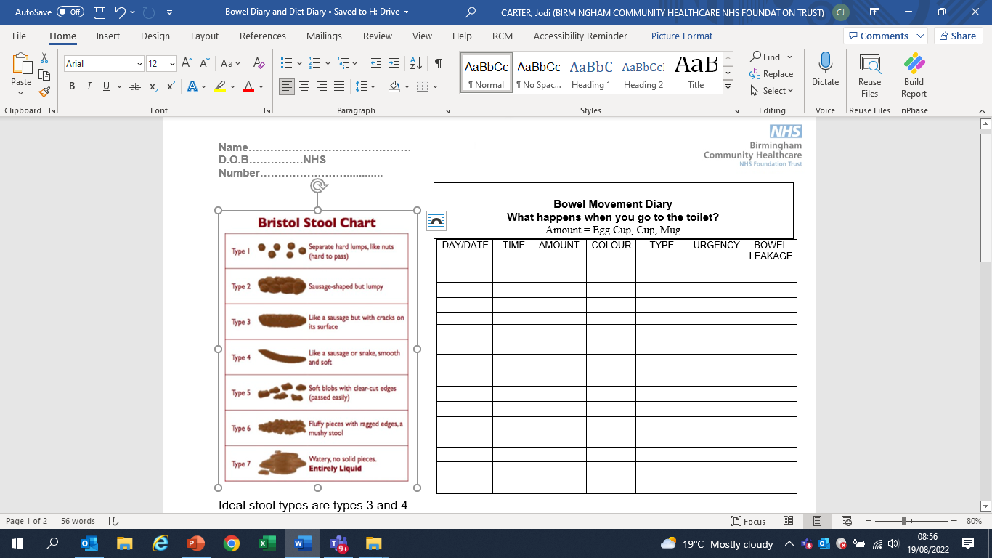
Bowel and food diary
Bowel diary
This is given to patients at the beginning of an assessment.
It is to be completed for 7 days prior to assessment, and it provides a snapshot of the patient's incontinence issues and severity
Food Diary
This works in conjunction with the Bowel diary. This diary provides the clinician a snapshot of the patient's dietary habits.
This allows the clinician to tailor their advice to the patient on the benefits of a good healthy diet

Slide 22
Stool Observation
Consistency - This means the degree of firmness to the faeces
Frequency -There is no “normal” number of bowel movements
Colour - Normal stool colour is brown
Amount – Is it small stools being passed
Notes:
Consistency – This means the degree of firmness to the faeces. The Faeces should be soft and pass easily. Hard, dry stools might be a sign of constipation. Watery stools could suggest diarrhoea
Frequency - There is no “normal” number of bowel movements. A healthy bowel movement frequency can range from three times a day to three times a week
Colour - Normal stool colour is brown. This is due to the presence of bile in the stool. Normal stool colour can range from light yellow to brown to almost black. If stool is red, maroon, black, clay-coloured, pale, yellow, or green this may signify a problem

Slide 23
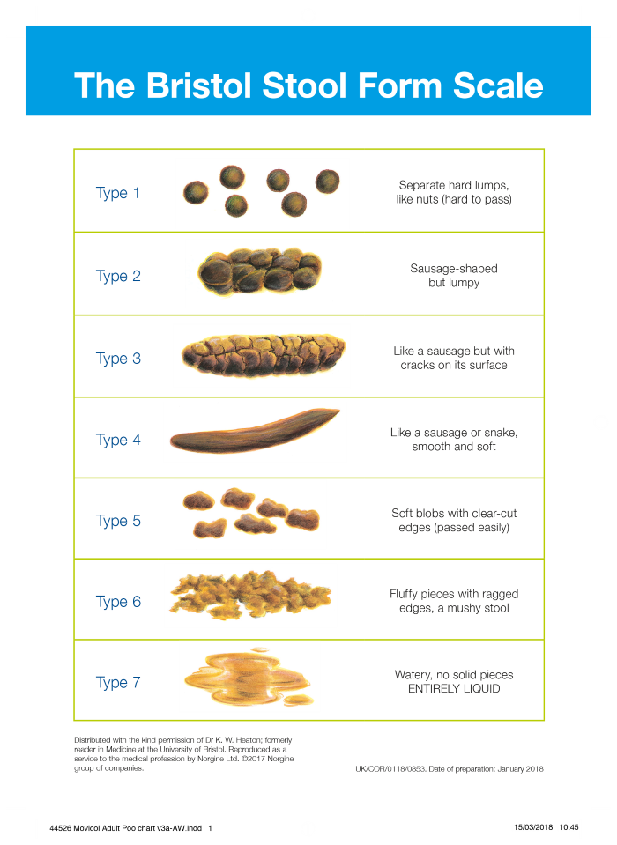
Bristol Stool Chart
The Bristol Stool Chart was developed in 1997 as a clinical assessment tool. There are seven types of stools (faeces) according to the Bristol Stool Chart
The chart is used to describe the shapes and types of stools. It is also used as a tool to diagnose constipation, diarrhoea and irritable bowel syndrome
Type 1-3 indicate constipation
Type 4-5 are ideal stools as they are easier to pass
Type 6-7 may indicate diarrhoea and urgency

Slide 24
Patient initiated treatment options and product support
As part of a for management plan there are several treatment options that you can think about.
The next few slides will take you through some of the advice you can give your patient in order for them to manage their bowels.

Slide 25
Toilet Positioning
Correct toileting position
https://youtu.be/M7G2vO_5ghU

Slide 26
Nutrition
A good diet promotes an ideal stool consistency and predictable bowel emptying. When discussing nutrition and diet with the patient consider the below
Any existing therapeutic diets
Establish baseline with food & fluid diary
Screen people with faecal incontinence for malnutrition
Consider cultural & religious beliefs
Consider your 5 a day (fruit/veg)
Consider referral to dietician
Aim for 30g fibre per day

Slide 27
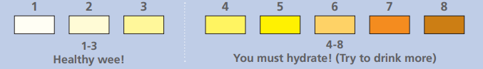
Fluid advice
Daily intake between 1.5 – 2 litres (consider any fluid restriction)
Observe urine colour as linked to concentration of urine
Dairy intolerance - a possible intolerance causing looser stools
Coffee/caffeine can increase gut motility
Diet drinks may contain sorbitol which could act as a laxative
Alcohol can increase gut motility
Some herbal teas can aid digestion
Fizzy/carbonated drinks may cause abdominal bloating

Slide 28
Skin care
Skin breakdown can be due to passive soiling, profuse diarrhoea, prolonged sitting on a hard toilet seat or wearing containment products
Reduce risk of incontinence associated dermatitis by using barrier products
Use foam cleansers to fully clean the skin
Avoid inappropriate creams or lotions e.g. oily based, over applying creams
Educate your patient on how to look after their skin
Regular inspection and evaluation of products, patients skin
If using containment products, ensure they are the most appropriate product and absorbency for their needs

Slide 29
Definition of Moisture Lesions
A moisture lesion is soreness and blistering where the skin has been exposed to wetness over a long period of time. This wetness can be urine, faeces, sweat or wound fluid. Millard, 2019
Or
Prolonged contact of the skin with urine or faeces leads to a specific form of moisture-associated skin damage, known as incontinence-associated dermatitis (IAD). D.Voegeli, 2017

Slide 30
Cause Of Moisture Lesions
There are a number of reasons patients get moisture lesions
Perspiration/added moisture
Inaccurate skin inspections
Misuse of barrier products

Slide 31
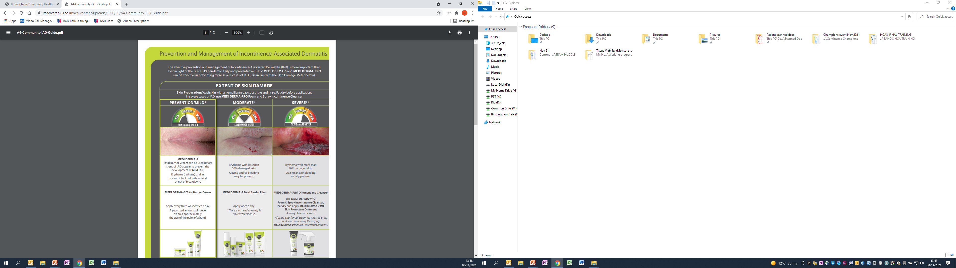
Think Continence
Inaccurate continence assessment
Incorrect containment products
Mild
Moderate
Severe
Medicare plus: Prevention and Management of Incontinence –Associated Dermatitis

Slide 32
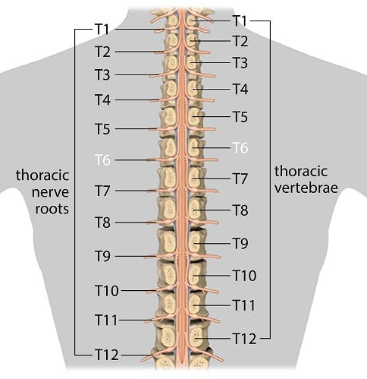
What is Autonomic Dysreflexia?
Autonomic dysreflexia (AD) is a condition affecting spinal cord injury persons with an injury at or above the level of the 6th thoracic vertebrae (T6). Bladder and Bowel management is important to avoid autonomic dysreflexia.

Slide 33
What causes Autonomic Dysreflexia?
Autonomic Dysreflexia is caused by the disruption of the autonomic nervous system when a spinal cord injury occurs. Harmful stimuli below the level of injury can cause a sympathetic response resulting in vasoconstriction while inhibitory signals from the brain are not received. As a result of the peripheral and splanchnic vasoconstriction, hypertension is seen, which is a classic sign of AD

Slide 34
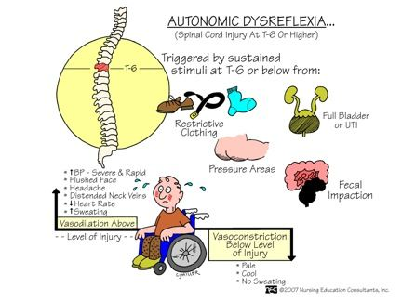
Autonomic dysreflexia signs & symptoms

Slide 35
Autonomic Dysreflexia in Bowel Care
To reduce the risk of Autonomic Dysreflexia you should always ensure that the patient is not constipated
Ensure that the patient has regular bowel movements
Making sure that patients are well educated of the signs and symptoms of Autonomic Dysreflexia and how to act
If patient is prescribed any medication for their bowels, ensure that patient takes this regular and as prescribed

Slide 36
Autonomic Dysreflexia in Bladder Care
To reduce the risk of Autonomic Dysreflexia you should always ensure that the patient is not constipated
Ensure that the patient doesn’t have a distended bladder, kink in the catheter, overfull catheter bag, blockage or obstruction, urine tract infection, bladder stone.
Making sure that patients are well educated of the signs and symptoms of Autonomic Dysreflexia and how to act

Slide 37

Lunch

Slide 38
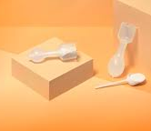
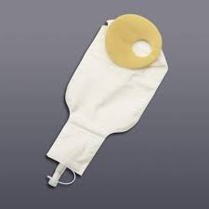
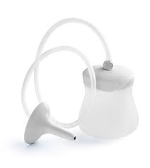
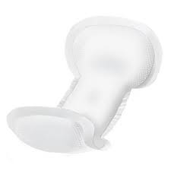
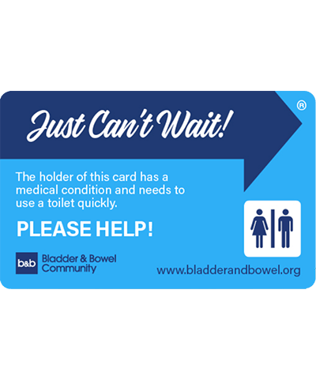
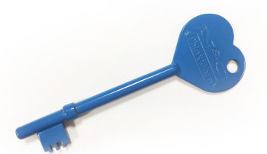
Products to manage Faecal incontinence
Anal Inserts
Faecal Collectors
Trans Anal Irrigation
Containment products
Radar Key
Can’t wait card
Notes:
Anal Inserts
Anal inserts may be used to manage faecal incontinence; the single use devices are inserted into the anal canal to prevent faecal leakage.
These are good for patients that have some small leakage and want to go out and not need to wear an containment products
Faecal Collectors
Faecal collection devices are a group of devices that are intended to collect stool as it passes from the rectum. The stool is collected in a bag or pouch, which is periodically emptied
Trans anal Irrigation
Trans anal bowel irrigation is a way of facilitating the evacuation of faeces from the bowel by introducing water (or other fluids) into the colon via the anus in a quantity sufficient to reach beyond the rectum
Abena Containment Products
Abri let Anatomic Faecal liner is designed to act as a grab pad that sits on top of another containment product. When patient has opened their bowels it is designed to be removed and replaced therefore protecting he pad underneath.
The Abri let Anatomic is designed for smearing, small leakage or firm formed bowel movements that can be removed in one go.
Abri San Special is a faecal pad that is designed with a waterproof backing meaning this can be used for patients with more leakage or constant loose stools

Slide 39
Anal irrigation
Anal irrigation is used to manage faecal incontinence, chronic constipation or as a form of bowel management.
It can be used by lots of different people with varying bowel problems and works by effectively emptying the bowels. If used regularly anal irrigation can prevent chronic constipation and faecal incontinence.
Bladder and Bowel Community, Understanding bowel irrigation as a medicinal treatment (2022)

Slide 40
Bowel Management Group Work
Each table has been given a Bowel Assessment case study.
Review the information you have and answer the following:
  Is the Bowel sample abnormal? Why
  What could this indicate?
  What actions would you take?

Slide 41
Bladder and Bowel Medication
Birmingham Community Healthcare
Professional Development Pharmacist
Aman-Kumar BASRA

Slide 42
Break

Slide 43
Summary
Gained an understanding of the bowel anatomy.
Confidence in completing a comprehensive bowel assessment, Bristol Stool Chart and alternative products to bowel care.
Have a better understanding in bowel care, Trans Anal Irrigation and documentation.
Mindfulness when identifying Autonomic Dysreflexia and how to treat if required.

Slide 44
Evaluation QR Code

Slide 45

Questions

Slide 46
Contact us
There are lots of useful resources on the Continence page on the intranet
Email: bchnt.continencereferrals@nhs.net
Telephone: 0121 466 3700
Option 1 Pad orders (Monday – Friday 9.00 - 4.00)
Option 2 Appointments & general enquires (Monday – Friday 9.00 - 4.00)
Option 3 Triage nurse (Monday – Friday 1.00 - 4.00)

Slide 47

Thank you

Slide 48
References
Birmingham Community Healthcare Trust: Bowel Care for Adults Policy CH694
Birmingham Community Healthcare Trust: Bladder and Bowel Service - Bowel and Diet diary
GOV.UK. (n.d). GC and IFST publish Information Statement on dietary fibre. [online] Available at: https://www.gov.uk/government/news/gc-and-ifst-publish-information-statement-on-dietary-fibre [Accessed June. 2022].
NICE 2014 Faecal Incontinence. The Management of faecal incontinence in adults. London NICE
Nursing & Midwifery Council 2018 Professional Standards of Practice and Behaviour for Nurses, Midwives and Nursing Associates (Accessed June 2022) http://www.NMC-UK.ORG/AFRAMEDISPLAY.ASPX?DOCUMENTID=1645
RCN 2019 Bowel care, Including Digital Rectal Examination, and manual removal of faeces. London RCN.

