Slide 1
Bladder and Bowel Bootcamp
Bladder Care
BCHC Bladder and Bowel Service
^{17th} February 2025

Slide 2
Aims and Objectives
Understanding of the male and female anatomy.
Confidence in completing a comprehensive continence assessment.
Gain awareness of urinalysis and red flags
Be more aware of alternative products and systems used in relation to bladder care.
Knowledge and understanding in catheter care, plans, documentation and bladder scanning.
Skills and knowledge in identifying and treating catheter complications in the community.

Slide 3
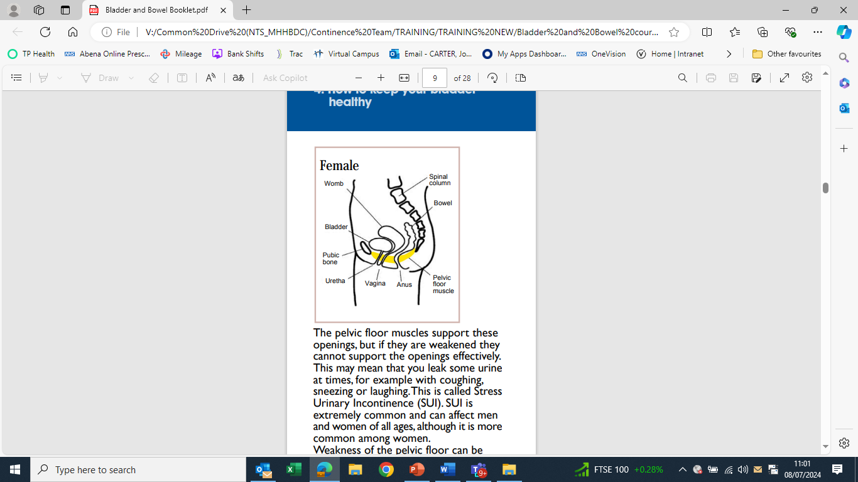

Female Anatomy

Slide 4
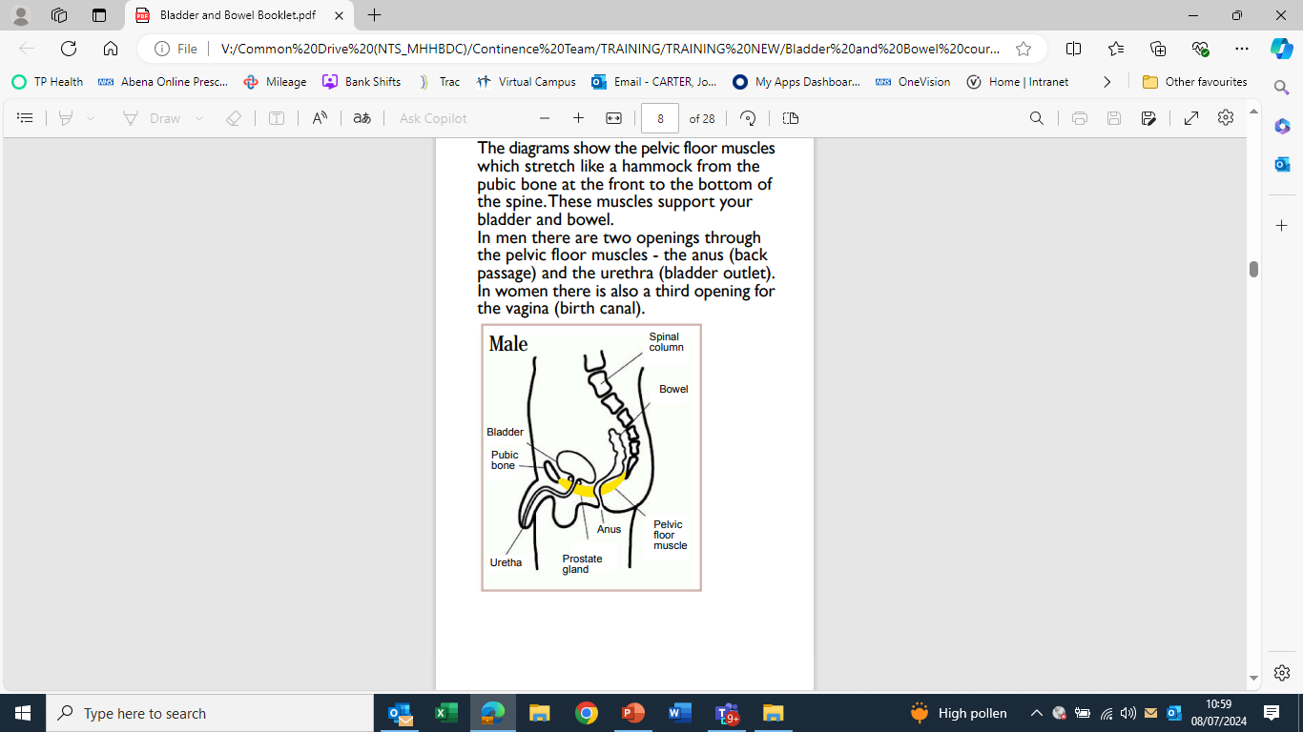
Male Anatomy

Slide 5
Unhealthy Bladder
What makes an unhealthy Bladder?

Slide 6
Unhealthy Bladder
Hydration – Too much/Too little
Caffeine and Sugar
Alcohol
Medication
Long Term Conditions
Mobility
Urine colour, odour

Slide 7
Healthy Bladder
What is a Healthy Bladder?

Slide 8
Healthy Bladder
Well hydrated
Clear urine
Feeling of complete emptying
Well-balanced diet

Slide 9
History of catheters
In ancient times catheters were made from tin, copper, bronze and even gold. Principles and practice of Urology, 2013
In 100BC, the Chinese used hollow onion stems, dried reeds and palm leaves. R.Feneley et al, 2015
In Europe, silver catheters were in use from Norman times up until the present century. R.Feneley et al, 2015
Up until the mid 1930’s catheters were intermittent. R.Feneley et al, 2015
In 1934 Dr Frederick Foley designed a self retaining catheter, which is a flexible tube retained in the bladder by a balloon. I Pomfret, 2000
Notes:
Can these come on one at a time?

Slide 10
Why catheterise?
Short Term Catheters
AND
Long Term Catheters
Notes:
Short Term
Surgery – Following a surgical procedure that requires a catheter during recovery period
Immobility – Following a period of immobility to support skin integrity
Fluid monitoring – To be able to get an accurate fluid input and output
Acute urinary retention – To support urinary retention symptoms
Tissue viability – To maintain skin integrity during a period of ill health causing tissue viability risks
Long Term
Bladder emptying problems – Issues with long term retention or related to prostate or prolapse issues causing reduction in bladder emptying
Not fit for surgery – Ill heath or immobility but not fit for surgical intervention or bladder emptying problems that can not be rectified through surgery due to ill heath
Incontinence/end of life – End of life patients where dignity, skin integrity and need is great

Slide 11
Factors to consider when catheterising
Risk of infection
Risk of trauma
Pain/discomfort
Sexuality/altered body image
Increased dependence
Increased anxiety
Notes:
Risk of infection – By having a catheter it can sometimes allow bacteria to enter your body creating a Urinary Tract Infection (UTI)
Risk of trauma - injury to the urethra (the tube that carries urine out of your body) when the catheter is inserted
Pain/discomfort - narrowing of the urethra because of scar tissue caused by repeated catheter use. Also irritation of the balloon inside from the catheter
Sexuality/altered body image - They may be conscious of having a leg bag, which may affect the clothes they choose to wear and their sexual relationships, and may also lead to social isolation
Increased dependence – The need to be at home to have the catheter changed or dependent on others for drainage bag changes, blockages etc
Increased anxiety - Anxiety raised when patient is due for a change of catheter i.e. pain, discomfort, personal

Slide 12
Possible complications to consider
Patient has a history of difficult catheterisation
Oedematous or ill-defined genitalia
Female Genital Mutilation
Autonomic Dysreflexia
Infection
Anxiety
(This list is not exhaustive)
Notes:
Patient has a history of difficult catheterisation – Patient has a history of bleeding, complicated or difficult catheterising in the past. There could be urethral strictures which will cause difficulty in passing a catheter. The risk of further difficult catheterisations, possible hospital admission should there be any complications
Oedematous or ill-defined genitalia – Unable to complete catheterisation due to changes to the genital area such as surgery altering the entry site where catheter is inserted or extreme oedema around the genital area
Female Genital Mutilation – Scar tissue covers the urethral meatus and part of the vaginal introitus
Autonomic Dysreflexia - Some circumstances patients with a Supra Pubic catheters can go into retention. You must remove the stimuli that is causing Autonomic Dysreflexia. You can insert an urethral catheter to drain the bladder
Infection – Having an indwelling catheter can increase your risk of infections as the body associates the catheter as a foreign body. By having a catheter it can sometimes allow bacteria to enter your body creating a Urinary Tract Infection (UTI)
Anxiety – This can be a complication if the patient is anxious or tense at catheter change as this can cause spasms which makes the catheter insertion difficult and sometimes painful

Slide 13
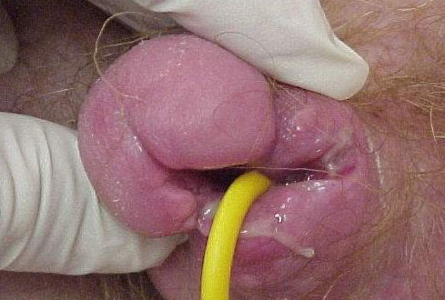
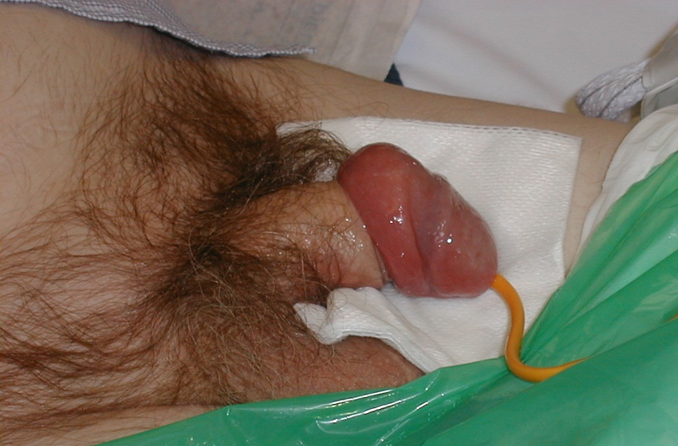
Possible complications to consider
Hypospadias
Paraphimosis
Notes:
Hypospadias - a birth defect in boys where the opening of the urethra (the tube that carries urine from the bladder to the outside of the body) is not located at the tip of the penis
Paraphimosis - a common urologic emergency that occurs in uncircumcised males when the foreskin becomes trapped behind the corona of the glans penis

Slide 14
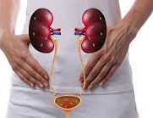
Catheter Acquired Urinary Tract Infection (CAUTI)
.
Notes:
A Symptomatic Infection of the kidneys and bladder in a person with a urinary catheter with no other source of Infection

Slide 15
Signs and Symptoms of CAUTI
Pyrexia
Rigors
Altered mental state
Lethargy
Pelvic/Flank pain
Haematuria
Notes:
Pyrexia - abnormal elevation of body temperature/fever
Rigors - Rigors are episodes in which your temperature rises - often quite quickly - whilst you have severe shivering accompanied by a feeling of coldness ('the chills'). The fever may be quite high and the shivering may be quite dramatic
Altered mental state – This is confusion or change in personality due to infection
Lethargy – the feeling of sleepy or fatigued and sluggish
Pelvic/Flank pain – This affects the area on either side of the lower back, between the pelvis and the ribs
Haematuria - the presence of blood in the urine

Slide 16
How To Minimise the Risk of UTI
DO NOT CATHETERISE!
Unless you really have to!
Every year CAUTI’s cost the NHS millions!

Slide 17
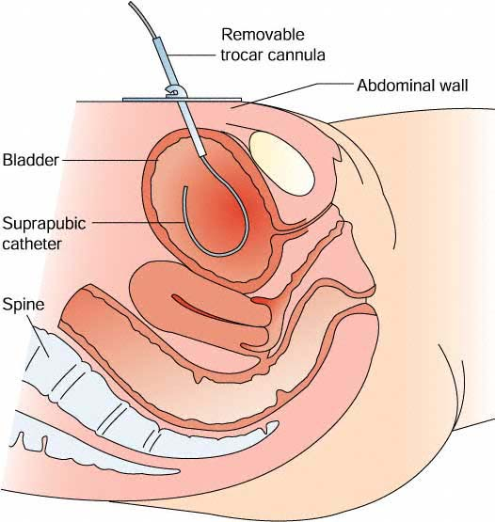
Suprapubic Catheter
Notes:
Suprapubic Catheter
The first change of a suprapubic catheter is usually completed in hospital and must be done without delay so the cystostomy (insertion site) is not allowed to close
Suprapubic catheters are used when a urethral catheter is unsuitable or if patient is to be or remain sexually active
When changing a suprapubic catheter the Carriere size must be changed like-for-like (e.g. ch16 changed for ch16)
Check the catheter being used is licensed for suprapubic usage with the manufacturer

Slide 18
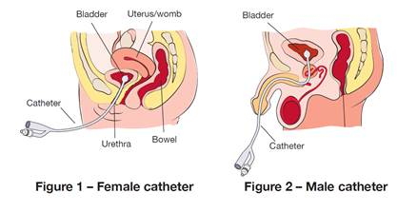
Male and Female Urethral Catheters
Notes:
Urethral Catheter
An indwelling urinary catheter is a catheter that sits in the bladder.
This type can be useful for short and long periods of time.
Most indwelling catheters need to be changed at least every 3 months.

Slide 19
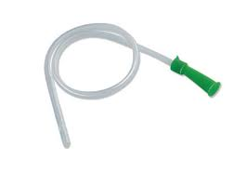
Short Term Catheters
Clean Intermittent self-catheterisation (CISC)
Notes:
Short Term Catheters (ISC)
Intermittent self-catheterisation (ISC) is used to treat bladders that do not empty fully
They are self lubricated in the individual packet
ISC catheters are inserted into the bladder at intervals throughout the day, or when you feel the need to go to the toilet.
It is sometimes necessary to catheterise during the night as well.
Once the urine has drained out, the catheter is removed they are single use

Slide 20
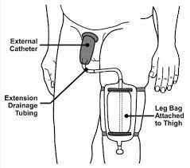
External Catheter (Sheaths)
Notes:
Sheaths (External Catheters)
A sheath is a self adhering external catheter.
They collect urine as it drains out of the bladder and send it to a collection bag strapped to your leg.
They’re typically used by men who have urinary incontinence
External urinary catheters are less invasive than internal catheters and can provide a good alternative to indwelling catheters, diapers or other absorbent products

Slide 21
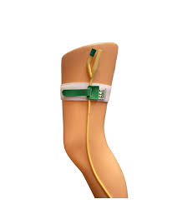
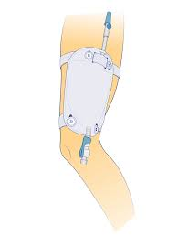
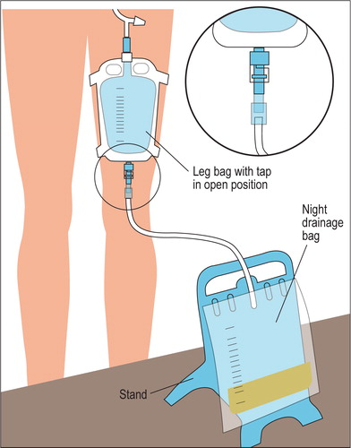
Drainage Systems
Leg bag Night Bag Fixation Straps
Notes:
Leg bag
Up to 500ml and can be attached to any indwelling and external catheter
Night Bag
Mainly used overnight up to 2 litres and can be attached to any indwelling and external catheter
Fixation Straps
G-Strap, Statlock or leg bag straps which hold the drainage system in place

Slide 22
Catheter Selection
Type of tip (e.g. open ended, Tiemann tip)
Material (e.g. Silicone, Latex, Coated catheters, etc.)
Size (e.g. Carriere/French Gauge) – Colour coded:
  CH10 – Black
  CH 12 – White
  CH14 – Green
  CH16 – Orange
  CH18 – Red
Length (Standard length for male/female/suprapubic, female for females only)
Balloon Volume (10ml or as per manufacturers/urology instructions)
Manufacturers license

Slide 23
Why Lubricate?
Pain free procedure
Urethral folds open.
Reduced risk of trauma to the urothelium.
Reduced risk of infection

Slide 24
What Lubrication should I use?
A Lignocaine Hydrochloride Gel – Instillagel (or Cathejel, Mono if allergic to Lignocaine)
11mls male catheterisation
6mls for female catheterisation
5 minutes to take effect
The effect is maintained for 30 minutes
Do not use Instillagel: If you are allergic (hypersensitive) to lidocaine, chlorhexidine, methyl hydroxybenzoate, propyl hydrobenzonate or any of other ingredients of Instillagel
If the moist lining of the application site is damaged or bleeding

Slide 25

Tiemann Tip Catheters
Pally Pagliuca

Slide 26

Break

Slide 27
Catheterisation/Change Care Plan in RIO
Locate patient in RIO and navigate to ‘Clinical Portal – Clients View’
Select ‘BCHC Generic Assessments’ then ‘BCHC Core Care Plans’
Select ‘BCHC Nutrition and Hydration’
Locate ‘Catheter Insertion Record’ and complete. Ensure you ‘save’ the assessment forms
Document your assessment in ‘Progress Notes’

Slide 28
Catheter Care Plan in RIO
Locate patient in RIO and navigate to ‘Clinical Portal – Clients View’
Select ‘BCHC Generic Assessments’ then ‘BCHC Core Care Plans’
Select ‘BCHC Nutrition and Hydration’
Locate ‘Catheter Care’ and complete. Ensure you ‘save’ the assessment forms
Document your assessment in ‘Progress Notes’

Slide 29

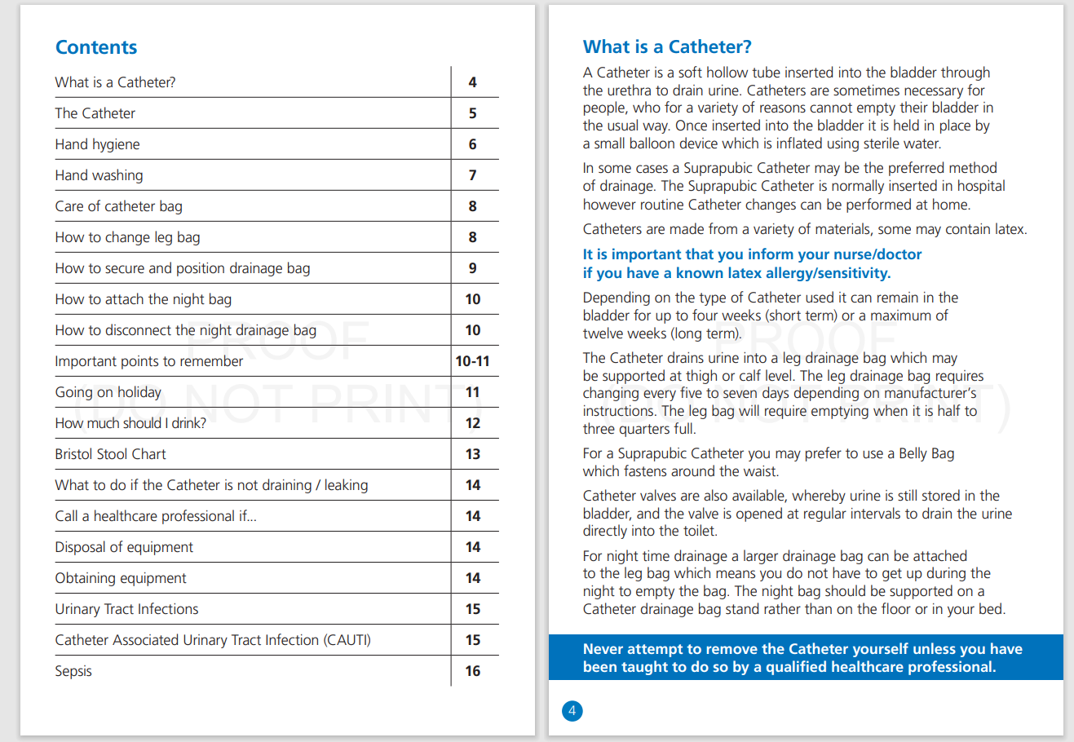
Catheter Passport

Slide 30
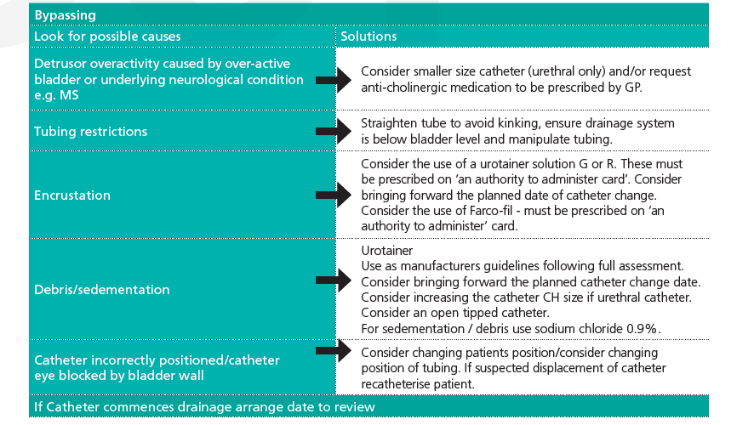
Troubleshooting - Bypassing

Slide 31
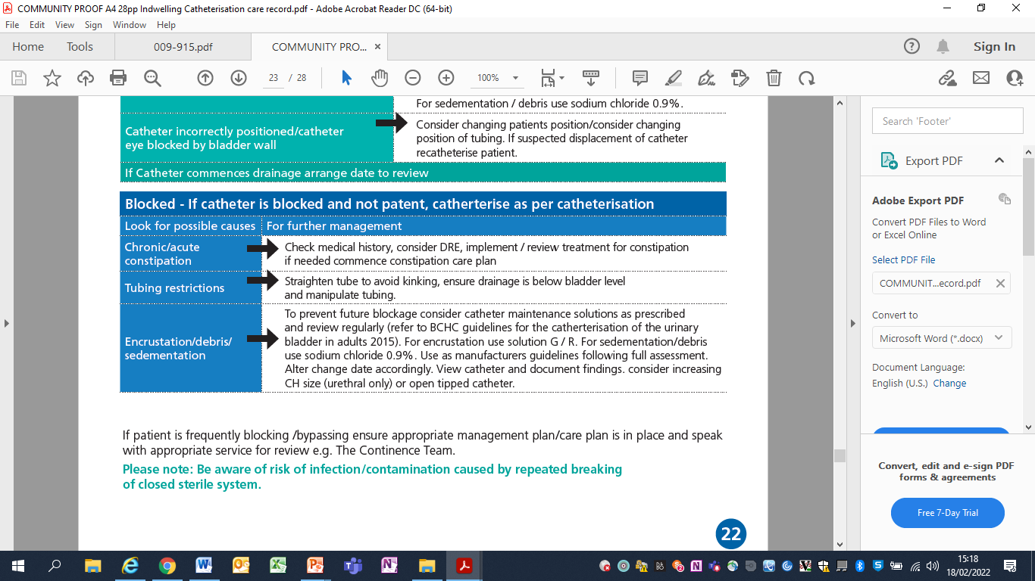
Troubleshooting – Blocking Catheter

Slide 32
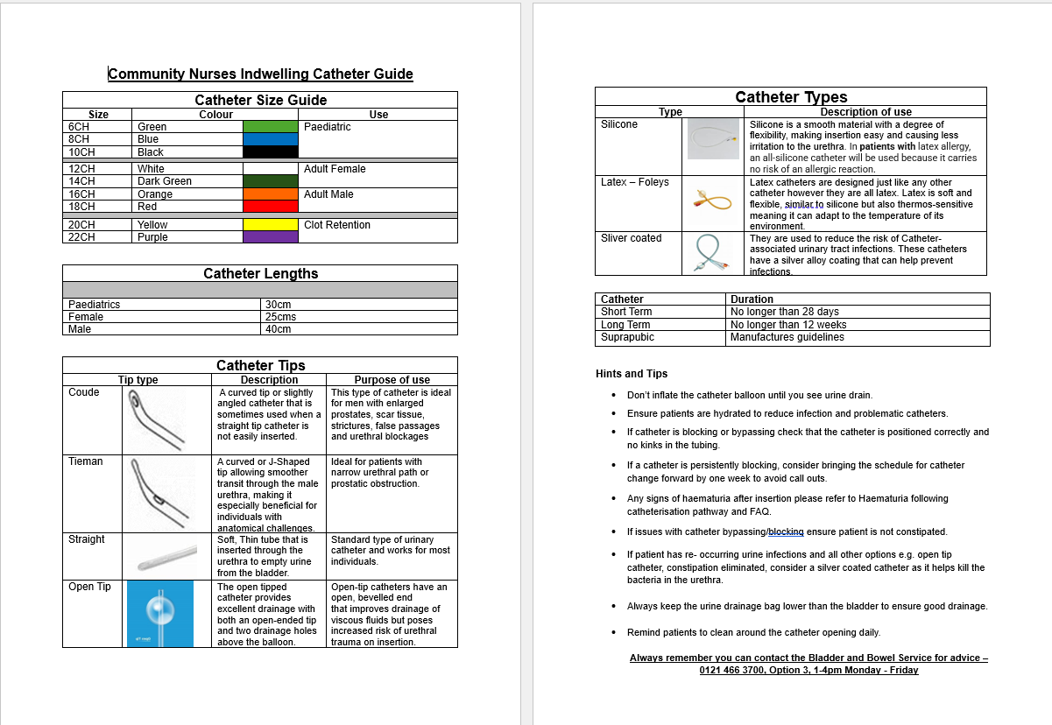
Community Nurse Indwelling Catheter Guide

Slide 33
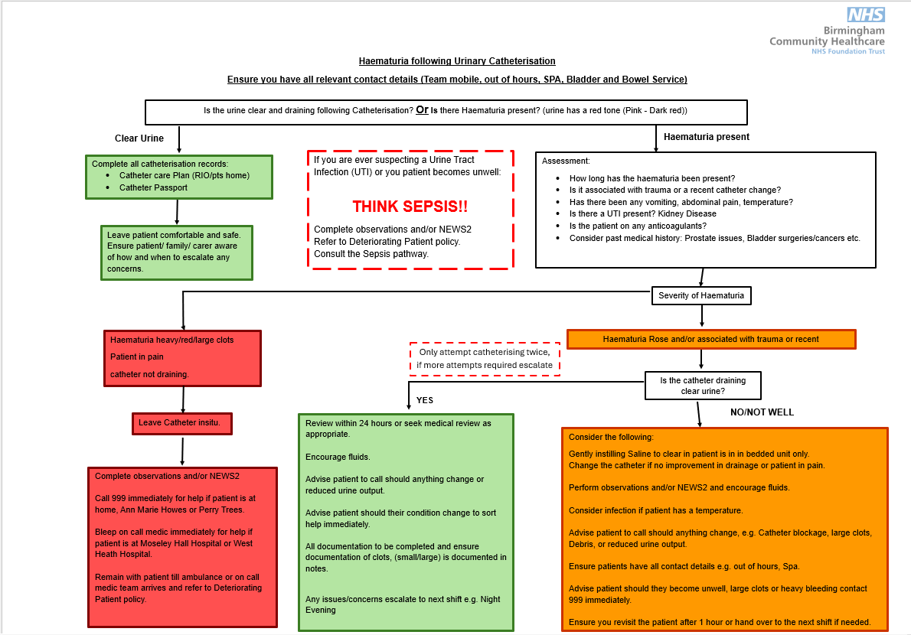
Haematuria following Catheterisation Pathway

Slide 34

Complications following Catheterisation Frequently Asked Questions (FAQ)

Slide 35
Continence Assessment RIO
Locate patient in RIO and navigate to ‘Clinical Portal – Clients View’
Select ‘BCHC Generic Assessments’ then ‘BCHC Core Care Plans’
Select ‘BCHC Nutrition and Hydration’
Complete the following assessment form
  Urinary Symptoms Profile (Including oral intake)
  Urinalysis
  Bladder Scan
Ensure you ‘save’ the assessment forms
Document your assessment in ‘Progress Notes’
Notes:
This may not be possible at present so here are the paper versions of the continence assessments.

Slide 36
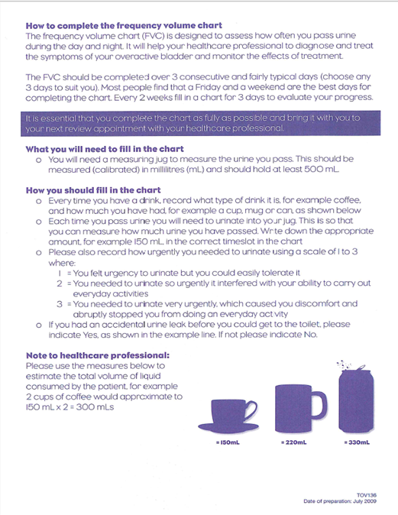
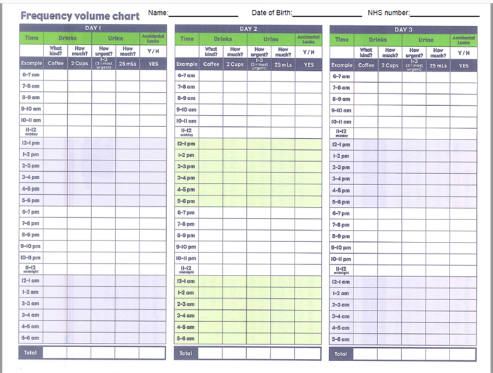
Bladder Chart

Slide 37
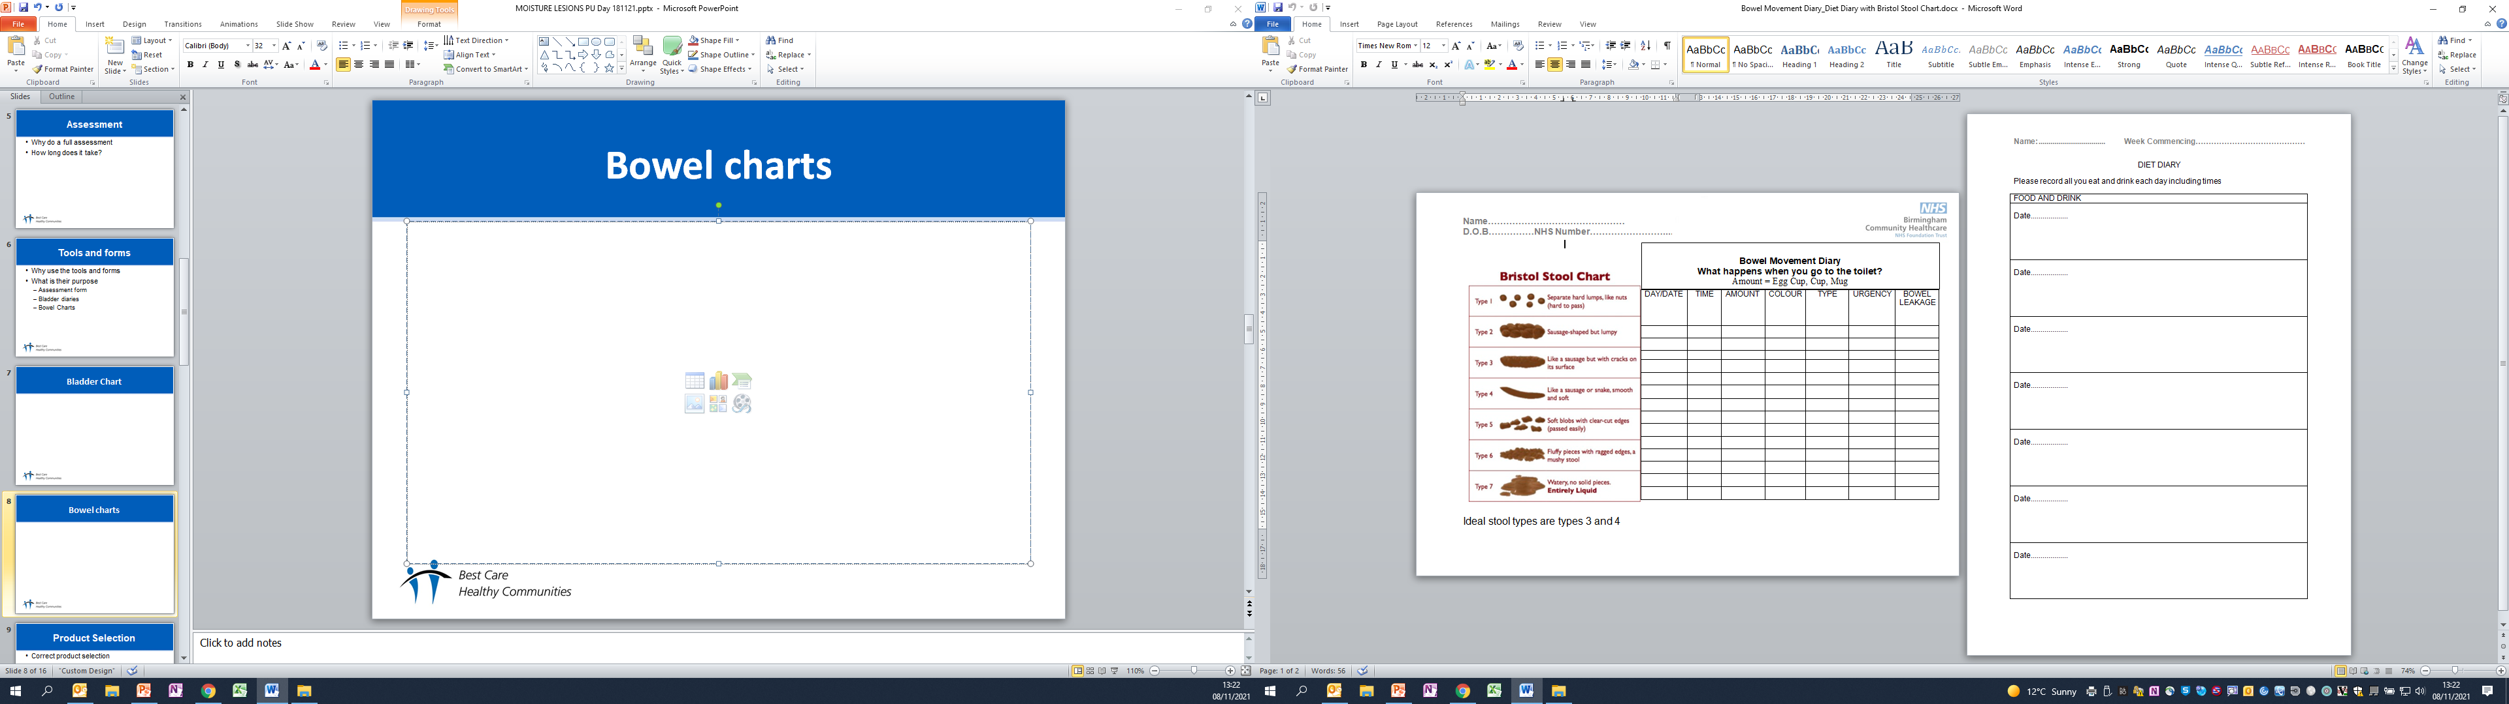
Bowel Chart

Slide 38
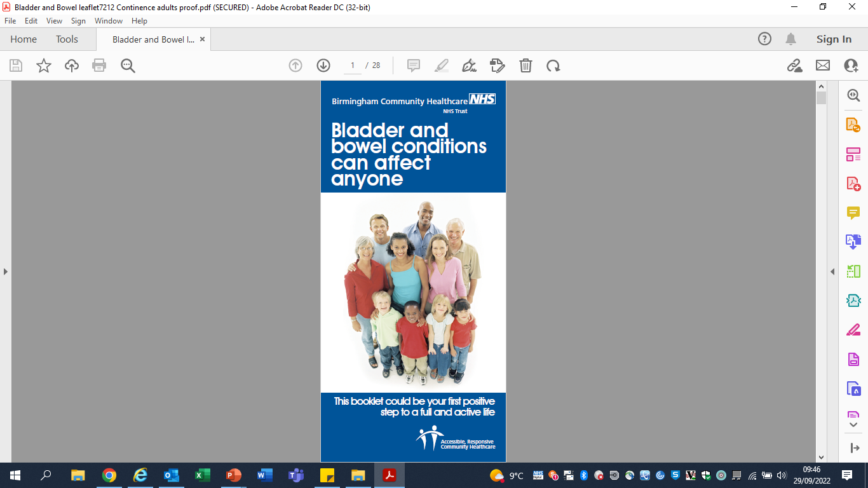
Trust Bladder and Bowel Leaflet
Content includes:
What is a healthy/unhealthy bladder habit
Fluid Modification
Pelvic Floor Muscle Exercises
Bladder retraining
What is a healthy/unhealthy bowel habit
Diet
Exercise
Correct positioning
Medications that can affect bowels
Bristol Stool Chart
Alternatives aids/appliances
Skin care
Volume chart

Slide 39
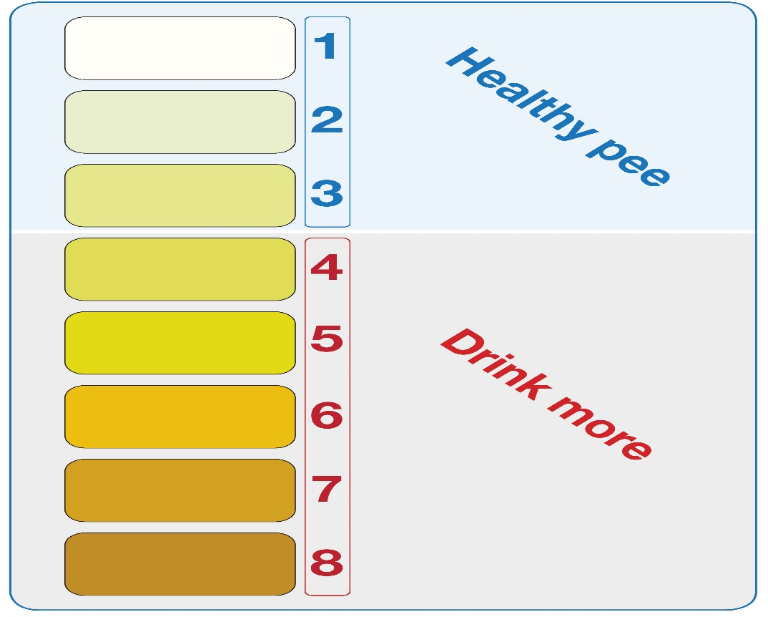
How good is your urine
The most optimal colour for your urine is a pale yellow.
If it is a darker yellow or orange, it can mean you are becoming dehydrated.
An orange urine could indicate a serious liver condition.
Darker brown can be caused by foods or medication

Slide 40
Clinical Urinalysis
Urinalysis i.e. Dip Stix analysis is a key component in not only continence assessment but also general patient assessment. This is used for several reasons such as;
Diagnosis i.e. urine infection (always consider urosepsis), renal disease
Routine Screening i.e. general health assessment
Specific screening i.e. diabetic control, hypertension
Monitoring health conditions as above
Before using the multistix the following observations should be made:
Odour
Colour

Slide 41
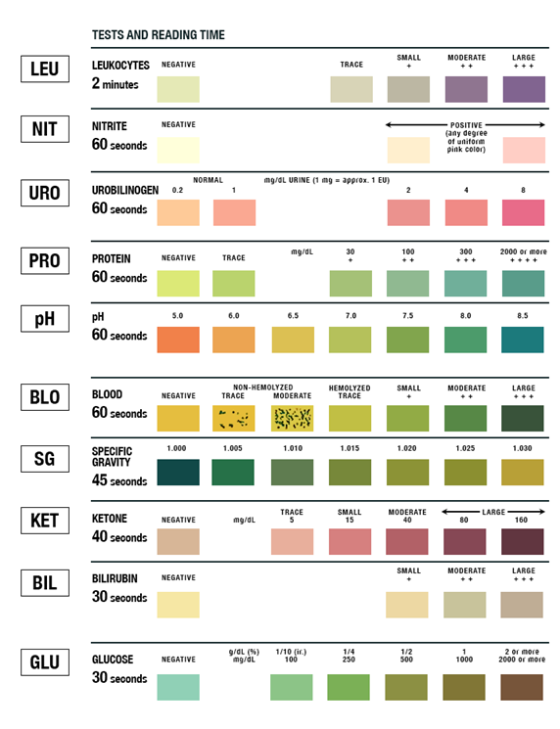
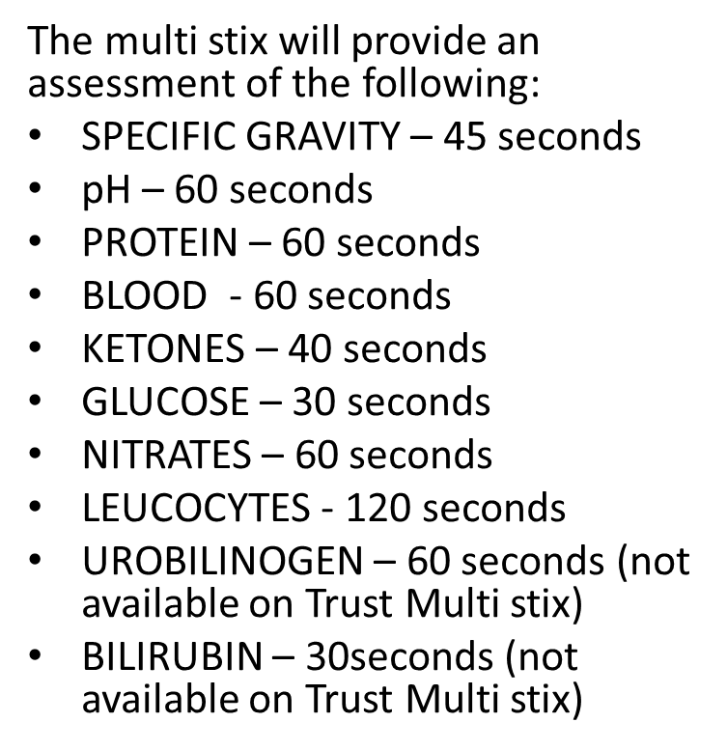
Clinical Urinalysis continued…
Notes:
We don’t cover the last 2 on the list using our trust Multi stix

Slide 42
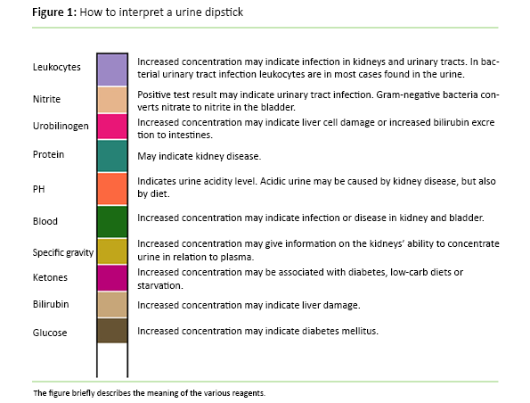
How to interpret a Urine dipstick

Slide 43
Completing Urinalysis in RIO
Locate patient in RIO and navigate to ‘Clinical Portal – Clients View’
Select ‘BCHC Generic Assessments’ then ‘BCHC Core Care Plans’
Select ‘BCHC Nutrition and Hydration’
Locate ‘Urinalysis’ assessment form and complete with your results. Ensure you ‘save’ the assessment forms
Document your assessment in ‘Progress Notes’
Notes:
This may be done in patients notes at present but should be completed in RIO

Slide 44
Urinalysis Group Work
Each table has been given a urinalysis case study.
Review the information you have and answer the following:
  Is the urine sample abnormal? Why
  What could this indicate?
  What actions would you take?

Slide 45

Lunch

Slide 46
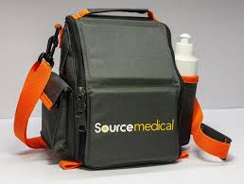
Bladder Scanning
Wayne Collins – Source Medical

Slide 47
Definition of Moisture Lesions
A moisture lesion is soreness and blistering where the skin has been exposed to wetness over a long period of time. This wetness can be urine, faeces, sweat or wound fluid. Millard, 2019
Or
Prolonged contact of the skin with urine or faeces leads to a specific form of moisture-associated skin damage, known as incontinence-associated dermatitis (IAD). D.Voegeli, 2017

Slide 48
Cause Of Moisture Lesions
There are several reasons patients get moisture lesions
Perspiration/added moisture
Inaccurate skin inspections
Misuse of barrier products

Slide 49
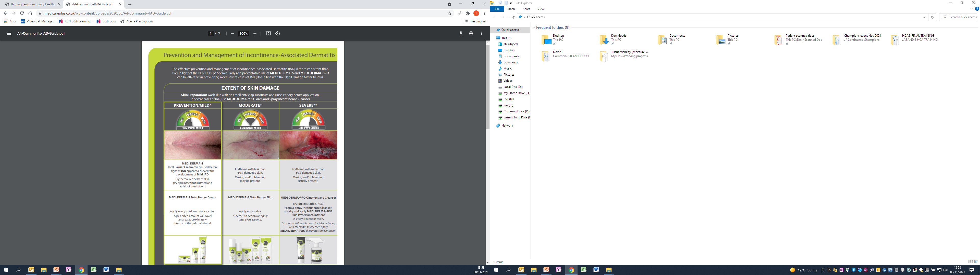
Think Continence
Inaccurate continence assessment
Incorrect containment products
Mild
Moderate
Severe
Medicare plus: Prevention and Management of Incontinence –Associated Dermatitis

Slide 50
Abena Containment Products
Fitting of products
Absorbency
Formulary

Slide 51
Abena Web Assessments
Ringback. 8-week delivery. Place a re-order 2 weeks before next delivery is due. Account will be removed if a delivery is not requested after 4 months
48-hour deliveries. End of life patients or Moisture Associated Skin Damage.
Collections. RIP, excessive supplies (Stock piling), Product amendments

Slide 52

Abena on-line video

Slide 53
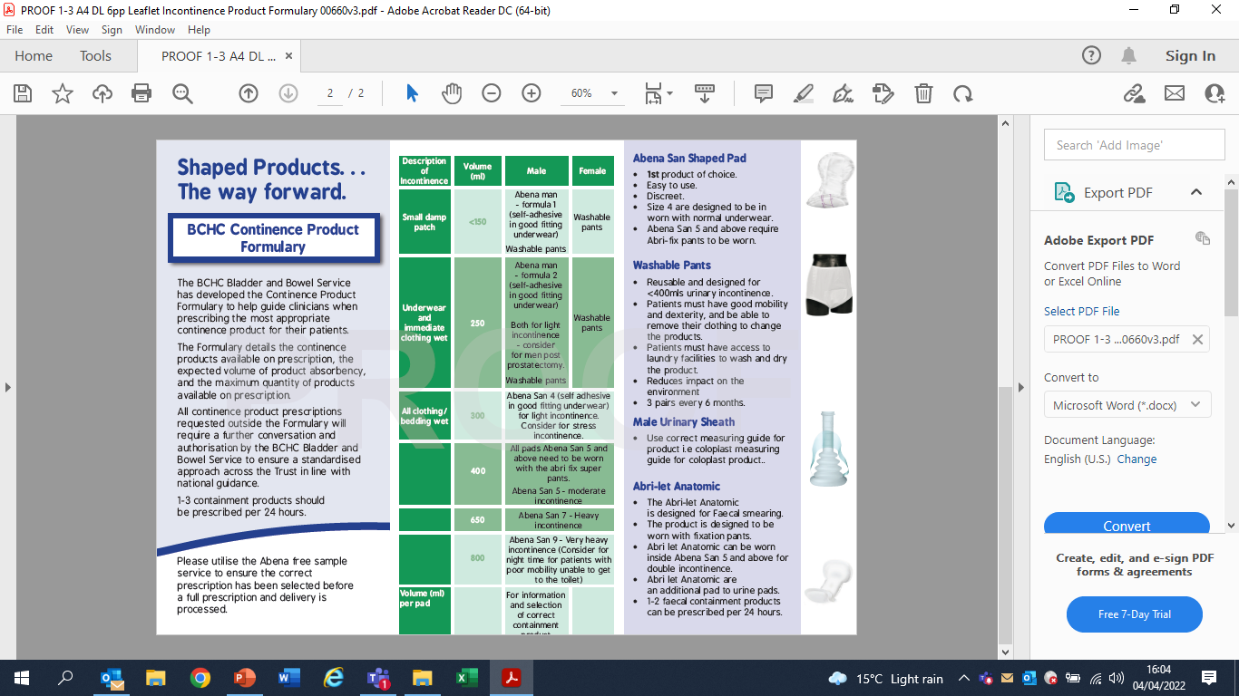
Product formulary

Slide 54
ABENA Top Tips
Always refer to the bladder and bowel service formulary when prescribing
Always explain the ‘ring back’ process to your clients.
Only new clients automatically generate a delivery.
Reassessed clients will need to call Abena for a delivery as normal.
Always provide a rationale for your product selection; even if no product changes have been made.
Non formulary item requested
e.g. Abena San 8, Abena Pants, Abena Slip, Abena Man Zero, Abri Let Mini
No rationale provided / inappropriate rationale
Fixation pants added but not required for pad selection / no fixation pants added when required
Requesting more than 3 products per 24 hours.

Slide 55
Disposal of Containment Products
Disposal of pads into house waste
Store in ambient conditions. Do not store pads in moist environments

Slide 56
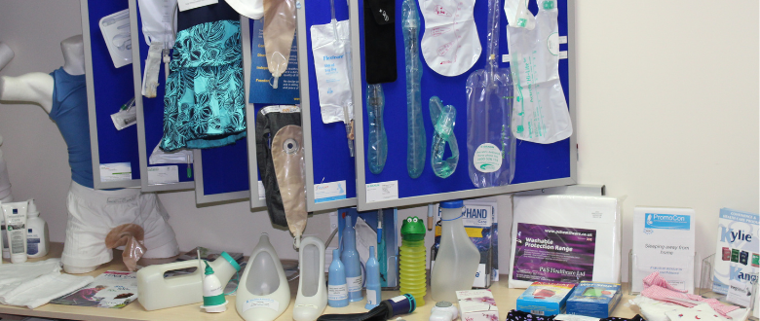
Product Availability

Slide 57
Break

Slide 58

IMedicare
Mohit Mitra

Slide 59
Summary
Awareness of the male and female anatomy.
Confidence in continence assessment, Urinalysis and alternative products and its systems.
Greater knowledge and understanding in catheter care, plans, documentation and bladder scanning.
Mindfulness in identifying and treating catheter complications in the community.

Slide 60

Questions

Slide 61
Contact us
There are lots of useful resources on the Continence page on the intranet
Email: bchnt.continencereferrals@nhs.net
Telephone: 0121 466 3700
Option 1 Pad orders (Monday – Friday 9.00 - 4.00)
Option 2 Appointments & general enquires (Monday – Friday 9.00 - 4.00)
Option 3 Triage nurse (Monday – Friday 1.00 - 4.00)

Slide 62
Evaluation QR Code

Slide 63

Thank you
Thank you and safe journey home

Slide 64
References
Bladder and Bowel Community. What is a Catheter? [Viewed 28 December 2023]. Available from: What is a Catheter? | Bladder & Bowel Community (bladderandbowel.org)
European Association of Urology Nurses, (2012). Catheterisation Indwelling catheters in adults – Urethral and Suprapubic. [Viewed 28 December 2023]. Available from: Catheterisation Indwelling catheters in adults - Urethral and Suprapubic | European Association of Urology Nurses - EAUN (uroweb.org)
National Health Service, (2023). Urinary tract infections (UTI) [Viewed 28 December 2023]. Available from: Urinary tract infections (UTIs) - NHS (www.nhs.uk)
National Institute for Clinical Excellence [NICE], (2018). Urinary tract infection (lower): antimicrobial prescribing NG109 [online]. [Viewed 28 December 2023]. Available from: www.nice.org.uk/guidance/ng109
National Institute for Clinical Excellence [NICE], (2017). Sepsis: recognition, diagnosis, and early management NG51 [online]. [Viewed 28 December 2023]. Available from: www.nice.org.uk/guidance/ng51
Royal College of Nursing [RCN], (2021). Catheter Care Guidance for Healthcare Professionals [online]. [Viewed 28 December 2023]. Available from: Catheter Care Guidance for Health Care Professionals| Royal College of Nursing (rcn.org.uk)

