Slide 1

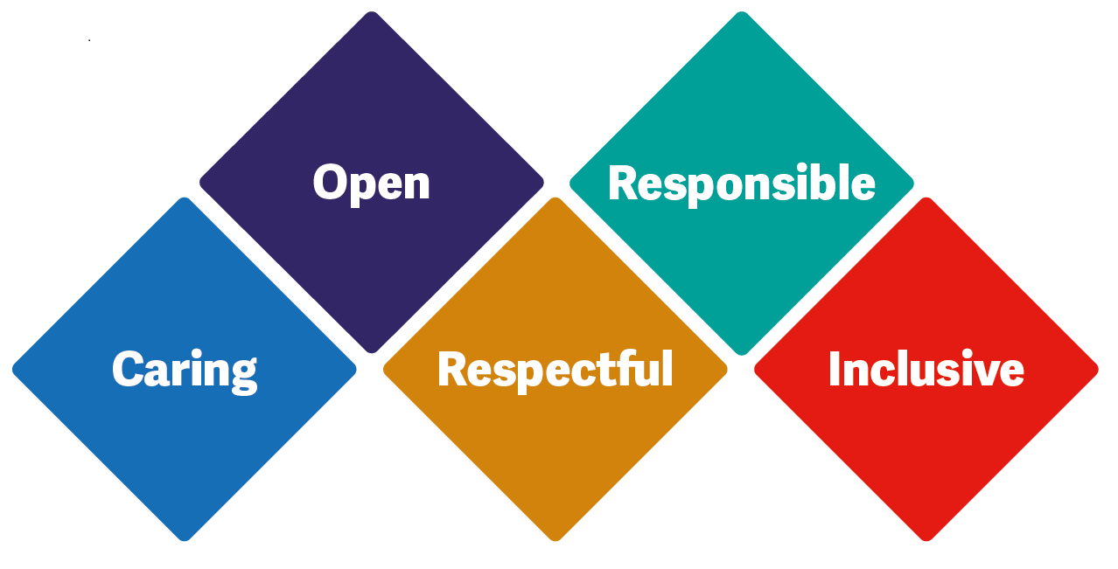

Podiatry Department
BCHC
Boot Camp
Mandy Cadge
Podiatrist

Slide 2
Introduction – About us
ASR : Adults Specialist Rehabilitation Division
One team of 50 FTE Podiatrists,
All Band 6’s and Band 7’s (plus development role Band 5)
8a clinical leads and 8b head of service
All clinicians, no HCAs or assistants, or admin/secretaries
Priestley wharf: Referral Management Centre: support appointment system & messages: 0121 466 7600 option 1
Trust wide coverage for patients with Birmingham GP’s
All notes on RiO (Summary, Podiatry Assessment / Podiatry)
Plus Documents, access to Shared care, Progress notes with advice / instructions for shared care
Notes:
Clinics not every day rotate.

Slide 3
12 Clinic locations:
All Saints – Kings Heath, Aston, Dove MC (Perry Common), Hall Green, Northfield, Quinton, Richmond (Bordesley Green), Soho (Handsworth), Summerfield (Winson Green), Walmley (Sutton Coldfield)
Stockland Green
MHH and WHH, Short stay bedded units (Perry Trees, Anne Marie Howse Centre)
Winson Green Prison
Birmingham and Solihull Mental Health Foundation Trust (secure units)
Hospital MDT clinics: Good Hope & Heartlands alongside Vascular, Diabetes Consultants, DSNs
Home visits for completely housebound patients only

Slide 4
What do we do?
Podiatrists specialise in the lower limb, assessment, diagnosis, treatment & advice
Wound care & high-risk patients, MSK, footwear and self care advice, Prevention and Nail surgery
We aim to improve the mobility, independence and quality of life for patients, Saving Limbs, Saves Lives
We are autonomous practitioners, who will triage, assess, diagnose, treat and discharge, All degree qualified, all POM A/S and some Prescribers
All foot referrals come through Triage: new pts from GPs, IMT, discharges from BHH Vascular after review / procedures / amputations

Slide 5
High Risk Podiatry
Doppler / ABPI / TP / Vascular referrals
NMP antibiotics / dressings, prescriptions
Diabetic Foot MDT clinics
Sharp Debridement
Decide / change dressing regimes
Offloading casts / insoles / padding
Advice about recurrence
Open appointments
Notes:
Anyone heard of ABPI / TP

Slide 6
MSK Podiatry
Often younger, active patients with pain
Gait Analysis / Force pressure assessment
Diagnostic ultrasound & guided steroid injections
Strapping
Rehab - stretching/strengthening
Insoles (casted / simple / off the shelf)
Joint Mobilisation
Acupuncture / trigger point therapy
Gait training & footwear advice
Bespoke devices made at Lansdowne HC (City Rd)
Notes:
Examples plantar fasciitis plantar fasciopathy

Slide 7
Prevention and Nail Surgery
Nail surgery with anaesthetic & phenol ablation partial/total
Corn and callus enucleation/debridement
Insole therapy
Advice/educate
Neurovascular screening
Pathological nail treatment/advice
No verrucae

Slide 8
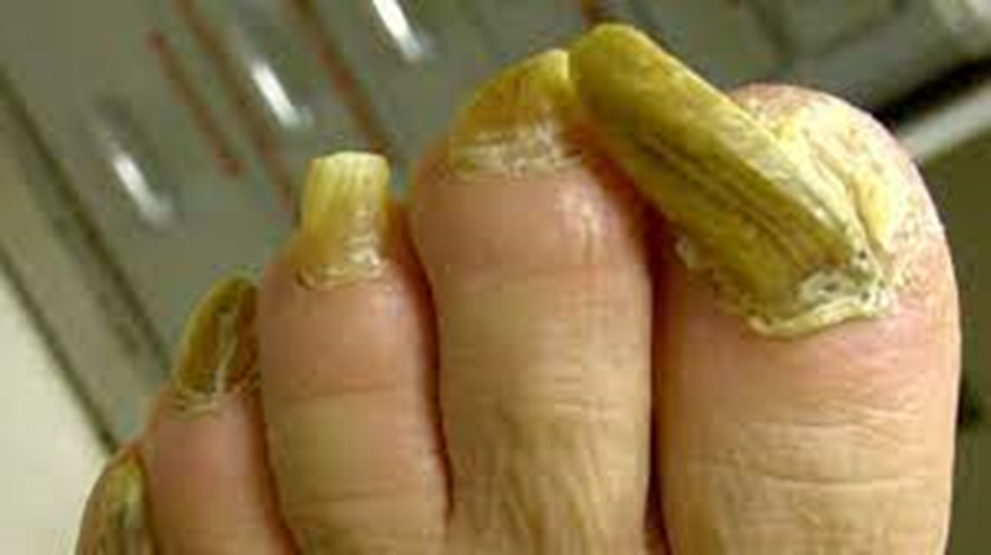
Do we cut nails?
Notes:
Private practice doing this all day long £££

Slide 9
Patients with:
Diabetes (often with all of the below)
Ischaemia
Neuropathy
Foot Deformity /corn and callus
Infection
but its not only patients with Diabetes that have high risk foot problems
and patients don’t have to have Diabetes to be referred
Notes:
DM vascular neurological PAD (smoker) severe deformity
Mental health

Slide 10
Diabetes in the UK (from Diabetes UK and WHO)
1998: total population 58 million, 1.8 million with Diabetes (3%)
2018: total population 66 Million, 3.7 million with Diabetes (5.6%)
2022: total population 68 million, 5.6 million with Diabetes (8.2%)
2025: total population 77 million, expected 11% with Diabetes
90% of these have Type 2 Diabetes, mainly due to rise in obesity
Obesity affects up to 30% in Uk, 40% in USA
High Blood Glucose over time can :
Create build-up of fatty plaques within arteries causing narrowing and blockages
PAD Peripheral Arterial Disease: reduced blood supply to feet, reduced tissue viability
Damaged Nerves – Neuropathy – effect sensation / foot shape / skin quality – undetected trauma / change in foot shape / Dry skin
80% of patients with Diabetes have ‘Low Risk feet’ and don’t require specialist input
Notes:
www.bhf.org.uk/what-we-do/news-from-the-bhf/news-archive/2018/february/diabetes-cases-double-in-the-last-20-years#:~:text=Almost%203.7%20million%20people%20have,report%20which%20was%20published%20today.

Slide 11
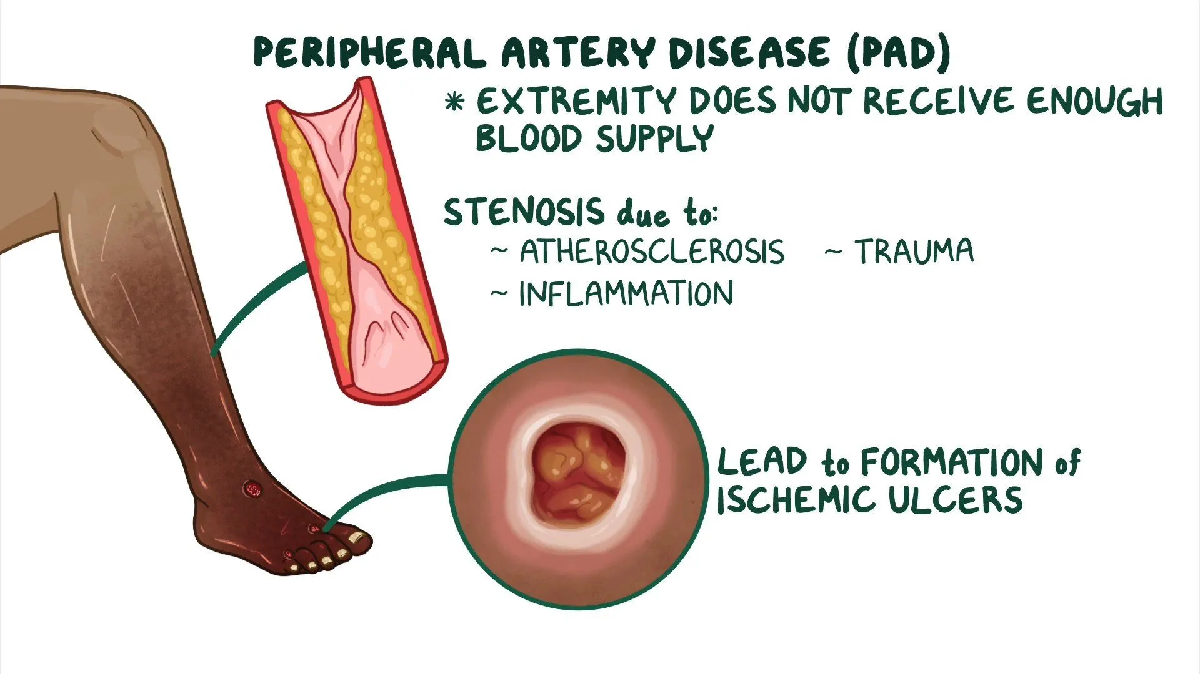
Ischaemia
Notes:
Peripheral arterial disease and ulcers: Video & Meaning | Osmosis

Slide 12

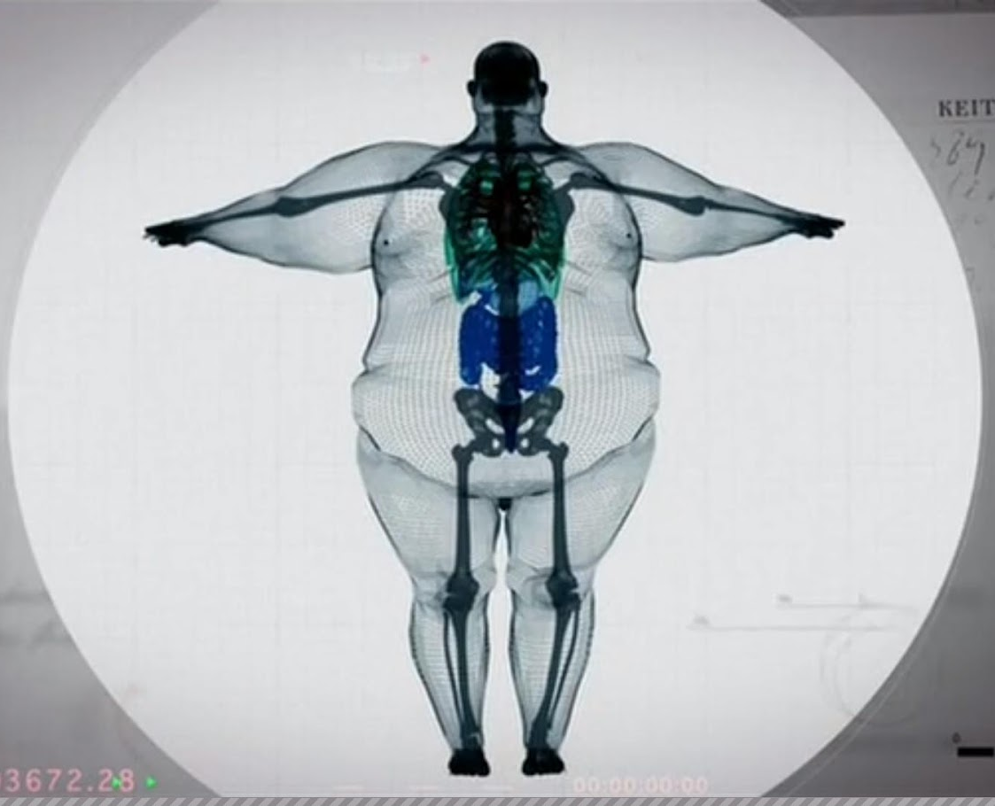
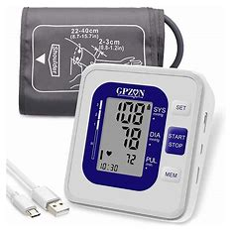
PAD
Often seen in conjunction with
High blood pressure
Atherosclerosis
Diabetes
High cholesterol
Age above 60 years
Obesity
Smoking
Depression
Lack of self care
Male
This Photo by Unknown Author is licensed under CC BY-NC-ND
Notes:
Cigarette | Definition, Facts, & Health Effects | Britannica
Amazon

Slide 13
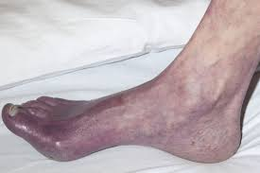
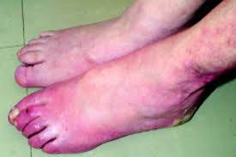

Look For:
hair loss on legs and feet
numbness / coldness
v slow-growing toenails
wounds on periphery, and over bony prominences which do not heal
changing skin colour such as turning paler than usual or blue – may present as grey/purple in brown and black skin. “sunset foot”
shiny taut skin
muscle wastage

Slide 14
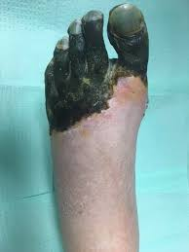
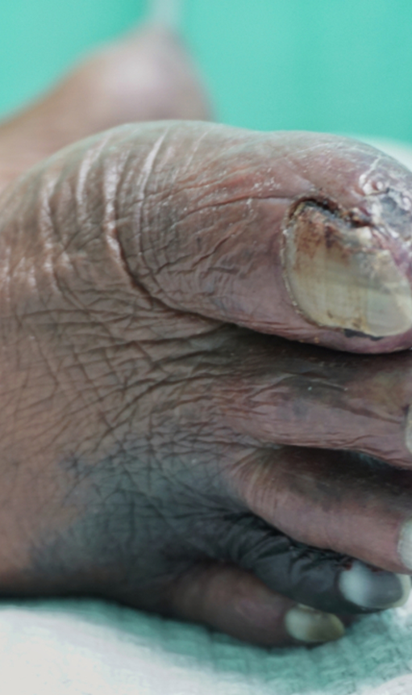
Clinical emergencies in PAD
Needs urgent review by Vascular
“sudden” arterial obstruction
gangrene
Pressure related ischaemia
Blood flow is easily reduced by compression
Notes:
https://www.google.co.uk/url?sa=i&url=https%3A%2F%2Fwww.thewoundpros.com%2Fpost%2Fdiagnosis-and-management-of-critical-limb-ischemia-cli&psig=AOvVaw3lpALfQDPTa07jnLSBFEkw&ust=1668675151637000&source=images&cd=vfe&ved=0CA0QjhxqFwoTCMjgwMypsvsCFQAAAAAdAAAAABAD
https://www.google.co.uk/url?sa=i&url=https%3A%2F%2Fwww.hmpgloballearningnetwork.com%2Fsite%2Fpodiatry%2Fattempting-limb-salvage-patient-critical-limb-ischemia-and-multiple-comorbidities&psig=AOvVaw3lpALfQDPTa07jnLSBFEkw&ust=1668675151637000&source=images&cd=vfe&ved=2ahUKEwi_j8W-qbL7AhXO0oUKHTP1AXgQr4kDegUIARCuAQ

Slide 15
Red Flag Pain
Ischaemic pain = ‘Cramping’ ‘biting’ (but not cramp itself)
Night Pain – Foot to Floor / sleeping in a chair to get relief
Rest Pain - especially when the feet get warm in bed
Intermittent Claudication –’Angina’ of the legs – can only walk so far before the pain stops them from going further. Short rest and they can walk again for a similar distance = claudication distance
All of these are symptoms of arterial insufficiency, lack of oxygen to the tissues/muscles. Made worse by increased demand
Notes:
IC worse going upstairs/slope. Stop to relieve

Slide 16
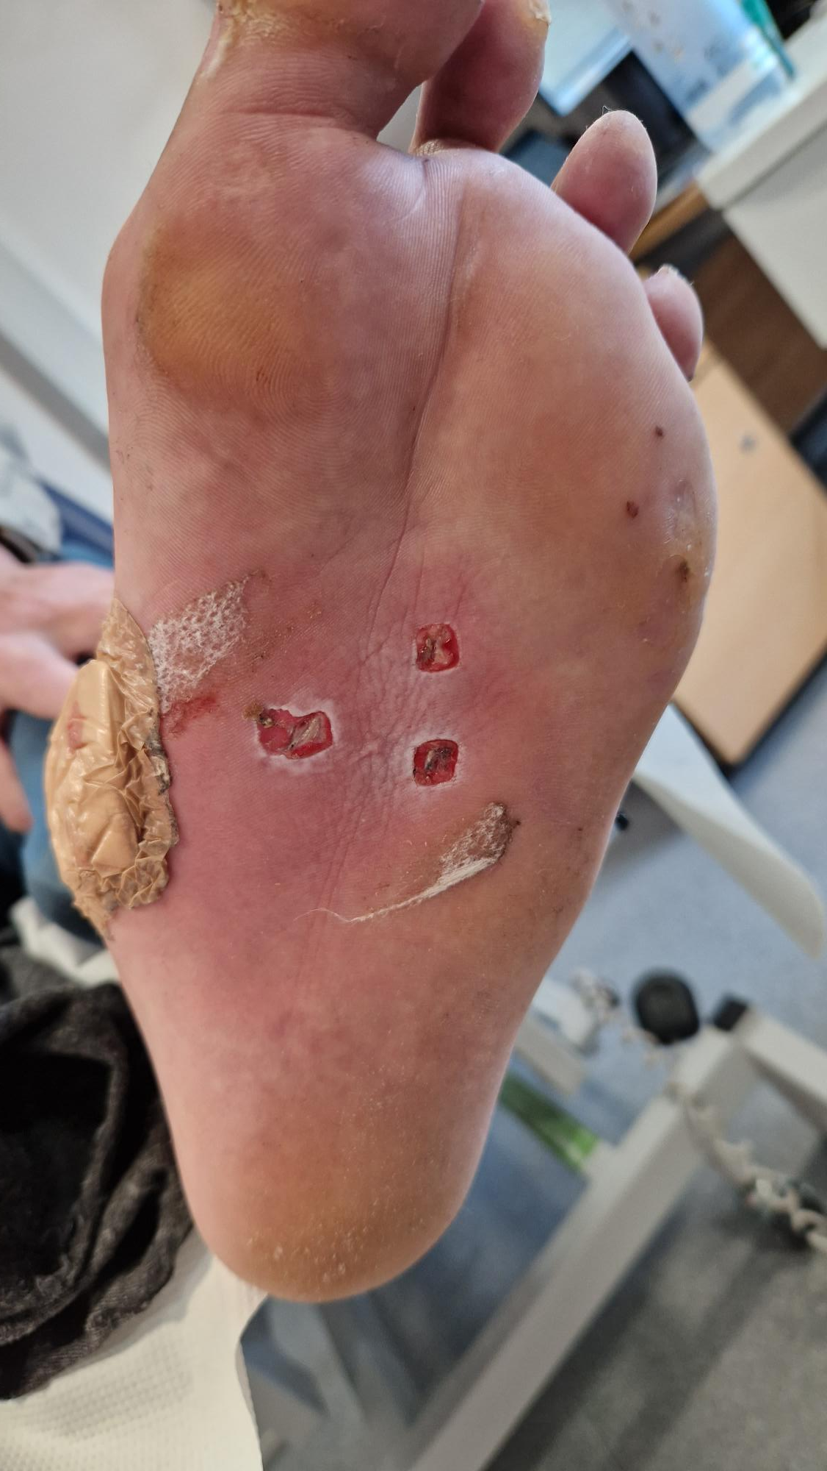
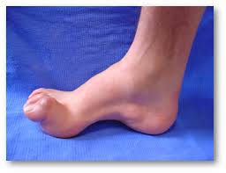
Neuropathy
Nerve death due to poisoning (sugar, alcohol)
Different types of nerves affected
Sensory: paraesthesia /anaesthesia.
Painful/Painless : burning/tingling/numbness
Autonomic: dry, cracked skin, heel fissures
Motor: contractures, muscle wastage
Notes:
https://food.ndtv.com/beauty/5-effective-home-remedies-for-cracked-heels-1226211
CMT Hereditary Motor and Sensory Neuropathy – Foot Scientific Store

Slide 17
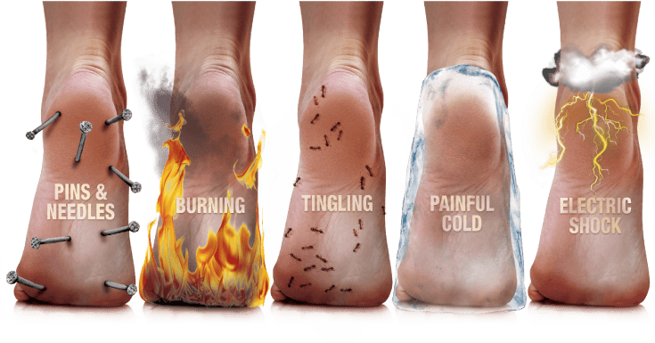
Sensory Neuropathy (night time?)
NICE Guidance: NG19 Duloxetine
Notes:
Diabetic Nerve Pain - Should I Be Worried? - Alpro Pharmacy

Slide 18
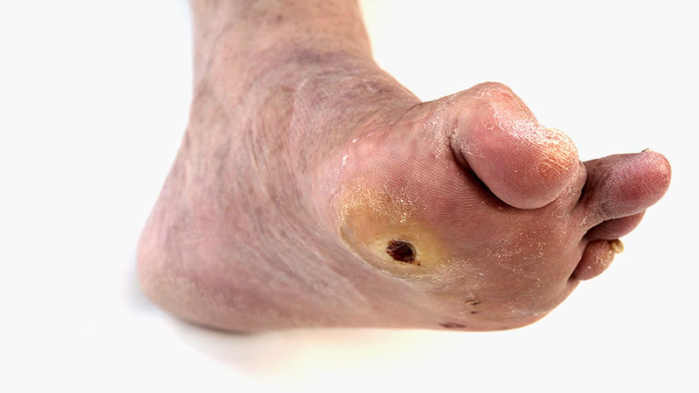
Callus /Corns – with discolouration
Increases in response to pressure / friction
Bleeding/bruising underneath signifies increased tissue damage and potential wound beneath
Can be a pre-curser to wounds/ulcers especially with neuropathy
Notes:
Diabetic Foot Ulcers: Life-Threatening Issue in Need of Help

Slide 19
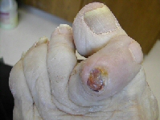
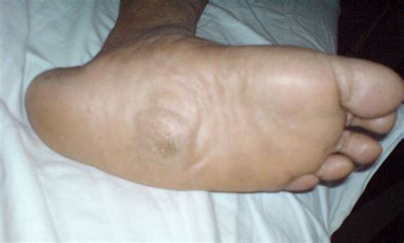
Foot Deformity
Abnormal foot shapes make areas vulnerable to pressure in footwear
Made worse by neuropathy
Charcot foot
Notes:
Hammertoe Treatment Guide | Foot & Ankle
Charcot Foot - Dr. Joseph Picciotti

Slide 20
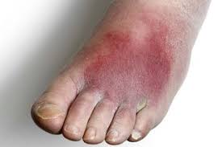
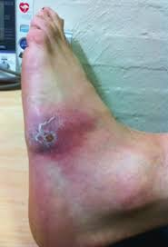
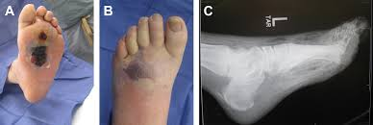
Signs of soft tissue Infection
Swelling
Heat
Pain
Colour Change
Malodour – open wound
Systemically unwell – sepsis risk

Slide 21
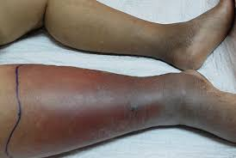
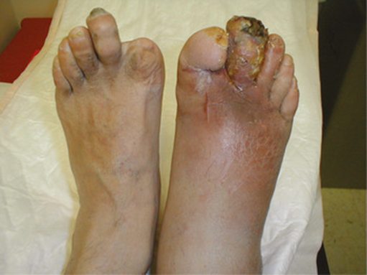
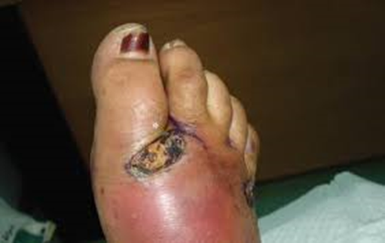
Infection
Notes:
https://www.google.com/url?sa=i&url=https%3A%2F%2Fwww.bmj.com%2Fcontent%2F359%2Fbmj.j5064&psig=AOvVaw3kQ-QzJ91B1gZYaj7J6s65&ust=1668619038314000&source=images&cd=vfe&ved=2ahUKEwii1s-52LD7AhXVhHMKHaRKAsIQr4kDegUIARC7AQ
https://www.google.com/url?sa=i&url=https%3A%2F%2Fwww.nhs.uk%2Fconditions%2Fcellulitis%2F&psig=AOvVaw3kQ-QzJ91B1gZYaj7J6s65&ust=1668619038314000&source=images&cd=vfe&ved=2ahUKEwii1s-52LD7AhXVhHMKHaRKAsIQr4kDegQIARBD
https://www.google.com/url?sa=i&url=https%3A%2F%2Fwww.cddft.nhs.uk%2Fmedia%2F209486%2F021218%2520chs%2520tissue%2520viability%2520booklet%2520march%25202011.pdf&psig=AOvVaw3kQ-QzJ91B1gZYaj7J6s65&ust=1668619038314000&source=images&cd=vfe&ved=0CBIQr4kDahcKEwiAyMP82LD7AhUAAAAAHQAAAAAQAg
https://www.google.com/url?sa=i&url=https%3A%2F%2Fwww.berkshirewestccg.nhs.uk%2Fmedia%2F1621%2Fdiabetes-foot-ulcer-workshop.pdf&psig=AOvVaw2_tTHx1cJWLsfzrHSrGl3r&ust=1668619250896000&source=images&cd=vfe&ved=2ahUKEwio3f6e2bD7AhUN3RoKHezABqUQr4kDegUIARCBAQ
https://www.google.com/url?sa=i&url=https%3A%2F%2Fwww.sussexcommunity.nhs.uk%2Fdownloads%2Fservices%2Fdiabetes%2Fwebinars%2Ffoot-ulcer-referral-pathway.pdf&psig=AOvVaw2vjsN2pEsQAPTeM3RyTt32&ust=1668619410766000&source=images&cd=vfe&ved=2ahUKEwjRtZzr2bD7AhUxhM4BHdHdBN0Qr4kDegQIARBS
https://www.google.com/url?sa=i&url=https%3A%2F%2Fwww.cuh.nhs.uk%2Four-services%2Fsurgery%2Fvascular-studies-unit%2Fan-ankle-brachial-pressure-indices-test%2F&psig=AOvVaw3-CcDlKo25JzF_c-PMYCy2&ust=1668619506938000&source=images&cd=vfe&ved=2ahUKEwiDo4qZ2rD7AhXAhc4BHe2WDyAQr4kDegUIARDPAQ
https://www.google.com/url?sa=i&url=https%3A%2F%2Fwww.complete-healthcare.co.uk%2Fdiagnostic-physio%2Fneurotips&psig=AOvVaw3c6XmZog5e5za3bjhsqnJz&ust=1668619566441000&source=images&cd=vfe&ved=2ahUKEwijiLq12rD7AhUFtBoKHYDCCFQQr4kDegQIARAi
https://www.google.co.uk/url?sa=i&url=https%3A%2F%2Fwww.cambridge.org%2Fcore%2Fbooks%2Femergency-management-of-infectious-diseases%2Fdiabetic-foot-infections%2FFFA3326296D939A8F39CD15B20CB6D53&psig=AOvVaw2vJgXdVSDilJReaSXi-ofn&ust=1668676064978000&source=images&cd=vfe&ved=0CA0QjhxqFwoTCPijp_qssvsCFQAAAAAdAAAAABAJ

Slide 22
Assess the risk
Look – discolouration, any breaks in the skin, swelling/blisters (use a mirror or light to see under heels and bony prominences)
Touch – compare feet: is one hotter or cooler than the other?
Smell – infection / necrosis / maceration / leaking
Listen – to patient/carers re concerns/changes
Refer – with as much information as possible
Notes:
Do you know where foot pulses are?

Slide 23
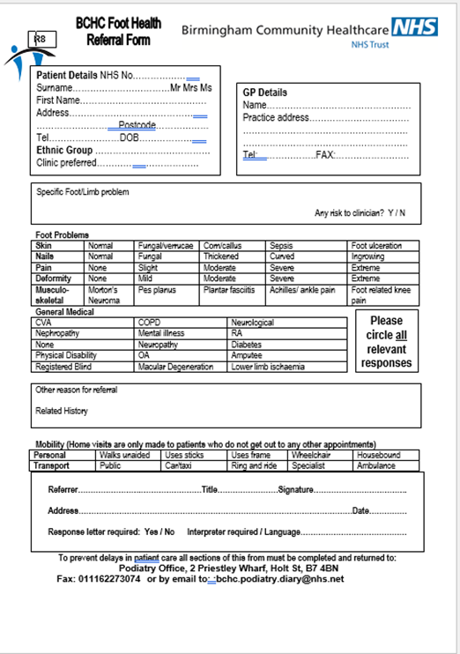

How to make a referral
Direct referral for inpatients
WHH MHH Wednesday visits - referral to be left on ward or can be sent to email address
Everything else: form on Intranet
Services and Teams > A-Z teams >Podiatry
Send to:
bchc.podiatry.diary@nhs.net
As much information as possible
Circle known problems & medical conditions
Triaged by Podiatrists according to what’s on here

Slide 24
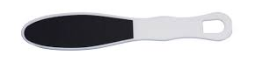
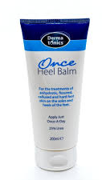
Rejected Referrals
Challenge if you think something was missed or add more info and we will review the decision
(approx. 30% are rejected as low risk)
Alternatives for lower risk patients:
(80% of people with Diabetes still have low risk feet)
HCPC registered Private Podiatrist
https://rcpod.org.uk/find-a-podiatrist
Family care with a nail file (weekly)
Daily use of emollients (Dermatonics)
Birmingham Nail Care

Slide 25
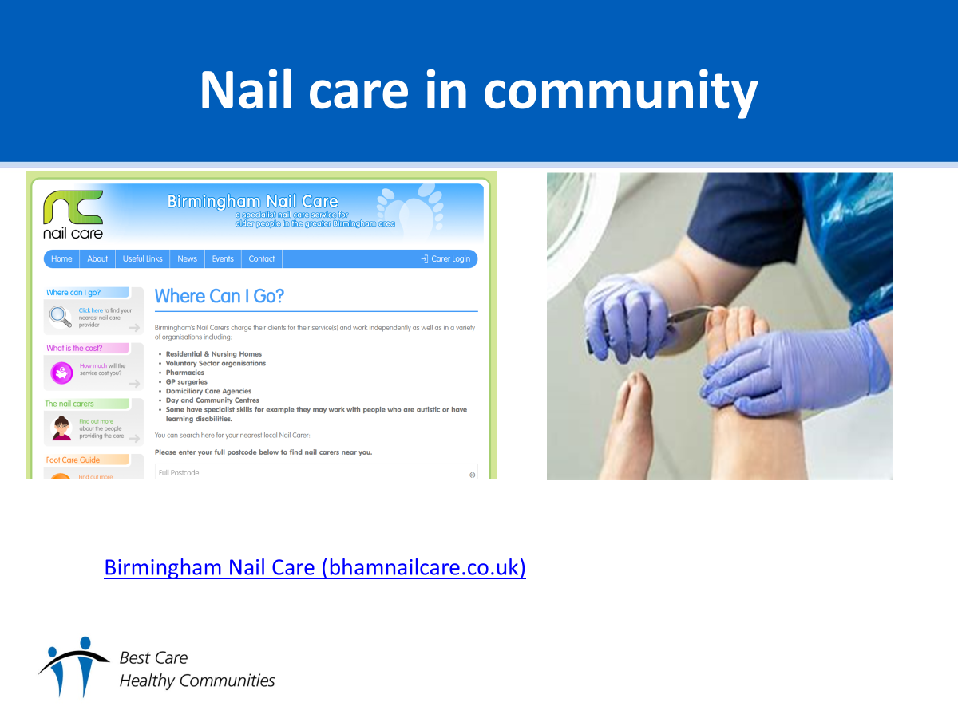
Podiatry and Nursing Teams –Shared Care
Ohh

Slide 26
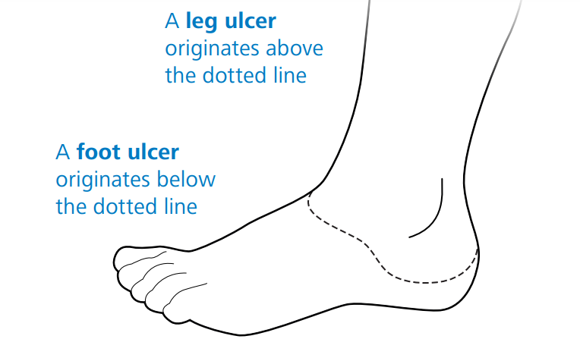
Podiatry and Nursing Teams
IMTs linked to GP practices have team bases
Podiatry work around postcode clusters. No team bases
8 Dom teams across the trust. Podiatrist work 9-5 Mon - Fri
Shared care of a patient with a foot wound.
If no regular debridement Podiatry may attend only periodically
Podiatry will assist with treatment plans and offloading advice
Palliative dressings will be completely with IMT
Notes:
NWCSP

Slide 27
Podiatry will usually lead on:
Ischaemia/Neuropathy, especially with deformity
Diabetes patients with corn/callus
Wounds / ulcers / infection, referral to MDT at Heartlands
Nails – ingrowing / causing abrasions on neighbouring toes/ nail bed ulcers / weeping / bleeding
Check RiO: if there is already an open referral you can just send a message via RMC: 0121 466 7600 option 1 or email bchc.podiatry.diary@nhs.net
Want to know more?
Find your nearest Podiatry clinic.
Introduce yourself, arrange to spend some time with us
Find out which Domicillary team you will be sharing care with and build some links, arrange joint visits

Slide 28
Thank you
Questions?
amanda.cadge1@nhs.net
based at Richmond PCC
Bordesley Green

