Slide 1



Clinical Bootcamp Programme
Adult Community Services

Slide 2
Clinical Bootcamp overview
Background to Programme
5 week programme- face to face session, e-learning, clinical skills session
Overview of programme timetable
First cohort October 2024-
Pre course questionnaire, daily evaluation and post course evaluation
Expectations regarding e-learning- virtual campus log in
Policies to read
Clinical skills sessions at Moseley Hall Hospital Training room- competencies

Slide 3
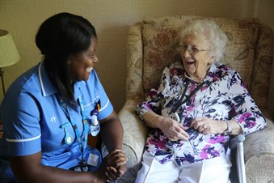
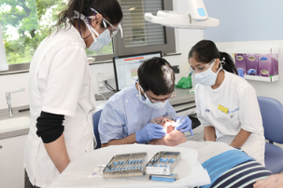
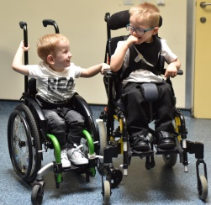
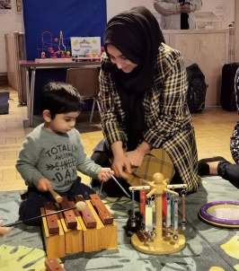
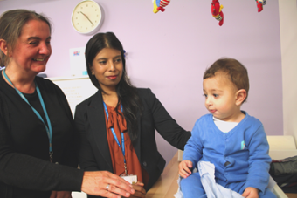
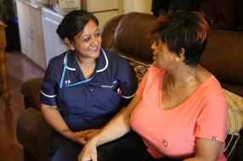
Community health services provider . . .
#TeamBCHC: c. 5,000 colleagues and c. 300 bases. Local community teams and regional specialist services
2.2 million interactions with patients and service users each year
Five clinical divisions.
  Adult Community Services
  Children & Families
  Adult & Specialist Rehabilitation
  Learning Disabilities
  Dental Services
  Corporate Services.
Five localities and 30 neighbourhoods

Slide 4
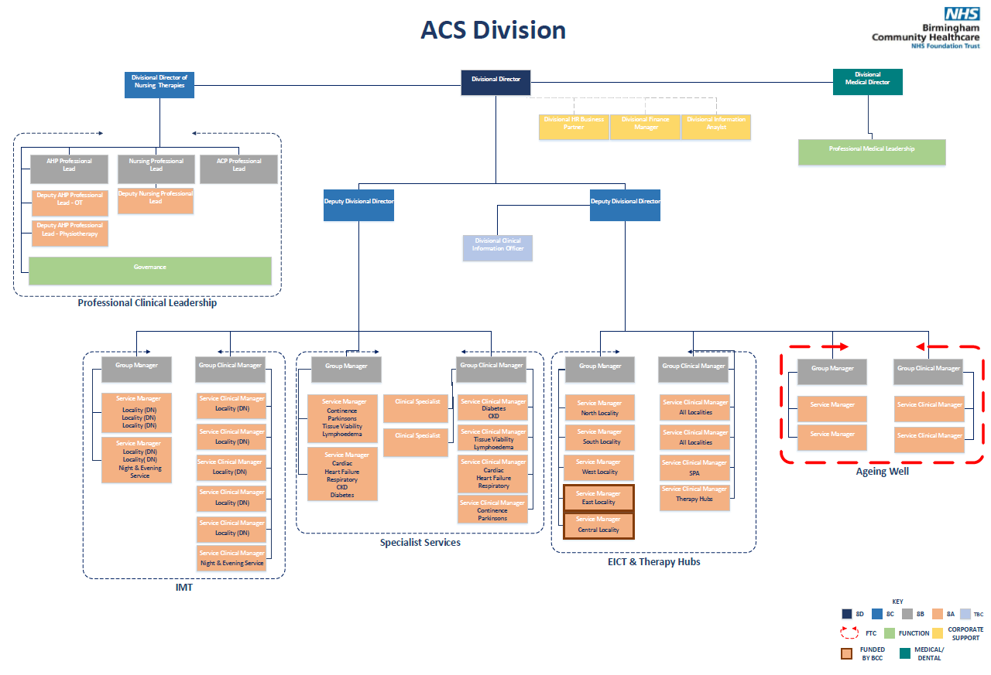
Adult Community Services

Slide 5
Adult Community Services
Community Nursing:
27 Planned Nursing Teams across the City, divided into 5 localities
4 Unplanned Nursing Team; Evening and Night services
Registered Nurses, Nursing Associates, Assistant Practitioners, Healthcare Assistants, Administrators & Community Nurse Drivers
Approximately 75,000 contacts per month
Service runs 24 hours a day 7 days week
Build relationships and treat people within their place of residence
Specialist Services:
Registered Nurses, Assistant Practitioners, Healthcare Assistants, Physiotherapists, Occupational Therapists, Administrators & Drivers
Specialist Nursing & Therapy Teams providing support and management of chronic health conditions
Continence, Parkinsons, Tissue Viability & Lymphodema
Cardiac, Respiratory. Chronic Kidney Disease & Diabetes
Treating people within their place of residence and within outpatient clinics across the city

Slide 6
Adult Community Services
Early Intervention Community Teams (EICT)
5 Localities
Registered Nurses, Nursing Associates, Healthcare Assistants, Therapists, Care Assistants Administrators, Drivers & Carers
Step Up: Supporting People to remain at home with Enhanced Community Intervention
Step Down: Supporting People out of Acute Hospital into the Community
Service runs 8:00-22:00 7 days a week
Therapy Hubs:
4 Hubs Central & West, East, North & South Covering 5 Localities
Physiotherapists, Occupational Therapists, Rehabilitation Assistants & Administrators
Longer Term Rehabilitation following on from EICT
Specialist Falls Therapy & Nursing Team, Specialist Neurotherapy Team
Treating people within their place of residence and within outpatient settings across the city

Slide 7
Adult Community Services
Intermediate Care
Urgent Community Response – Advanced Clinical Practitioners, (Nurses & Therapists) providing urgent community response within 2 hours
Urgent Care Bureau, Triage and assessment of step up and step-down referrals for EICT & Urgent Community Response
Virtual Wards: Supporting People to remain at home / return home form hospital with enhanced support
Frailty Virtual Ward & Respiratory Virtual Ward
Service runs 8:00-22:00, 7 days a week

Slide 8
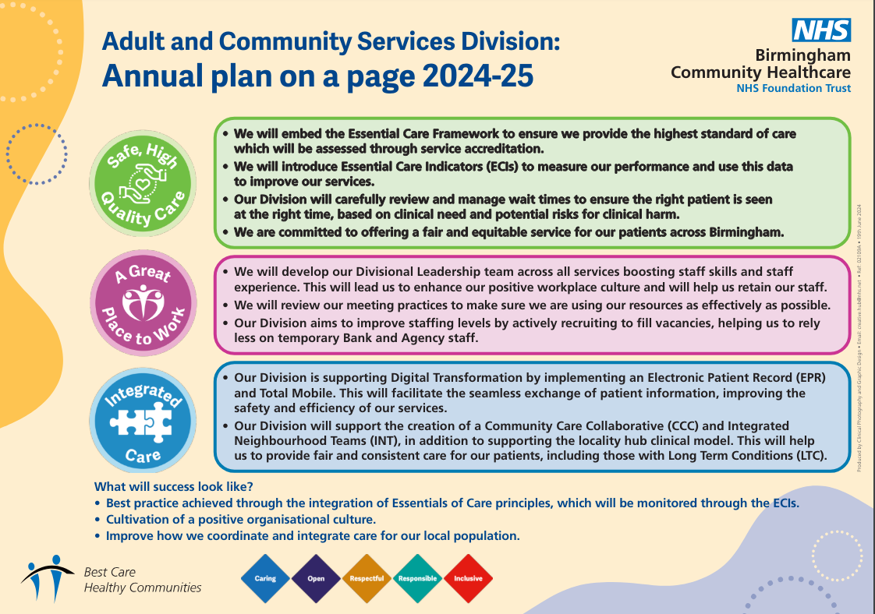

Slide 9


Becoming a Great Place to Work
Embedding our values: launch behavioural framework for our values
Developing our leaders: operational structures, Inspire and Horizon leadership development.
Engaging our colleagues: 50 Voices, internal communications refresh.
Improving systems and processes: recruitment, onboarding and digital.
Supporting health and wellbeing: Hear for You; support package, cost of living support, wellbeing conversations and support for stress.
Increasing workforce capacity: Short-term actions for Winter and Summer longer-term workforce plan development.
Promoting equality and inclusion: Truly Inclusive Organisation plan, anti-racism commitment, talent management plan, disability actions.

Slide 10
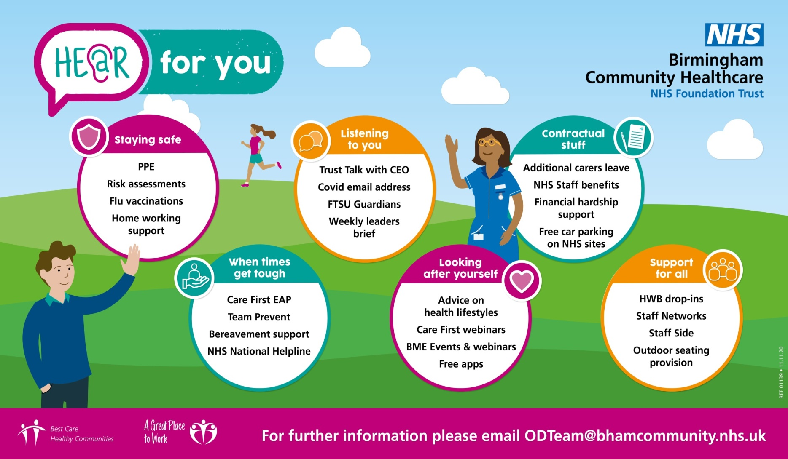
For more information email bchc.ODTeam@nhs.net

Slide 11
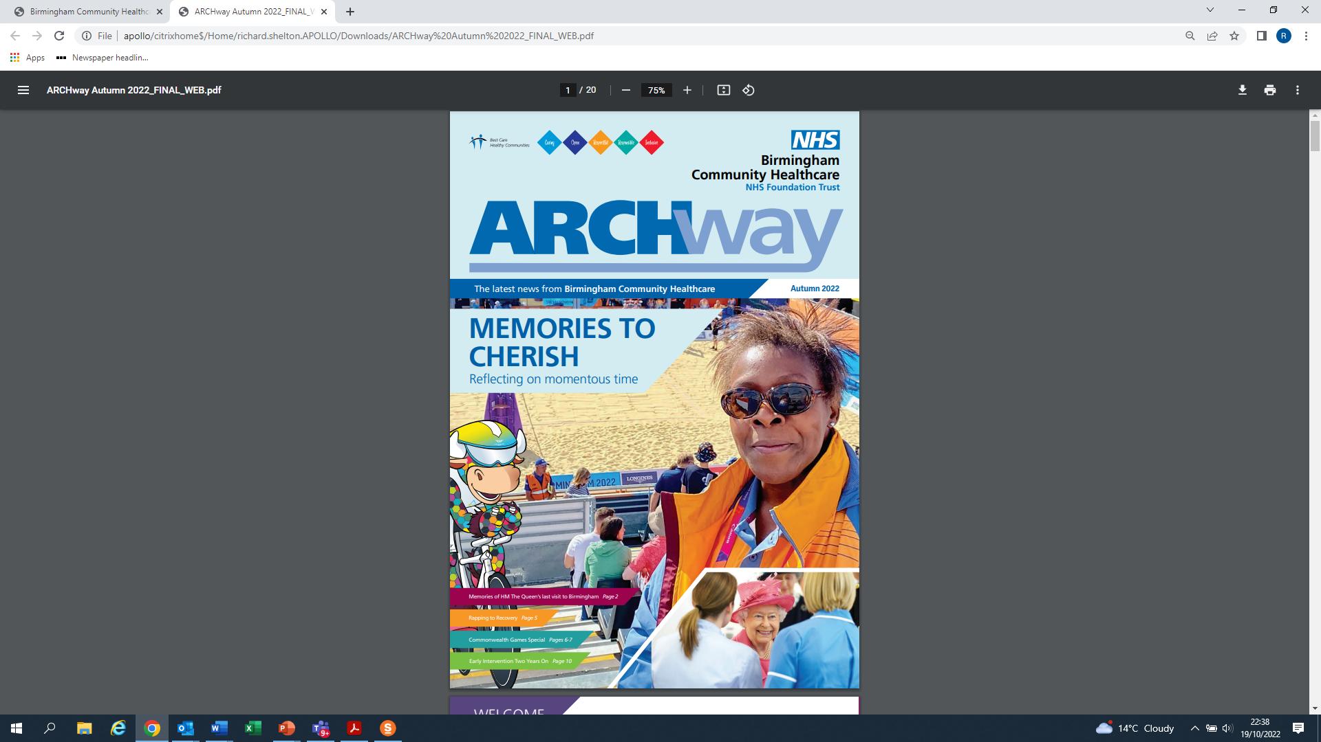


Keeping in Touch
Weekly Bulletin – weekly e-mail update for everyone.
Team Brief – weekly briefing by CEO of senior leaders each Thursday and is shared through line managers. Plus a Friday e-mail and video (via intranet) from the CEO
Trust Talk – monthly session for everyone led by CEO or one of the Exec. Briefing and question and answer.
Archway – regular newsletter for everyone.
Contact Executive Directors – direct via intranet front page.
Freedom to Speak Up – get in touch with the Guardian or our network of Champions.
50 Voices Panel – regular panel of 50 colleagues who meet with the CEO to work through difficult issues together.

Slide 12

Equality & Inclusion
Becoming a truly inclusive organisation is at the heart of our Great Place to Work objective.
Our Equality & Inclusion Council, chaired by a non-executive director meets quarterly. The Equality & Inclusion Programme board chaired by the CEO meets monthly to ensure progress.
Our Staff Networks play a vital role in ensuring we hear and respond to the voice of our colleagues
  BME Staff Network
  Women’s Equality Network
  Disability and Neurodiversity Staff Network
  LGBT+ & Allies Network

Slide 13
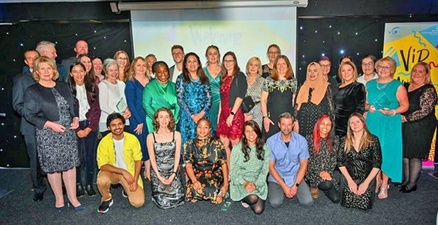


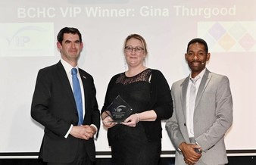
Celebrating Success
Our annual Values in Practice (VIP) Awards provide an opportunity to celebrate colleagues who bring our trust values to life. Watch out for the invitation to nominate colleagues.
Learning from Excellence is a rolling opportunity to share examples of great care and great colleagues so can learn from the example. See the intranet LfE page for more info.

