Slide 1


Patient Experience and Engagement
September 2024
Alex Evans
Patient Experience & Engagement Lead,
Adult Community Services

Slide 2
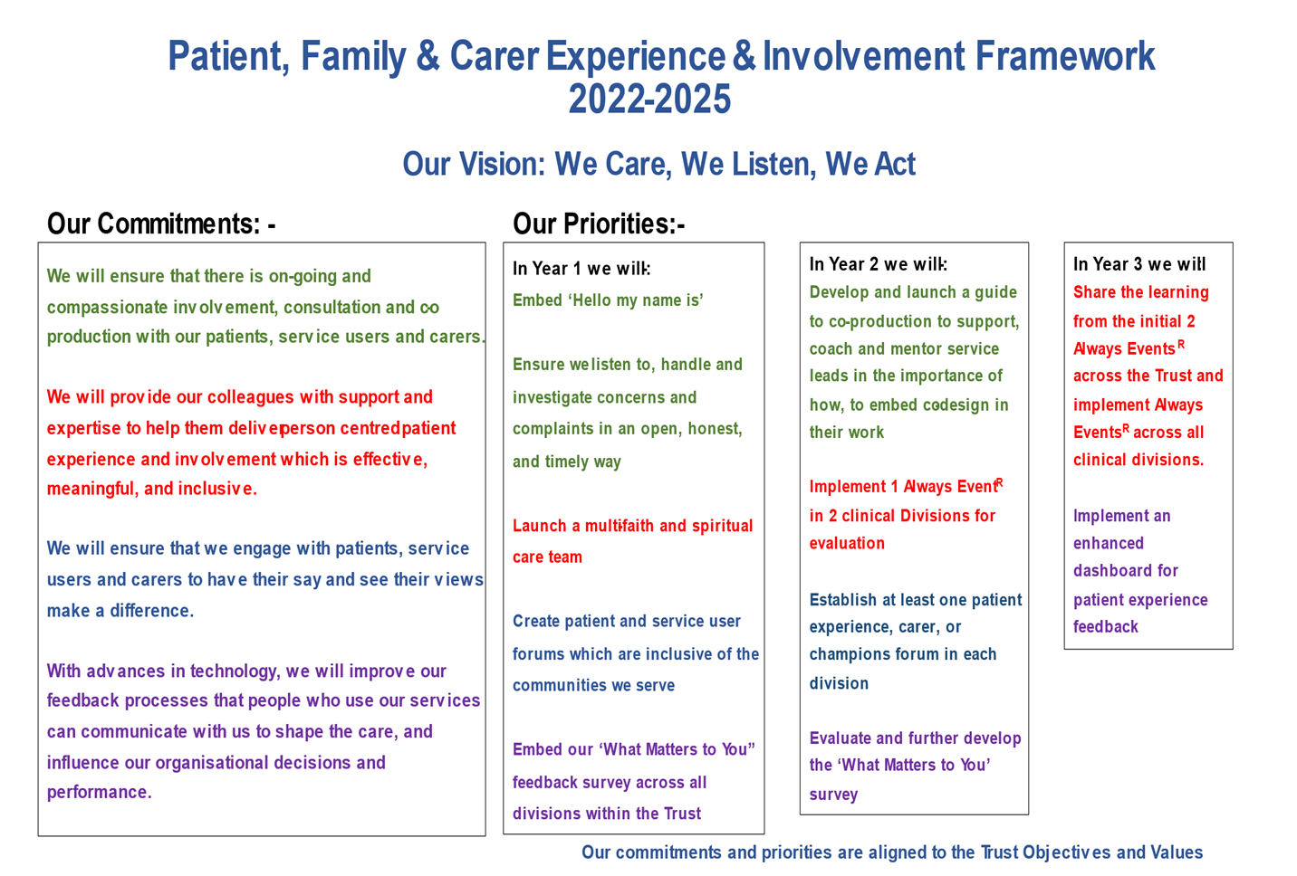


2

Slide 3


BCHC and the Sight Loss Councils
Within Adult Community Services, Patient Experience have been helping to raise awareness for people living with sight loss. As part of the Year 3 of our Framework we are encouraging other divisions to begin to think about what they can do to improve the experience of blind and partially sighted patients and service users.
Collaborated on 25 min film for staff training
Delivered VI Awareness sessions to over 600 staff
Shared lived experiences with practical improvements across multiple departments with patient focus groups
Secret word / Password system on Rio for District Nursing in ACS
Collaborated on NHS England VI ‘Always Experience’ initiative
What can your service do to help now?
Think about what your service is doing to ensure ALL patients receive their information in their preferred format. For example is a letter the best way to communicate an appointment?
How are you asking for and capturing this data? Are your clinical staff trained on using communication preferences and reasonable adjustments on RiO? If not what do you do next.
If you’d like to organise a one hour – 90 minute sight loss awareness session at a divisional away day email: alexevans@nhs.net
Notes:
List the key messages for each bullet point, or remove the bullet points that are not relevant to your audience.
Blind and partially sighted people are twice as likely to be inactive compared to the general public.
One in two blind and partially sighted people feel that having sight loss stops them from exercising as much as they want to.
One in three blind and partially sighted people said there were sports or fitness activities they would like to try but haven’t been able to.
Accessibility and awareness, cost, confidence and transportation are all key barriers to accessing sport and physical activity for blind and partially sighted people.
Sporting clubs and governing bodies struggle to reach blind and partially sighted people, and they lack awareness of the barriers faced by people with sight loss trying to access sports and activities.
There is a lack of confidence among coaches to work with blind and partially sighted people.
Make sure your website is accessible
Make sure payment options are accessible
Tell people on your website where your sports club, gym or leisure centre is located, what time you are open and when you close and how far you are from the nearest bus stop you are.
Where you put your reception or customer service point is crucial. People need to locate this as soon as they can on arrival to get the help they need. Describe where this is in on your website or pre arrival communications.
Ensure that you’ve got somewhere for their guide dog to go to the toilet fantastic. Have facilities available for a dog bowl with water.
Know how to adapt activities for blind and partially sighted people.
Provide training to your staff to give them the confidence to adapt session, interact with blind and partially sighted people and guide them around your facility.
Use audio guides and audio description for live performances and website content.
Create tactile maps.

Slide 4
What’s happening in ACS?
Therapy Hubs making improvements to the appointments card for Therapy visits. This includes adding QR code and link to provide a way for patients and service users to give feedback and their experience.
Services trying new methods of capturing feedback using traditional (paper) and innovative (digital) methods. Asking each clinician to collect feedback a couple of times each week.
Participated in a family feedback session, After Action Review and learning from Patient Safety Incidents within EICT
Diabetes Services beginning to explore “You Said, We Did” at their team meetings
Delivered a Trust Leadership workshop on sharing learning from the ACS division with the other divisions.
Recommended to Lymphoedema to amend an appointment letter

Slide 5


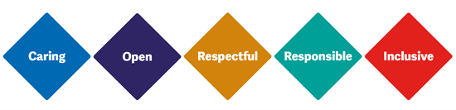
Communication – What do we all do and want?
Adult Community Services
Collect feedback and co-produce the services we offer
Review feedback to improve services
Patient Experience & Engagement
Support how services gather & increase feedback received
Report service concerns, compliments and improvements to help review
Support how we engage with adults using ACS services and communities that could use them.
Act on feedback - work with patients to make the changes required
Patients, Service Users and Communities
Give feedback and co-produce the services we offer
Find the right support and information
Understand the services we provide
Evidence feedback has helped - capture the outcomes and impact
Share how their feedback has improved services and made a difference. Take this back into the community
Report & share feedback received and help to analyse the information
Link back into the community to share service improvement
Be listened to and share their stories in easy, safe spaces
Be part of the solution
Hear about the changes made and how their feedback has improved services and made a difference

Slide 6
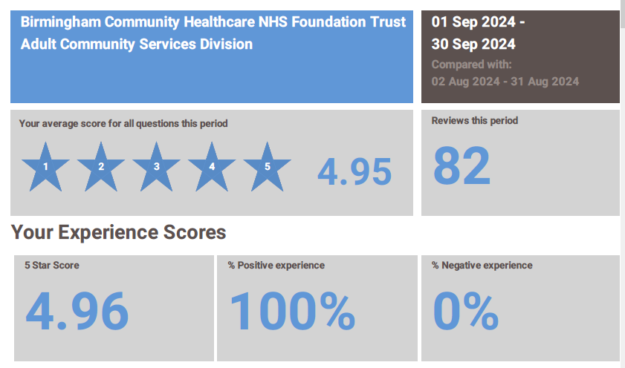

Slide 7
Overview of feedback in September

Slide 8
ACS Services Friends and Family

Slide 9
100% patients rated ACS either Very Good or Good

