Slide 1

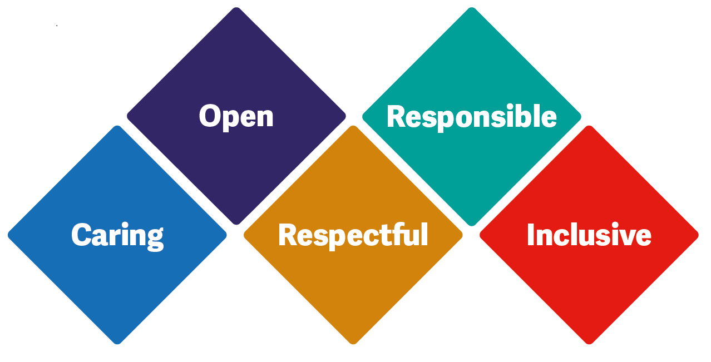

Advance Care Planning
Cohort 1

Slide 2
Advance Care Planning (ACP)
What is it?
Why do we do it?

Slide 3

Common difficult questions…
“How long have I got left?”
“How will I die?”
“How long do you think she/he has got left?”
“Am I dying?”
Notes:
Common difficult questions that are asked
ASK- has anyone been asked any of these question or something similar before?
How did you respond? Was you taking off guard/could you answer it
Am I dying- as HCP we should always practice open and honestly. A response to this could be “ what makes you say that”, “ what have you been previously told about your condition”
How will I die- again answer honestly “ for most it’s a case of becoming so relaxed and slipping into an unconsciousness state”

Slide 4
What?
Advance care planning is a voluntary process of discussion about future care between an individual and those who provide care for them, for example a nurse, doctor, care home manager or a family member.

Slide 5
Why?
Facilitate discussions about what to expect.
Allow patients preferences to be shared and followed.
Prevent unnecessary or inappropriate interventions.
Focus on things that are important to the patient.
Improved outcomes – place of death, patient and family experience.
Notes:
Dixon J, King D, Knapp M. Advance care planning in England: is there an association with place of death? Secondary analysis of data from the National Survey of Bereaved People. BMJ Support Palliat Care 2016;pii:bmjspcare-2015-000971. http://spcare.bmj.com/content/early/2016/06/16/bmjspcare-2015-000971

Slide 6

Some useful questions to ask.
Could you tell me what the most important things are to you at the moment?
When you think about the future, do you have any hopes or fears?
Thinking ahead to a time when your illness could be worse, have you thought about where you would prefer to be cared for ?
Notes:
These question can help initiate and guide a person through ACP discussion – Although these opening questions are not ACP they do help us recognise what is important to a person
But more importantly it is about listening to what you get back

Slide 7
Barriers, RCP 2018
Culture
  Death as a failure
  Death as a taboo
Confidence
  Lack of role models
Practicalities
  Who should have the conversation
  When – lack of continuity
Notes:
You gov poll 2017 20% had not shared worries and 22% of these because did not want to burden people.
The impact of advance care planning on end of life care in elderly patients: RCT BMJ 2010; 340 :c1345
ACP offered vs no ACP offered
84% expressed wishes or nominate a surrogate (advocate)
Less depression, less family anxiety
Higher patient satisfaction
ACP done well enables autonomy, control, hope, preparedness, insight, achieving goals.
Benefits patient and family.
But - it takes skill and courage.

Slide 8
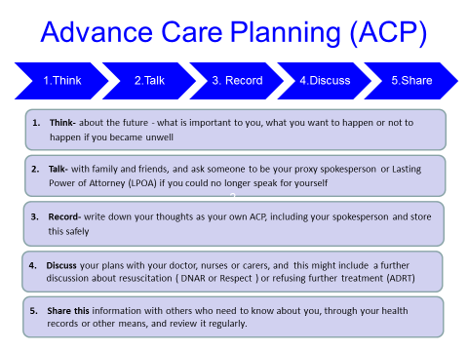

Slide 9
How and when to start?
Acknowledge willingness to discuss this topic
Listen … Give plenty of time to support the person Avoid interruptions
Does the person need anyone else to be present for support?
Use open questions and active listening techniques, get the person to talk about what they think and feel. Gently explore their ideas, concerns and expectations
Notes:
Making Time
Explain that any such document would need to be communicated with a variety of professionals to ensure that it is followed
Take time to document clearly in your own record the relevant detail of the initial discussion leading to and the absolute decision.
Make sure when you met again you were fully prepared with adequate time

Slide 10
A word about words….
End of Life
Palliative care
Terminal
Time is short
The end is coming
At peace
Fading away
Not long for this world
DEATH…..DYING…..DEAD

Slide 11
Documentation
ACP
Lasting Power of Attorney (LPA)
DNACPR
Preferred Priorities of Care
ReSPECT
Advanced Decision to Refuse Treatment (ADRT)
TEAL
Notes:
UHB may send people home with a TEAL – this is accepted in the community as a document instead of a ReSPECT form

Slide 12
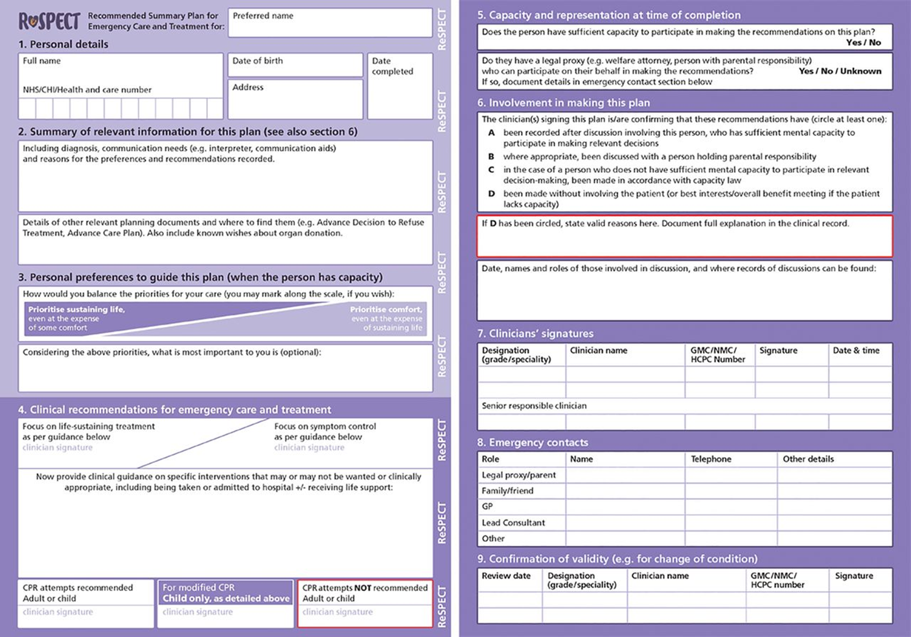
ReSPECT form
Notes:
Recommended Summary Plan for Emergency Care and Treatment.

Slide 13
Best interests and capacity
Decisions made on behalf of someone who lacks capacity must be in their “best interests”
Best guess as to what they would choose if they were able
Not what you would choose or think is best
Notes:
If you do complete a ReSPECT form in best interests complete the capacity assessment on RIO

Slide 14
Decisions related to CPR
Emergency treatment
Used when the heart and/or lungs stop working (cardiorespiratory arrest) prematurely
Using
  Ventilation
  Chest compressions
  Electricity
  Adrenaline
CPR will not prevent the heart stopping as part of the dying process

Slide 15
CPR can theoretically be attempted on all individuals who stop breathing or have no signs of life
But, there comes a time, for all of us, when death is inevitable
Essential to identify those patients for whom a cardiopulmonary arrest represents a terminal event in their illness and in whom CPR should be avoided.

Slide 16
Perceptions of CPR
That it is a patients choice whether or not to be “brought back or revived”.
Unrealistic expectations of treatment success
  ‘50:50 chance of survival without disability’.
Concerns about withholding other treatment
  Giving up, not doing everything.
Notes:
Reassurance must be offered that when people are not for resuscitation that they would be still cared for and any symptoms managed

Slide 17
“Advance care plans are like birth plans. Things might not go to plan and people can change their minds. Its the process of having the conversation that’s important.”

Slide 18

Self care
Clinical Supervision is:
A place for reflection and to explore professional curiosity
Open to questions and constructive discussions
A tool for professional development
A safe place of learning
A supportive environment
A place to be listened to
Self-driven by individual

Slide 19
Things to look out for when its getting too much - staff
Changes in usual behaviour
Poor performance
Tiredness or irritability
Increased sickness absence
Increased use of alcohol, drugs or smoking
Poor timekeeping
Difficulties with relationships at work
Tearfulness
Headaches
Loss of sense of humour
Over-performance, driving yourself to excess
Rapid changes of emotional mood
Notes:
Reassurance must be offered that when people are not for resuscitation that they would be still cared for and any symptoms managed

Slide 20
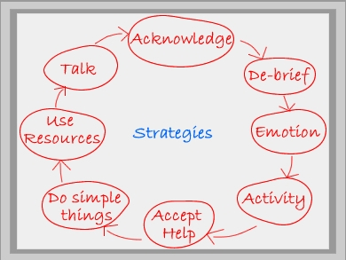
Notes:
Reassurance must be offered that when people are not for resuscitation that they would be still cared for and any symptoms managed

Slide 21
Resources
CCG website: sample letter , ACP guide
eLfH (Kathryn Mannix)
https://portal.e-lfh.org.uk/Catalogue/Index?HierarchyId=0_45016&programmeId=45016
ReSPECT guidance and resources
https://www.resus.org.uk/respect/downloads/
REDMAP difficult conversations mindmap
https://www.openchange.co.uk/wp-content/uploads/2020/03/Difficult-Conversations.pdf
SC guidelines
http://www.wmcares.org.uk/covid-19/
REALTALK difficult conversations
https://www.realtalktraining.co.uk/covid19-evidence-based-advice-difficult-conversations
NICE guidance on critical care admission using frailty as a determinant of chances of benefit from treatment escalation
https://www.nice.org.uk/guidance/ng159/resources/clinical-frailty-scale-pdf-8712262765
file:///C:/Users/lu.birch/Desktop/critical-care-admission-algorithm-pdf-8708948893.pdf
Notes:
Reassurance must be offered that when people are not for resuscitation that they would be still cared for and any symptoms managed

