Slide 1

Professional Nurse Advocate (PNA)
Implementing the Professional Nurse Advocate (PNA) Role
Randeep Kaur Professional Lead for Nursing- RN SCPHN (HV) RM PNA MSc MA Ed. NMC Teacher

Slide 2
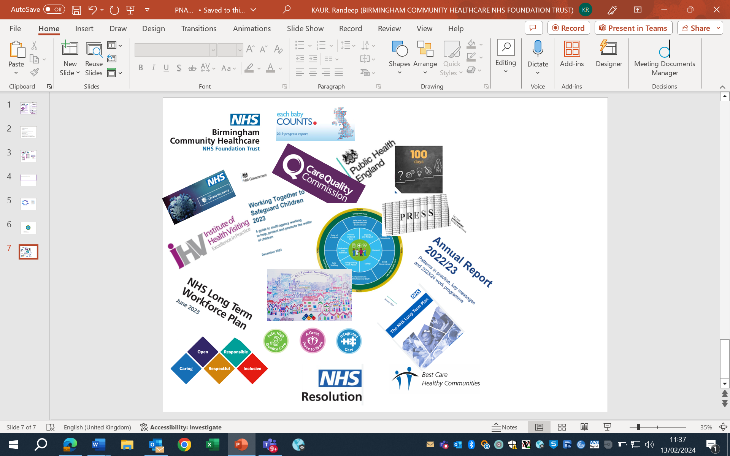
Background and development
A-Equip model (2017) was developed and introduced to advocate and educate for quality improvements
The A-EQUIP model works for Nurses/Midwives in four ways:
Advocating for the patient, the nurse and healthcare staff
Providing clinical supervision using a restorative approach
Enabling nurses to undertake personal action for quality improvement
Promoting the education and development of nurses.

Slide 3
A-EQUIP Model-Advocating and Educating for Quality Improvement (2017)
Normative
Monitoring, evaluation and quality control
Civility culture
Learning
Governance
QI goals
Safety and assurance
Positive outcomes for our staff, women and babies
Education and development
Quality improvements
Containment
Research
Formative
Reciprocity
Audits
Clinical supervision
Behaviour
Restorative
Aims of Restorative Supervision
Provide a safe space to:
• discuss the impact and challenges of change and the new ways of working
• explore feelings, concerns or worries and new ideas
• improve emotional and physical health and wellbeing
• allow discussion about issues that feel particularly challenging
• encourage and enhance good working relationships both within the team and with clients, parents, partners and families
• increase awareness of issues impacting on behaviours within relationships
• to work more effectively, provide optimum client care and build resilience

Slide 4



BCHC Strategic Objectives
Providing safe, high-quality care for our patients and service users
Becoming a great place to work for colleagues
Delivering integrated care working with partners
Role of leadership within the role of the PNA
Leadership styles
  Transformational
  Situational
  Transactional
  Collective – all taking responsibility
Overall appreciation and understanding of all, playing to the strengths of individuals for best outcomes

Slide 5
Importance of self-care and personal supervision within the role of PNA
Increases enjoyment in work and job satisfaction
Increases retention and staff feel valued
Improves working relationships and team dynamics
Enhances management of work life balance
Evidence supports self-care being one of the important factors within supervision and the role of the PNA
Facilitates professional resilience
Supports provision of high-quality care
Identifies areas for improvement
Supports revalidation
Improves sickness and absence rates
Decreases stress and reduce burnout

Slide 6
The future of the PNA role…
1 PNA to 20 nurses
Regular forums
Accessible register of PNA’s
Regular timeout for PNA’s to complete their role
Ensure staff are able to access a PNA to give them the opportunity to reflect on their practice

Slide 7
The future of the PNA role…Where we are now
Target 30
Numbers Trained 14
Currently in Training 3
Waiting List
  C&F 6
  ACS 2
  ASR 3
FAQs
Aspiring PNA’s EOI, email Linda Walker

Slide 8
Feedback ☺
• Reflection has always been an important part of nursing, but not having the time to do so effectively can have a negative effect, having the opportunity to be able to reflect in an unhurried session in times of crisis or stress enabled myself to question processes and feelings being supported to investigate and find solutions and ways forward, without this support from my assessor i would not have been able to complete the SPQN course.
• Following a traumatic event with a young end of life patient, I contacted Gail for further support and to reflect on the challenges and demands I faced. Gail was extremely responsive and attentive towards me. She took the time to listen and understand the challenges I had faced, with a focus on my wellbeing. I found it reassuring that during a very emotive time for me, Gail was present to assist and guide me to reflect on what went well, what other services we could have involved, and the outcome for the patient and their family. Furthermore, we discussed how we could raise awareness of dealing with similar difficult situations. Gail’s support really helped me to positively reflect and having the opportunity to have this discussion helped me to reduce my self-doubt and rather focus on my personal and professional resilience.

Slide 9
Feedback
• I whole heartedly believe in taking time out to talk and reflect helped. No one understands a nurse like a nurse. At the time I really remember struggling with the issues at home and how it was affecting work commitments, and sadly I remember feeling that my problems were my own and that there was no time for anyone to listen because we are all so busy. (No reflection on my team or team leader they were very supportive but busy). After taking time out I really realised that my issues weren't trivial that they did matter and that I needed to address them rather than keep struggling alone.
• Following my PNA session, I am letting you know that I have booked an appointment with my GP, speaking to you has realised I have to stop pretending I’m ok.

Slide 10
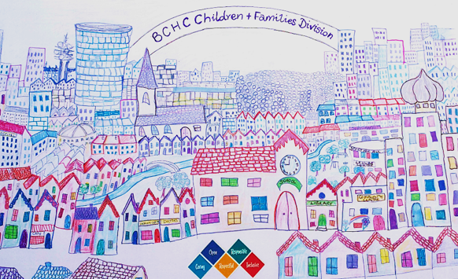
Conclusion
It is very clear stress and burnout are not new and nurses find themselves increasingly under pressure to deliver safe, high quality personalized care.
By implementing the PNA role within BCHC the intention is to work towards building a safe, secure and sustainable infrastructure and being a great place to work.
Any Questions?

